Slide 1
The More the Better? Assessing the Influence of Wikipedia’s Growth on
Semantic Relatedness Measures
Torsten Zesch and Iryna Gurevych
Ubiquitous Knowledge Processing Lab
Technische Universität Darmstadt

Slide 2

Wikipedia as a Language Resource
NLP applications
Information Extraction [Ruiz-Casado et al., 2005]
Information Retrieval [Gurevych et al., 2007]
Keyphrase Extraction [Medelyan, Milne & Witten, 2008]
Named Entity Recognition [Bunescu & Pasca, 2006]
Question Answering [Ahn et al., 2004]
Semantic Relatedness [Zesch & Gurevych, 2010]
Text Categorization [Gabrilovich & Markovitch, 2006]
WSD [Mihalcea, 2007]
[Medelyan et al., 2008] for an excellent overview.
Notes:
7. Mai 2008
|
| 2
7. Mai 2008
|
| 2
7. Mai 2008
|
| 2
12. Mai 2008
|
| 2

Slide 3
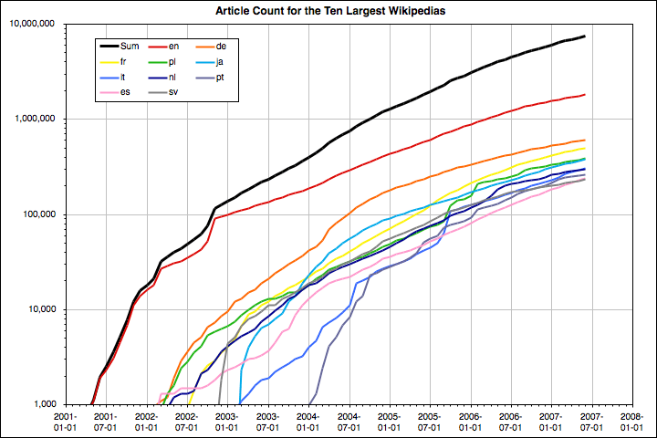

Growth of Wikipedia
Notes:
Wikipedia grows very fast
Growth of the ten largest language editions
log scale

Slide 4
Growth of Wikipedia
Categories introduced
Notes:
Wikipedia grows very fast
Growth of the ten largest language editions
log scale

Slide 5
Growth of Wikipedia
Coverage
Influence of Wikipedia’s growth on task performance is unknown
Only most recent Wikipedia snapshots are publicly available
Previous research cannot be reproduced
Notes:
Wikipedia grows very fast
Growth of the ten largest language editions
log scale

Slide 6
JWPL – TimeMachine
Java-based API (JWPL)
Snapshot from a certain date is reconstructed
Multiple snapshots from a time span possible
Deleted articles not included
Available as part of the JWPL Wikipedia API release
http://www.ukp.tu-darmstadt.de/
research/software/jwpl/
Application
Application
Application
TimeMachine
Run-time
Snapshot 1
Snapshot 2
Wikipedia Dump
(All revisions)
One time effort
http://dumps.wikimedia.org
>1TB uncompressed (Eng)

Slide 7
Wikipedia as a Language Resource
NLP applications
Information Extraction [Ruiz-Casado et al., 2005]
Information Retrieval [Gurevych et al., 2007]
Keyphrase Extraction [Medelyan, Milne & Witten, 2008]
Named Entity Recognition [Bunescu & Pasca, 2006]
Question Answering [Ahn et al., 2004]
Semantic Relatedness [Zesch & Gurevych, 2010]
Text Categorization [Gabrilovich & Markovitch, 2006]
WSD [Mihalcea, 2007]
[Medelyan et al., 2008] for an excellent overview.
Notes:
7. Mai 2008
|
| 7
7. Mai 2008
|
| 7
7. Mai 2008
|
| 7
12. Mai 2008
|
| 7
Why semantic relatedness?
Besides being familiar with the topic …

Slide 8
Wikipedia as a Language Resource
Direct use of Wikipedia
Uses many features
  Article text
  Article titles
  Categories
  Links
  Link anchors
  Redirects
  …
NLP applications
Information Extraction [Ruiz-Casado et al., 2005]
Information Retrieval [Gurevych et al., 2007]
Keyphrase Extraction [Medelyan, Milne & Witten, 2008]
Named Entity Recognition [Bunescu & Pasca, 2006]
Question Answering [Ahn et al., 2004]
Semantic Relatedness [Zesch & Gurevych, 2010]
Text Categorization [Gabrilovich & Markovitch, 2006]
WSD [Mihalcea, 2007]
[Medelyan et al., 2008] for an excellent overview.
Notes:
7. Mai 2008
|
| 8
7. Mai 2008
|
| 8
7. Mai 2008
|
| 8
12. Mai 2008
|
| 8

Slide 9
Semantic Relatedness Measures
tree
willow
tree
car
Quantify the strength of semantic relatedness [0,1]
Notes:
More formally speaking, we need a semantic relatedness measures
This means an algorithms that quantifies the strength of a semantic relationship between two words using a knowledge source.

Slide 10
Semantic Relatedness Measures
0.9
tree
willow
0.1
tree
car
Quantify the strength of semantic relatedness [0,1]

Slide 11
Types of Semantic Relatedness Measures
Path Based
Gloss Based
Concept Vector Based
Link Vector Based

Slide 12
Path based Measures
Semantic relatedness corresponds e.g. to number of edges of the shortest path between two nodes (articles, categories)
motor vehicle
bike
car
truck
garbage truck
tractor
tractor
cab
cab
...
minivan
minivan
cab – minivan: 2
cab – tractor: 4
Notes:
Implementation makes use of the category graph, category – article links, redirects, and article titles.

Slide 13
Gloss based measures
WordNet glosses
  tree (plant) “a tall perennial woody plant having a main trunk and branches forming a distinct elevated crown”
  trunk (tree) “the main stem of a tree; usually covered with bark; the bole is usually the part that is commercially useful for lumber”
A Wikipedia article is a kind of a (very long and detailed) gloss.

Slide 14
Term – Document Matrix
 | t₁ | t₂ | t₃ | … | t_{m-1} | t_{m}
d₁ | 3 | 1 | 0 | … | 0 | 0
d₂ | 0 | 5 | 0 | … | 1 | 0
d₃ | 1 | 0 | 2 | … | 3 | 3
… | … | … | … | … | … | …
d_{n-1} | 0 | 2 | 3 | … | 2 | 1
d_{n} | 2 | 3 | 0 | … | 5 | 0
Terms
Documents
Notes:
We visualize the working principle of this measure type using a term-document matrix.
Cell
importance of a term in a document
usually determined
term weighting method like tf.idf.

Slide 15
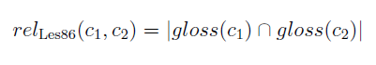

Gloss Based Measures
 | t₁ | t₂ | t₃ | … | t_{m-1} | t_{m}
d₁ | 3 | 1 | 0 | … | 0 | 0
d₂ | 0 | 5 | 0 | … | 1 | 0
d₃ | 1 | 0 | 2 | … | 3 | 3
… | … | … | … | … | … | …
d_{n-1} | 0 | 2 | 3 | … | 2 | 1
d_{n} | 2 | 3 | 0 | … | 5 | 0
c₁
c₂
c₃
Inner Product (usually Lesk)
c_{n-1}
c_{n}
[Lesk, 1986]
Article Titles
Articles
Notes:
In structured knowledge sources, each document corresponds to a certain concept.
The comparison between the document vectors thus also tells us something about the relatedness of the corresponding concepts.
However, WordNet and Wiktionary only contain very short definitions, result in a very sparse matrix and rather poor results.

Slide 16
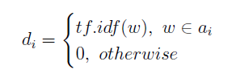
Concept Vector Based Measure
 | t₁ | t₂ | t₃ | … | t_{m-1} | t_{m}
d₁ | 3 | 1 | 0 | … | 0 | 0
d₂ | 0 | 5 | 0 | … | 1 | 0
d₃ | 1 | 0 | 2 | … | 3 | 3
… | … | … | … | … | … | …
d_{n-1} | 0 | 2 | 3 | … | 2 | 1
d_{n} | 2 | 3 | 0 | … | 5 | 0
c₁
c₂
c₃
c_{n-1}
c_{n}
Inner Product (usually Cosine)
ESA [Gabrilovich & Markovitch, 2007]
Notes:
Concept vector based measures can also be visualized using the term-document matrix.
However,
term vectors instead of document vectors
G&M07 propose to use Wikipedia articles as the concept space.

Slide 17
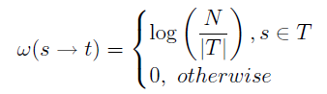
Link Vector Based Measure
 | l₁ | l₂ | l₃ | … | l_{m-1} | l_{m}
d₁ | 3 | 1 | 0 | … | 0 | 0
d₂ | 0 | 5 | 0 | … | 1 | 0
d₃ | 1 | 0 | 2 | … | 3 | 3
… | … | … | … | … | … | …
d_{n-1} | 0 | 2 | 3 | … | 2 | 1
d_{n} | 2 | 3 | 0 | … | 5 | 0
Links
c₁
c₂
c₃
Inner Product (usually Cosine)
c_{n-1}
c_{n}
Article Titles
Articles
Notes:
Visualized using the document/link matrix.

Slide 18
Types of Semantic Relatedness Measures
Path Based
Gloss Based
Concept Vector Based
Link Vector Based
Category Graph
Titles
Redirects
motor vehicle
bike
car
truck
garbage truck
tractor
tractor
cab
cab
...
minivan
minivan
Titles
Text
 | t₁ | t₂ | t₃ | … | t_{m-1} | t_{m}
d₁ | 3 | 1 | 0 | … | 0 | 0
d₂ | 0 | 5 | 0 | … | 1 | 0
d₃ | 1 | 0 | 2 | … | 3 | 3
… | … | … | … | … | … | …
d_{n-1} | 0 | 2 | 3 | … | 2 | 1
d_{n} | 2 | 3 | 0 | … | 5 | 0
 | t₁ | t₂ | t₃ | … | t_{m-1} | t_{m}
d₁ | 3 | 1 | 0 | … | 0 | 0
d₂ | 0 | 5 | 0 | … | 1 | 0
d₃ | 1 | 0 | 2 | … | 3 | 3
… | … | … | … | … | … | …
d_{n-1} | 0 | 2 | 3 | … | 2 | 1
d_{n} | 2 | 3 | 0 | … | 5 | 0
Text
Titles
Links
 | l₁ | l₂ | l₃ | … | l_{m-1} | l_{m}
d₁ | 3 | 1 | 0 | … | 0 | 0
d₂ | 0 | 5 | 0 | … | 1 | 0
d₃ | 1 | 0 | 2 | … | 3 | 3
… | … | … | … | … | … | …
d_{n-1} | 0 | 2 | 3 | … | 2 | 1
d_{n} | 2 | 3 | 0 | … | 5 | 0

Slide 19
Experimental Setup
Created 6-montly snapshots of the German Wikipedia
    Start 01.12.2002
    End 23.11.2008
  Accessed the dumps using JWPL Wikipedia API
  Implemented all measure types on top of JWPL
  Two evaluation approaches:
    Correlation with human judgments on word pair lists
    Solving word choice problems
Notes:
Exact dates for all snapshots are given in the paper.
German Wikipedia, because English dump was unavailable at that time.

Slide 20
Experimental Setup
Created 6-montly snapshots of the German Wikipedia
    Start 01.12.2002
    End 23.11.2008
  Accessed the dumps using JWPL Wikipedia API
  Implemented all measure types on top of JWPL
  Two evaluation approaches:
    Correlation with human judgments on word pair lists
    Solving word choice problems
Notes:
Exact dates for all snapshots are given in the paper.
Only report results for first task, as they are consistent with the results obtained on the other task.

Slide 21
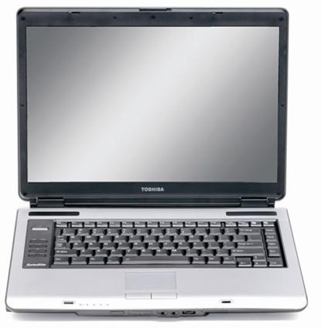


Evaluation Datasets
Ø
tree – lake
0.5
0.5
0.75
0.58
0.7
tree – willow
0.75
0.75
1.0
0.83
0.9
tree – car
0.25
0.0
0.0
0.08
0.0
Spearman rank correlation coefficient σ
Notes:
For the evaluation process, we need human judgments of SR as a reference.
present word pairs

Slide 22
Evaluation Datasets
Ø
Gur350 dataset [Gurevych, 2005]
350 word pairs
Nouns, verbs, and adjectives
tree – lake
0.5
0.5
0.75
0.58
0.7
tree – willow
0.75
0.75
1.0
0.83
0.9
tree – car
0.25
0.0
0.0
0.08
0.0
Spearman rank correlation coefficient σ
Notes:
For the evaluation process, we need human judgments of SR as a reference.
present word pairs

Slide 23


Coverage
2003
2007
tree – lake
tree – willow
tree – car
Coverage:
0.33
1.0

Slide 24
Coverage – Gur350

Slide 25
Coverage – Gur350

Slide 26
Coverage – Gur350
Categories introduced

Slide 27
Correlation – Gur350

Slide 28
Correlation – Gur350 (Fixed Coverage)

Slide 29
Experimental Setup
Created 6-montly snapshots of the German Wikipedia
    Start 01.12.2002
    End 23.11.2008
  Accessed the dumps using JWPL Wikipedia API
  Implemented all measure types on top of JWPL
  Two evaluation approaches:
    Correlation with human judgments on word pair lists
    Solving word choice problems
Notes:
Exact dates for all snapshots are given in the paper.
Only report results for first task, as they are consistent with the results obtained on the other task.

Slide 30
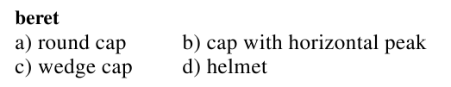
Dataset
Datasets
  1008 German word choice problems [Mohammad et al., 2007]
Evaluation metric
  Coverage / Accuracy / Harmonic Mean

Slide 31
Coverage

Slide 32
Accuracy

Slide 33
Harmonic Mean

Slide 34
Summary
Wikipedia is a great resource for many NLP tasks
Wikipedia grows very fast
The more, the better?
Growth does not hurt performance of semantic relatedness measures
Using more recent Wikipedia dumps does not increase coverage much
JWPL Time Machine
Create a snapshot reflecting any past state of Wikipedia
  Reproducing previous results obtained using a certain snapshot
  Perform similar studies for other NLP tasks
http://www.ukp.tu-darmstadt.de/research/software/jwpl/
Notes:
More recent also means a lot bigger.

Slide 35
References (I)
Ahn, D., Jijkoun, V., Mishne, G., Müller, K., de Rijke, M., and Schlobach, S. (2004). Using Wikipedia at the TREC QA Track. In Proceedings of the Thirteenth Text REtrieval Conference (TREC), Gaithersburg, Maryland
Bunescu, R. and Pasca, M. (2006). Using Encyclopedic Knowledge for Named Entity Disambiguation. In Proceedings of the 11th Conference of the European Chapter of the Association for Computational Linguistics (EACL), pages 9–16, Trento,Italy.
Gabrilovich, E. and Markovitch, S. (2007). Computing Semantic Relatedness using Wikipedia-based Explicit Semantic Analysis. In Proceedings of The 20th International Joint Conference on Artificial Intelligence (IJCAI), pages 1606–1611, Hyderabad, India.
Gurevych, I. (2005). Using the Structure of a Conceptual Network in Computing Semantic Relatedness. In Proceedings of the 2nd International Joint Conference on Natural Language Processing, pages 767–778, Jeju Island, Republic of Korea.
Gurevych, I., Müller, C., and Zesch, T. (2007). What to be? - Electronic Career Guidance Based on Semantic Relatedness. In Proceedings of the 45th Annual Meeting of the Association of Computational Linguistics, pages 1032–1039, Prague, Czech Republic.
Lesk, M. (1986). Automatic Sense Disambiguation Using Machine Readable Dictionaries: How to tell a pine cone from an ice cream cone. In Proceedings of the 5th Annual International Conference on Systems Documentation, pages 24–26, Toronto, Canada.

Slide 36
References (II)
Mihalcea, R. (2007). Using Wikipedia for Automatic Word Sense Disambiguation. In Proceedings of HLT 2007: The Conference of the North American Chapter of the Association for Computational Linguistics, Rochester, NY, April 2007
Medelyan, O, Legg, C., Milne, D., and Witten. I.H. (2008) Mining Meaning from Wikipedia. International Journal of Human-Computer Studies. 67:9, September 2009, p. 716-754
Medelyan, O, Witten, I.H., and Milne, D. (2008) Topic Indexing with Wikipedia. In Proceedings of the first AAAI Workshop on Wikipedia and Artificial Intelligence (WIKIAI'08), Chicago, I.L.
Mohammad, S., Gurevych, I., Hirst, G., and Zesch, T. (2007). Cross-lingual Distributional Profiles of Concepts for Measuring Semantic Distance. In Proceedings of EMNLP-CoNLL, pages 571–580, Prague, Czech Republic.
Ruiz-Casado, M., Alfonseca, E., and Castells, P. (2005). Automatic Assignment of Wikipedia Encyclopedic Entries to WordNet Synsets. In Advances in Web Intelligence, pages 380–386.
Zesch, T., and Gurevych, I. (2010). Wisdom of Crowds versus Wisdom of Linguists - Measuring the Semantic Relatedness of Words. In: Journal of Natural Language Engineering., vol. 16, no. 01, pages 25—59.

Slide 37
Backup Slides

Slide 38
Coverage – Gur65

Slide 39
Correlation – Gur65

Slide 40
Correlation – Gur65

Slide 41
Correlation – Gur65

