Slide 1
An Evaluation Framework for Natural Language Understanding in Spoken Dialogue Systems
Joshua B. Gordon and Rebecca J. Passonneau
Columbia University

Slide 2
Outline
Motivation: Evaluate NLU during design phase
Comparative evaluation of two SDS systems using CMU’s Olympus/RavenClaw framework
  Let’s Go Public! and CheckItOut
  Differences in language/database characteristics
  Varying WER for two domains
Two NLU approaches
Conclusion

Slide 3
Motivation
For our SDS CheckItOut, we anticipated high WER
  VOIP telephony
  Minimal speech engineering
    WSJ read speech acoustic models
    Adaptation with ~12 hours of spontaneous speech for certain types of utterances
    0.49 WER in recent tests
  Related experience
  Let’s Go Public! had WER of 17% for native speakers in laboratory conditions; 60% in real world conditions

Slide 4
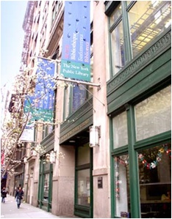


CheckItOut
Andrew Heiskell Braille & Talking Book Library
  Branch of New York City Public Library,
  National Library Service
  One of first users of Kurzweil Reading Mach.
Book transactions by phone
  Callers order cassettes/braille books/large
  type books by telephone
  Orders sent/returned by U.S.P.O.
CheckItOut dialog system
  Based on Loqui Human-Human Corpus
    82 recorded patron/librarian calls
    Transcribed, aligned with the speech signal
  Replica of Heiskell Library catalogue (N=71,166)
  Mockup of patron data for 5,028 active patrons

Slide 5
ASR Challenges
Speech phenomena - disfluencies, false starts . . .
Intended users comprise a diverse population of accents, ages, native language
Large vocabulary
Variable telephony: users call from
  Land lines
  Cell
  VOIP
Background noise

Slide 6
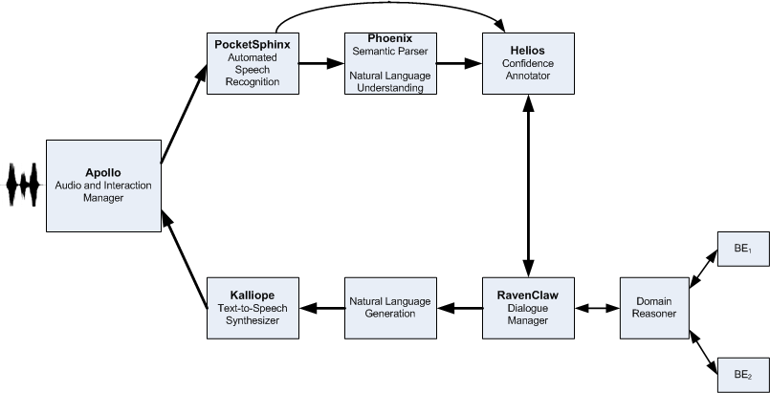
The Olympus Architecture

Slide 7
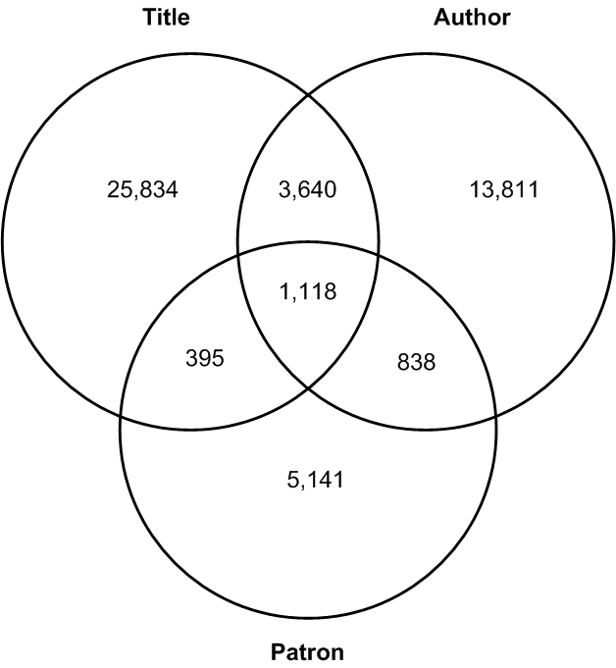
CheckItOut
Callers order books by title, author, or catalog number
Size of catalogue: 70,000
Vocabulary
  50K words
  Title/author overlap
    10% of vocabulary
    15% of title words
    25% of author words

Slide 8
Natural Language Understanding
Utterance: DO YOU HAVE THE DIARY OF .A. ANY FRANK
Dialogue act identification
  Book request by title
  Book request by author
Concept identification
  Book-title-name
  Author-name
Database query: partial match based on phonetic similarity
  THE LANGUAGE OF .ISA. COME WARS
  The Language of Sycamores

Slide 9
Comparative Evaluation
Load or bootstrap a corpus from representative examples with labels for dialogue acts/concepts
Generate real ASR (in the case of an audio corpus)
OR Simulate ASR at various levels of WER
Pipe ASR output through one or more NLU modules
Voice search against backend
Evaluate using F-measure

Slide 10
Bootstrapping a Corpus
Manually tag a small corpus into
  Concept strings, e.g., book titles
  Preamble/postamble strings bracketing the concept
  Sort preamble/postamble into mutually substitutable sets
  Permute: (PREAMBLE) CONCEPT (POSTAMBLE)
Sample bootstrapping for book requests by title
Preamble | Title String
It’s called | T1, T2, T3, . . . . TN
I’m wondering if you have | T1, T2, T3, . . . . TN
Do you have | T1, T2, T3, . . . . TN

Slide 11
Evaluation Corpora
Two corpora
  Actual: Lets Go
  Bootstrapped: CheckItOut
Distinct language characteristics
Distinct backend characteristics
 | Total Corpus | Mean Utt. Length | Vocab. size
CheckItOut | 3411 | 9.1 words | 6209
Let’s Go | 1947 | 4.4 words | 1825
 | Grammar | Backend
CheckItOut: Titles | 4,000 | 70,000
CheckItOut: Authors | 2,315 | 30,000
LetsGo: Bus Routes | 70 | 70
LetsGo: Place Names | 1,300 | 1,300

Slide 12
ASR
Simulated: NLU performance over varying WER
  Simulation procedure adapted from both (Stuttle, 2004) and (Rieser, 2005)
  Four levels of WER for bootstrapped CheckItOut
  Two levels of WER based on Let’s Go transcriptions
Two levels of WER based on Lets Go audio corpus
  Piped through PocketSphinx recognizer
    Lets Go acoustic models and language models
  Noise introduced into the language model to increase WER

Slide 13
Semantic versus Statistical NLU
Semantic parsing
  Phoenix: a robust parser for noisy input
  Helios: a confidence annotator using information from the recognizer, the parser, and the DM
Supervised ML
  Dialogue Acts: SVM
  Concepts: A statistical tagger, YamCha, trained on a sliding five word window of features

Slide 14
Phoenix
A robust semantic parser
  Parses a string into a sequence of frames
  A frame is a set of slots
  Each slot type has its own CFG
  Can skip words (noise) between frames or between slots
Lets Go grammar: provided by CMU
CheckItOut grammar
  Manual CFG rules for all but book titles
  CFG rules mapped from MICA parses for book titles
Example slots, or concepts
  [ AreaCode] (Digit Digit Digit)
  [Confirm] (yeah) (yes) (sure) . . .
  [TitleName] ([_in_phrase])
  [_in_phrase] ([_in] [_dt] [_nn] ) . . .

Slide 15
Using MICA Dependency Parses
Parsed all book titles using MICA
Automatically builds linguistically motivated constraints on constituent structure and word order into Phoenix productions
Frame: BookRequest
Slot: [Title]
[Title] ( [_in_phrase] )
Parse: ( Title [_in] (IN) [_dt] ( THE ) [_nn] ( COMPANY ) [_in] ( OF ) [_nns] ( HEROES ) ) ) )

Slide 16
Dialogue Act Classification
Robust to noisy input
Requires a training corpus which is often unavailable for a new SDS domain: solution -- bootstrap
Sample features:
  Acoustic confidence
  BOW
  N-grams
  LSA
  Length features
  POS
  TF/IDF

Slide 17
Concept Recognition
Concept identification cast as a named entity recognition problem
YamCha a statistical tagger that uses SVM
YamCha labels words in an utterance as likely to begin, to fall within, or end the relevant concept
I WOULD LIKE THE DIARY A ANY FRANK ON TAPE
N N N BT IT IT IT ET N N

Slide 18
Voice Search
A partial matching database query operating on the phonetic level
Search terms are scored by Ratcliff / Obershelp similarity
  =|Matched characters|/|Total characters|
  where |Matched characters| = recursively find longest common subsequence of 2 or more characters
Query “THE DIARY A ANY FRANK”
Anne Frank, the Diary of a Young Girl | .73
The Secret Diary of Anne Boleyn | .67
Anne Frank | .58

Slide 19
Dialog Act Identification (F-measure)
 | WER = 0.20 |  | WER = 0.40 |  | WER = 0.60 |  | WER = 0.80
 | CFG | ML | CFG | ML | CFG | YML | CFG | ML
Lets Go | 0.87 | 0.73 | 0.74 | 0.69 | 0.61 | 0.65 | 0.52 | 0.55
CheckItOut | 0.58 | 0.90 | 0.36 | 0.85 | 0.30 | 0.78 | 0.23 | 0.69
Difference between semantic grammar and ML
  Small for Lets Go
  Large for CheckItOut
Difference between Lets Go and CheckItOut
  CheckItOut gains more from ML

Slide 20
Concept Identification (F-measure)
 | WER=0.20 |  | WER=0.40 |  | WER=0.60 |  | WER=0.80
 | CFG | Yamcha | CFG | Yamcha | CFG | Yamcha | CFG | Yamcha
Title | 0.79 | 0.91 | 0.74 | 0.84 | 0.64 | 0.70 | 0.57 | 0.59
Author | 0.57 | 0.85 | 0.49 | 0.72 | 0.40 | 0.57 | 0.34 | 0.51
Place | 0.70 | 0.70 | 0.55 | 0.53 | 0.48 | 0.46 | 0.36 | 0.34
Bus | 0.74 | 0.84 | 0.55 | 0.65 | 0.48 | 0.46 | 0.36 | 0.44
Difference between semantic grammar and learned model
  Small for Lets Go
  Large for CheckItOut
    Larger for Author than Title
    As WER increases, difference shrinks

Slide 21
Conclusions
The small mean utterance length of Let’s Go results in less difference between the NLU approaches
The lengthier utterances and larger vocabulary for CheckItOut provide a diverse feature set which potentially enables recovery from higher WER
The rapid decline in semantic parsing performance for dialog act identification illustrates the difficulty of writing a robust grammar by hand
The title CFG performed well and did not degrade as fast

