Slide 1
The problems of language identification within hugely multilingual data sets
Fei Xia Carrie Lewis William Lewis
Univ. of WA Univ. of WA Microsoft Research
fxia@uw.edu westplc@uw.edu wilewis@microsoft.com

Slide 2
Highly multilingual data sets
LREC 2010 Map (Calzolari et al., 2010): 170 languages
ODIN (Lewis, 2006): 1300+ languages
WALS (Haspelmath et al., 2005): 2600+ languages
Ethnologue (Gordon, 2005): 7400+ languages
Question: How should we refer to the languages?

Slide 3
What about language names?
English 729 | … | Mandarin Chinese 1
German 166 | … | Old Swedish 1
Arabic 85 | … | Portuguese dialects 1
Chinese 68 | … | Quechua 1
… | … | …
LREC 2010 Map

Slide 4
Outline
Issues with language names
Existing language code sets
Case study: language ID for ODIN
Good practice

Slide 5
Different types of language names
Collection of languages: e.g., Central American Indian languages
Language families: e.g., Bantu, Australian
Macrolanguages: e.g., Arabic, Chinese, Malay, Quechua
Individual languages: e.g., English, Mandarin
Dialects: e.g., African American English, Westfries, Osaka-ben

Slide 6
Languages and Language names
Language names can be ambiguous
  Macrolanguages: Chinese, Quechua
  Unrelated languages:
    Ex: Tiwa (Sino Tibetan) and Tiwa (Tanoan)
A language can have multiple names
  Ex: Alumu, Tesu, Arum, Alumu-Tesu, Alumu, Arum-Cesu, Arum-Chessu, and Arum-Tesu
➔ Assign a language code to each language

Slide 7
Language code sets
A language code set is a set of (language name, language code) pairs.
Two existing language code sets:
  Ethnologue (www.ethnologue.com):
    v1 published in 1951 with 46 languages.
    v16 published in 2009 with 7413 languages.
  ISO 639 (http://www.sil.org/iso639-3):
    It has six parts.
    The most relevant part is Part 3: 639-3
Notes:
part1: 100+ langs
part2: 500 langs
part5: lang families
part 6: lang variations

Slide 8
ISO 639-3
Three-letter language codes: e.g., cmn for Mandarin, zho for Chinese
Initial release in 2005, and the current version has 7700+ languages
Updated every year by SIL International , which also maintains Ethonologue
Certain languages are excluded:
  Dialects: They should be covered in ISO 639-6
  Reconstructed languages: e.g., Proto-Oceanic
  Languages that do not meet other strict criteria

Slide 9
Changes to ISO 639-3
Created new language codes: e.g., Nonuya (noj)
Split existing codes: e.g., Beti (btb) ➔ Bebele (beb), Bebil (bxp), Bulu (bum), …
Merged several codes: e.g., Tangshewi (tnf), Darwazi (drw) ➔ Dari (prs)
Retired codes: e.g., btb for Beti, tnf for Tangshewi
Updated the reference information: e.g., Estonian (est) changes from an individual language to a macrolanguage.
Notes:
Changes on this slide (plurals and past tense)

Slide 10
Outline
Issues with language names
Existing language code sets
Case study: language ID for ODIN
Good practice

Slide 11
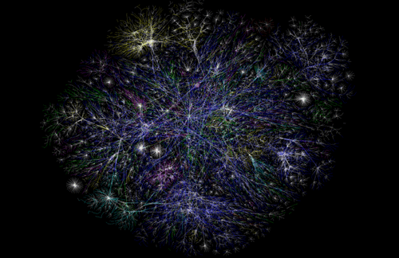
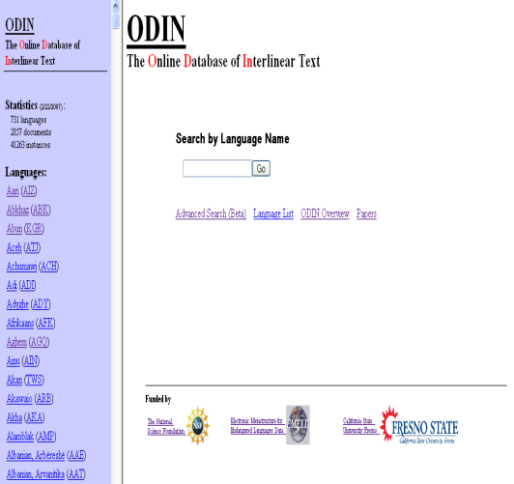
The RiPLes project
Docs
ODIN
 | Q₁ | Q₂ | …
L₁
L₂
…
…

Slide 12
Interlinear glossed text (IGT)
Rhoddodd yr athro lyfr i’r bachgen ddoe
Gave-3sg the teacher book to-the boy yesterday
The teacher gave a book to the boy yesterday
(Welsh, from Bailyn, 2001)
ODIN is a collection of IGT
(Online Database of INterlinear glossed text)
It currently contains about 200K IGT instances from
3000 documents, covering 1300+ languages.

Slide 13
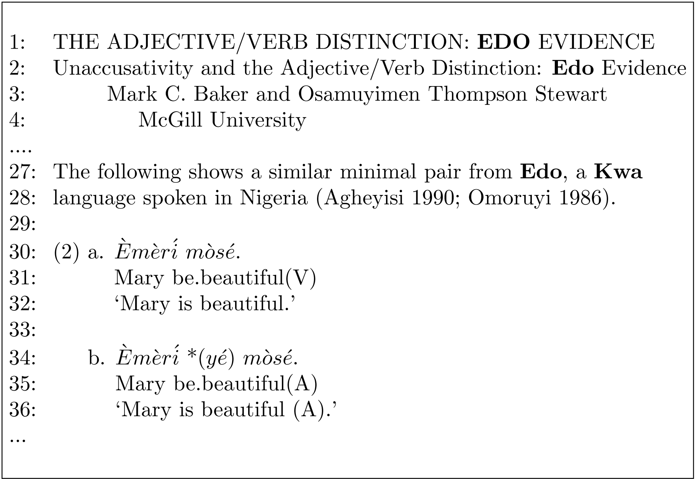
Treating Language ID as a conference task
We used a language table made of ISO 639-3, Ethnologue v15 and
the Ancient Language list (provided by LinguistList).
System accuracy: 85.1% vs. TextCat: 51.4%
More detail is in (Xia et al., 2009)

Slide 14
Manual correction
Choosing language codes is much harder than choosing language names.
  This is true even for linguistic experts.
Two main issues:
  Missing entries in the language table
  Ambiguous language names

Slide 15
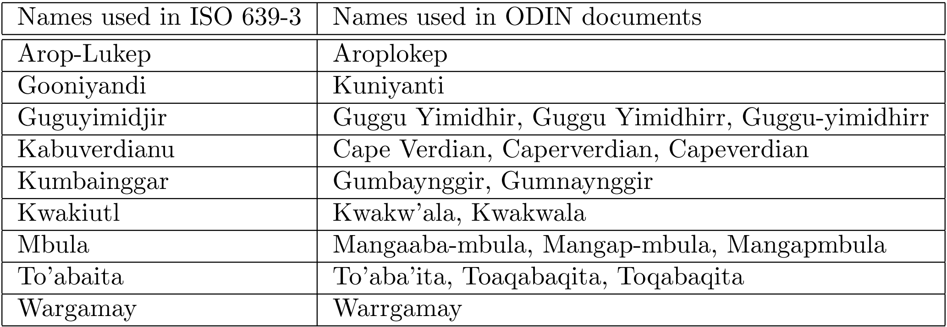
“Missing” language names due to spelling variations

Slide 16
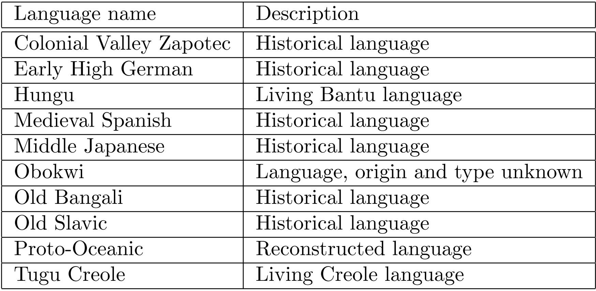
Other “missing” language names
Living language: there are people still living who learn it as a first language.
Historic language:“have a literature that is treated distinctly by the scholarly community”.
Notes:
oceanic: o shi ‘anic

Slide 17
How common is this?
Original language table has 7816 language codes, 47728 (name, code) pairs.
From two thousand ODIN documents:
  720 new language names
  900 new (name, code) pairs
  a few dozen new languages

Slide 18
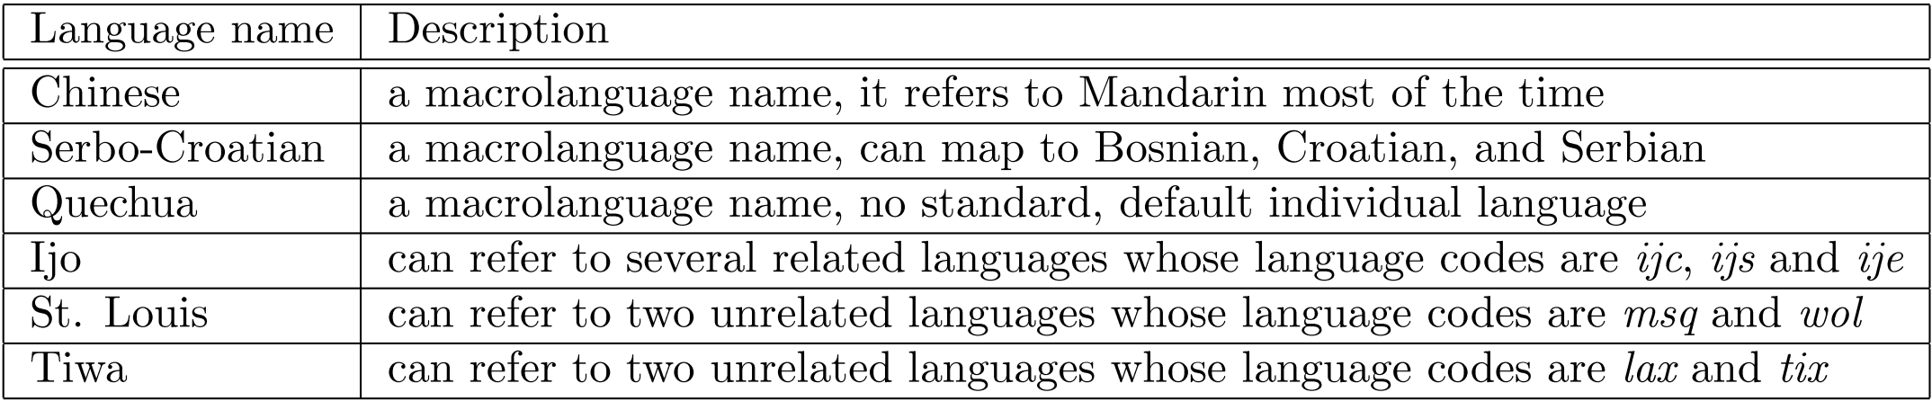
Ambiguous language names
To disambiguate, we have to find the cues in the documents
(e.g., where, when, by what people, by what author, IGT)
The process can be labor intensive.

Slide 19
Outline
Issues with language names
Existing language code sets
Case study: language ID for ODIN
Good practice

Slide 20
Good practice
For the linguistic and NLP communities:
  Multilingual resources should use a standard language code set (e.g., ISO 639)
  Maintenance agency of language code sets should ensure the compatibility of different versions:
    Ex: the changes from Ethnologue v14 to v15
  For languages that are not in ISO 639, there should be a place for people to share standard language names.
  Conferences/journals should
    provide a way for authors to upload language data or provide urls
    enforce consistent language labeling, e.g., through language codes
Notes:
ODIN uses v14, v15 forces major remapping

Slide 21
Good practice (cont)
For individuals:
  Distinguish different types of languages
  Check whether the language is already in ISO 639
    If so, use the standard spelling and language code
    If not, consider making a request to ISO 639 or other language code set.
  When a language name is uncommon or ambiguous, additional information (e.g., where, what language family) will be helpful.
    Ex: “Design and development of POS resources for Wolof (Niger-Congo, spoken in Senegal)”
    Wolof (wol) and Gambian Wolof (wof)
    “wol”: 15 names (e.g., Baol, Cayor, Djolof, Jolof, Lebou, Ndyanger, Volof, Walaf, Waro-Waro, Yallof, …)

Slide 22
LREC 2010 Map
English 729 | … | Mandarin Chinese 1
German 166 | … | Old Swedish 1
Arabic 85 | … | Portuguese dialects 1
Chinese 68 | … | Quechua 1
… | … | …
English (eng) 729 | … | Mandarin Chinese 1
German (deu) 166 | … | Old Swedish (??) 1
Standard Arabic (arb) 85 | … | Portuguese dialects (??) 1
Madarin (cmn) 69 | … | Quechua (que??) 1
… | … | …
Notes:
Arabic has 30 lang codes
Quechua has 44 lang codes

Slide 23
Conclusion
For highly multilingual data sets, properly identifying languages is not trivial.
  Language names are not sufficient.
Existing language code sets are far from complete, and are subject to frequent updates.
Following good practice will alleviate the problems.

Slide 24
Acknowledgment
NSF
Three reviewers
You!
ODIN: http://odin.linguistlist.org/

Slide 25
Additional slides

Slide 26
ISO 639
639-1: 2-letter codes for 140+ languages
639-2: 3-letter codes for 460+ languages
639-3: 3-letter codes for 7000+ languages
639-4: guidelines and general principles for language coding
639-5: 3-letter codes for language families and groups
639-6: 4-letter codes for language variants

Slide 27
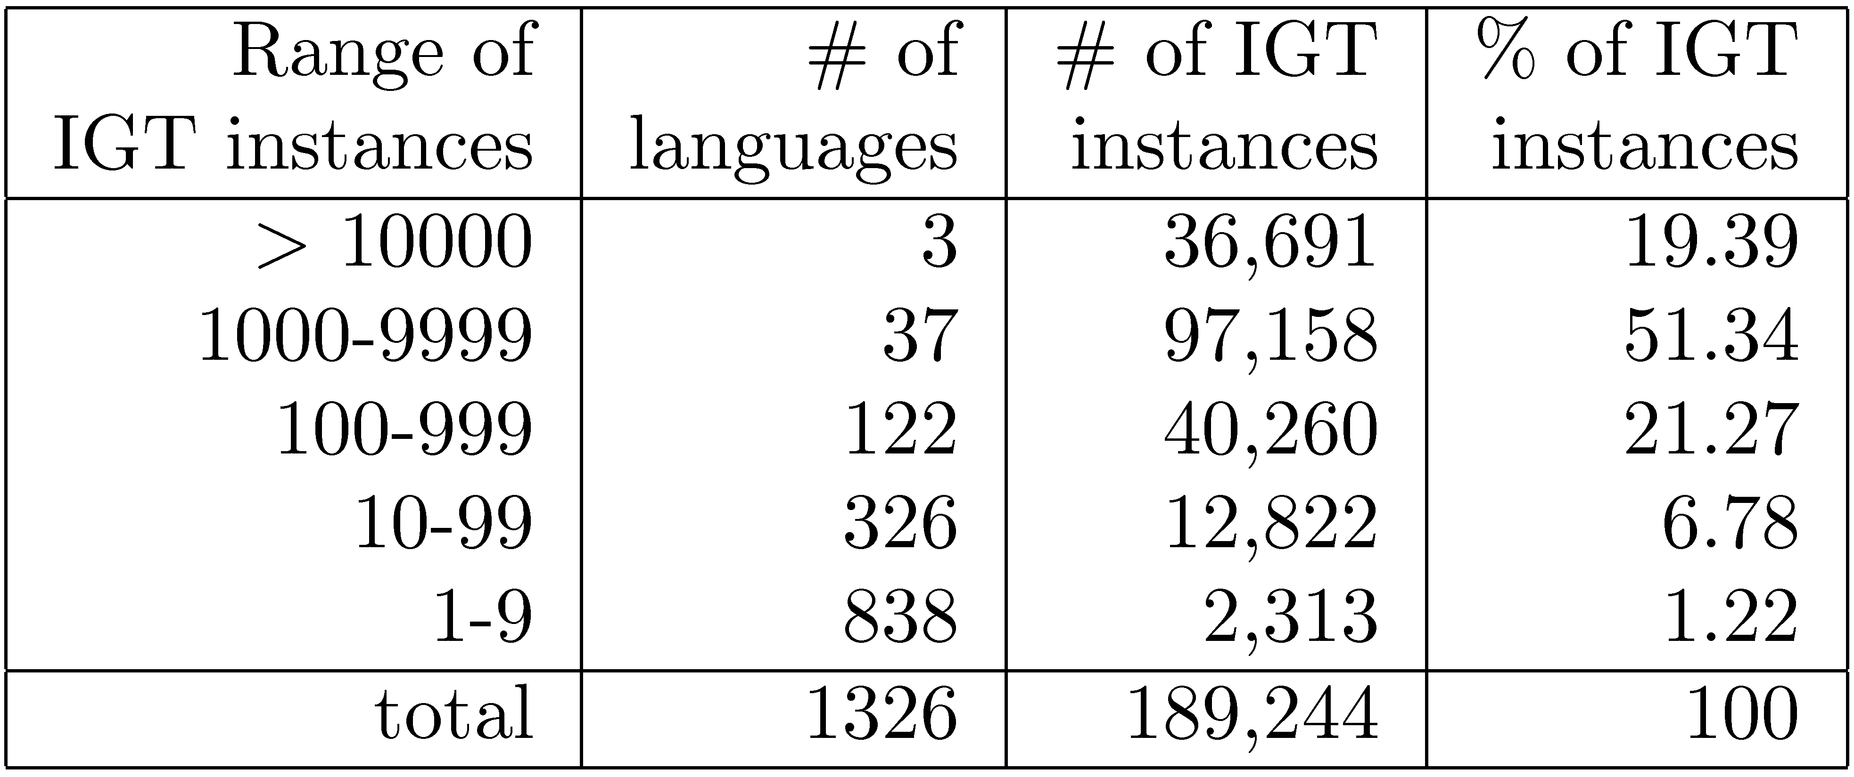
ODIN database
The IGT is extracted from 3000 documents.

Slide 28
References
ODIN database: http://odin.linguistlist.org
More information on ODIN: http://faculty.washington.edu/fxia/riples/
Cyberling workshop: http://elanguage.net/cyberling09/
Cavnar, W. B. and J. M. Trenkle. 1994. "N-Gram-Based Text Categorization." In Proceedings of Third Annual Symposium on Document Analysis and Information Retrieval, Las Vegas, NV, UNLV, April 1994.
Gordon, R. G. (ed). 2005. Ethnologue: Languages of the World, Fifteenth edition. Dallas, TX: SIL International. http://www.ethnologue.com
Haspelmath, Martin, Mathew Dryer, David Gil, and Bernard Comrie. 2005. World Atlas of Language Structures. Oxford University Press.

Slide 29
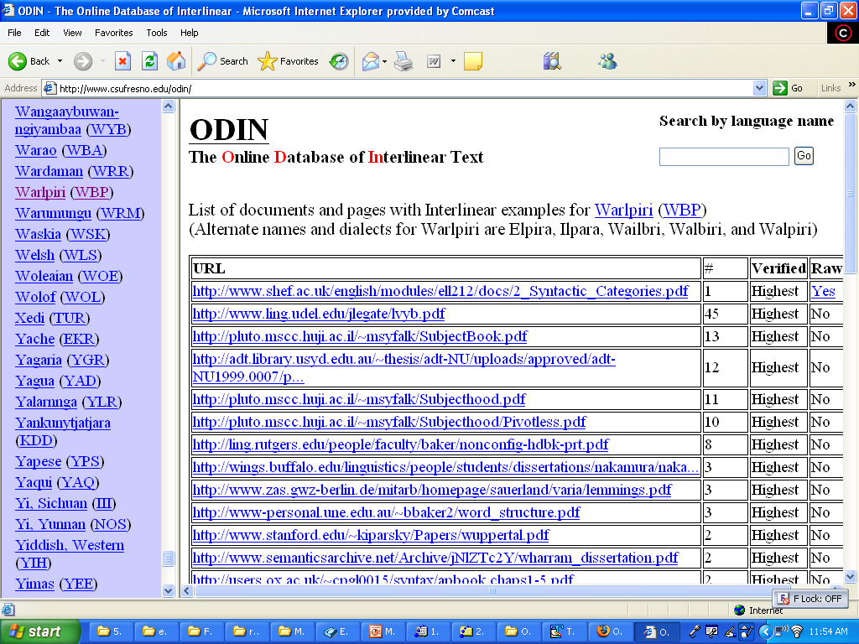

Slide 30
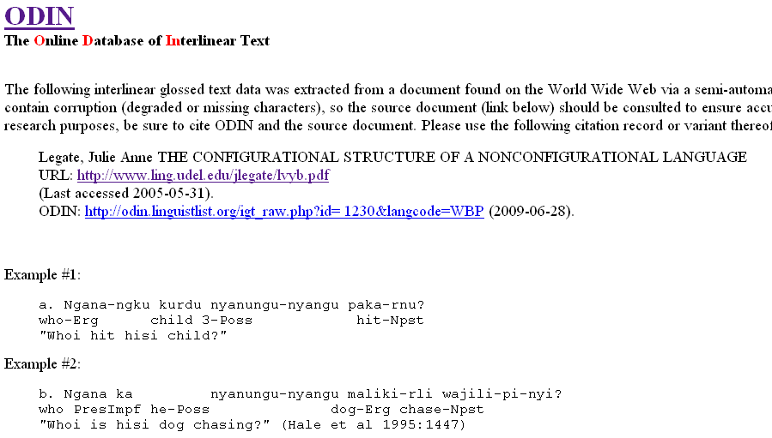

Slide 31
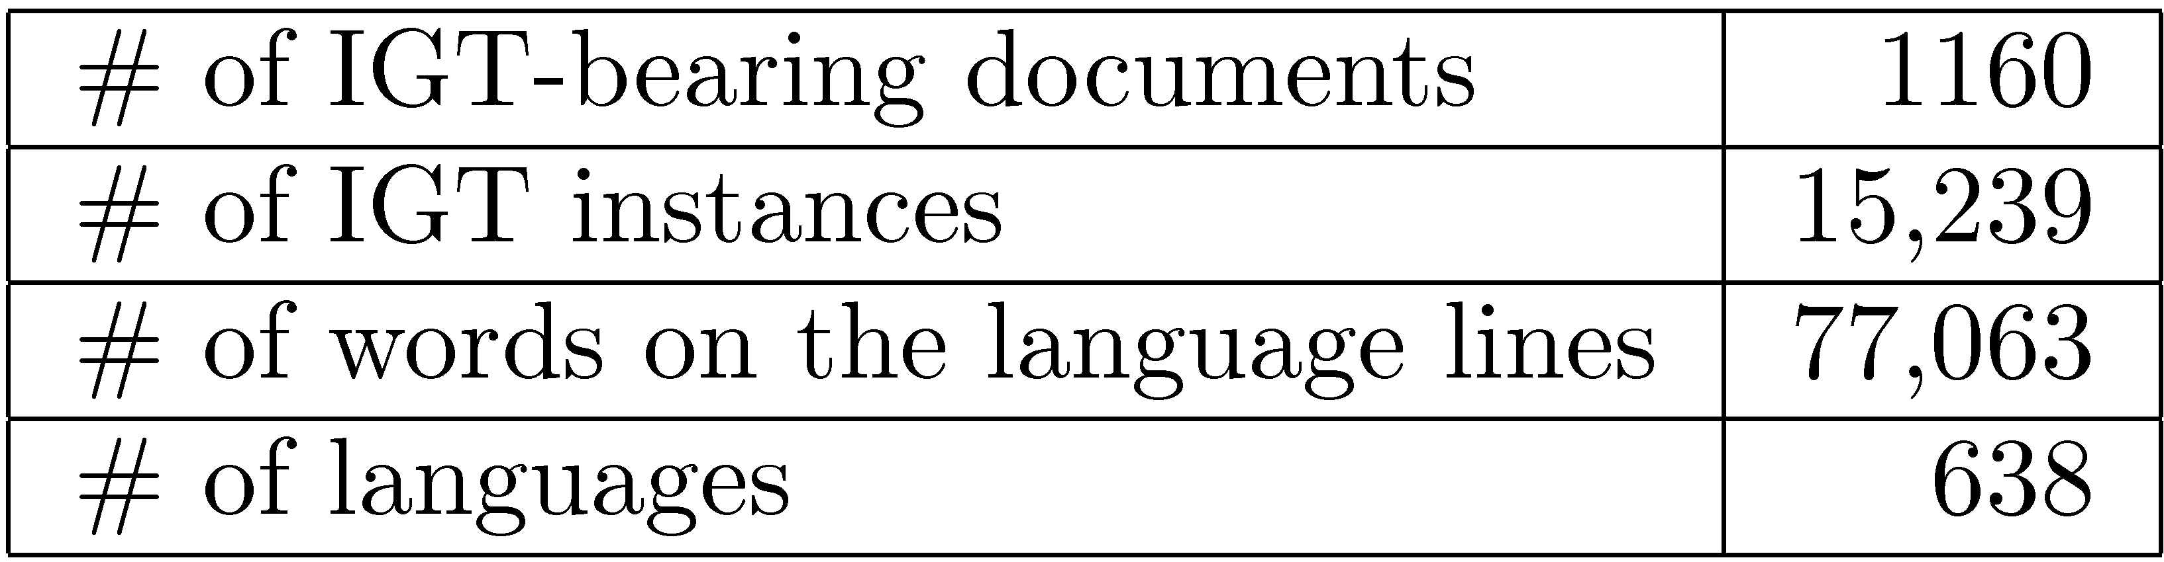
Our data set

Slide 32
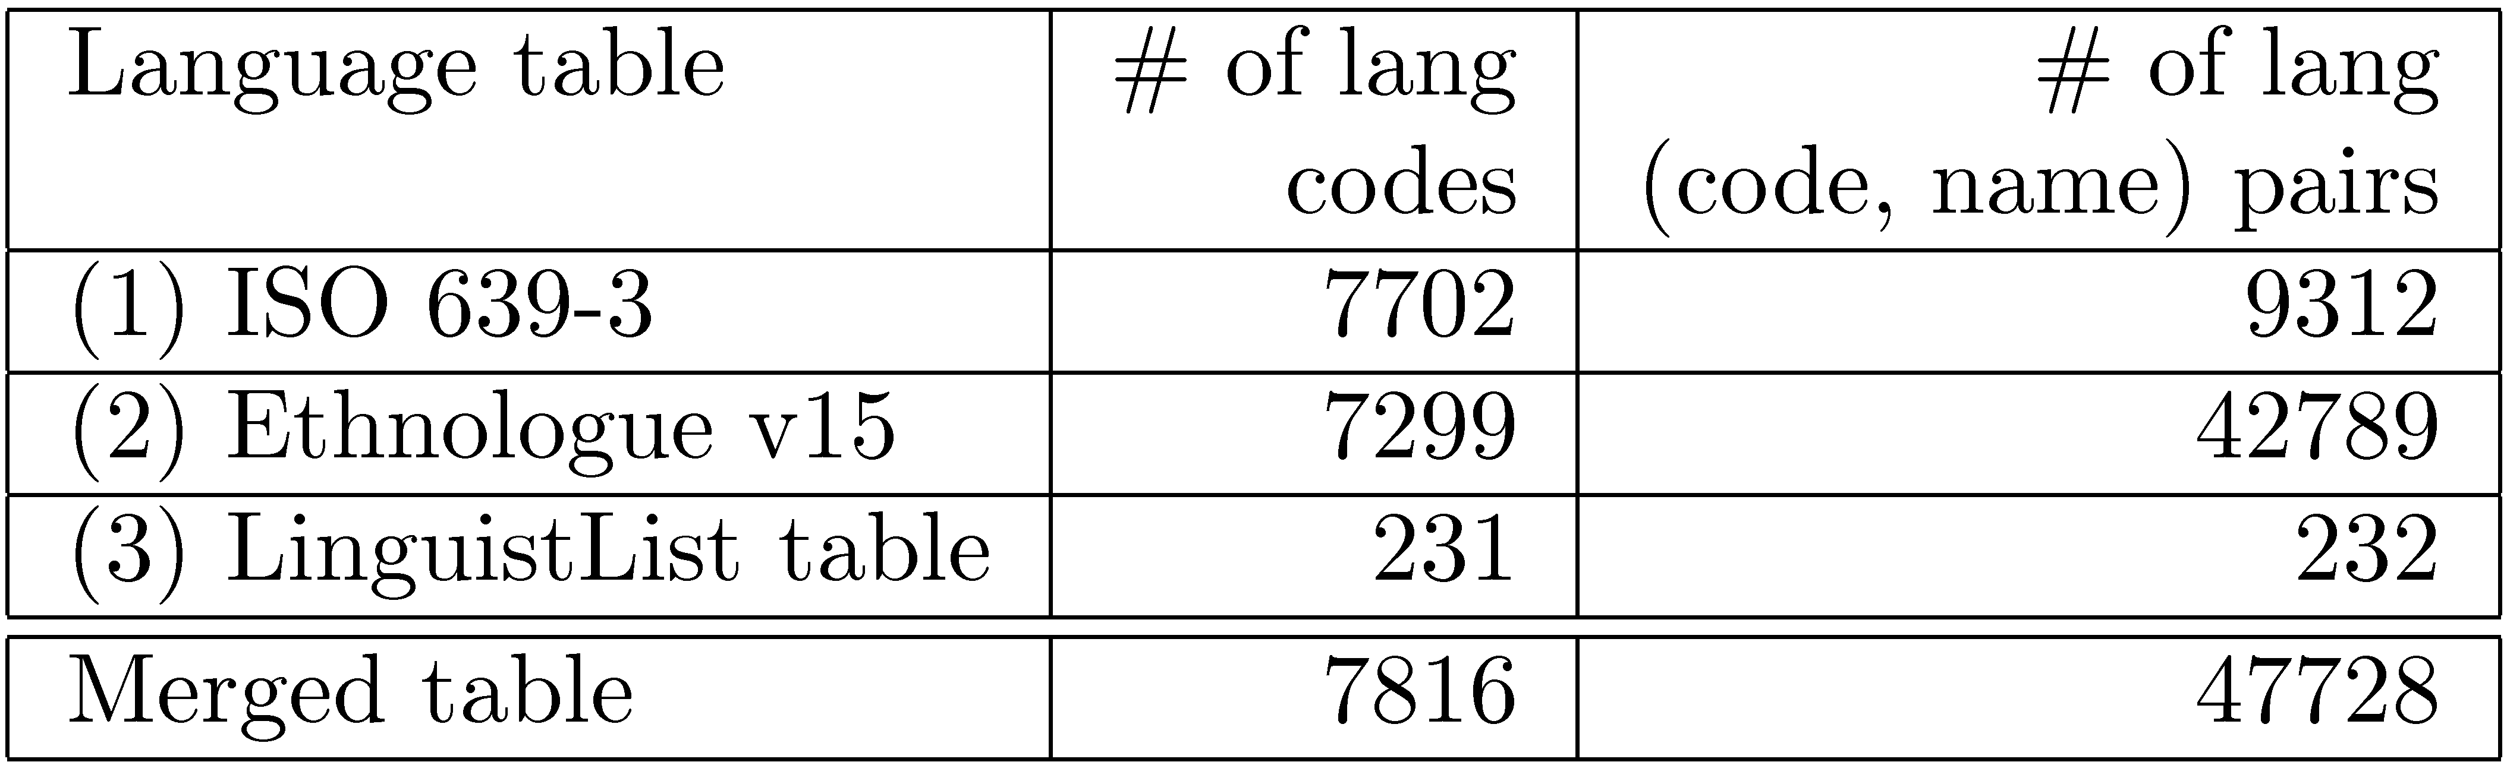
Language tables
6.0% of language names in the merged table are ambiguous
The table is not complete:
  Dozens of languages (e.g., Early High German) do not have language codes.
  More than 900 pairs are missing from the table
  (e.g., Aroplokep vs. Arop-Lukep)

Slide 33
Treating language ID as a coreference task
CoRef task:
  Ex: Bryan called Alisa. He found her book.
  A language name is like a proper name.
  An IGT is like a pronoun.
Unseen languages is no longer a major problem.
All the existing algorithms on CoRef can be applied to the task.
Notes:
Even if you have never seen the name “Alisa” in your training data, you can still link “her” to “Alisa” correctly.

Slide 34
Experiments
Features (“cues”):
  (F1) The languages appearing right before the IGT
  (F2) The languages appearing in the neighborhood of the IGT
  (F3) Word/character ngrams in the current IGT vs. ngrams for a language in the training data
  (F4) Word/character ngrams in the current IGT vs. ngrams in other IGTs in the same document
Data set: 1160 documents (90% training, 10% testing)
Learning methods:
  Sequence decision with a Maximum entropy classifier (Berger et al., 1996)
  Joint model with Markov Logic Network (Richardson and Domingos, 2006)
Notes:
use 1% of the training data

Slide 35
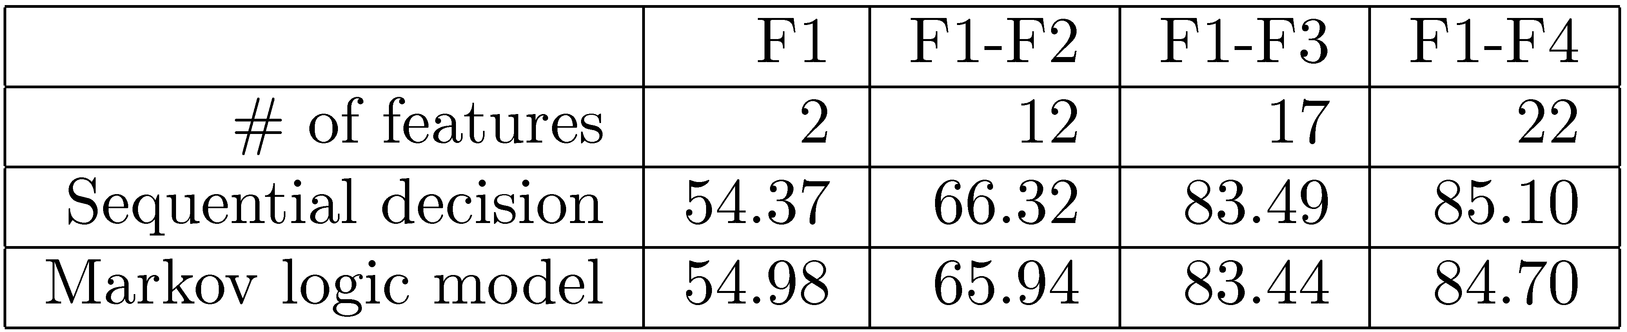
System performance
Upper bound of CoRef approach: 97.31%
TextCat: 51.38%

Slide 36
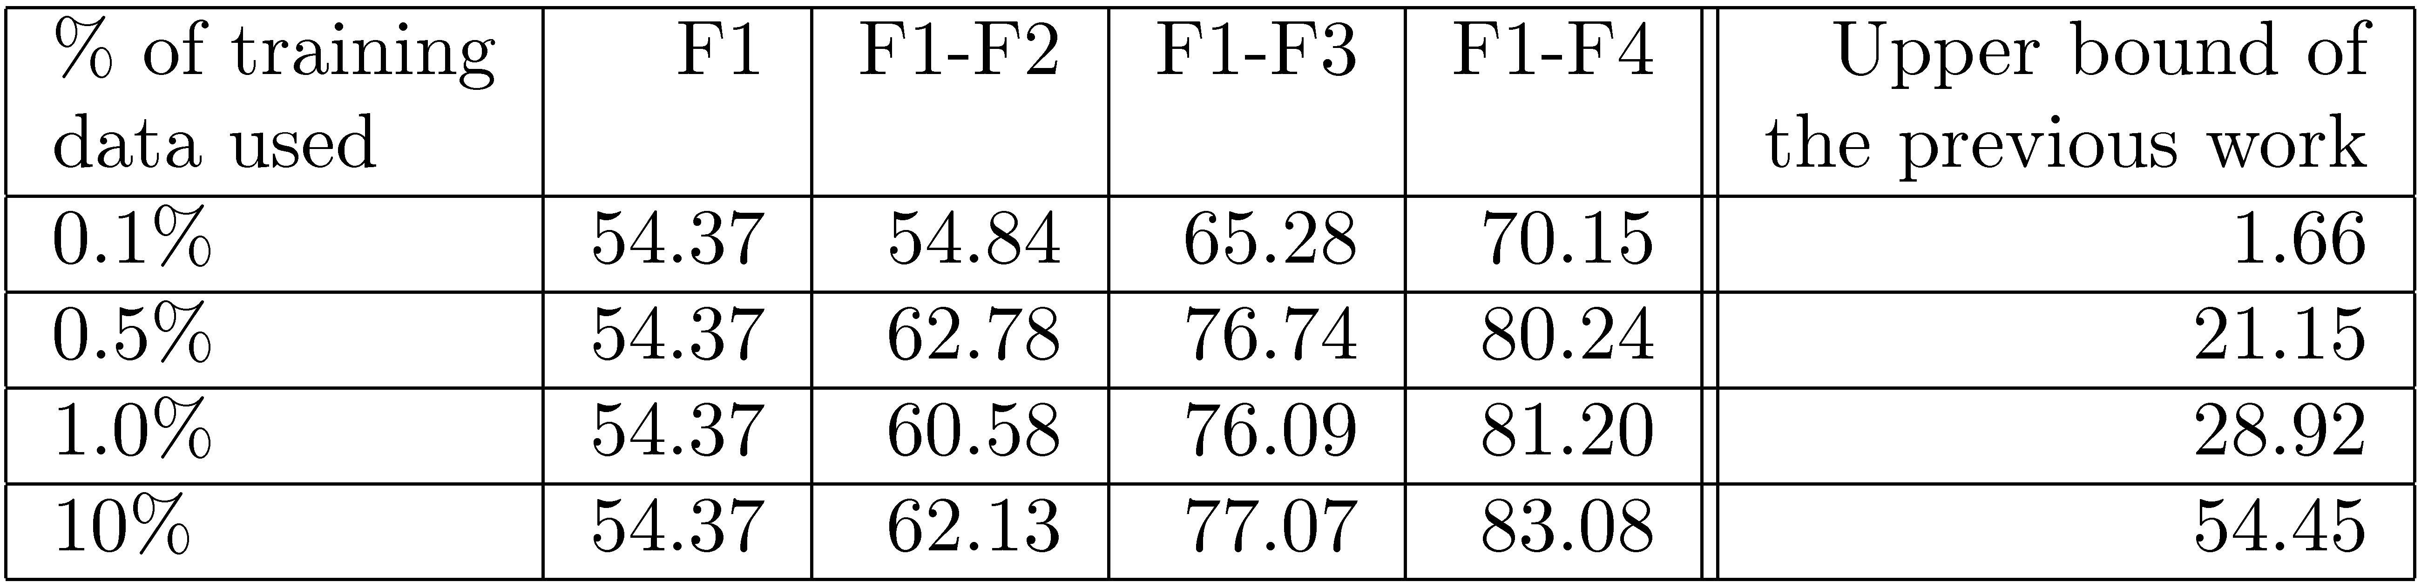
With less training data

