Slide 1
GermanPolarityClues
A Lexical Resource for German Sentiment Analysis
University of Bielefeld
Ulli Waltinger
ulli_marc.waltinger@uni-bielefeld.de
LREC2010
The International Conference on Language Resources and Evaluation
Valletta, Malta
O21 – Emotion, Sentiment
20. May 2010

Slide 2
GermanPolarityClues
A Lexical Resource for German Sentiment Analysis
Agenda
  Introduction
  Related Work
  Sentiment Resources
  Study Overview
  Experiments - English / German
  Results
  Conclusion

Slide 3
GermanPolarityClues
A Lexical Resource for German Sentiment Analysis
Introduction:
  Sentiment analysis - a discipline of information retrieval – the
  opinion mining (OM)
  OM analyzes the characteristics of opinions, feelings and
  emotions that are expressed in textual (Pang et al., 2002) or
  spoken (Becker-Asano and Wachsmuth, 2009) data with respect to
  a certain subject.
  Subtask of sentiment analysis - categorization on the basis of
  certain polarities - the sentiment polarity identification
  (Pang et al.,2002)
Notes:
Sentiment analysis refers to a discipline of information retrieval – the opinion mining (OM)
OM analyzes the characteristics of opinions, feelings and emotions that are expressed in textual (Pang et al., 2002) or spoken (Becker-Asano and Wachsmuth, 2009) data with respect to a certain subject.)
A subtask of sentiment analysis, which has been extensively studied in recent years, is the sentiment categorization on the basis of certain polarities - the sentiment polarity identification (Pang et al.,2002)

Slide 4
GermanPolarityClues
A Lexical Resource for German Sentiment Analysis
Introduction:
  Polarity Identification focuses on the classification of positive,
  negative or neutral expressions in texts.
  Polarity-related term feature interpretation, most of the proposed
  methods make use of manually annotated or automatically
  constructed lists of polarity terms.
  English language: Only a small number are freely available to the
  public.
  German language: Currently no annotated dictionary freely
  available.

Slide 5
GermanPolarityClues
A Lexical Resource for German Sentiment Analysis
Introduction
  Determination of polarity-features is in the center in order to draw
  conclusions of polarity-related orientation of the entire text.
  “Wonderful when it works... I owned this TV for a month. At first I
  thought it was terrific. Beautiful clear picture and good sound for
  such a small TV. Like others, however, I found that it did not always retain the programmed stations and then had to be reprogrammed every time you turned it off. I called the manufacturer and they admitted this is a problem with the TV.”

Slide 6
GermanPolarityClues
A Lexical Resource for German Sentiment Analysis
Introduction:
  Problem - text categorization approaches (e.g. bag-of-words) need
  to be extended or seized to the domain of sentiment analysis
  Proposed (semi-) supervised sentiment-related approaches
  make use of annotated and constructed lists of subjectivity
  terms.
  Coverage rate, the number of comprised subjectivity terms varies
  significantly - ranging between 8,000 and 140,000 features.

Slide 7
GermanPolarityClues
A Lexical Resource for German Sentiment Analysis
Research Questions:
  How does the significant coverage variations of the English
  sentiment resources correlate to the task of polarity identification?
  Are there notable differences in the accuracy performance, if
  those resources are used within the same experimental setup?
  How does sentiment term selection combined with machine
  learning methods affect the performance?
  Are we able to draw conclusions from the results of the experiments
  in building a German sentiment analysis resource?

Slide 8
GermanPolarityClues
A Lexical Resource for German Sentiment Analysis
Related Work:
  Turney and Littman (2002): Counting positive and negative terms.
  Machine-learning approaches (Turney, 2001) on different document
  levels
    entire documents (Pang et al. (2002))
    phrases (Wilson et al., 2005; Agarwal et al., 2009)
    sentences (Pang and Lee, 2004)
  Kennedy and Inkpen (2006): Discourse-based contextual valence
  shifters.

Slide 9
GermanPolarityClues
A Lexical Resource for German Sentiment Analysis
Related Work:
  Chaovalit and Zhou (2005): Comparative study on supervised
  and unsupervised classification methods. Machine learning on the
  basis of SVM are more accurate than any other unsupervised
  classification approaches.
  Tan and Zhang (2008): Empirical study on feature selection (e.g.
  chi square, subjectivity terms) and learning methods (e.g. kNN, NB,
  SVM) on a Chinese data set. Combination of sentimental feature
  selection and machine learning-based SVM performs best.
  Prabowo and Thelwall (2009): Combined approach using rule-
  based, supervised and machine learning methods. No single
  classifier outperforms the other.

Slide 10
GermanPolarityClues
A Lexical Resource for German Sentiment Analysis
Related Work:
  In general, sentence-based polarity identification contributes to a
  higher accuracy performance, but induces also a higher
  computational complexity.
  Reported increase of accuracy of document and sentence
  classifier range between 2 - 10% (Pang and Lee, 2004; Wiegand
  and Klakow, ) mostly compared to the baseline (e.g. Naive Bayes).
  At the focus of almost all approaches, a set of subjectivity terms is
  needed, either to train a classifier or to extract polarity-related terms
  following a bootstrapping strategy (Yu and Hatzivassiloglou, 2003).

Slide 11
GermanPolarityClues
A Lexical Resource for German Sentiment Analysis
Subjectivity Dictionaries:
  Hatzivassiloglou et al. (1997) - Adjective Conjunctions:
  Bootstrapping approach on the basis of adjective conjunctions.
  Small set of manually annotated seed words (1,336 adjectives),
  used in order to extract a number of 13,426 conjunctions, holding the
  same semantic orientation.
  Maarten et al. (2004) - WordNet Distance:
  Measuring the semantic orientation of adjectives on the basis of the
  linguistic resource WordNet (Fellbaum, 1998).
  Strapparava and Valitutti (2004) - WordNet-Affect:
  Synset-relations of WordNet with respect to their semantic
  orientation. Dataset comprises 2,874 synsets and 4,787 words

Slide 12
GermanPolarityClues
A Lexical Resource for German Sentiment Analysis
Subjectivity Dictionaries:
  Wiebe et al. (2005) - Subjectivity Clues:
  Most fine-grained polarity resource. In total, 8,221 term features
  rated by their polarity (+,-) but also by their reliability (e.g. strongly
  subjective, weakly subjective)
  Takamura et al. (2005) - SentiSpin:
  Extracting the semantic orientation of words using the Ising Spin
  Model. Dataset offers a number of 88,015 words for the English
  language.
  Esuli and Sebastiani (2006) - SentiWordNet:
  Analysis of glosses associated to synsets of the WordNet data set.
  Dataset comprises 144,308 terms with polarity scores assigned.

Slide 13
GermanPolarityClues
A Lexical Resource for German Sentiment Analysis
Experiments:
  Focus is set on the most widely used and freely available subjectivity
  dictionaries for the task of sentiment-based feature selection.
    Subjectivity Clues (Wiebe et al., 2005)
    SentiSpin (Takamura et al., 2005)
    SentiWordNet (Esuli and Sebastiani, 2006)
    Polarity Enhancement (Waltinger, 2009)
  Evaluating polarity classification is a document-based hard-partition
  machine learning classifier (Pang et al., 2002) using SVM.

Slide 14
GermanPolarityClues
A Lexical Resource for German Sentiment Analysis
Evaluation Corpus (English):
  Polarity identification classification using the movie review corpus
  initially compiled by (Pang et al.,2002)
  Two polarity categories (positive and negative), each category
  comprises 1000 articles with an average of 707.64 textual features
  Using Leave-One-Out cross-validation, reporting F1-Measure as the
  harmonic mean between Precision and Recall.

Slide 15
GermanPolarityClues
A Lexical Resource for German Sentiment Analysis
German Subjectivity Dictionary:
  Majority of subjectivity resources are based on the English language
  Translated the two most comprehensive dictionaries, the Subjectivity
  Clues (Wiebe et al., 2005) and the SentiSpin (Takamura et al., 2005)
  dictionary into the German language by automatic means (top3).
  (English: ”brave”—”positive” -- German: ”mutig”—”positive”)
  Compiled the GermanPolarityClues dictionary, (resolve ambiguity) by
  manually assessing individual term features of the dataset by their
  sentiment orientation
  Added additional negation-phrases and the most frequent positive and
  negative synonyms of existing term features (Wiktionary)

Slide 16
GermanPolarityClues
A Lexical Resource for German Sentiment Analysis
German Subjectivity Dictionary:
  Overview of the data schema by (A) automatic- and (B) corpus-based polarity orientation rating
Id: | Feature | PoS | A(+) | A(-) | A(o) | B(+) | B(-) | B(o)
5653 | Begündung | NN | 0 | 0 | 1 | 0 | 0.5 | 0.5
7573 | Katastrophe | NN | 0 | 1 | 0 | 0 | 0.68 | 0.32
7074 | ideal | ADJD | 1 | 0 | 0 | 0.76 | 0.13 | 0.11
GPC-Overall Features: | 10,141
No. Positive Features: | 3,220
No. Negative Features: | 5,848
No. Neutral Features: | 1,073
German SentiSpin: | 10,802
German Subjectivity: | 2,657
German Polarity Clues: | 2,700

Slide 17
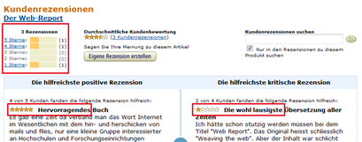
GermanPolarityClues
A Lexical Resource for German Sentiment Analysis
Evaluation Corpus (German):
  Manually created a reference corpus by extracting review data
  from the Amazon.com website
  Human-rated product reviews with an attached rating scale
  from 1 (worst) to 5 (best) stars.
  1000 reviews for each of the 5 ratings, each comprising 5
  different categories.

Slide 18
GermanPolarityClues
A Lexical Resource for German Sentiment Analysis
Resource Overview : The standard deviation and arithmetic mean of subjectivity features by resource, text corpus and polarity category.
Resource: | Subject. Clues | Senti Spin | Senti WordNet | Polarity Enhance | German SentiSpin | German Subject. | German Polarity Clues
No. of Features: | 6,663 | 88,015 | 144,308 | 137,088 | 105,561 | 9,827 | 10,141
Positive-AMean: | 76.83 | 236.94 | 241.36 | 239.25 | 53.63 | 27.70 | 26.66
Positive-StdDevi: | 30.81 | 84.29 | 85.61 | 84.98 | 6.90 | 4.59 | 5.01
Negative-AMean: | 69.72 | 218.46 | 223.11 | 221.25 | 50.18 | 25.68 | 24.14
Negative-StdDevi: | 26.22 | 74.08 | 75.37 | 74.68 | 10.40 | 5.88 | 5.41
Text-AMean: | 707.64 | 707.64 | 707.64 | 707.64 | 109.75 | 109.75 | 109.75
Text-StdDevi: | 296.94 | 296.94 | 296.94 | 296.94 | 24.52 | 24.52 | 24.52

Slide 19
GermanPolarityClues
A Lexical Resource for German Sentiment Analysis
Results English: Accuracy results comparing four subjectivity resources and four baseline
Sentiment-Method | Accuracy
Naive Bayes -unigrams (Pang et al., 2002) | 78.7
Maximum Entropy -top 2633 unigrams (Pang et al., 2002) | 81.0
SVM -unigrams+bigrams (Pang et al., 2002) | 82.7
SVM -unigrams (Pang et al., 2002) | 82.9
Polarity Enhancement -PDC (Waltinger, 2009) | 83.1
Subjectivity-Clues SVM Linear-Kernel | 84.1
Subjectivity-Clues SVM RBF-Kernel | 83.5
SentiWordNet SVM Linear-Kernel | 83.9
SentiWordNet SVM RBF-Kernel | 82.3
SentiSpin SVM Linear-Kernel | 83.8
SentiSpin SVM RBF-Kernel | 82.5

Slide 20
GermanPolarityClues
A Lexical Resource for German Sentiment Analysis
Results - English
  F1-Measure evaluation results of an English subjectivity feature selection using SVM.
Resource | Model | F1-Positive | F1-Negative | F1-Average
English Subjectivity Clues | SVM-Linear | .832 | .823 | .828
 | SVM-RBF | .828 | .823 | .826
English SentiWordNet | SVM-Linear | .832 | .828 | .830
 | SVM-RBF | .816 | .812 | .814
English SentiSpin | SVM-Linear | .831 | .827 | .829
 | SVM-RBF | .815 | .811 | .813
English Polarity Enhancement | SVM-Linear | .841 | .837 | .839

Slide 21
GermanPolarityClues
A Lexical Resource for German Sentiment Analysis
Results German
Resource | Model | F1-Positive | F1-Negative | F1-Average
German SentiSpin Star12 vs. Star45 | SVM-Linear | .827 | .828 | .828
 | SVM-RBF | .830 | .830 | .830
German SentiSpin Star1 vs. Star5 | SVM-Linear | .857 | .861 | .859
 | SVM-RBF | .855 | .858 | .857
German Subjectivity Star12 vs. Star45 | SVM-Linear | .810 | .813 | .811
 | SVM-RBF | .804 | .803 | .803
German Subjectivity Star1 vs. Star5 | SVM-Linear | .841 | .842 | .841
 | SVM-RBF | .834 | .834 | .834
GermanPolarityClues Star12 vs. Star45 | SVM-Linear | .875 | .730 | .803
 | SVM-RBF | .866 | .661 | .758
GermanPolarityClues Star1 vs. Star5 | SVM-Linear | .875 | .876 | .876
 | SVM-RBF | .855 | .850 | .853

Slide 22
GermanPolarityClues
A Lexical Resource for German Sentiment Analysis
Results:
  English-based baseline experiments indicate, that the smallest
  resource, Subjectivity Clues, perform with a touch better than
  SentiWordNet, SentiSpin and the Polarity Enhancement dataset
  (F1-Measure results between 82.9 - 83.9).
  Subjectivity feature selection in combination with machine
  learning classifier clearly outperform the well known baseline
  results as published by Pang et al., 2002
  (NB: acc = 78.7; ME: acc = 81.0; N-Gram-based SVM: acc = 82.9).
  Size of the dictionary clearly correlates to the coverage
  (arithmetic mean of polarity-features selected varies between 76.83
  241.36) but not to accuracy.

Slide 23
GermanPolarityClues
A Lexical Resource for German Sentiment Analysis
Results:
  Newly build German subjectivity resources, used for the
  document-based polarity identification, indicate similar perceptions.
  German SentiSpin version, comprising 105,561 polarity features, lets
  us gain a promising F1-Measure of 85.9.
  The German Subjectivity Clues, comprising 9,827 polarity features,
  performs with an F1-Measure of 84.1 almost at the same level.
  The German Polarity Clues dictionary, comprising 10,141 polarity
  features, outperforms with an F1-Measure of 87.6 all other resources.

Slide 24
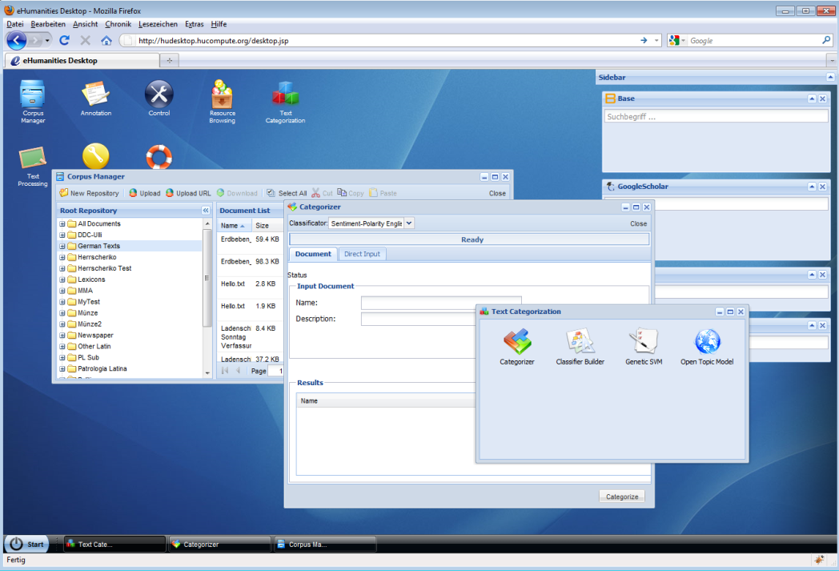
GermanPolarityClues
A Lexical Resource for German Sentiment Analysis
Resource
  The constructed resources can be freely accessed and downloaded:
  http://hudesktop.hucompute.org/

Slide 25
GermanPolarityClues
A Lexical Resource for German Sentiment Analysis
University of Bielefeld
Ulli Waltinger
ulli_marc.waltinger@uni-bielefeld.de
LREC2010
The International Conference on Language Resources and Evaluation
Valletta, Malta
O21 – Emotion, Sentiment
20. May 2010

