Slide 1



Sentiment Analysis in the News
7th International Conference on Language Resources and Evaluation – LREC 2010
Alexandra Balahur, Ralf Steinberger, Mijail Kabadjov, Vanni Zavarella,
Erik van der Goot, Matina Halkia, Bruno Pouliquen, Jenya Belyaeva
http://langtech.jrc.ec.europa.eu/
http://press.jrc.it/overview.html

Slide 2
Agenda
Introduction
  Motivation
  Use in multilingual Europe Media Monitor (EMM) family of applications
Defining sentiment analysis for the news domain
Data used
  Gold standard collection of quotations (reported speech)
  Sentiment dictionaries
Experiments
  Method
  Results
  Error analysis
Conclusions and future work

Slide 3
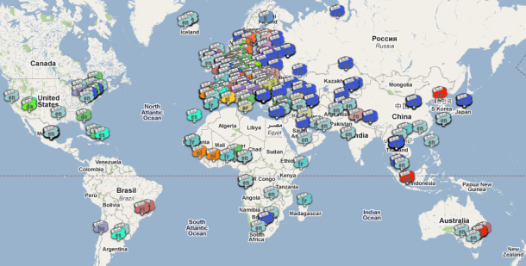
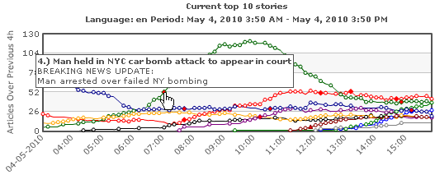
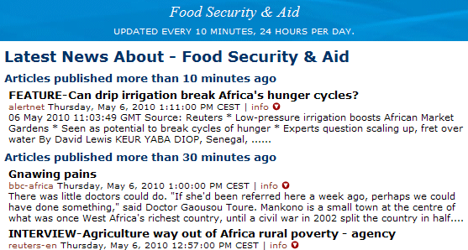
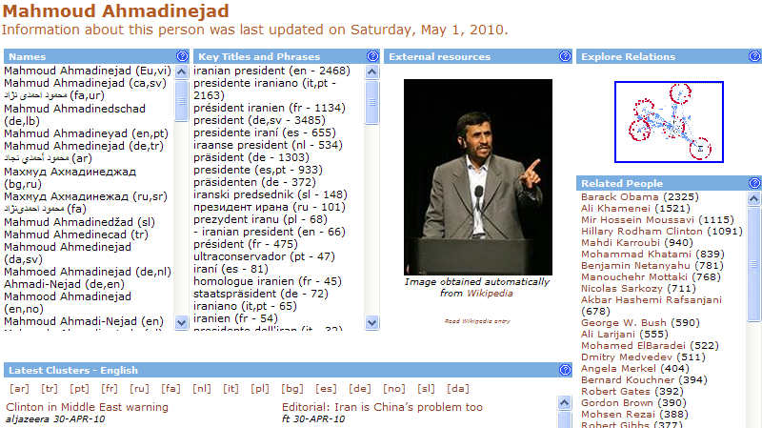
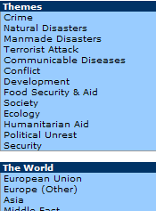
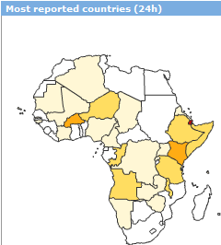
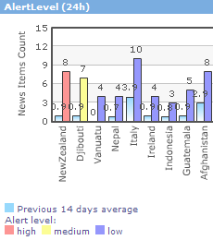
Background: multilingual news analysis in EMM
Current news analysis in Europe Media Monitor
  100,000 articles per day in 50 languages;
  Clustering and classification (subject domain classes);
  Topic detection and tracking;
  Collecting multilingual information about entities;
    Cross-lingual linking and aggregation, …
    Publicly accessible at http://press.jrc.it/overview.html.

Slide 4
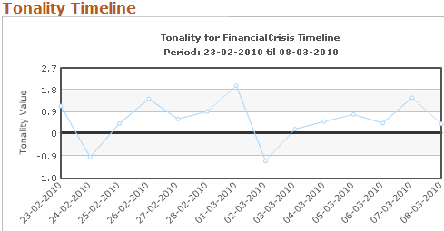
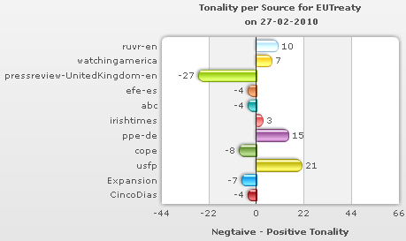
Objective: add opinions to news content analysis
E.g. Detect opinions on
  European Constitution; EU press releases;
  Entities (persons, organisations, EU programmes and initiatives);
Use for social network analysis
Detect and display opinion differences across sources and across countries;
Follow trends over time.
Highly multilingual (20+ languages) → use simple means
  no syntactic analysis, no POS taggers, no large-scale dictionaries.
  → count sentiment words in word windows

Slide 5
Sentiment analysis – Definitions
Definition of sentiment analysis:
  Many Definitions, e.g. Wiebe (1994), Esuli & Sebastiani (2006), Dave et al. (2003),
  Kim & Hovy (2005)
  Sentiment/Opinion of a Source/Opinion Holder on a Target
  (e.g. a blogger or reviewer’s opinion on a movie / product and its features)
  Negative sentiment in news on natural disaster or bombing: what does it mean?

Slide 6
Complexity of sentiment in news analysis
Sentiment?
Source?
Target?
It is incredible how
something like this can happen!
SUBJ
Reader/Author
Politician A’s son was caught selling drugs.
OBJ/SUBJ
Author
Politician B said: “We
support politician A’s reform.”
SUBJ/OBJ
Pol.B/Author
Politician A said: “We have declared a war on drugs”.
OBJ/SUBJ
Author/Pol.A
1 million people die every year because of drug consumption.
OBJ/SUBJ
Author/Reader
Inter-annotator agreement ~50%

Slide 7
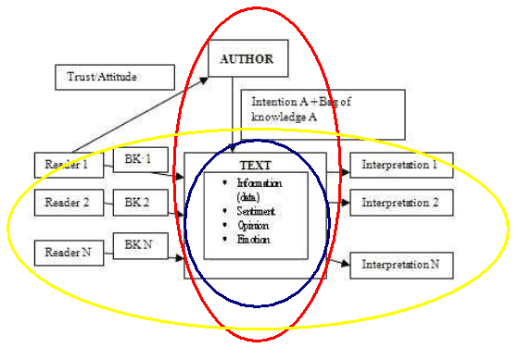
Helpful model: distinguish three perspectives
Author
  may convey opinion by stressing upon some facts, omitting other aspects;
  word choice; story framing; …
Reader
  interprets texts differently depending on background and opinions.
Text
    Some opinions are stated explicitly in the text (even if metaphorically)
    Contains (pos. or neg.) news content and (pos. or neg.) sentiment values.

Slide 8


News sentiment analysis – What are we looking for?
Before annotating, we need to specify what we want to annotate:
  → sentiment or not?
  Do we want to distinguish positive and negative sentiment from good and bad news!
    Inter-annotator agreement rose from ~50% to ~ 60%.
  What is the Target of the sentiment expression?
No
Yes
Entities

Slide 9
News sentiment analysis – Annotation guidelines used
Sentiment annotation guidelines, annotating 1592 quotes, included:
  Only annotate the selected entity as a Target;
  Distinguish news content from sentiment value;
    Annotate attitude, not news content;
  If you were that entity, would you like or dislike the statement;
  Try not to use your world knowledge (political affiliations, etc.), focus on
  explicit sentiment;
  In case of doubt, leave un-annotated (neutral).
→ Inter-annotator agreement reached 81%.

Slide 10
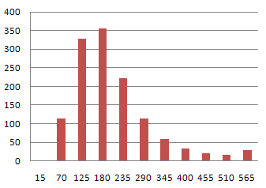
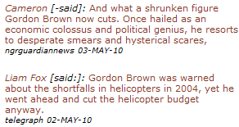

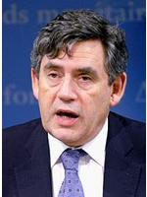

Quotation test set / inter-annotator agreement
Test set of 1592 quotes (reported speech) whose source and target are known.
  Test set of 1114 usable quotes agreed upon by 2 annotators.
  Baseline: percentage of quotes in the largest class (objective) = 61%
 | No. quotes | No. agreed quotes | No. agreed neg. quotes | No. agreed pos. quotes | No. Agreed obj. quotes
 | 1592 | 1292 | 234 | 193 | 865
Agreement |  | 81% | 78% | 78% | 83%
Histogram of quotes’ length in characters

Slide 11
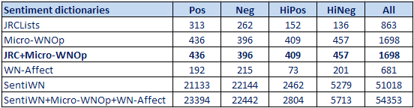
Sentiment dictionaries
Distinguishing four sentiment categories (HP, HN, P, N)
  Summing the respective intuitive values (weights) of ± 4, ± 1;
  Performed better than binary categories (Pos/Neg).
Mapping various English language resources to these four categories:
  JRC Lists
  MicroWN-Op ([-1 … 1]; cut-off point ± 0.5)
  WNAffect (HN: anger, disgust; N: fear, sadness; P: joy; HP: surprise )
  SentiWN ([-1 … 1]; cut-off point ± 0.5)

Slide 12

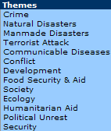
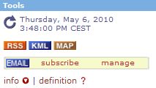
Experiments, focusing on entities
Count sentiment word scores in windows of different sizes around the entity
(or its co-reference expressions, e.g.
Gordon Brown = UK Prime Minister, Minister Brown, etc.);
Using different dictionaries and combinations of dictionaries;
Subtracting the sentiment value of words that belong to EMM category definitions
  to reduce the impact of news content;
  Simplistic and quick approximation.
E.g. category definition for EMM category CONFLICT.
  car bomb
  military clash
  air raid
  armed conflict
  civil unrest
  armed conflict
  genocide
  war
  insurrection
  massacre
  rebellion
  …

Slide 13
Evaluation results
Word window | With or Without using Category Definitions | JRC Dictionaries | MicroWN | WNAffect | SentiWN
Whole text | yes | 0.47 | 0.54 | 0.21 | 0.25
 | no | 0.44 | 0.53 | 0.2 | 0.2
3 | yes | 0.51 | 0.53 | 0.24 | 0.25
 | no | 0.5 | 0.5 | 0.23 | 0.23
6 | yes | 0.63 | 0.65 | 0.2 | 0.23
 | no | 0.58 | 0.6 | 0.18 | 0.15
6 | yes | 0.82 |  | 0.2 | 0.23
 | no | 0.79 |  | 0.18 | 0.15
10 | yes | 0.61 | 0.64 | 0.22 | 0.2
 | no | 0.56 | 0.64 | 0.15 | 0.11
Results in terms of accuracy
(number of quotes correctly classified as positive, negative or neutral)

Slide 14
Error analysis
Largest portion of failures: erroneous misclassification of quotes as neutral:
  No sentiment words present – but clear sentiment expressed
    “We have video evidence that the activists of X are giving out food products to voters”
    “He was the one behind all these atomic policies”
    “X has been doing favours to friends”
  Use of idiomatic expressions to express sentiment:
    “They’ve stirred the hornet’s nest”
Misclassification of sentences as positive or negative
  Because of the presence of another target:
    “Anyone who wants X to fail is an idiot, because it means we’re all in trouble”

Slide 15
Conclusion
News sentiment analysis (SA) is different from the ‘classic’ SA text types.
  It is less clear what source and target are, and they can change within the text
    Shown by low inter-annotator agreement;
Need to define exactly what we are looking for → We focused on entities.
Search in windows around entities.
We tested different sentiment dictionaries.
We tried to separate (in a simplistic manner) pos./neg. news content
from pos./neg. sentiment.

Slide 16
Future Work
Future work:
  Use cross-lingual bootstrapping methods to produce sentiment dictionaries
  in many languages;
  Compare opinion trends across multilingual sources and countries
  over time.

