Slide 1
Towards Semi-Automated Annotation for Prepositional Phrase Attachment
Sara Rosenthal
William J. Lipovsky
Kathleen McKeown
Kapil Thadani
Jacob Andreas
Columbia University

Slide 2
Background
Most standard techniques for text analysis rely on existing annotated data
LDC and ELRA provide annotated data for many tasks
But systems do poorly when applied to text from a different domain or genre
Can annotation tasks be extended to new genres at low cost?

Slide 3
Experiment
Determine whether annotators without formal linguistic training can do as well as linguists:
Task: Identify the correct attachment point for a given prepositional phrase (PP)
Annotators: workers on Amazon Mechanical Turk
Evaluation: Comparison with Penn Treebank

Slide 4
Approach
Automatic extraction of PPs plus correct and plausible attachment points from Penn Treebank
Creation of multiple choice questions for each PP to post on Mechanical Turk
Comparison of worker responses to Treebank

Slide 5
Outline
Related Work
Extracting PPs and attachment points
User Studies
Evaluation and analysis

Slide 6
Related Work
Recent work in PP attachment achieved 83% accuracy on formal genres (Agirre et al 2008)
PP attachment training typically done on RRR dataset (Ratnaparkhi et al 1994)
  Presumes the presence of an oracle to extract 2 hypotheses
Previous research has evaluated workers for other smaller scale tasks (Snow 2008)

Slide 7
Extracting PPs and Attachment Points
The meeting, which is expected to draw 20,000 to Bangkok, was going to be held at the Central Plaza Hotel, but the government balked at the hotel’s conditions for undertaking the necessary expansions.

Slide 8
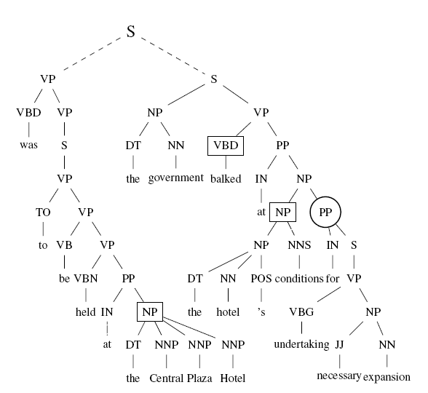
Extracting PPs and Attachment Points
PPs are found through tree traversal
The closest left sibling is the correct attachment
Verbs or NPs to left are plausible attachments

Slide 9
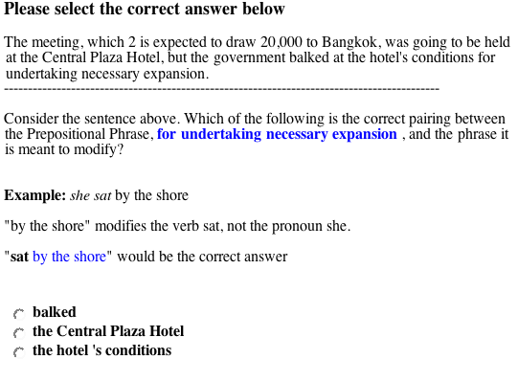

Slide 10
User Studies
Pilot Study
  20 PP attachment cases
  Experimented with 3 question wordings
  Selected wording with most accurate responses (16/20)
Full Study
  Ran question extraction on 3000 Penn Treebank sentences
  Selected first 1000 for questions avoiding
    Similar sentences (e.g. “University of Pennsylvania” “University of Colorado”)
    Complex constructions where tree structure didn’t identify answer (e.g., “The decline was even steeper than in November.’’)
    Forward modification
  Workers self-identified as US residents
  Each question posed to 3 workers

Slide 11
Full Study Statistics
Average time/task: 49 seconds
5 hours and 25 min to complete entire task
Total expense: $135
  $120 on workers
  $15 on mechanical turk fee

Slide 12
Results
Basis | Percent Correct Attachment Points
3000 individual responses | 86.7%
Unanimous agreement for 1000 responses | 71.8%
Majority agreement for 1000 responses | 92.2%

Slide 13
Error Analysis
Manual analysis of incorrect cases (78)
Difficulty when correct attachment point a verb or adj
  The morbidity rate is a striking finding among many of us
No problem when correct attachment point a noun
System incorrectly handled conjunction as attachment point
  Workers who chose the first constituent marked incorrect
  The thrift holding company said it expects to obtain regulatory approval and complete the transaction by year-end.

Slide 14
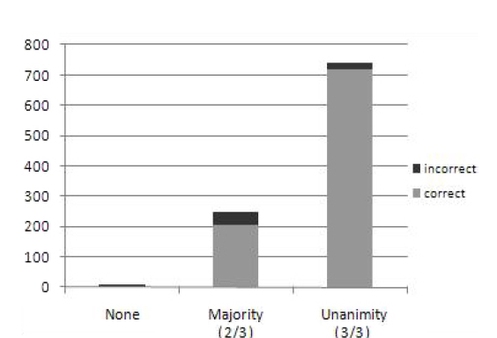
Number of Questions
When 3/3 agree, response is correct 97% of the time
When just 2/3 agree, response is correct 82% of the time
When no agreement, the answer is always wrong

Slide 15
Conclusions
Non-experts capable of disambiguating PP attachment in Wall Street Journal
Accuracy increases by 15% from agreement between 2 to 3 workers -> possible higher accuracy with more
Methodology for obtaining large corpora for new genres and domains
What’s next? See our paper in the NAACL Workshop on Amazon Mechanical Turk
    Presents a method and results for collecting PP attachment on blogs without parsing

