Slide 1
Achieving Domain Specificity in SMT without Over Siloing
William Lewis, Chris Wendt, David Bullock
Microsoft Research
Machine Translation

Slide 2
Domain Specific Engines
Typically: News, Govt., Travel (e.g., WMT workshops, etc.)
Typically: do quite well on test data drawn from the same source/domain (e.g., Koehn&Monz 2006, etc.)
But domain can be taken very narrowly:
  E.g., Data supply for a particular company
  “Micro-domain”

Slide 3
Domain Specific Engines
Given large samples of in-domain data, quality can be quite high
Examples from MS engines (test systems):
Language Pair | Size | In-Domain | Size | General
ENU-DEU | 7.6M | 52.39 | 4.4M | 25.19
ENU-JPN | 4.4M | 41.32 | 9.4M | 17.99
  * eval data consists of 5000 same/similar domain snts
Notes:
Need background on BLEU

Slide 4
Availability of Statistical Machine Translation (SMT)
Tools such as Moses and Giza++ has opened SMT to the masses
SMT far more accessible than it ever has been
Company X or University Y needs to localize documents from English into Spanish
Given ample data can
  Align the data (at the sentence level)
  Train an MT engine
  Produce first-pass translations
    Post edit
    Leave as is for some dynamic Web content
Requirement: Need some amount of parallel data

Slide 5
Data and Micro-Domains
Problems with Micro-Domain engines: data
The more data you have, the better the engine quality
Improvements in BLEU over MS data (enu-deu)
  500K snts → BLEU of 37.68
  7.7M snts → BLEU of 52.39
  * eval data consists of 5000 in-domain snts
Problem: If there isn’t a sufficient supply of in-domain data, the quality of the resulting engine may be reduced
Solution: Take advantage of data outside the domain
Notes:
Note about TMs?

Slide 6
Taking Advantage of Out of Domain Data
At least three ways this can be done:
  No domain specific parallel training data, only monolingual target
  Same, but parallel dev/test data, and monolingual target
  Supply of parallel training data, dev/test, and monolingual target (may be derived from parallel)
Our focus has been on the most expensive, #3 (assume the best results) = “Pooling”
Notes:
Backup slides with the results from (1)? Mention we did some tests on (1)?

Slide 7
Pooling Data
Benefit: May improve quality and generalizability of the engine
Drawback: Engine may not do as well on domain specific content
Solution:
  Train on all available data
  Use target language models to “focus” engine
Notes:
Target LM’s decrease hypothesis space
Citations here?

Slide 8
Pooling: How it works
Combine all readily available parallel data
Include “in-domain” parallel training data
Create one or more target language models (LMs)
  Must have one that is “in-domain”, with as much monolingual data as possible
Use held-out in-domain data for LM tuning (lambda training) – 2K
Evaluate against held-out in-domain data – 5K
Notes:
Target LM’s decrease hypothesis space
Citations here?

Slide 9
Pooled Data, Domain Specific LMs
Sources of data
  TAUS Data Association (www.tausdata.org)
    Parallel data for 70+ languages
    Significant number of company-specific TMs (200+)
  MS localization data
  General data (e.g., newswire, govt., etc.)
Notes:
Need background on LMs

Slide 10
The Experiments
Initial experiments on:
  enu-deu in-domain: Sybase
  enu-jpn in-domain: Dell
Training
  MS MT’s training infrastructure
  Word alignment: WDHMM (He 2007)
  Lambda training using MERT (Moore&Quirk 2008, Och 2003)
Notes:
Show just the

Slide 11
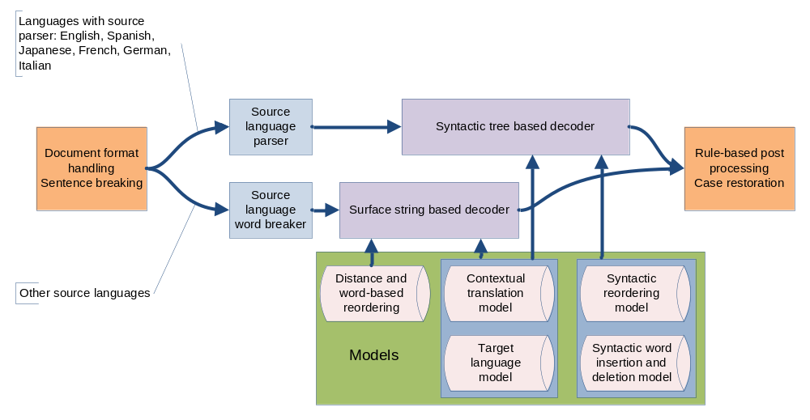
Microsoft’s Statistical MT Engine
Linguistically informed SMT

Slide 12
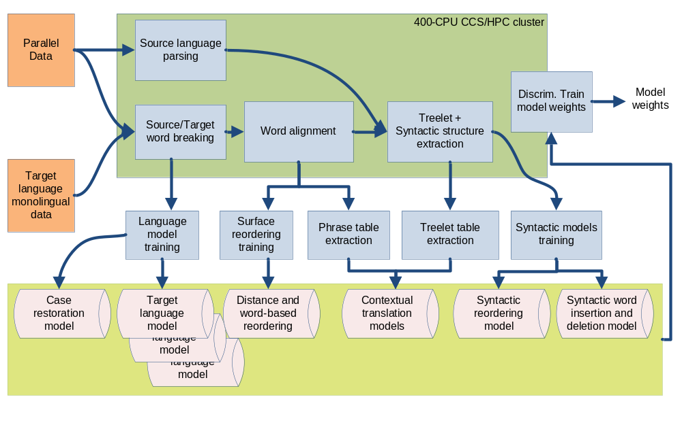
Training

Slide 13
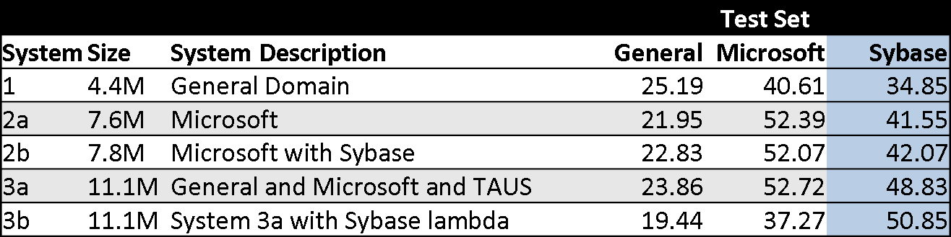
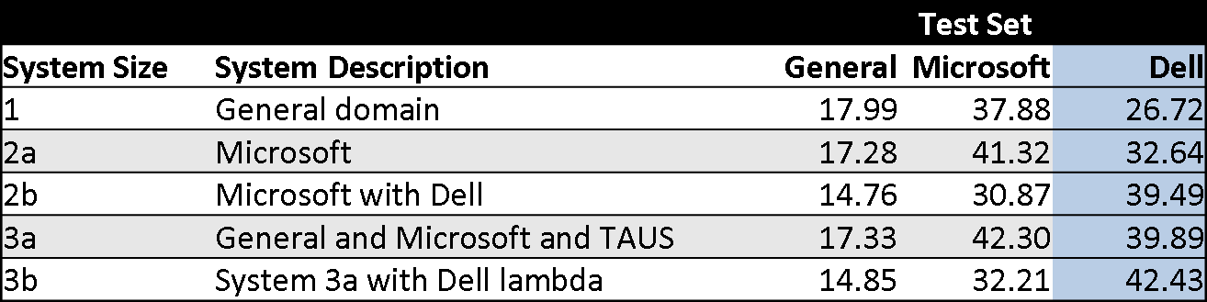
The Experiments
Results
English-German
English-Japanese
Notes:
Show just the

Slide 14
The Experiments
Results
English-German
English-Japanese
Notes:
Show just the

Slide 15
Additional Experiments
What about additional data providers, additional languages?
Further, what are the results against provider’s own engines?
Tested against:
  Adobe, eBay, ZZZ (in addition to Sybase & Dell)
  chs, deu, pol, jpn, esn
Notes:
To verify results

Slide 16
Additional Experiments
Provider | Language | BLEU 3a | BLEU Provider Only | # Segments
Adobe | CHS | 28.44 | 33.13 | 80002
Adobe | DEU | 30.97 | 36.38 | 165203
Adobe | POL | 33.74 | 32.26 | 129084
Dell | JPN | 42.43 | 40.85 | 172017
eBay | ESN | 51.94 | 45.50 | 45535
Sybase | DEU | 50.85 | 50.23 | 160394
ZZZ | CHS | 32.72 | 34.81 | 173892
ZZZ | ESN | 54.26 | 52.12 | 790181
Notes:
3a=all available data, including provider specific lambdas. Provider only=only their data, w/ relevant sizes

Slide 17
Additional Experiments
Provider | Language | BLEU 3a | BLEU Provider Only | # Segments
Adobe | CHS | 28.44 | 33.13 | 80002
Adobe | DEU | 30.97 | 36.38 | 165203
Adobe | POL | 33.74 | 32.26 | 129084
Dell | JPN | 42.43 | 40.85 | 172017
eBay | ESN | 51.94 | 45.50 | 45535
Sybase | DEU | 50.85 | 50.23 | 160394
ZZZ | CHS | 32.72 | 34.81 | 173892
ZZZ | ESN | 54.26 | 52.12 | 790181
Notes:
3a=all available data, including provider specific lambdas. Provider only=only their data, w/ relevant sizes

Slide 18
Analysis of Additional Results
Some new data showed promising results
Some were counter the expectation (a couple dramatically)
Why?

Slide 19
Hypothesis 1
Domain specific training data less diverse
Ergo, less data required for domain specific engine
Looked at:
  Vocabulary saturation
  Word edit distance between sentences (1-5)
  Perplexity of LM (training data) against test
No statistically significant pattern emerged

Slide 20
Hypothesis 2
In-domain test data “similar” to out of domain training data (i.e., greater contribution from out of domain data)
Examined BLEU scores of general system against in-domain eval data

Slide 21
Hypothesis 2
In-domain test data “similar” to out of domain training data (i.e., greater contribution from out of domain data)
Examined BLEU scores of general system against in-domain eval data
Provider | Language | 3a | Provider Only | 3a, No Provider Data
Adobe | DEU | 30.97 | 36.38 | 26.18
eBay | ESN | 51.94 | 45.50 | 45.97
Sybase | DEU | 50.85 | 50.23 | 35.73
ZZZ | CHS | 32.72 | 34.81 | 25.17
Notes:
Red from original list
Low BLEU scores in final column for Adobe and ZZZ suggest pooled data does not contribute; opposite holds for eBay. In fact, the out-of-domain engine does better on eBay’s eval data than eBay’s own data does. Note: eBay’s the less “tech” of the systems.

Slide 22
Hypothesis 2
In-domain test data “similar” to out of domain training data (i.e., greater contribution from out of domain data)
Examined BLEU scores of general system against in-domain eval data
Provider | Language | 3a | Provider Only | 3a, No Provider Data
Adobe | DEU | 30.97 | 36.38 | 26.18
eBay | ESN | 51.94 | 45.50 | 45.97
Sybase | DEU | 50.85 | 50.23 | 35.73
ZZZ | CHS | 32.72 | 34.81 | 25.17
Notes:
Red from original list
Low BLEU scores in final column for Adobe and ZZZ suggest pooled data does not contribute; opposite holds for eBay. In fact, the out-of-domain engine does better on eBay’s eval data than eBay’s own data does. Note: eBay’s the less “tech” of the systems.

Slide 23
Hypothesis 2
In-domain test data “similar” to out of domain training data (i.e., greater contribution from out of domain data)
Examined BLEU scores of general system against in-domain eval data
Provider | Language | 3a | Provider Only | 3a, No Provider Data
Adobe | DEU | 30.97 | 36.38 | 26.18
eBay | ESN | 51.94 | 45.50 | 45.97
Sybase | DEU | 50.85 | 50.23 | 35.73
ZZZ | CHS | 32.72 | 34.81 | 25.17
Notes:
Red from original list
Low BLEU scores in final column for Adobe and ZZZ suggest pooled data does not contribute; opposite holds for eBay. In fact, the out-of-domain engine does better on eBay’s eval data than eBay’s own data does. Note: eBay’s the less “tech” of the systems.

Slide 24
Conclusion
Pooling data can help in micro-domain contexts
Suspect where it does not help, there may be
  Similarity between in-domain and pooled content
  “Reduced” diversity in the in-domain data
Notes:
The latter experiments are not borne out.

Slide 25
Future Work
Determine when pooling will help and when it will not
Develop metric for measuring the contribution of various data (other than BLEU)
Data selection from “out of domain” data that most closely resembles in-domain (using methods discussed in Moore&Lewis 2010)
Run much larger scale tests on large sample of TDA data suppliers and languages
Determine when a TM might be the most appropriate solution (e.g., very narrow domain) (Armstrong, 2010)

Slide 26
Microsoft Translator
Microsoft Translator: http://microsofttranslator.com

