Slide 1


Building High Quality Databases for Minority Languages such as Galician
F. Campillo, D. Braga, A.B. Mourín, Carmen García-Mateo, P. Silva, M. Sales Dias, F. Méndez

Slide 2


Outline
Introduction /Background
Resources for TTS development:
  Voice talent selection
  Design and recording of the speech corpus
  Building up the lexicon
Description of the TTS systems
Evaluation and Discussion

Slide 3
Background
Collaboration between the GTM group of the University of Vigo and MLDC in Portugal
Common interest for developing linguistic resources for Galician
Galician language suffers from a serious shortage of speech and text resources
The Multimedia Technology Group of the University of Vigo has been working on Speech technologies in Galician for more than ten years, and Microsoft has a widely developed methodology to build new languages in a short period of time
First step of the collaboration: A 6-month project for TTS development
  Acquisition of a speech database
  Construction of a lexicon
  Integration of the new voice in the GTM-UVIGO system
  Developing of a first prototype of the Galician Microsoft TTS
  Preliminary evaluation

Slide 4
Voice Talent Selection
Microsoft Protocol was used
First step:
  Short recordings of 12 native female professional speakers
  An online subjective perceptual test was conducted: pleasantness, intelligibility, correct articulation and expressiveness were assessed
  Five speakers were selected
Second step:
  1-hour recording per speaker (approx. 600 sentences)
  Objective evaluation was conducted: reading rhythm, amplitude of the speech signal

Slide 5
Linguistic and Speech Resources
Speech Corpus
10.000 Galician isolated sentences between 1-25 word length extracted from a large newspaper text data: declarative, interrogative, exclamatory, ellipsis and lists of numbers.
An automatic greedy selection algorithm was used with criteria:
  A good phonemic coverage.
  A variety of syntactic structures: Noun phrase, Verb phrase, Adjective phrase, Adverb phrase, different types of conjunctions
Manual revision by a linguist
Recorded in a professional studio
  Three people took care of the recording sessions to pay attention to technical recording issues, errors in the pronunciation and variations in the rhythm.
  Fs= 44,1 KHz
  Duration: 14 hours and 28 minutes

Slide 6
Linguistic and Speech Resources
Lexicon
Search of most frequent words in Galician using a large text corpora
Approximately 100.000 words were selected augmented with 300.000 conjugated verbal forms
Following Microsoft specifications, each word is tagged with phonetic transcription, syllable boundaries, stress marks and POS.
Phonetic transcription, stress and syllable marking were automatically assigned using UVIGO system and manually reviewed by a linguist expert

Slide 7
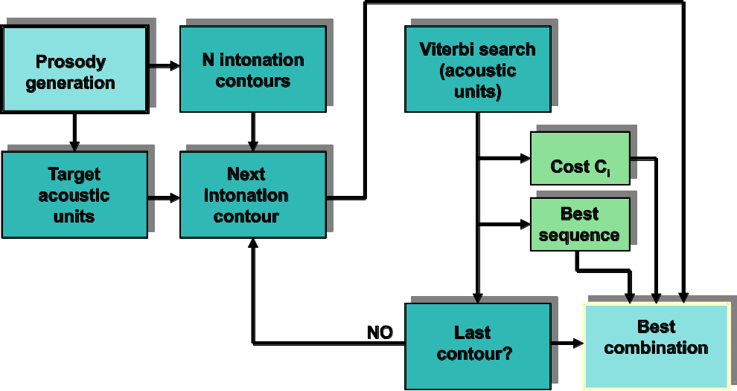
UVIGO : TD-PSOLA Based Cotovia TTS
Unit selection speech synthesizer
Demiphone based , Fs= 16 KHz downsampled to Fs=8 Khz for comparison with the Microsoft system
The best sequence of units is chosen by dynamic programming, using a Viterbi algorithm
Regarding duration, different linear regression models are trained for each phoneme class.

Slide 8
Microsoft: HMM-Based TTS
Dictionary based front-end made in collaboration with UVIGO:
  Lexicon,
  Text analysis, which involves the sentence separator and word splitter modules, the TN (Text Normalization) rules, the homograph ambiguity resolution algorithm, a stochastic-based LTS (Letter-to-Sound) converter to predict phonetic transcriptions for out-of-vocabulary words
  Prosody models, which are data-driven using a prosody tagged corpus of 2.000 sentences. In this stage of the Galician system, the prosody models were not enabled yet because the prosody tagged corpus is still not complete.
Statistical parametric speech synthesis based on Hidden Markov Models (HMM) using the HTS back-end module with Fs= 8Khz and 8 bits resolution. It has been trained with the 10.000 utterance voice-font.

Slide 9
Evaluation
MOS (Mean Opinion Score) test
Pairwise comparison between “System A” and “System B” with a five scale grading
40 isolated sentences between four and twenty words length, and belonging to different types: declaratives, questions, ellipsis, etc.
Each test consists of 20 sentences
  two sentences were equal in order to test the ability of the evaluators
33 tests were performed
  3 evaluators were discarded because of their lack of ability to recognize the two realizations that were the same
570 valid scores were obtained
Score | Meaning
1 | “A” system much better
2 | “A” system better
3 | Equal
4 | “B” system better
5 | “B” system much better

Slide 10
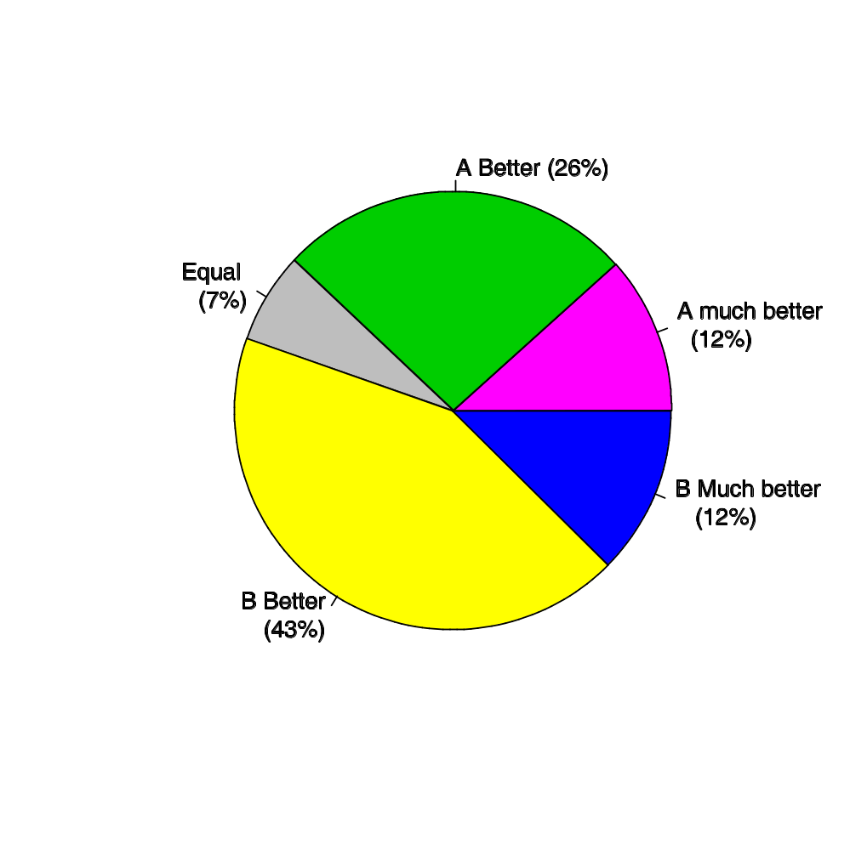
Evaluation

Slide 11
Evaluation
System B is Microsoft HMM Based TTS
System A is GTM Unit Based TTS

Slide 12
Evaluation
Some conclusions drawn
Comments of the evaluators remarked that they found the samples from the unit selection system more natural and human-like, but the presence of artifacts made them prefer the other system.
The artifacts are caused by a problem with the pitch tracking algorithm: pitch marks were not always located at the same point of each period, which caused discontinuities of up to 30Hz at the concatenation points.
It seems that HMM based systems are more robust to pitch marking which it is a very attractive feature when dealing with a large database as this one
Next steps:
  Microsoft: to finalize the missing front-end features (compounding, polyphony, morphology, vowel liaison and prosody marking)
  UVIGO: to improve the pitch marking and segmentation algorithms and to start to work with HMM based systems

Slide 13
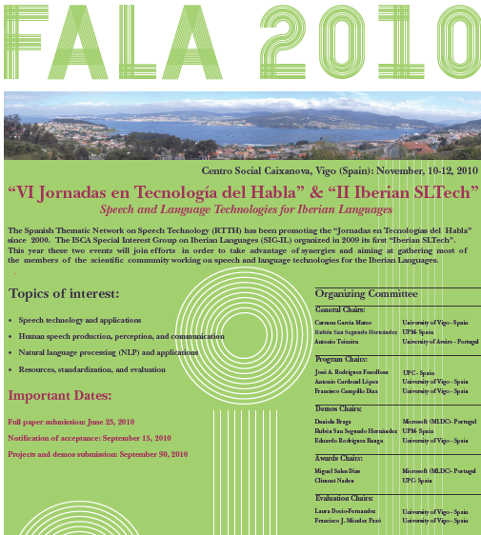
http://fala.uvigo.es

Slide 14
