Slide 1
A Web Application for Customized Corpus Delivery
Nancy Ide, Keith Suderman, Brian Simms
Department of Computer Science
Vassar College
USA

Slide 2
Web services
Language processing tasks are likely to be handled by web services in the future
  Applications such as machine translation
  Low- and mid-level NLP tasks that can be pipelined
    Tokenization
    POS labeling
    Shallow syntax
    Etc.
  Access to resources that is otherwise undesirable or prohibited (e.g. retrieval of information from lexicons)

Slide 3
Context
Open American National Corpus
  15 million word corpus of contemporary American English
  Range of genres comparable to those in the British National Corpus (BNC)
  Also newer genres such as blogs, email, rap lyrics, tweets, etc.
  Automatically annotated for a variety of linguistic phenomena
  All annotations available as standoff files

Slide 4
Context
Manually Annotated Sub-Corpus (MASC)
  Ide et al., 2008, LREC
  Balanced subset of half a million words of written texts and transcribed speech
  drawn from the OANC
  Hand-validated or manually-produced annotations for a wide variety of linguistic phenomena
  Also a corpus of 10,000 sentences manually annotated for WordNet senses (WN 3.1)

Slide 5
Context
All data and annotations freely available for any use
Downloadable from ANC web site
  http://www.anc.org

Slide 6
Context
Both OANC and MASC
  many annotations of different types
  several different annotations of the same type
    E.g. 3-4 different tokenizations, POS annotations
  Many different genres
Many users want only part of data, certain annotations
Desirable to provide in a variety of formats

Slide 7
MASC
Now
  Validated or manually produced annotations for a wide variety of linguistic phenomena at several linguistic levels available for 82K words
  1000 occurrences of each of 50 words manually sense-tagged with Wordnet senses
MASC contains or shortly will contain sixteen different types of annotation
  Most produced at different sites using specialized annotation software
  FrameNet annotation of 500 sentences from the WordNet corpus

Slide 8
MASC Annotations (first 220K words)

Slide 9
MASC Composition (first 220K words)

Slide 10
MASC Format
The layering of annotations over MASC texts dictates the use of a stand-off annotation representation format
  Each annotation contained in a separate document linked to the primary data
All annotations represented using the Graph Annotation Format (GrAF)
  XML serialization of abstract model : directed graph decorated with feature structures providing the annotation content
  Enables merging annotations originally represented in different
  Enables transducing annotations to a variety of other formats

Slide 11
MASC File Structure
Each text provided in a separate file in UTF- 8 encoding
  contains no annotation or markup of any kind
Each text associated with a set of stand- off files, one for each annotation type
  Some or all of annotation types in previous slide
  Also, minimal segmentation and logical structure (titles, headings, paragraphs, etc.)

Slide 12
WordNet/FrameNet Annotation
Annotation of 1000 occurrences of 100 words selected by WordNet and FrameNet teams
  Provide corpus evidence for an effort to harmonize sense distinctions in WordNet and FrameNet
  Use WordNet 3.1 senses
    WN database modified based on tagging experience in MASC
    WN3.1 will be released in the future
100 of the 1000 sentences for each word also annotated for FrameNet frame elements

Slide 13
Sentence Corpus
Annotated sentences provided as a stand- alone corpus
WordNet and FrameNet annotations represented in standoff files
Each sentence linked to its occurrence in the original text in the MASC or OANC

Slide 14
ANC Tool
Few software systems handle stand-off annotation
  or require lots of computational expertise
To solve the problem, ANC project developed the “ANC Tool”
  Merges data and annotations in GrAF
  Generates output in various formats
Required downloading and installing the ANC Tool in order to use

Slide 15
ANC Tool
Built on XCES parser
  SAX- like parser that combines selected annotations with primary data
  Uses multiple implementations of the org.xml.sax.DocumentHandler interface
Freely available from the ANC website
Can be used by any application that allows the user to specify the SAX parser to be used
    e.g., Saxon can be used to apply XSLT stylesheets to GrAF annotations without first merging annotations and primary data
Provides several options for representing overlapping hierarchies

Slide 16
ANC2Go
Web application
  will be implemented as a RESTful web service this summer
Users choose data and annotations and desired output format
Send request via web interface
ANC2Go returns a URL from which the user can download the requested corpus
Users create a “personalized” corpus
  data and annotations of their choosing
  format most useful to them

Slide 17
ANC2Go
Can be applied to
  MASC data and annotations
  Sentence Corpus (WN/FN)
  OANC
MASC user need never deal directly with or see the underlying representation of the corpus and stand-off annotations
  But gains all the advantages that representation offers

Slide 18
Output formats
XML in-line
  Suitable for use with the BNCs XAIRA search and access interface
  Input to any XML-aware software
Token with part of speech tags, separated by character of the user’s choice
  Input to general-purpose concordance software including MonoConc and Word- Smith
Token/part of speech input for the Natural Language Toolkit (NLTK)
CONLL IOB format
  Used in the Conference on Natural Language Learning shared tasks

Slide 19
Additional GrAF Tools
Modules to use GrAF annotations in general-purpose annotation and analysis tools
  GATE
  UIMA
  NLTK
Can use these systems independently or interchangeably
Java API for GrAF
  Includes a GraphVizRenderer to generate visualizations of an annotation subgraph

Slide 20
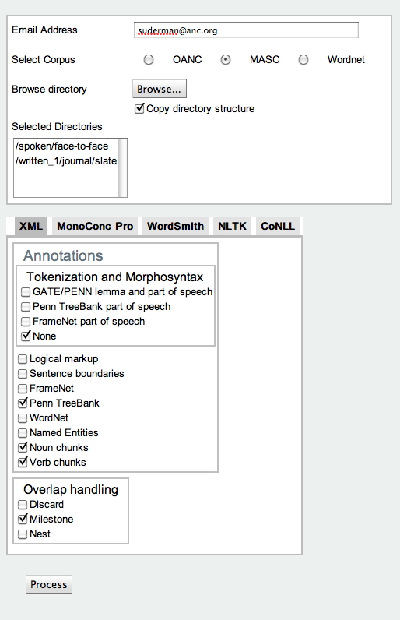

Slide 21
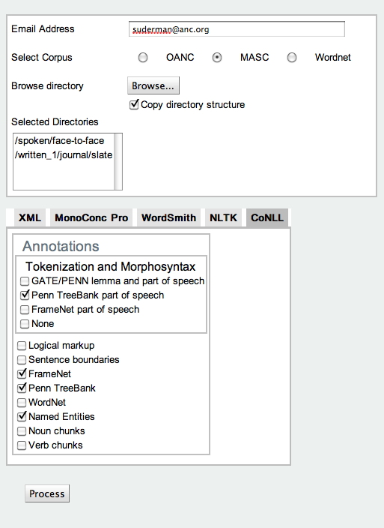

Slide 22
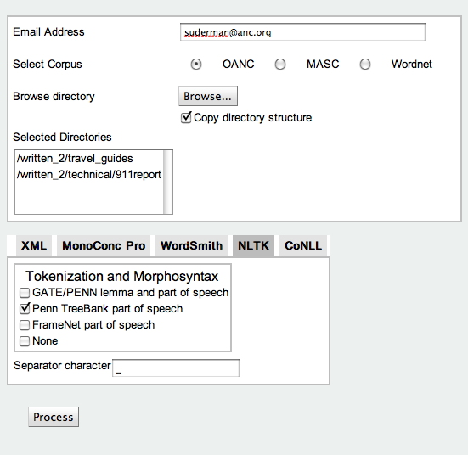

Slide 23
Using ANC2Go
Choose among 3 corpus options (OANC, MASC, WordNet sense corpus)
Choose entire corpus and annotations, or browse corpus file hierarchy and limit the texts to be included
When a corpus is chosen, list of available annotations dynamically updated to include only those annotations available for that corpus
Annotation options may be further limited when the user chooses an output format
  For example, MonoConc and Wordsmith formats available for token/POS only

Slide 24
Using ANC2Go
ANC2Go generates only token/POS for NLTK, although NLTK processes other annotation types.
  NLTK corpus reader for other annotation types
If XML is the chosen output format, the user is provided with a set of alternative means to handle overlapping hierarchies

Slide 25
Using ANC2Go
ANC2Go consults the corpus and text headers to determine dependencies among annotations
  Occurs when annotation references another annotation rather the primary data itself
  ANC2Go automatically includes required annotations
  For example, the Penn Treebank syntactic annotations reference Penn Treebank token/POS annotations
    also referenced by other annotations in MASC
  When user chooses Penn Treebank annotations ANC2Go automatically includes the Treebank token annotations

Slide 26
Download
http://www.anc.org
  OANC data (15 million words) and annotations freely downloadable
  NB: Still in a previous version of GrAF—will be updated this summer
http://www.anc.org/MASC
  MASC data (220K words) and annotations (for 82K words) freely downloadable
  Uses the new and final ISO version of GrAF
http://www.anc.org:8080/ANC2Go
  ANC2Go web application

Slide 27
Thank you!
Questions?

