Slide 1

The Dictionary of Italian Collocations: Design and Integration in an Online
Learning Environment
Stefania Spina
University for Foreigners Perugia, Italia

Slide 2

The Dictionary of Italian Collocations
Part of APRIL project (“Personalised web environment for language learning”)
NLP resources as a support for the lexical competence of students of Italian within a Virtual Learning Environment (VLE).

Slide 3
Presentation outline
background and motivation
reference corpus
methodology
dictionary compilation
integration within VLE

Slide 4
Background
Complexity of MWU:
  different syntactic and semantic profiles
  prototypical features:
    semantic (non-)compositionality
    (non-)substitutability of components by semantically similar words
    (non-)insertion of external items
  continuum rather than definite categories

Slide 5
Motivation: collocations in SLA
improve learners fluency
examples from Italian leaner corpora
  preoccupata per l’esame vado a prendere una doccia (Vietnam)
    Fare la doccia “take a shower”
  ho dimenticato la macchina di fotografia (China)
    Macchina fotografica “camera”
non-native speakers and L2 vocabulary: first single words, then more extended chunks
trend to overuse the creative combination of isolated words
  Sinclair’s open choice principle

Slide 6
DICI
collocations require specific pedagogical attention
Dictionary of Italian Collocations (DICI)
  it is corpus-based;
  it is a learner-oriented tool: list of the most common Italian collocations, classified on a frequency basis;
  it is also based on statistical methodologies (dispersion in the different textual genres represented in the corpus).

Slide 7
Reference corpus
Perugia corpus: POS-tagged, lemmatized
Textual genres
fiction
non-fiction
web
academic prose
press
language of administration
television programs
spoken texts
TOTAL: 18 million words

Slide 8
Extraction based on POS sequences
Analysis of existing list of collocations:
  150 different POS sequences
10 most productive (75%)
ADJ ADV N | nudo come un verme "as naked as a worm"
ADJ CONG ADJ | bianco e nero "black and white"
ADJ N | terzo mondo "third world"
N ADJ | cassa comune "common fund"
N CONG N | andata e ritorno "back and forth"
N N | caso limite "borderline case"
N PRE N | abito da sera "evening dress"
V ADJ | stare zitto "keep quiet"
V ART N | fare la doccia "take a shower"
V N | avere paura "be afraid"

Slide 9
Experimental methodology: 4 steps
  extraction of candidate collocations from corpus;
  filtering of the candidate collocations: frequency;
  filtering of the candidate collocations: dispersion;
  filtering of the candidate collocations: manual
ADJ CONG ADJ
N CONG N
N N
N PRE N
V ART N
V N
6 POS sequences
fiction
press
academic prose
web
12-million-word sample
4 corpus sections

Slide 10
Collocations extraction + frequency
IMS Corpus Workbench
  removing all the candidates with frequency = 1
41643 collocations

Slide 11
Dispersion
Examples:
  Aggrottare la fronte “to frown” (fiction)
  Vincere le elezioni “to win the elections” (press)
  Dare una definizione “to give a definition” (academic prose)

Slide 12
Dispersion
Juilland’s D value (Juilland - Chang-Rodriguez, 1964)

Slide 13
Dispertion + frequency
D value: combined with frequency = usage
  U = FD
Usage value ≥ 2: 2047 candidate collocations
Manual selection. Final result:
list of 1553 word combinations = dictionary entries

Slide 14
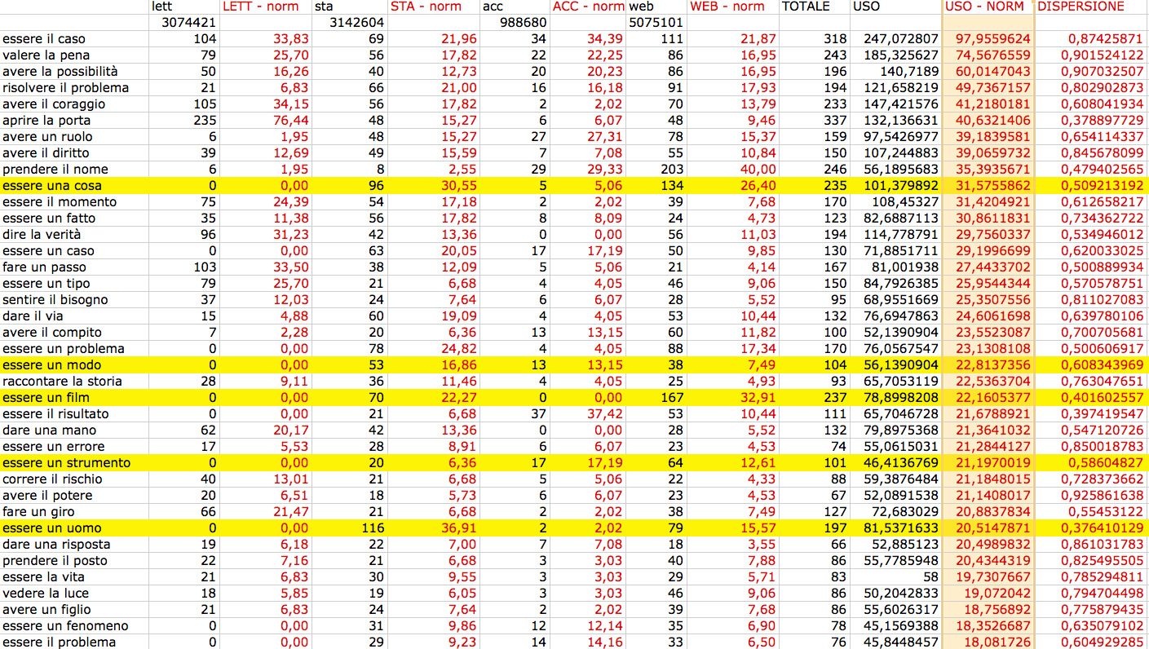
Collocations list

Slide 15
Compilation of the Dictionary
Lexical database enriched with two kinds of data:
  visible to the learner (client output)
    definition, examples, part-of-speech, syntactic context of occurrence of collocations
  to be processed by other applications (server)
    internal syntactic configuration for automatic recognition
Collocation | Syntactic configuration
Fare la doccia “take a shower” | [V$fare][ADV]? la|una|NUM [ADJ]? [N$doccia]
Abito da sera “evening dress” | [N$abito] da_sera
Alti e bassi “highs and lows” | alti_e_bassi

Slide 16
DB integration in the VLE
Virtual Learning Environment:
  web application specifically devoted to language learning
LELE (Linguistically-Enhanced Learning Environment)
  provide language learners with additional NLP resources, in order to improve their linguistic competence
  receptive and productive learning activities concerning the recognition and the active use of collocations

Slide 17
LELE Features
to automatically recognize and highlight multi-word units in written Italian texts;
to show additional linguistic information about the selected collocations;
to generate collocation tests for collocational competence assessment of second language learners.
…

Slide 18
LELE scheme
DB + tagger
VLE
browser
server
client

Slide 19
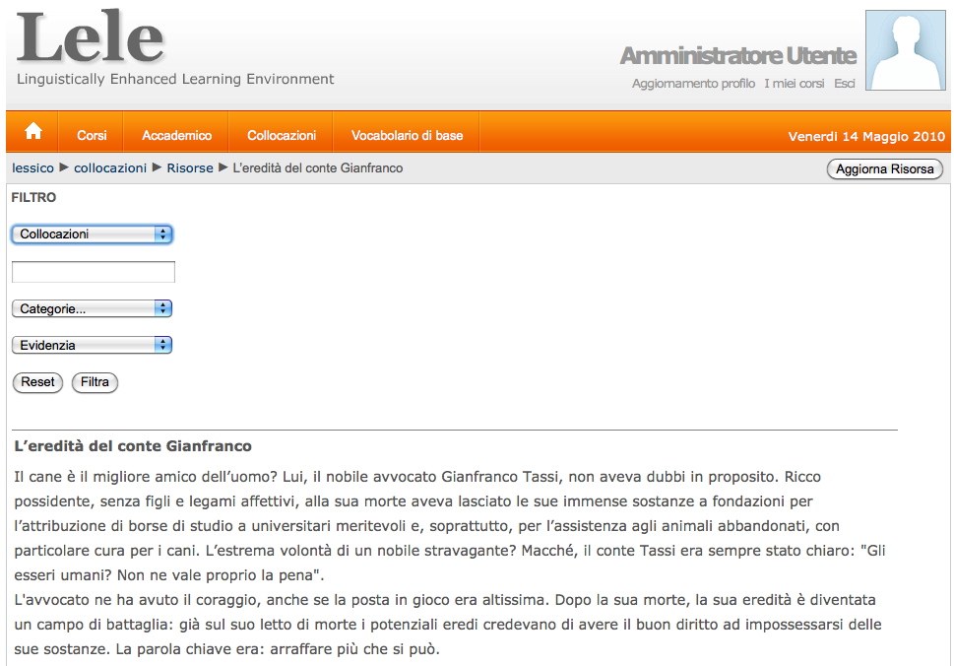

Slide 20
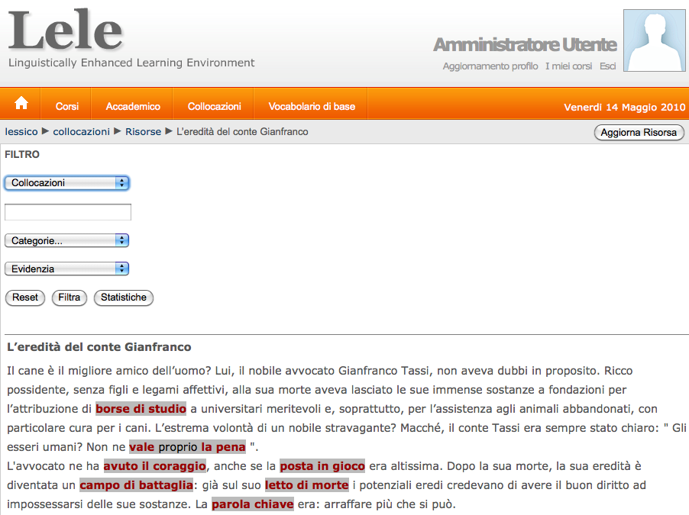
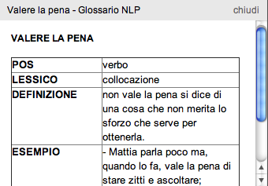

Slide 21
Conclusions
Next steps:
  same methodology to the whole corpus, for all the 10 selected POS sequences
  test of LELE system with students: starting january 2011
Further research
  refine statistical measures
  assign collocations to different levels of competence
  other tools (productive tasks)

Slide 22
Stefania Spina
E-learning and Language Technologies
University for Foreigners Perugia, Italy
stefania.spina@unistrapg.it
http://april.unistrapg.it

Slide 23
References
Juilland, A & Chang-Rodriguez, E. (1964). Frequency Dictionary of Spanish Words. The Hague: Mouton & Co
Meunier, F. & Granger S. (2008). Phraseology in foreign language learning and teaching. Amsterdam: John Benjamins
Nesselhauf, N. (2005). Collocations in a learner corpus. Amsterdam: John Benjamins
Pazos Bretaña, M. & Pamies Bertrán, A. (2008). Combined statistical and grammatical criteria. In S. Granger & F. Meunier (Eds), Phraseology. An interdisciplinary perspective. Amsterdam: John Benjamins, pp. 391-406.

Slide 25
Backgroud: prototypical features
  semantic (non)-compositionality
Tagliare la corda “run away”
aprire la porta “open the door”
  (non)-substitutability
{fare|porre|rivolgere|formulare} una domanda
“ask a question”
Camera oscura “dark room”
* Stanza oscura
  (non)-insertion of external items
fare una lunga, calda, riposante doccia
“take a long, hot, restful shower”
Sistema *molto operativo “operating system”

