Slide 1
Resource and Service Centers as the
Backbone for a Sustainable Infrastructure
Peter Wittenburg
CLARIN Research Infrastructure
Co-Authors: Nuria Bel, Lars Borin, Gerhard Budin, Nicoletta Calzolari, Eva Hajicova, Kimmo Koskenniemi, Lothar Lemnitzer, Bente Maegaard, Maciej Piasecki, Jean-Marie Pierrel, Stelios Piperidis, Inguna Skadina, Dan Tufis, Remco van Veenendaal, Tamas Varadi, Martin Wynne

Slide 2
Which Scenario are we aiming at?
let's first say which researchers we have in mind
speaking primarily about the typical researcher in the
humanities and social sciences, but probably not limited to them
  small research departments
  little of no technical minded support staff
  little knowledge about standards (why should they)
  lacking knowledge about computer-based methods
  etc.
increasingly often they are excluded from data-driven research
"even" at an institute such as MPI many research questions cannot be
dealt with due to the effort needed to find and operate on resources
Only little fits together as we all know.

Slide 3




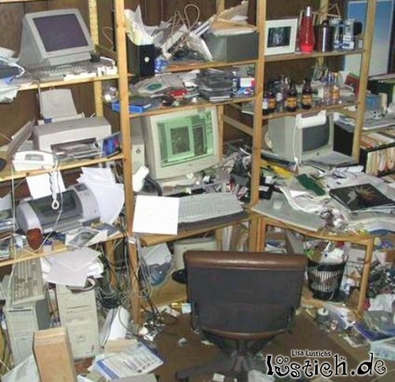
Which Scenario are we aiming at?
everyone is relying on Google to search for all sorts of web information
i.e. the web-based paradigm is widely accepted
  ~100% available, robust, simple, critical mass of information, etc.
when it comes to research work people still apply the "down-load first
paradigm" and "manage their own creative data backyard"
only my theory is
relevant and papers count
my creative
data backyard
is private
Wall of Silence

Slide 4
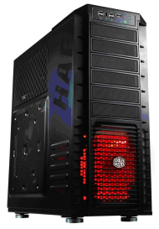


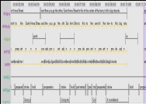
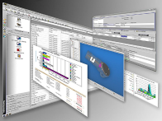
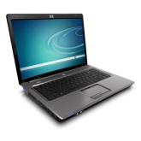
Which Scenario are we aiming at?
down-load first
vs. cyberinfrastructure
make data explicit
set up services
network of
centers
offering data
and services
does not seem to be efficient
but has some advantages
will remain - but need another dimension
this may facilitate working with language resources and tools
many communities are working along same goals
(life sciences, bioinformatics, geosciences, etc.)
funders are changing their rules (NL, recently NSF)

Slide 5
What is required?
trust of the researchers which has many facets:
  availability and easiness of services
  security of services and workspaces
  persistency of services
  scalability of services (not just for a few users)
  added functionality such as virtual collection and workflow building
AND as James Pustejovsky put it recently:
we are talking about international collaboration which we will only manage
when we agree on standards
are we mature enough?
  recently a joint roadmap document for working towards standards
  Nuria Bel, Jonas Beskow, Lou Boves, Gerhard Budin, Nicoletta Calzolari,
  Khalid Choukri, Erhard Hinrichs, Steven Krauwer, Lothar Lemnitzer,
  Stelios Piperidis, Adam Przepiorkowski, Laurent Romary, Florian Schiel,
  Helmut Schmidt, Hans Uszkoreit, Peter Wittenburg
in the mean time adopted by CLARIN

Slide 6
How can we ensure all this?
there are many ingredients of course
one is establishing a network of service centers fulfilling requirements
  be ready for deposits & take full responsibility of all deposited resources
  a proper repository system guaranteeing availability, persistency
  and authenticity of stored objects
  in case of services requirements are not as obvious
  adhere to CLARIN standards and providing high-quality metadata
  regular quality assessment according to TRAC or DSA
  support dynamic and flexible research workflows
  participation in the national identity federation and in the CLARIN
  service provider federation to establish a TRUST domain
  explicitness about IPR, licenses, ethical issues etc.
  probably a linguistic/technical staff is required to manage all this and to
  support users

Slide 7
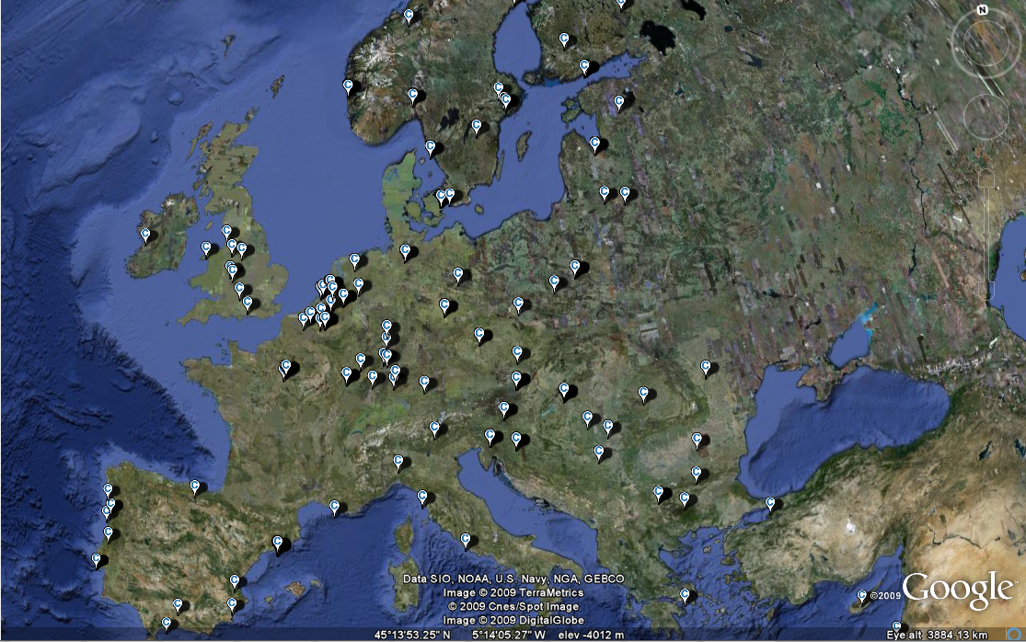
What is the state?
CLARIN:
> 180 members
~ 25 centre candidates
setup at different speeds

Slide 8
State of federations?
Initial SPF
  Finland
  Germany
  Netherlands
all documents with IdPs were signed
more than 1 Mio potential users for
single identity and single sign-on
now quick extension in EU

Slide 9
Can they do everything?
what about long-term preservation?
what about workspaces and execution spaces (compute time)?
collaboration with big EU computer/storage centers on a data service infra
CLARIN (our domain)
LifeWatch (biodiversity)
ELIXIR (biogenetics)
METAFOR (climate)
open slot
"general user"
User Communities
Data Generation
Virtual Research Environments
RI
domain
already an open deposit offer in place
together with two centers
with 50 years guarantee
Community Centers
Data Curation
Community Access Services
data centers
domain
SARA, CSC, RZG, FZJ, CENECA,
BSCC, etc.
Data Centers
Data Preservation
Generic Data Services

Slide 10

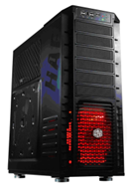
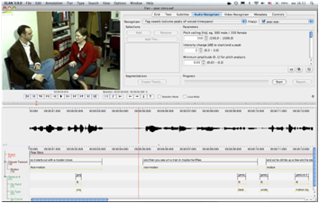
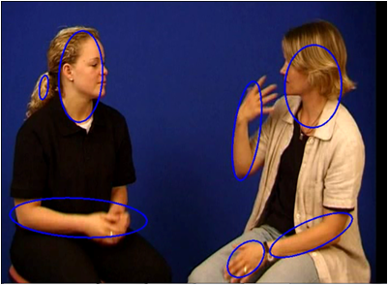
Do we have concrete examples?
service deployment
data replication
department server
User 1
archive
User x
other archives
domain of data centers

Slide 11
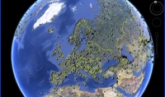
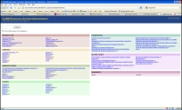
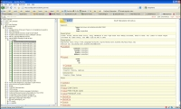
Can users rely on information?
Virtual Language Observatory with 270.000 objects, but ...
CGN (12.000)
OAI PMH harvesting
and transformation
End.Lang. (35.000)
GIS overlay
IMDI
Domain
MPI (33.000)
BAS (7.400)
AILLA (1.800)
Facetted Browser
OLAC (40.000)
Indexes
LRT Inventory (800/137)
DFKI Tool Registry (292)
hard problem:
- mapping
- granularity
- curation
Catalogue
ELDA (60)
others

Slide 12
Summarizing
we need stable and powerful service centers to convince
researchers
  to deposit their data (and thus make it explicit) and
  to rely on web-based services
we know that this will take a while and also requires some pressure
(see NSF, NWO, ...)
there are some major ingredients for continuing on this road
  establish trust along various dimensions
  (availability, security, persistence, scalability, ...)
  stepwise move towards standards (as discussed the other 2 days)
  (hide complexity by tools!!)
  carry out regular quality assessment and performance monitoring
  support dynamic research workflows
  participate in European trust federations
THIS IS ALREADY HAPPENING - BUT NOT YET SYSTEMATICALLY

Slide 13
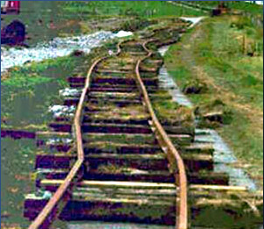
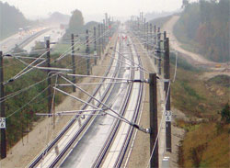
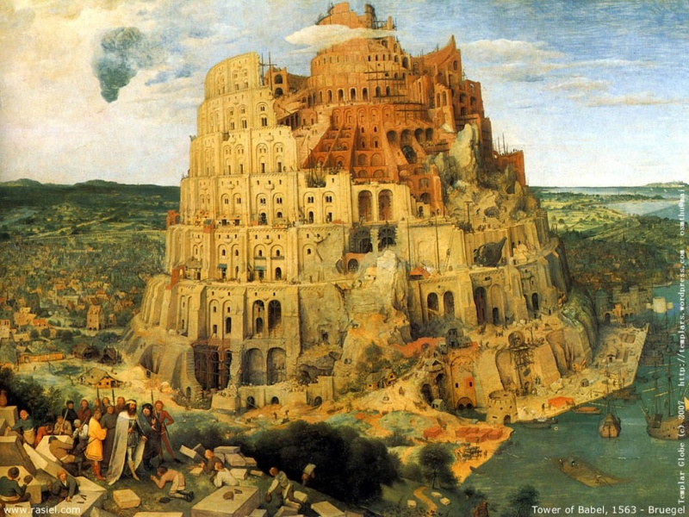
Can we achieve something?
Roberto's key question:
how many infrastructures?
But ...
Falls nicht to end in Babylonish scenario
nous avons still algo time om sistemas
te improve.
Thanks for your attention.

