Slide 1
Dialogues in Context: An Objective User-Oriented Evaluation Approach for Virtual Human Dialogue
Susan Robinson, Antonio Roque & David Traum

Slide 2
Overview
We present a method to evaluate the dialogue of agents in complex non-task oriented dialogues.

Slide 3
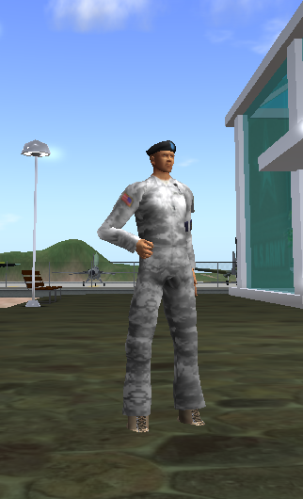
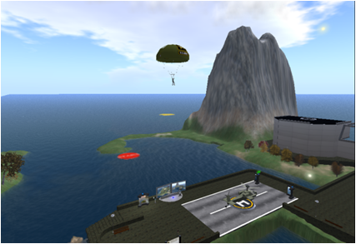
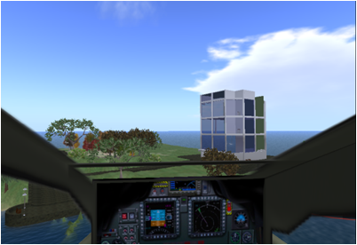
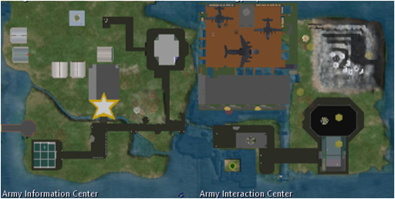
Staff Duty Officer Moleno

Slide 4
System Features
Agent communicates through text-based modalities (IM and chat)
Core response selection handled by statistical classifier NPCEditor (Leuski and Traum, P32 Sacra Infermeria Thurs 16:55-18:15)
To handle multi-party dialogue, Moleno:
  Keeps a user model with username, elapsed time, typing status and location
  Delays response when unsure about an utterance until no users are typing

Slide 5
Desired Qualities
Ideally would have an evaluation method that:
- Gives direct measurable feedback on the quality of the agent’s actual dialogue performance
- Has sufficient detail to direct improvement of an agent’s dialogue at multiple phases of development
- Is largely transferrable to the evaluation of multiple agents in different domains, and with different system architectures

Slide 6
Problems with Current Approaches
Component Performance
  Difficulty comparing between systems
  Does not directly evaluate dialogue performance
User Survey
  Lacks objectivity and detail
Task Success
  Problem when tasks are complex or success is hard to specify

Slide 7
Our Approach: Linguistic Evaluation
Evaluate from perspective of interactive dialogue itself
  Allows evaluation metrics to be divorced from system-internal features
  Allows for more objective measures than the user’s subjective experience
  Allows detailed examination and feedback of dialogue success
Paired coding scheme
  Annotate the dialogue action of the user’s utterances
  Evaluate the quality of the agent’s response

Slide 8
Scheme 1: Dialogue Action Top
Code | Category (Subcategories)
D | Dialogue Functions (Greeting / Closing / Politeness)
C | Critique (Positive/Negative of Agent / Domain)
E | Exclamations - Emotive Expressions
H | Hazing (Testing / Flaming)
F | Flirting– Playful question or offer
Q | Information Request (about Domain / Agent / Modality / Other)
R | Requests (for Help / Clarification / Motion / Domain-specific)
A | Answers– responses to agent questions/offers
S | Statements (Social topic / Domain-related / Responsive / Other)
L | Utterance in another language
G | Garbage– Incomprehensible to annotator
O | Other Addressee

Slide 9
Scheme 1: Domain Actions
Increasingly detailed sub-categorization of acts relevant to domain activities and topics
Categories defined empirically and by need—what distinctions the agent needs to recognize to appropriately respond to the user’s actions
Code | Domain Specific Information Request
QDG | General Army Island Information
QDL | Location/Navigational Questions
QDE | Specific Events/Activity Information
QDJ | Information about joining the army
QDU | About getting a uniform
QDA | Other questions about US Army
QMB | Biographical info about agent
QMJ | Agent’s job/purpose
QMP | Agent’s preferences (favorite food, etc)
QMI | Agent’s immediate experience
QMA | Agent’s agency (are you a real person?)

Slide 10
Scheme 2: Evaluative Codes
CODE | VALUE
3 | Fully Appropriate Response
NR3 | No Response (Appropriate Silence)
2 | Partially Appropriate Response – Adequate, but lacks some coherence or relevance
RR | Requests Repair
NR1 | No Response (Inappropriate Silence)
1 | Inappropriate Response

Slide 11
Example Annotation
Speaker | Utterance | Code
Moleno | Good evening, I’m Lt Moleno, the Army Island Duty Officer | I
 | Here is a calling card if you ever need to call me | I
 | How can I help you? | I
User | hold on [pause, 1 min. 26 seconds] | RMW-NR3
User | Hey i wanna go sky diving | SDP-3
Moleno | Jumpmaster Neiro at the Skydiving Center will help you.
User | i wanna fly that black thing | SDP-RR
Moleno | Could you rephrase that?
User | the airplane do you compute | SDP-1
Moleno | I don’t know but I will find out and get back to you.

Slide 12
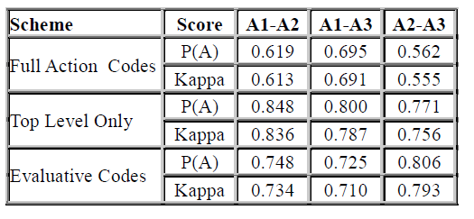
Agreement Measures

Slide 13
Results 1: Overview
Appropriateness Rating:
AR = (‘3’+ NR3) / Total = 0.56
Response Precision:
RP = ‘3’/ (‘3’+’2’+’RR’+1) = 0.50
Rating | Result (% Total)
3 | 167 (24.6%)
NR3 | 211 (31.1%)
2 | 67 (9.9%)
RR | 73 (10.8%)
NR1 | 65 (9.6%)
1 | 95 (14%)
Total | 678

Slide 14
Results2: Silence & Multiparty
Quality of Silences (AR^{nr}) = NR3/ (NR3 + NR1) = 0.764
By considering the 2 schemes together, can look at the performance on specific subsets of data.
  Performance in Multiparty Dialogues on Utterances Addressed to Others:
    Appropriate (AR) = 0.734
    Precision (RP) = 0.147

Slide 15
Results 3: Combined Overview
Category | Total# | AR | RP
Dialogue General | 100 | 0.82 | 0.844
Answer/Acceptance | 59 | 0.610 | 0.647
Requests | 45 | 0.489 | 0.524
Information Requests | 154 | 0.403 | 0.459
Critiques | 15 | 0.533 | 0.222
Statements | 113 | 0.478 | 0.186
Hazing | 39 | 0.128 | 0.167
Exclamations/Emotive | 34 | 0.853 | 0.167
Other Addressee | 109 | 0.734 | 0.147

Slide 16
Results 4: Domain Performance
461 utterances fell into ‘actual domain’
410 of these were actions (89%) covered in the agent’s design
51 of these were not anticipated in initial design; performance is much lower

Slide 17
Conclusion
General performance scores may be used to measure system progress over time
Paired coding method allows analysis to provide specific direction for agent improvement
General method may be applied to the evaluation of a variety of agents

Slide 18
Thank You
Questions?

