Slide 1
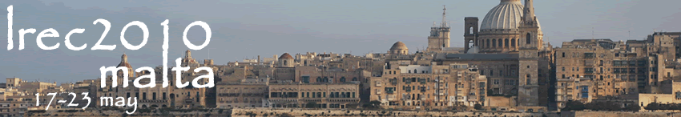
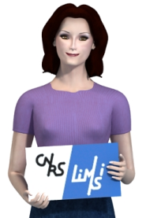

Sign Language corpora for analysis, processing and evaluation
A. Braffort, L. Bolot, E. Chételat-Pelé,
A. Choisier, M. Delorme, M. Filhol,
J. Segouat, C. Verrecchia, F. Badin, N. Devos
LIMSI-CNRS, Orsay, France
annelies.braffort@limsi.fr

Slide 2
Introduction: Sign language corpora
Sign languages: less-resourced languages
  No written form
  Few/little
    reference books
    corpora
    software
Corpora used for
  Education: deaf children, hearing adults, interpreters...
  Scientific studies: linguistics, language processing...
Kinds of data
  Video: one or several shots
  3d motion capture data

Slide 3
Outline
Corpus for language analysis
  Alignment of video and annotation
  Annotation on the video
  Data provided by a specific device
Corpus for animation processing
  Video: Rotoscoping and database of isolated signs
  Motion capture: Database of isolated signs
  Motion capture: Statistical modelling
Corpus for model evaluation
  Lexical description
Conclusion and perspective
  Dicta-Sign corpus

Slide 4
Language analysis
Aim
  Capture knowledge on SL functioning
Data
  Video
  Motion capture
Methods
  Visualisation
  Annotation

Slide 5
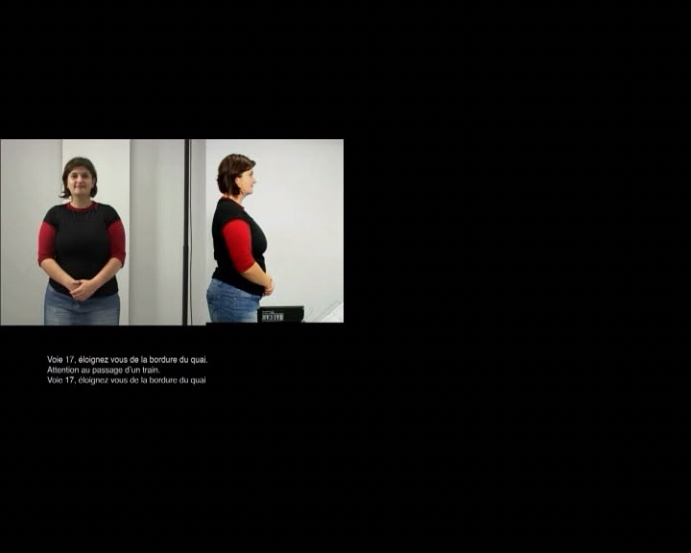
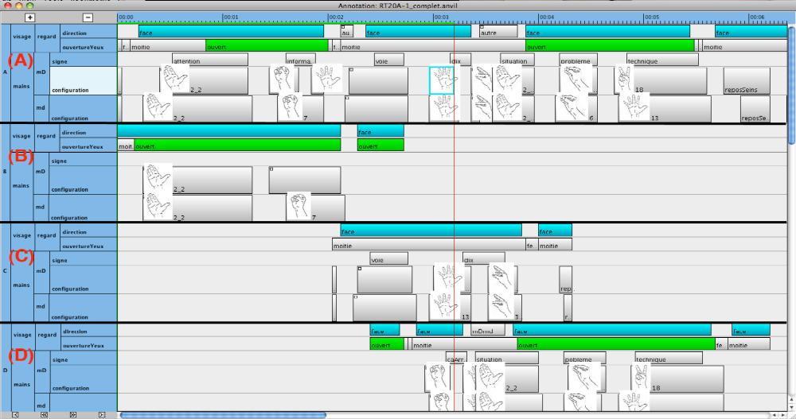
Language analysis
Visualisation of synchronised videos and annotations
  J. Segouat – LIMSI (FR)
  Study on coarticulation
  Comparison of durations, modifications, suppression...
  “SNCF” corpus: LSF, whole utterances, isolated signs
[Segouat 2009]

Slide 6
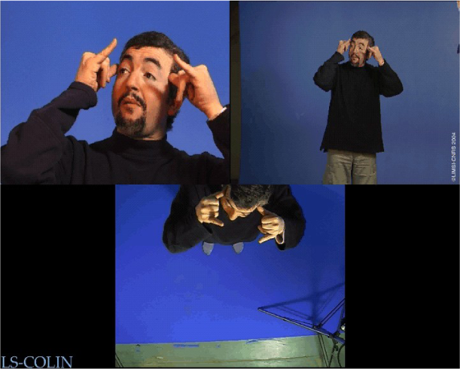
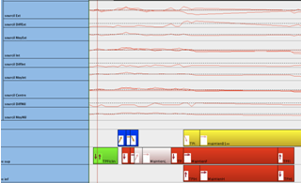
Language analysis
Annotation on the video
  E. Chételat-Pelé – LIMSI (FR)
  Study on non-manual components
  Fine description of movements: eyebrow and blinking
  “LS-Colin” corpus: LSF narrations, image quality, close-up view
[Chételat-Pelé et al 2008]

Slide 7
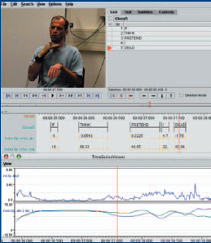
Language analysis
Data provided by a specific device
  O. Crasborn – Radboud Univ. (NL)
  Data glove synchronised with the video
  Phonetic study of SL: manual component
    Handshape
    Hand location and orientation
  NGT corpus
[Crasborn et al 2006]

Slide 8
Animation processing
Aim
  Animation processing of a virtual signer
Data
  Video
  Motion capture
Methods
  Video corpora: aided realistic generation
  Motion capture corpora: automatic generation

Slide 9
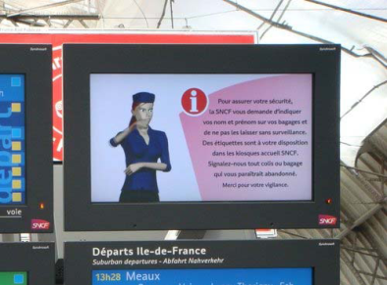


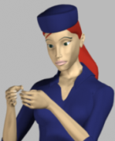
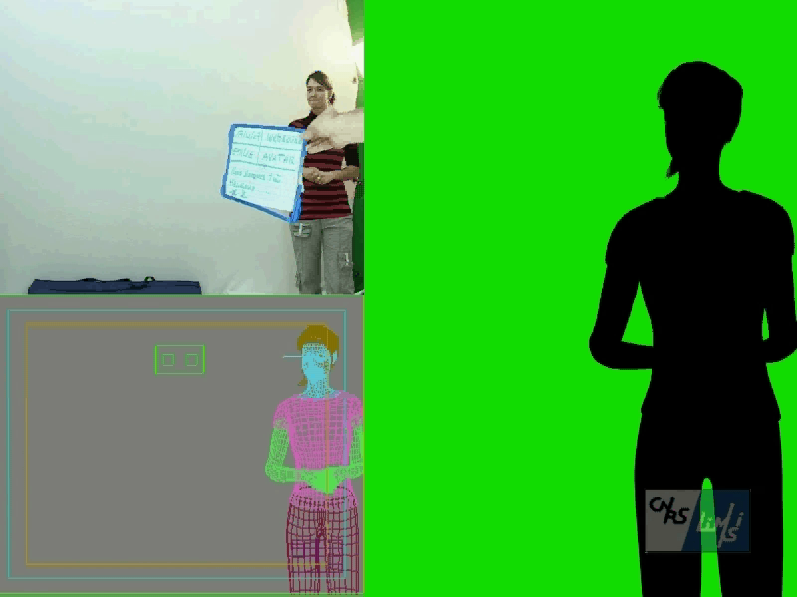

Animation processing
Video corpora as a model for realistic animation
  C. Verrecchia, L. Bolot – LIMSI (FR)
  Rotoscoping: Duplication of the signer’s movements
  on the virtual signer’s skeleton
  The virtual signer’s skin “follows” the skeleton movements
  “SNCF” corpus: 2 shots
[Braffort et al 2007]

Slide 10
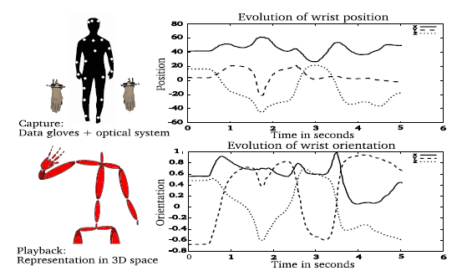
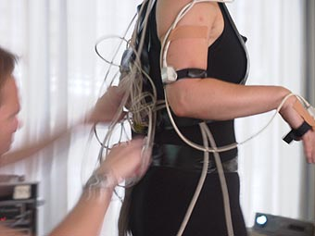
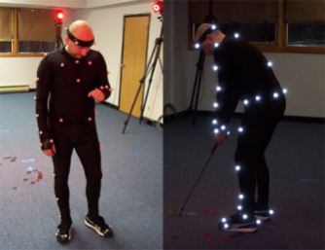
Animation processing
Motion capture data for animation
  S. Gibet – Valoria (FR)
  Adapting captured data to new situations
    Reordering, interpolation, edition, combination...
    Database of isolated signs that are interpolated
  “SIGN” corpus: LSF, weather report sentences, isolated signs (towns...)
[Héloir et al 2005]

Slide 11
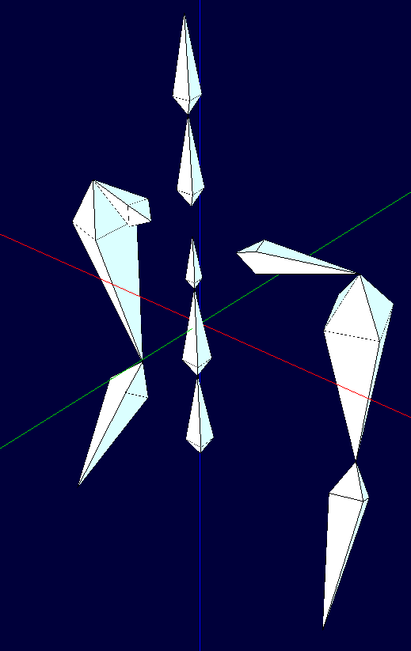
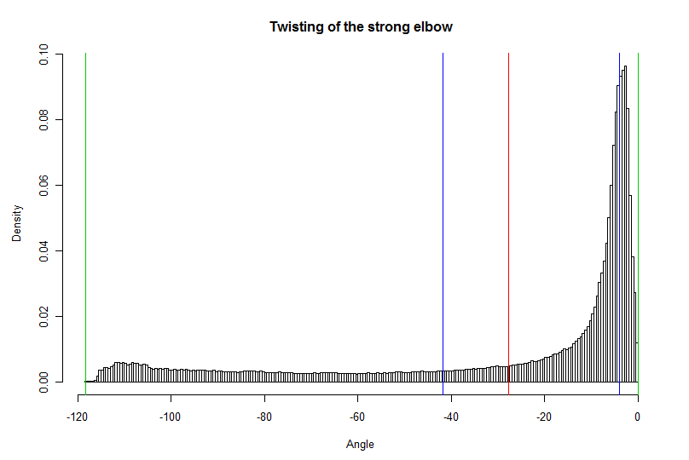
Animation processing
Motion capture data for modelling
  M. Delorme – LIMSI (FR)
  Body movement modelling, joint constraints, rest posture
  CMU Corpus: Various kinds of 3d motion, all the body except the hands (sport, dance, interaction...)
  SL corpus will be added
[Delorme 2010]

Slide 12
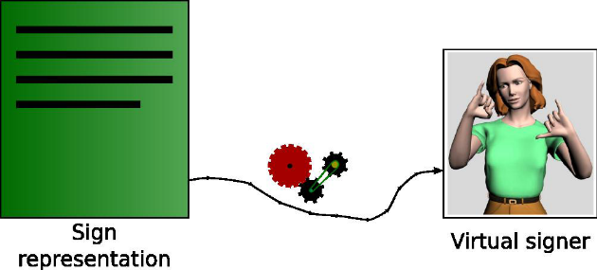
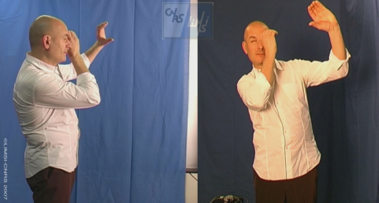
Model evaluation
Aim: Evaluation of formal models
Description of lexical signs
  M. Filhol – LIMSI (FR)
  LIMSI’s model “Zebedee”
    Geometrical model
    Covers citation form and context variations
  How well the model covers the vocabulary
  LSF corpus: 1600+ isolated signs in their citation form (Dictionaries, Dicta-Sign EU project)
[Filhol 2009]

Slide 13

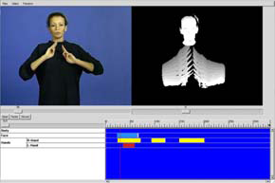
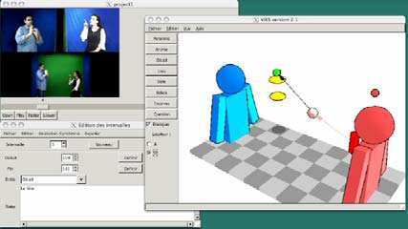
Conclusion
Ongoing
  Data: video and motion capture
  Combination of various shots or devices
  Methods: visualisation, annotation, animation, evaluation
Beginning
  Data: new devices - bumblebee
  Combination of various devices: HD cam, bumblebee
  Methods: Integration of image processing and 3d representation
  C. Collet & P. Dalle – IRIT (FR)
[Dalle et al 2007]

Slide 14

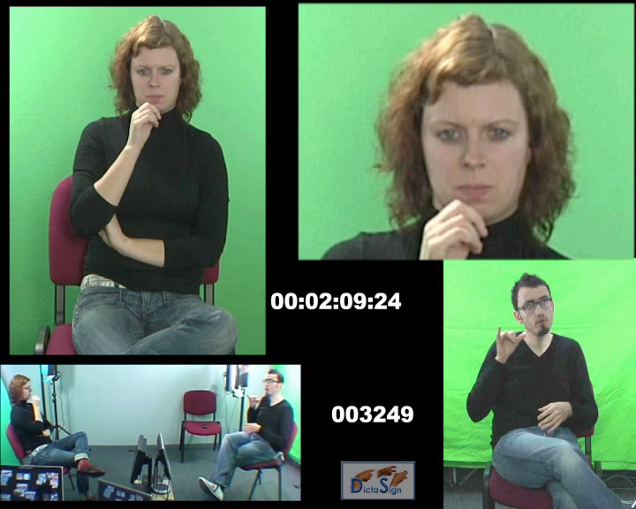
Current work
EU Dicta-Sign project (booth, W SL)
  Corpus setting:
    7 cameras (3 cam, 2 HD, 2 bumblebees)
  Corpus content:
    Common concept list
    => 1000+ isolated lexical signs in the citation form for 4 SL
    5+ hours of dialog for 4 SL
  Annotation software
    Image processing
    3D representation of the
    signing space
  SL processing
    SL modelling: lexicon, grammar
    Automatic recognition,
    generation,
    SL-to-SL translation
[Eftimiou et al 2010]

