Slide 1
Arabic Word Segmentation for Better Unit of Analysis
Yassine Benajiba¹ and Imed Zitouni²
1 CCLS, Columbia University
2 IBM T.J. Watson Research Center
ybenajiba@ccls.columbia.edu , izitouni@us.ibm.com

Slide 2
Outline
The Arabic Language
ATB vs. Morph segmentation
Segmentation algorithm
Segmentation Results and Error Analysis
Impact on Mention Detection
Conclusions& Future Directions

Slide 3
The Arabic Language
The Ph.D. Abdelnabi Serokh a professor in Abdelmalek Essaâdi University in Tangier
الدكتور عبد النبي صروخ الأستاذ بجامعة عبد المالك السعدي بطنجة

Slide 4
The Arabic Language
-Lack of short vowels
Th Ph.D. Abdlnbi Srkh a prfssr n Abdlmalek Essâdi Unvrsty n Tangr
الدكتور عبد النبي صروخ الأستاذ بجامعة عبد المالك السعدي بطنجة
Increases ambiguity

Slide 5
The Arabic Language
-Lack of capital letters
th ph.d. abdlnbi srkh a prfssr n abdlmalek essâdi unvrsty n tangr
الدكتور عبد النبي صروخ الأستاذ بجامعة عبد المالك السعدي بطنجة
IE becomes harder

Slide 6
The Arabic Language
-Complex/rich morphology
thph.d. abdlnbi srkh aprfssr nabdlmalek essâdi unvrsty ntangr
الدكتور عبد النبي صروخ الأستاذ بجامعة عبد المالك السعدي بطنجة
Increases data sparseness

Slide 7
The Arabic Language
thph.d. abdlnbi srkh aprfssr nabdlmalek essâdi unvrsty ntangr
The Ph.D. Abdelnabi Serokh a professor in Abdelmalek Essaâdi University in Tangier

Slide 8
The Arabic Language
In order to decrease the data sparseness we can separate each word in the text into its different components.
However, there are many ways in which we can segment the data.
  What scheme should we use?
  Is there a scheme better than the other or should we adopt a specific scheme depending on the task?

Slide 9
The Arabic Language
wsyElmh (and he will teach him)
  w+ syElmh
  w+ s+ yElmh
  w+ s+ yElm +h
(Sadat and Habash, 06) made experiments on different segmentation schemes for MT and found out that the ATB-like segmentation leads to the best results.

Slide 10
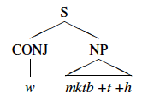
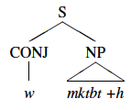
ATB vs. Morph segmentation
Morph.
ATB
aims at segmenting all affixes of a word. Thus, all the prefixes and suffixes which are attached to the stem are separated.
considers splitting the word into affixes if and only if it projects an independent phrasal constituent in the parse tree.

Slide 11
Segmentation algorithm
Both ATB and morphological segmentation systems are based on weighted finite state transducers (WFST) as described by (Mohri et al., 2002).
The segmentation process consists of separating the Arabic normal white-space delimited words into (hypothesized) prefixes, stems, and suffixes.

Slide 12


Segmentation accuracy
ATB segmentation results
Morph. segmentation results

Slide 13
Segmentation
-Error analysis
Ambiguous words:
(polysemous—fAn): meaning either so it, or mortal where in the first case it should be segmented as “f +An” and in the second case as “fAn”.
(polysemous—bEyd): meaning either in holiday or far where the former case should be segmented as “b +Eyd” and the second as “bEyd”.
(polysemous — AlA): meaning either so that no resulting from merging “An” and “lA” or except where the first case should be segmented as “A +lA” and thesecond as “AlA”.

Slide 14


Segmentation
-Error analysis
OOVs:
, and : are proper nouns, both segmentation systems have segmented the first character (b) as the prefix “in”.
and have also been incorrectly segmented by both models for confusing the first character as the prefixes.

Slide 15
Impact on Mention Detection
- Task definition
President Barack Obama declared that he will visit the Middle East next week.

Slide 16
Impact on Mention Detection
- Task definition
President Barack Obama declared that he will visit the Middle East next week.
Person/Nominal
Person/Named
GPE/Named
Person/Pronominal

Slide 17
Impact on Mention Detection
- Data
Experiments are conducted on the Arabic ACE 2007 data (NIST, 2007). There are 379 Arabic documents and almost 98,000 words.
Split: 85% / 15%
7 types of mentions in ACE’07 data:
  Facility: FAC;
  Geo-Political Entity: GPE;
  Location: LOC;
  Organization: ORG;
  Vehicle: VEH; and
  Weapons: WEA.

Slide 18
Impact on Mention Detection
- Feature sets
1. Lex_{f} - lexical features: system that has access to n-grams spanning the current segment; both preceding and following it. A number of n equal to 3 turned out to be a good choice.
2. Stem_{f} - Lex_{f} + morphological features: system that has access to lexical features and morphological features computed as stem trigram spanning the current stem; both preceding and following it (Zitouni et al., 2005).
3. Synt_{f} - Stem_{f} + syntactic features: system that has access to lexical and morphological features as well as POS tags and shallow parsing information in a window of 2 segments.

Slide 19

Impact on Mention Detection
- Results
What if we don’t segment the data?

Slide 20
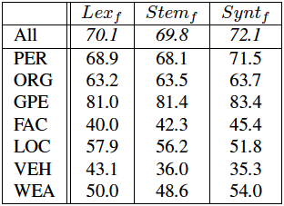
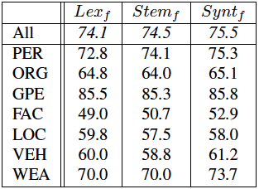
Impact on Mention Detection
- Results
ATB segmented data:
Morph. Segmented data:

Slide 21
Impact on Mention Detection
- Results discussion
The Morph. Segmentation results in less sparse data and less OOVs.
The ATB allows the MD model to capture a broader context.
Using Morph. Segmentation with a broader context doesn’t lead to the same results as ATB because of the increase of the features.

Slide 22
Conclusions
The ATB segmenter is more accurate. However, it is important to consider that the Morph. segmenter deals with a greater set of prefixes and suffixes.
An MD system trained on Morph. Data leads to a better performance than training on ATB.
An MD system trained on ATB captures a broader context and thus performs better on multi-word mentions.

Slide 23
Future directions
A combination of both segmentation could lead to a better performance since it could benefit from the advantages of both segmentation schemes

Slide 24
Questions ??

