Slide 1



Identification of the Question Focus: Combining Syntactic Analysis and Ontology-based Lookup through the User Interaction
All sections to appear here
Danica Damljanović, Milan Agatonović, Hamish Cunningham
email: danica@dcs.shef.ac.uk

Slide 2
Question Answering
traditional
approach
documents
Question category
  usually identified based on the syntax
Answer type
  identifies the type of the answer
Focus:
  the part of the question which retrieves what the user is interested in
Example:
  Who works for IBM?
    category: Who, answer type: Person, focus: IBM
our approach
ontologies

Slide 3
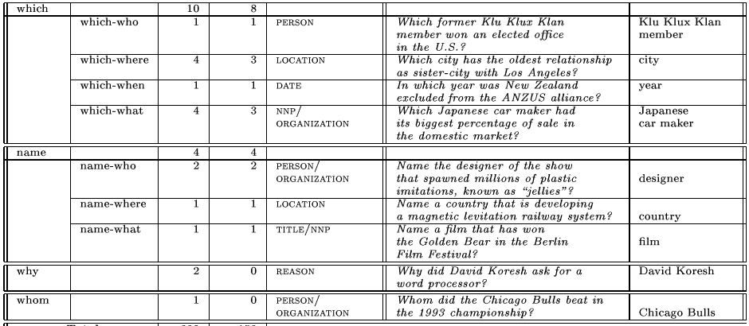
What is the question focus?
Table taken from: Dan Moldovan and Sanda M. Harabagiu. 2000. The structure and performance of an open-domain question answering system. In Proceedings of the 38th Meeting of the Association for Computational Linguistics (ACL-2000), pages 563–570.

Slide 4
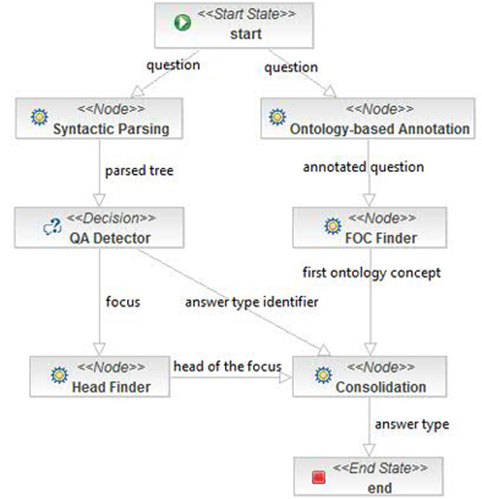

2
1
3

Slide 5
[Finding Focus or Answer Type Identifier]
pptPlex Section Divider
The slides after this divider will be grouped into a section and given the label you type above. Feel free to move this slide to any position in the deck.

Slide 6
1

Slide 7
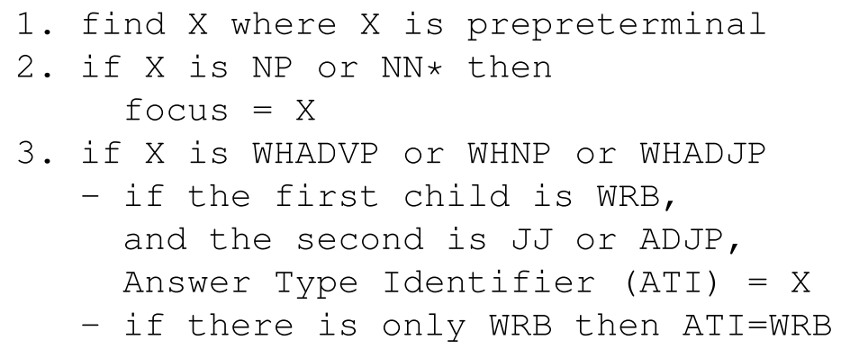
Focus
Answer Type Identifier
Question

Slide 8
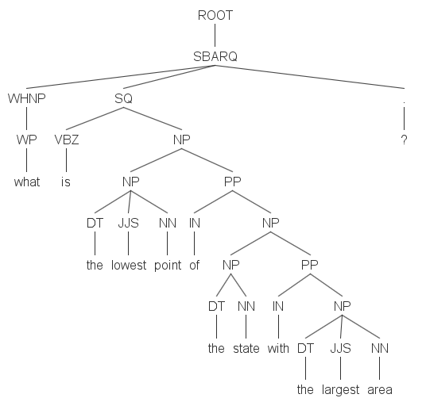
Finding focus

Slide 9
Finding focus

Slide 10
[Ontology-based annotation]
pptPlex Section Divider
The slides after this divider will be grouped into a section and given the label you type above. Feel free to move this slide to any position in the deck.

Slide 11
2

Slide 12

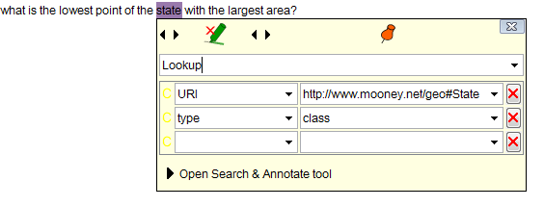
Ontology-based annotations
OntoRootGaz PR from GATE (http://gate.ac.uk ), part of Gazetteer_Ontology_Based plugin

Slide 13
[Consolidation]
pptPlex Section Divider
The slides after this divider will be grouped into a section and given the label you type above. Feel free to move this slide to any position in the deck.

Slide 14
3

Slide 15
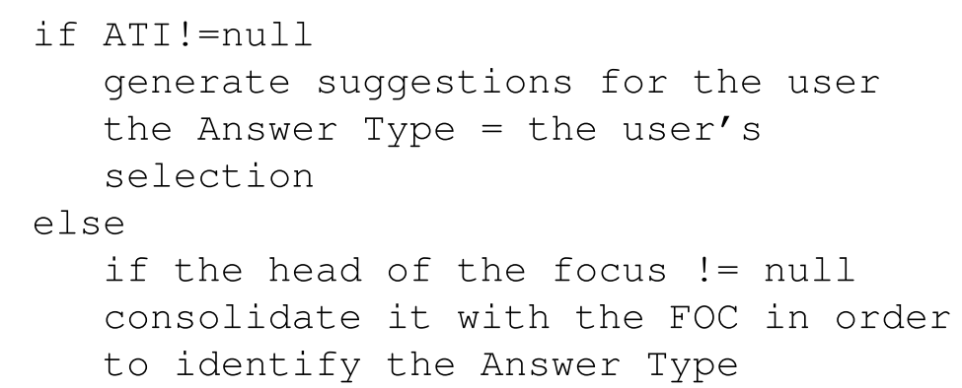
Consolidation

Slide 16
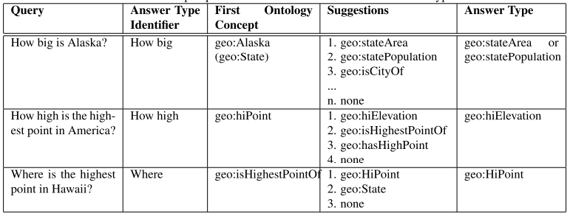
Answer Type Identifier found?
Means we need to engage the user into the dialog in order to identify the answer type

Slide 17
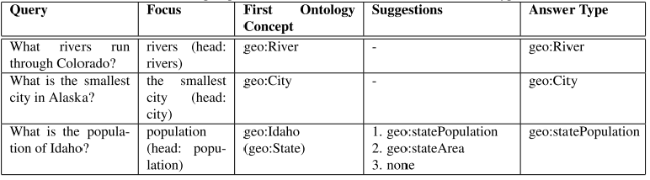
No Answer Type Identifier (WH-phrases) Found?
Often means we could derive the answer type without engaging the user

Slide 18
[FREyA: a Natural Language Interface to Ontologies]
pptPlex Section Divider
The slides after this divider will be grouped into a section and given the label you type above. Feel free to move this slide to any position in the deck.

Slide 19
FREyA: a Natural Language Interface to Ontologies
FREyA: a Natural Language Interface to Ontologies:
  http://gate.ac.uk/freya

Slide 20
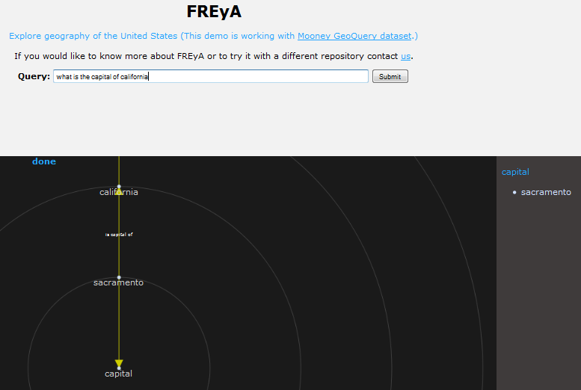
FREyA: a Natural Language Interface to Ontologies
http://gate.ac.uk/freya

Slide 21
[Evaluation]
pptPlex Section Divider
The slides after this divider will be grouped into a section and given the label you type above. Feel free to move this slide to any position in the deck.

Slide 22
Evaluation
Subset of the Mooney GeoQuery dataset: 250 questions
we have manually labelled the focus/ATI/answer type for each question and then measured correctness of identifying
  the focus/Answer Type Identifier (no ontology-based lookup involved)
  correctness of consolidation algorithm: whether the Answer Type was identified correctly

Slide 23
Identification of the question focus

Slide 24
Identification of the Answer Type Identifier (WH-phrases)

Slide 25
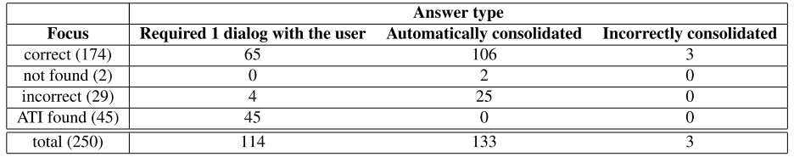
Consolidation

Slide 26
Questions?
All sections to appear here
Danica Damljanović, Milan Agatonović, Hamish Cunningham
email: danica@dcs.shef.ac.uk

