Slide 1
Towards investigating effective affective dialogue strategies
Gregor Bertrand, Florian Nothdurft, Steffen Walter, Andreas Scheck, Henrik Kessler and Wolfgang Minker

Slide 2
Outline
Introduction
Role of Emotion in SLDS
Purpose of our Study
Design of our Study
Current Status
Conclusion / outlook

Slide 3
Introduction
Research on Companion Technologies (www.sfb-trr-62.de)
Speech dialogue one form of UI
Role of emotion in dialogue:
  Agreement / disagreement
  Adapt dialogue style
  Need of clarification
  Misunderstanding
Additional modality
Adapt dialogue to user emotion

Slide 4
Outline
Introduction
Role of Emotion in SLDS
Purpose of our Study
Design of our Study
Current Status
Conclusion / outlook

Slide 5
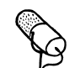
Role of Emotion in SLDS
Spoken Language Dialogue System architecture
Extend with emotional capabilities
Spoken language dialogue system
Acoustic front-end
Speech recognition
Linguistic
analysis
Dialogue
management
Application
Speech synthesis
Text generation

Slide 6

Role of Emotion in SLDS
Emotion based on sensor measurements
React to user emotion in an appropriate way – but how?
Acoustic front-end
Speech recognition
Linguistic
analysis
Dialogue
Management
Application
Speech synthesis
Text generation

Slide 7
Outline
Introduction
Role of Emotion in SLDS
Purpose of our Study
Design of our Study
Current Status
Conclusion / outlook

Slide 8
Purpose of our study
Investigation of emotions relevant for speech interaction
Investigation of biophysiological features connected to emotion
  EEG (electro encephalography)
  Blood pressure
  Heart rate
  Skin conductance level
  Breathing
Explorative testing of emotional strategies

Slide 9
Outline
Introduction
Role of Emotion in SLDS
Purpose of our Study
Design of our Study
Current Status
Conclusion / outlook

Slide 10
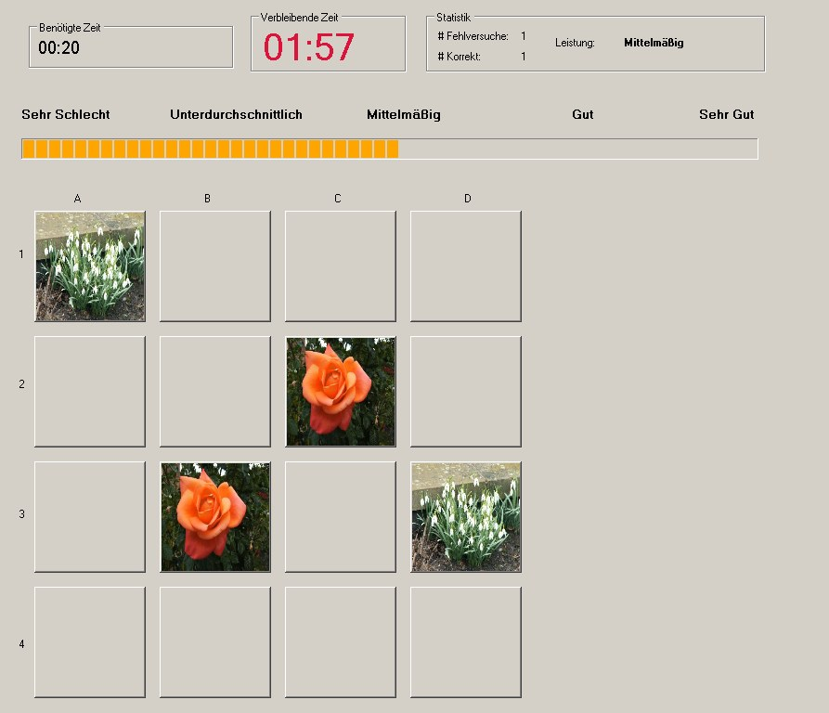
Design of our Study
User GUI
Speech Interface provided by Wizard of Oz architecture
Timer
Performance feedback

Slide 11
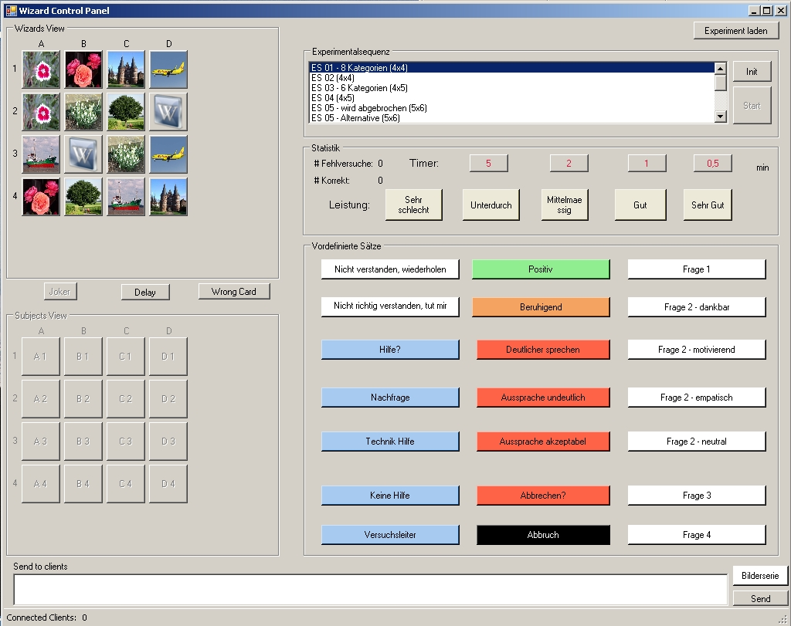
Design of our Study
Wizard GUI
Application
control
Performance
rating
Predefined
feedback

Slide 12
Design of our Study
Biophysiological data is taken
5 Rounds of Memory
Each Round is supposed to evoke an emotional state (points in PAD-space)
Classification of the data
Emotional dialogue strategies
  Thankful
  Motivating
  Empathetic
  Neutral
Pleasure
Arousal
Dominance

Slide 13
Outline
Introduction
Role of Emotion in SLDS
Purpose of our Study
Design of our Study
Current Status
Conclusion / outlook

Slide 14
Current Status
14 Persons (aged between 20 and 50 years)
SVM - Classifiers for intraindividual emotional features do well
SVM - Classifiers for interindividual emotional features do not so well
Individuals show different features on biophysiological level
Dialogue strategies need to adapt to individual emotional situation

Slide 15
Outline
Introduction
Role of Emotion in SLDS
Purpose of our Study
Design of our Study
Current Status
Conclusion / Outlook

Slide 16
Conclusion / Outlook
WoZ experiment on user emotion
Speech interface
Individuality of user emotion
Requirements for dialogue management
→ Design of an appropriate dialogue model
→ Design of an appropriate dialogue management algorithm

Slide 17
Thanks for your attention!
…Questions?

