Slide 1
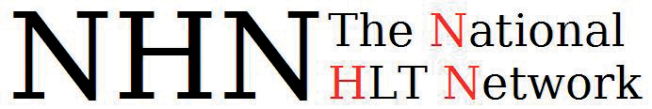
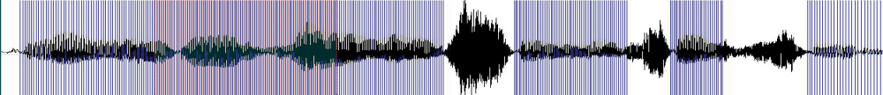

The South African HLT Audit
Aditi Sharma Grover^{1,2}, Gerhard B van Huyssteen^{1,3} & Marthinus W. Pretorius²
¹HLT Research Group, CSIR, South Africa
²Graduate School of Technology Management, University of Pretoria, South Africa
³Centre for Text Technology (CTexT), North-West University, South Africa

Slide 2
Why?
Why bother listening
  Discuss PROCESS rather than results
  Lessons to learn for other similar projects

Slide 3
Overview
Background
Process
  Phases and instruments
  Samples of outcomes and results
    Detail results presented at 2nd AfLaT Workshop
Conclusion
  Lessons to learn about HLT audits
  Future view

Slide 4
Why a technology audit?
Background
  Lack of a unified technological profile of HLT activities
Notes:
Therefore, despite a number of efforts by government and the R&D community, South Africa has not yet been able to maximise on the opportunities of HLT and create a thriving HLT industry. One of the key challenges in addressing this problem is the perceived fragmentation of the R&D activities in this domain: there is insufficient codified knowledge about the currently available South African HLT resources and applications. Hence, in 2009 NHN undertook a large-scale technology audit for the HLT landscape in South Africa (henceforth SAHLTA). The need for a technology audit is evident in the HLT community where discourse with respect to R&D is vibrant, but with a lack of a unified picture which presents the technological profile of the South African HLT landscape. Such a picture would allow the research fraternity to closely align their research activities with each other, encourage collaborations and sharing of language resources (LRs), and identify technologies that are capable of being commercialised. Thus, the objective of our study was to codify and present a profile of HLT components in the South African R&D environment. This article aims to provide an overview of the SAHLTA process, as well as to present a selection of the results (cf. Sharma Grover (2009) for an extensive report).

Slide 5

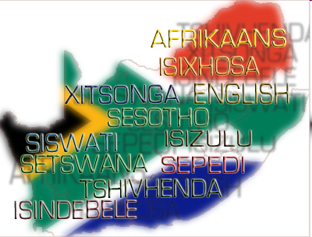
South African HLT landscape
Background
Notes:
South Africa (SA), often called the “rainbow nation”, is a country that epitomises diversity in various forms, the most prominent of which are ethnicity and language. There are roughly twenty five languages spoken in South Africa, of these 11 have been declared as official languages based on the grounds that their usage includes about 98% of the total population (DAC, 2002). The eleven official languages are isiNdebele, isiXhosa, isiZulu and siSwati, Sesotho, Sepedi and Setswana, Tshivenda, Xitsonga, English and Afrikaans.
Human language technologies (HLT) can be described as the set of technologies that apply the knowledge of language for the development of computer systems; that can recognise, understand, interpret and generate human language in all forms. It includes technologies as automatic speech recognition, text-to-speech and machine translation.
The HLT landscape in South Africa is made up of a relatively young research and development (R&D) community (universities and science councils) and a handful of companies in the private sector. Numerous local R&D activities have been taking place with many instances of international recognition for the quality and impact of work and South Africa has invested a reasonable amount of capital into the development of HLT. However, in contrast, the potential for impact that HLT has, as an enabling technology, across various application domains is not aligned with the current scale of HLT activities in the country. Service delivery, disabled, economic development, cultural diversity, skills creation, jobs.
Over the past few years, a number of planning activities have been undertaken (including a series of consultations involving government, industry, national research laboratories, and academics) to develop the HLT field as a national collaborative activity. These include:
The DAC confirmed the need to advance HLT in the South African context by developing and establishing the national HLT Strategy.
The Department of Science and Technology (DST) also identified HLT as a key technology during its ‘DST Technology Roadmapping’ process (Davel, Barnard & Kuun, 2007).
The DST sponsored a national workshop on HLT in 2005 where a national HLT roadmap was developed to guide research and development in HLT for the next ten years (2005-2015).
The workshop also led to discussions around national collaborative working groups to focus efforts around core technologies and resources. The workshop also acquainted HLT researchers and stakeholders with national initiatives which were likely to support the development of HLT in South Africa (Barnard, 2005).
In order to align and strengthen the national HLT research activities, DST provided financial support for the establishment of the National HLT Network (NHN) in 2006/7. The NHN is a collaborative effort which aims to strengthen synergies between HLT research practitioners in South Africa (SA). Currently, the members of the NHN are most of the major South African tertiary institutions and research councils who are actively involved in HLT R&D activities.
In November 2008, a workshop titled The “HLT Collaboration between South Africa and the Low Countries” was organised by NHN and the Dutch Language Union. Various aspects of HLT were discussed ranging from policy-making, R&D status, industry activities, educational & training opportunities and HLT road-mapping. The workshop aimed to stimulate and strengthen the cooperation between South Africa and the Dutch-speaking region in the field of HLT. Attendees included representatives from the South African, Dutch and Flemish HLT communities (science, business and government).
Much recently, in 2009 the DAC has initiated the process of establishing a National Centre for HLT (NCHLT) which will support and enable the development of HLT resources for all the official languages of South Africa.

Slide 6








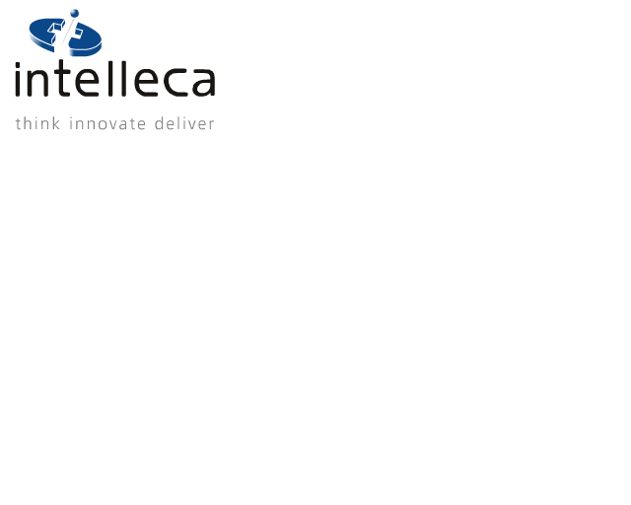




South African HLT landscape
Background
Notes:
South Africa (SA), often called the “rainbow nation”, is a country that epitomises diversity in various forms, the most prominent of which are ethnicity and language. There are roughly twenty five languages spoken in South Africa, of these 11 have been declared as official languages based on the grounds that their usage includes about 98% of the total population (DAC, 2002). The eleven official languages are isiNdebele, isiXhosa, isiZulu and siSwati, Sesotho, Sepedi and Setswana, Tshivenda, Xitsonga, English and Afrikaans.
Human language technologies (HLT) can be described as the set of technologies that apply the knowledge of language for the development of computer systems; that can recognise, understand, interpret and generate human language in all forms. It includes technologies as automatic speech recognition, text-to-speech and machine translation.
The HLT landscape in South Africa is made up of a relatively young research and development (R&D) community (universities and science councils) and a handful of companies in the private sector. Numerous local R&D activities have been taking place with many instances of international recognition for the quality and impact of work and South Africa has invested a reasonable amount of capital into the development of HLT. However, in contrast, the potential for impact that HLT has, as an enabling technology, across various application domains is not aligned with the current scale of HLT activities in the country. Service delivery, disabled, economic development, cultural diversity, skills creation, jobs.
Over the past few years, a number of planning activities have been undertaken (including a series of consultations involving government, industry, national research laboratories, and academics) to develop the HLT field as a national collaborative activity. These include:
The DAC confirmed the need to advance HLT in the South African context by developing and establishing the national HLT Strategy.
The Department of Science and Technology (DST) also identified HLT as a key technology during its ‘DST Technology Roadmapping’ process (Davel, Barnard & Kuun, 2007).
The DST sponsored a national workshop on HLT in 2005 where a national HLT roadmap was developed to guide research and development in HLT for the next ten years (2005-2015).
The workshop also led to discussions around national collaborative working groups to focus efforts around core technologies and resources. The workshop also acquainted HLT researchers and stakeholders with national initiatives which were likely to support the development of HLT in South Africa (Barnard, 2005).
In order to align and strengthen the national HLT research activities, DST provided financial support for the establishment of the National HLT Network (NHN) in 2006/7. The NHN is a collaborative effort which aims to strengthen synergies between HLT research practitioners in South Africa (SA). Currently, the members of the NHN are most of the major South African tertiary institutions and research councils who are actively involved in HLT R&D activities.
In November 2008, a workshop titled The “HLT Collaboration between South Africa and the Low Countries” was organised by NHN and the Dutch Language Union. Various aspects of HLT were discussed ranging from policy-making, R&D status, industry activities, educational & training opportunities and HLT road-mapping. The workshop aimed to stimulate and strengthen the cooperation between South Africa and the Dutch-speaking region in the field of HLT. Attendees included representatives from the South African, Dutch and Flemish HLT communities (science, business and government).
Much recently, in 2009 the DAC has initiated the process of establishing a National Centre for HLT (NCHLT) which will support and enable the development of HLT resources for all the official languages of South Africa.

Slide 7

2009
Background
  Align R&D activities and stimulate cooperation
  Similar to Dutch, Arabic, Swedish, Bulgarian (BLaRK), EuroMap
Notes:
Therefore, despite a number of efforts by government and the R&D community, South Africa has not yet been able to maximise on the opportunities of HLT and create a thriving HLT industry. One of the key challenges in addressing this problem is the perceived fragmentation of the R&D activities in this domain: there is insufficient codified knowledge about the currently available South African HLT resources and applications. Hence, in 2009 NHN undertook a large-scale technology audit for the HLT landscape in South Africa (henceforth SAHLTA). The need for a technology audit is evident in the HLT community where discourse with respect to R&D is vibrant, but with a lack of a unified picture which presents the technological profile of the South African HLT landscape. Such a picture would allow the research fraternity to closely align their research activities with each other, encourage collaborations and sharing of language resources (LRs), and identify technologies that are capable of being commercialised. Thus, the objective of our study was to codify and present a profile of HLT components in the South African R&D environment. This article aims to provide an overview of the SAHLTA process, as well as to present a selection of the results (cf. Sharma Grover (2009) for an extensive report).

Slide 8
SAHLTA Process
Process
Phase 1
①
②
③
④
⑤
Preparation

Slide 9
SAHLTA Process
Process
Phase 2
①
②
③
④
⑤
Verification and prioritisation

Slide 10
SAHLTA Process
Process
Phase 3
①
②
③
④
⑤
Gathering and analysis of information

Slide 11
SAHLTA Process
Process
Phase 1
①
②
③
④
⑤
Preparation

Slide 12
SAHLTA Process
Process
Terminology
Phase 1
①
②
③
④
⑤
Preparation

Slide 13
① Terminology
Process
Why?
  Establish a common lingua franca
    Text vs. speech people
    Variances in terminology
      E.g. “part-of-speech tagging” vs “word sort disambiguation”
Notes:
Data – the linguistic data sets or collections, which maybe either speech or text, in a machine readable form that are used to create, evaluate and improve HLT technology modules. Data includes items such as corpora, lexicas, pronunciation dictionaries, and grammars.
Modules – the basic software units or processes that are usually required to create HLT applications and products. This includes items such as part-of-speech taggers, sentence tokenisers, language models and acoustic models.
Applications – the categories of different application areas where HLT is used. It includes application domains such as speech input, document production, proofing/authoring tools and translation.
The HLT component classifications used by the Dutch (Binnenpoorte, 2002) and Arabic (Maegaard, 2006, 2009) BLaRK efforts were used as a point of departure, however, some adaptation was required for the South African context. It was noted during the review of HLT literature, there are often variances in the terminology used to refer to a particular data collection or technology module, due to different geographic locations or research background. For example, ‘word sense disambiguation’ is a technology module in the Dutch BLaRK matrix, but it is often also referred to as a ‘part-of-speech tagger’ in literature, especially in South Africa.
Also through preliminary interviews with three HLT experts it was found that an informal small-scale BLaRK survey was attempted in 2008 by some HLT community members, based on an exact replica of the Dutch BLaRK survey. However, some participants commented that the data, modules and applications categories and the taxonomy used were at times ambiguous. For example, a ‘monolingual lexicon’ can be interpreted as a ‘pronunciation dictionary’ from a speech technology perspective or a ‘lexicon’ of different word-forms from a text technology perspective.
The revision of the ‘applications’ category was of particular interest, since they provide a link to HLT products and markets and the environments of the Dutch and Arabic language are significantly different from that of South African languages due to various reasons:
SA has different market needs where the target users are not only multilingual but also of diverse socio-economic and cultural backgrounds.
Significant technological advancement has been made in the field of HLT for Dutch and Arabic, thus their ‘application’ categories encompass more advanced applications that may not currently be feasible for SA, both from a technical and market-related standpoint.
Departing from these application categories, we refined them (for example, categories for audio search and reference works were added), taking into account the above-mentioned issues.

Slide 14
① Terminology
Process
Outcomes:
  Glossary
    ~ 126 items
  Detailed taxonomy for all HLT components
    Data, modules, applications and tools/platforms
    Extended and updated Dutch and Arabic efforts; adapted to South African context
Notes:
Data – the linguistic data sets or collections, which maybe either speech or text, in a machine readable form that are used to create, evaluate and improve HLT technology modules. Data includes items such as corpora, lexicas, pronunciation dictionaries, and grammars.
Modules – the basic software units or processes that are usually required to create HLT applications and products. This includes items such as part-of-speech taggers, sentence tokenisers, language models and acoustic models.
Applications – the categories of different application areas where HLT is used. It includes application domains such as speech input, document production, proofing/authoring tools and translation.
The HLT component classifications used by the Dutch (Binnenpoorte, 2002) and Arabic (Maegaard, 2006, 2009) BLaRK efforts were used as a point of departure, however, some adaptation was required for the South African context. It was noted during the review of HLT literature, there are often variances in the terminology used to refer to a particular data collection or technology module, due to different geographic locations or research background. For example, ‘word sense disambiguation’ is a technology module in the Dutch BLaRK matrix, but it is often also referred to as a ‘part-of-speech tagger’ in literature, especially in South Africa.
Also through preliminary interviews with three HLT experts it was found that an informal small-scale BLaRK survey was attempted in 2008 by some HLT community members, based on an exact replica of the Dutch BLaRK survey. However, some participants commented that the data, modules and applications categories and the taxonomy used were at times ambiguous. For example, a ‘monolingual lexicon’ can be interpreted as a ‘pronunciation dictionary’ from a speech technology perspective or a ‘lexicon’ of different word-forms from a text technology perspective.
The revision of the ‘applications’ category was of particular interest, since they provide a link to HLT products and markets and the environments of the Dutch and Arabic language are significantly different from that of South African languages due to various reasons:
SA has different market needs where the target users are not only multilingual but also of diverse socio-economic and cultural backgrounds.
Significant technological advancement has been made in the field of HLT for Dutch and Arabic, thus their ‘application’ categories encompass more advanced applications that may not currently be feasible for SA, both from a technical and market-related standpoint.
Departing from these application categories, we refined them (for example, categories for audio search and reference works were added), taking into account the above-mentioned issues.

Slide 15
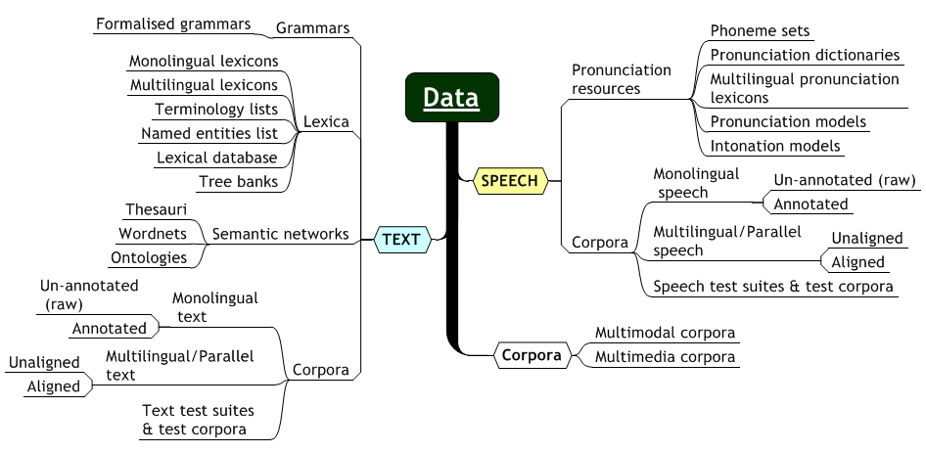
① Terminology
Process
Notes:
Data – the linguistic data sets or collections, which maybe either speech or text, in a machine readable form that are used to create, evaluate and improve HLT technology modules. Data includes items such as corpora, lexicas, pronunciation dictionaries, and grammars.
Modules – the basic software units or processes that are usually required to create HLT applications and products. This includes items such as part-of-speech taggers, sentence tokenisers, language models and acoustic models.
Applications – the categories of different application areas where HLT is used. It includes application domains such as speech input, document production, proofing/authoring tools and translation.
The HLT component classifications used by the Dutch (Binnenpoorte, 2002) and Arabic (Maegaard, 2006, 2009) BLaRK efforts were used as a point of departure, however, some adaptation was required for the South African context. It was noted during the review of HLT literature, there are often variances in the terminology used to refer to a particular data collection or technology module, due to different geographic locations or research background. For example, ‘word sense disambiguation’ is a technology module in the Dutch BLaRK matrix, but it is often also referred to as a ‘part-of-speech tagger’ in literature, especially in South Africa.
Also through preliminary interviews with three HLT experts it was found that an informal small-scale BLaRK survey was attempted in 2008 by some HLT community members, based on an exact replica of the Dutch BLaRK survey. However, some participants commented that the data, modules and applications categories and the taxonomy used were at times ambiguous. For example, a ‘monolingual lexicon’ can be interpreted as a ‘pronunciation dictionary’ from a speech technology perspective or a ‘lexicon’ of different word-forms from a text technology perspective.
The revision of the ‘applications’ category was of particular interest, since they provide a link to HLT products and markets and the environments of the Dutch and Arabic language are significantly different from that of South African languages due to various reasons:
SA has different market needs where the target users are not only multilingual but also of diverse socio-economic and cultural backgrounds.
Significant technological advancement has been made in the field of HLT for Dutch and Arabic, thus their ‘application’ categories encompass more advanced applications that may not currently be feasible for SA, both from a technical and market-related standpoint.
Departing from these application categories, we refined them (for example, categories for audio search and reference works were added), taking into account the above-mentioned issues.

Slide 16
SAHLTA Process
Process
Terminology
Phase 1
①
②
③
④
⑤
Preparation

Slide 17
SAHLTA Process
Process
Inventory criteria framework
Phase 1
①
②
③
④
⑤
Preparation

Slide 18
② Inventory criteria framework
Process
Why?
  In order to do detailed assessment of all components:
  Define criteria/dimensions for auditing and documenting HLT components
    e.g. quality, maturity, accessibility, adaptability, etc.
Notes:
a preliminary HLT inventory criteria framework which defined the criteria or dimensions on which the HLT components would be audited and documented. It is not sufficient to know whether a component exists or not but rather a detailed assessment (e.g. quality, availability, adaptability etc.) is required on the component to determine its usability. Here, we closely followed the Dutch and the Arabic BLaRK efforts, however we customised to include the most important and relevant criteria for the South African context (discussed in detail later).

Slide 19
② Inventory criteria framework
Process
Outcomes
  Criteria and dimensions for all components
    Basis for questionnaire
Notes:
a preliminary HLT inventory criteria framework which defined the criteria or dimensions on which the HLT components would be audited and documented. It is not sufficient to know whether a component exists or not but rather a detailed assessment (e.g. quality, availability, adaptability etc.) is required on the component to determine its usability. Here, we closely followed the Dutch and the Arabic BLaRK efforts, however we customised to include the most important and relevant criteria for the South African context (discussed in detail later).

Slide 20
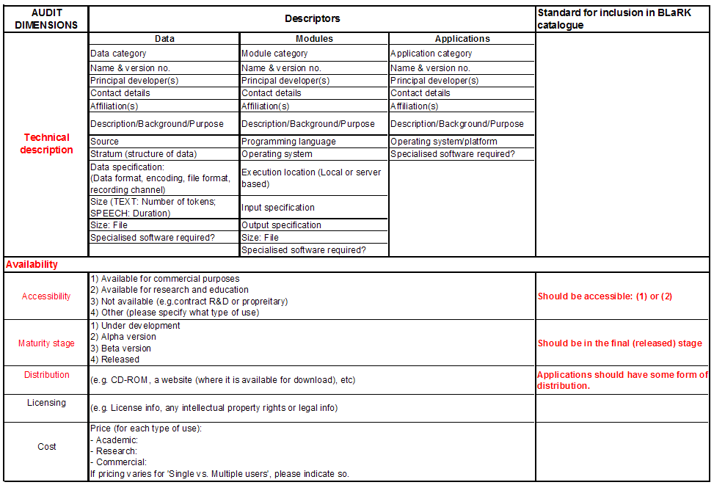
② Inventory criteria framework
Notes:
a preliminary HLT inventory criteria framework which defined the criteria or dimensions on which the HLT components would be audited and documented. It is not sufficient to know whether a component exists or not but rather a detailed assessment (e.g. quality, availability, adaptability etc.) is required on the component to determine its usability. Here, we closely followed the Dutch and the Arabic BLaRK efforts, however we customised to include the most important and relevant criteria for the South African context (discussed in detail later).

Slide 21
SAHLTA Process
Process
Inventory criteria framework
Phase 1
①
②
③
④
⑤
Preparation

Slide 22
SAHLTA Process
Process
Cursory inventory
Phase 1
①
②
③
④
⑤
Preparation

Slide 23
③ Cursory inventory
Process
Why?
  Describe existing, well-known HLT components for all 11 languages
    Inform development of inventory criteria framework and questionnaire
    Identify potential experts for workshop and respondents for questionnaire
Notes:
a preliminary HLT inventory criteria framework which defined the criteria or dimensions on which the HLT components would be audited and documented. It is not sufficient to know whether a component exists or not but rather a detailed assessment (e.g. quality, availability, adaptability etc.) is required on the component to determine its usability. Here, we closely followed the Dutch and the Arabic BLaRK efforts, however we customised to include the most important and relevant criteria for the South African context (discussed in detail later).

Slide 24
③ Cursory inventory
Process
Terminology
Cursory inventory
Inventory criteria
Outcomes:
①
②
③
④
⑤
Seed inputs for audit workshop
Notes:
a preliminary HLT inventory criteria framework which defined the criteria or dimensions on which the HLT components would be audited and documented. It is not sufficient to know whether a component exists or not but rather a detailed assessment (e.g. quality, availability, adaptability etc.) is required on the component to determine its usability. Here, we closely followed the Dutch and the Arabic BLaRK efforts, however we customised to include the most important and relevant criteria for the South African context (discussed in detail later).

Slide 25
SAHLTA Process
Process
Workshop
Phase 2
①
②
③
④
⑤
Verification and prioritisation

Slide 26
④ Audit workshop
Process
Why?
  Workshop with seven South African HLT experts
  To verify preparatory work
    e.g. consensus on audit terminology, inventory criteria framework, etc.
  To identify priorities for the South African context
Notes:
Subsequently the HLT terminology list, preliminary inventory criteria framework and the high-level inventory were used as seed information for an audit workshop with seven South African HLT experts (across both speech and text), who are internationally well-regarded scientists in the HLT field and the majority serve on the DAC’s national ‘HLT expert panel’. In this workshop, a session was dedicated to obtaining consensus on the data/modules/applications terminology. Participants were divided into ‘speech’ and ‘text’ based on their expertise, and each group identified additional HLT components and evaluated the suitability of the proposed nomenclature and taxonomy of the HLT components for the South African context.

Slide 27
④ Audit workshop
Process
Outcomes:
  Based on international trends, local needs, and feasibility
  And using a 3-point scale
    1 = Immediate attention
  Categorise all items under data, modules and applications
Notes:
Subsequently the HLT terminology list, preliminary inventory criteria framework and the high-level inventory were used as seed information for an audit workshop with seven South African HLT experts (across both speech and text), who are internationally well-regarded scientists in the HLT field and the majority serve on the DAC’s national ‘HLT expert panel’. In this workshop, a session was dedicated to obtaining consensus on the data/modules/applications terminology. Participants were divided into ‘speech’ and ‘text’ based on their expertise, and each group identified additional HLT components and evaluated the suitability of the proposed nomenclature and taxonomy of the HLT components for the South African context.

Slide 28
Preliminary HLT Priorities
Results
Priority 1: Applications
Text
Proofing tools
Speech
Accessibility
Information Extraction
Information Retrieval
Human-aided machine translation
Machine-aided human translation
Telephony applications
Computer-assisted language learning
Voice search
Audio management
Notes:
It is observed from this prioritisation that many advanced HLT applications are priority 2 and 3 based on the local market needs and feasibility factors although there is much work focussed on them internationally. Similarly a few advanced HLT applications feature in the priority one section due to their significance in the local market needs and ensuring world class research in South Africa.
Along with the three prioritisation factors determined by the participants, the prioritised applications (Table 5.1) were also taken into consideration when assigning priorities to the modules to ensure that basic HLT modules as well as specific HLT modules required for the prioritised applications were taken into account.
Table 5.3 below illustrates the prioritisation of text and speech data. Here again, along with the prioritisation factors, both applications and modules were kept in mind in order to ensure that not only basic data but also the specific data required for the prioritised applications and modules are considered.
The trend in the results of the language resources’ (data & modules) prioritisation reveals that; the HLT experts’ felt it was important to focus on development of basic and robust core HLT technology modules (e.g. ASR, TTS in the case of speech; text pre-processing, morphological analysis for text-based HLT) and the related data collections required for these HLT modules (priority one). Priority ‘2 and 3’ modules and data tend to be those LRs which can further enhance and complement the core LRs (priority one). However, the optimal and most-efficient use of priority 2 and 3 LRs would be to base their development on a strong foundation of the core HLT LRs (priority 1) which may further be re-used and carried forward to generate more advanced HLT outputs.

Slide 29
Preliminary HLT Priorities
Results
Priority 2: Applications
Text
OCR/ICR
Speech
Access control
Multilingual comprehension assistants
CALL
Authorship identification
Embedded speech recognition
Speaking devices
Computer-assisted training
Notes:
It is observed from this prioritisation that many advanced HLT applications are priority 2 and 3 based on the local market needs and feasibility factors although there is much work focussed on them internationally. Similarly a few advanced HLT applications feature in the priority one section due to their significance in the local market needs and ensuring world class research in South Africa.
Along with the three prioritisation factors determined by the participants, the prioritised applications (Table 5.1) were also taken into consideration when assigning priorities to the modules to ensure that basic HLT modules as well as specific HLT modules required for the prioritised applications were taken into account.
Table 5.3 below illustrates the prioritisation of text and speech data. Here again, along with the prioritisation factors, both applications and modules were kept in mind in order to ensure that not only basic data but also the specific data required for the prioritised applications and modules are considered.
The trend in the results of the language resources’ (data & modules) prioritisation reveals that; the HLT experts’ felt it was important to focus on development of basic and robust core HLT technology modules (e.g. ASR, TTS in the case of speech; text pre-processing, morphological analysis for text-based HLT) and the related data collections required for these HLT modules (priority one). Priority ‘2 and 3’ modules and data tend to be those LRs which can further enhance and complement the core LRs (priority one). However, the optimal and most-efficient use of priority 2 and 3 LRs would be to base their development on a strong foundation of the core HLT LRs (priority 1) which may further be re-used and carried forward to generate more advanced HLT outputs.

Slide 30
Preliminary HLT Priorities
Results
Priority 3: Applications
Text
Text generation
Speech
Transcription/dictation
Document classification
Summarisation
QA
Multimodal information access
Command&Control
Announcement systems
Dialogue systems
Reference works
Audio books
S2S translation
Notes:
It is observed from this prioritisation that many advanced HLT applications are priority 2 and 3 based on the local market needs and feasibility factors although there is much work focussed on them internationally. Similarly a few advanced HLT applications feature in the priority one section due to their significance in the local market needs and ensuring world class research in South Africa.
Along with the three prioritisation factors determined by the participants, the prioritised applications (Table 5.1) were also taken into consideration when assigning priorities to the modules to ensure that basic HLT modules as well as specific HLT modules required for the prioritised applications were taken into account.
Table 5.3 below illustrates the prioritisation of text and speech data. Here again, along with the prioritisation factors, both applications and modules were kept in mind in order to ensure that not only basic data but also the specific data required for the prioritised applications and modules are considered.
The trend in the results of the language resources’ (data & modules) prioritisation reveals that; the HLT experts’ felt it was important to focus on development of basic and robust core HLT technology modules (e.g. ASR, TTS in the case of speech; text pre-processing, morphological analysis for text-based HLT) and the related data collections required for these HLT modules (priority one). Priority ‘2 and 3’ modules and data tend to be those LRs which can further enhance and complement the core LRs (priority one). However, the optimal and most-efficient use of priority 2 and 3 LRs would be to base their development on a strong foundation of the core HLT LRs (priority 1) which may further be re-used and carried forward to generate more advanced HLT outputs.

Slide 31
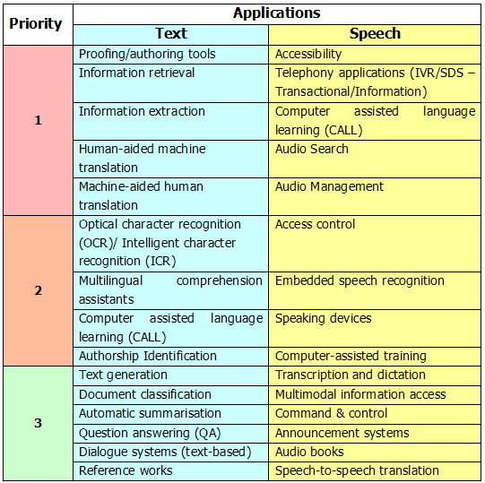
Results
Notes:
It is observed from this prioritisation that many advanced HLT applications are priority 2 and 3 based on the local market needs and feasibility factors although there is much work focussed on them internationally. Similarly a few advanced HLT applications feature in the priority one section due to their significance in the local market needs and ensuring world class research in South Africa.
Along with the three prioritisation factors determined by the participants, the prioritised applications (Table 5.1) were also taken into consideration when assigning priorities to the modules to ensure that basic HLT modules as well as specific HLT modules required for the prioritised applications were taken into account.
Table 5.3 below illustrates the prioritisation of text and speech data. Here again, along with the prioritisation factors, both applications and modules were kept in mind in order to ensure that not only basic data but also the specific data required for the prioritised applications and modules are considered.
The trend in the results of the language resources’ (data & modules) prioritisation reveals that; the HLT experts’ felt it was important to focus on development of basic and robust core HLT technology modules (e.g. ASR, TTS in the case of speech; text pre-processing, morphological analysis for text-based HLT) and the related data collections required for these HLT modules (priority one). Priority ‘2 and 3’ modules and data tend to be those LRs which can further enhance and complement the core LRs (priority one). However, the optimal and most-efficient use of priority 2 and 3 LRs would be to base their development on a strong foundation of the core HLT LRs (priority 1) which may further be re-used and carried forward to generate more advanced HLT outputs.

Slide 32
Preliminary HLT Priorities
Results
Priority 1: Modules
Text
G2P
Speech
Complete ASR
Text pre-processing
Normalisation
Morphological analysis
POS tagging
Chunking
WSD
Language/dialect ID
Non-native ASR
Complete TTS
Speaker ID
Diarisation
Language ID
Confidence measures
Notes:
It is observed from this prioritisation that many advanced HLT applications are priority 2 and 3 based on the local market needs and feasibility factors although there is much work focussed on them internationally. Similarly a few advanced HLT applications feature in the priority one section due to their significance in the local market needs and ensuring world class research in South Africa.
Along with the three prioritisation factors determined by the participants, the prioritised applications (Table 5.1) were also taken into consideration when assigning priorities to the modules to ensure that basic HLT modules as well as specific HLT modules required for the prioritised applications were taken into account.
Table 5.3 below illustrates the prioritisation of text and speech data. Here again, along with the prioritisation factors, both applications and modules were kept in mind in order to ensure that not only basic data but also the specific data required for the prioritised applications and modules are considered.
The trend in the results of the language resources’ (data & modules) prioritisation reveals that; the HLT experts’ felt it was important to focus on development of basic and robust core HLT technology modules (e.g. ASR, TTS in the case of speech; text pre-processing, morphological analysis for text-based HLT) and the related data collections required for these HLT modules (priority one). Priority ‘2 and 3’ modules and data tend to be those LRs which can further enhance and complement the core LRs (priority one). However, the optimal and most-efficient use of priority 2 and 3 LRs would be to base their development on a strong foundation of the core HLT LRs (priority 1) which may further be re-used and carried forward to generate more advanced HLT outputs.

Slide 33
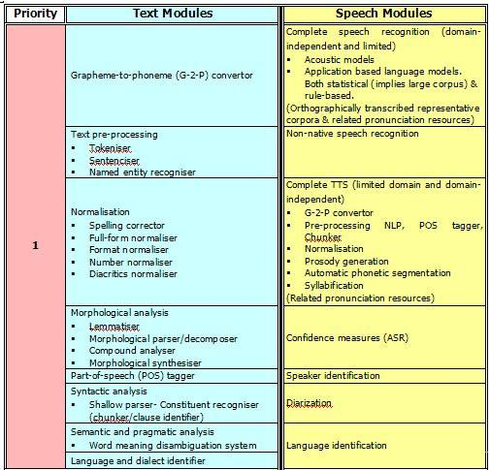
Results
Notes:
It is observed from this prioritisation that many advanced HLT applications are priority 2 and 3 based on the local market needs and feasibility factors although there is much work focussed on them internationally. Similarly a few advanced HLT applications feature in the priority one section due to their significance in the local market needs and ensuring world class research in South Africa.
Along with the three prioritisation factors determined by the participants, the prioritised applications (Table 5.1) were also taken into consideration when assigning priorities to the modules to ensure that basic HLT modules as well as specific HLT modules required for the prioritised applications were taken into account.
Table 5.3 below illustrates the prioritisation of text and speech data. Here again, along with the prioritisation factors, both applications and modules were kept in mind in order to ensure that not only basic data but also the specific data required for the prioritised applications and modules are considered.
The trend in the results of the language resources’ (data & modules) prioritisation reveals that; the HLT experts’ felt it was important to focus on development of basic and robust core HLT technology modules (e.g. ASR, TTS in the case of speech; text pre-processing, morphological analysis for text-based HLT) and the related data collections required for these HLT modules (priority one). Priority ‘2 and 3’ modules and data tend to be those LRs which can further enhance and complement the core LRs (priority one). However, the optimal and most-efficient use of priority 2 and 3 LRs would be to base their development on a strong foundation of the core HLT LRs (priority 1) which may further be re-used and carried forward to generate more advanced HLT outputs.

Slide 34
Preliminary HLT Priorities
Results
Priority 1: Data
Text
Monolingual corpora
Speech
Annotated monolingual corpora
Multilingual corpora
Test suites and corpora
Lexica (incl. named-entity lists)
Domain-/Application-specific corpora
Domain-/Application-specific corpora
Test suites and corpora
Pronunciation resources (e.g. Phone sets, dictionaries, etc.)
Notes:
It is observed from this prioritisation that many advanced HLT applications are priority 2 and 3 based on the local market needs and feasibility factors although there is much work focussed on them internationally. Similarly a few advanced HLT applications feature in the priority one section due to their significance in the local market needs and ensuring world class research in South Africa.
Along with the three prioritisation factors determined by the participants, the prioritised applications (Table 5.1) were also taken into consideration when assigning priorities to the modules to ensure that basic HLT modules as well as specific HLT modules required for the prioritised applications were taken into account.
Table 5.3 below illustrates the prioritisation of text and speech data. Here again, along with the prioritisation factors, both applications and modules were kept in mind in order to ensure that not only basic data but also the specific data required for the prioritised applications and modules are considered.
The trend in the results of the language resources’ (data & modules) prioritisation reveals that; the HLT experts’ felt it was important to focus on development of basic and robust core HLT technology modules (e.g. ASR, TTS in the case of speech; text pre-processing, morphological analysis for text-based HLT) and the related data collections required for these HLT modules (priority one). Priority ‘2 and 3’ modules and data tend to be those LRs which can further enhance and complement the core LRs (priority one). However, the optimal and most-efficient use of priority 2 and 3 LRs would be to base their development on a strong foundation of the core HLT LRs (priority 1) which may further be re-used and carried forward to generate more advanced HLT outputs.

Slide 35
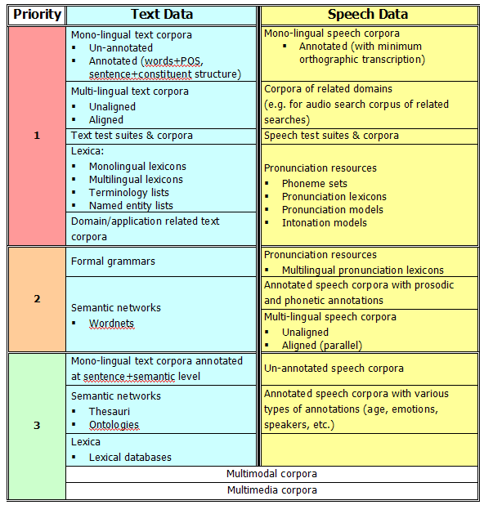
Results
Notes:
It is observed from this prioritisation that many advanced HLT applications are priority 2 and 3 based on the local market needs and feasibility factors although there is much work focussed on them internationally. Similarly a few advanced HLT applications feature in the priority one section due to their significance in the local market needs and ensuring world class research in South Africa.
Along with the three prioritisation factors determined by the participants, the prioritised applications (Table 5.1) were also taken into consideration when assigning priorities to the modules to ensure that basic HLT modules as well as specific HLT modules required for the prioritised applications were taken into account.
Table 5.3 below illustrates the prioritisation of text and speech data. Here again, along with the prioritisation factors, both applications and modules were kept in mind in order to ensure that not only basic data but also the specific data required for the prioritised applications and modules are considered.
The trend in the results of the language resources’ (data & modules) prioritisation reveals that; the HLT experts’ felt it was important to focus on development of basic and robust core HLT technology modules (e.g. ASR, TTS in the case of speech; text pre-processing, morphological analysis for text-based HLT) and the related data collections required for these HLT modules (priority one). Priority ‘2 and 3’ modules and data tend to be those LRs which can further enhance and complement the core LRs (priority one). However, the optimal and most-efficient use of priority 2 and 3 LRs would be to base their development on a strong foundation of the core HLT LRs (priority 1) which may further be re-used and carried forward to generate more advanced HLT outputs.

Slide 36
4) SAHLTA mini workshop
Process
Preliminary HLT components prioritisation
  Factors for assigning priorities
    International trends
    Local market needs
    Feasibility
  Descending 3-point priority scale
    1 = Requires definite attention
    2 = Attention given based on specific needs & trends
    3 = Nice-to-have for further research or
    enhancement
    TRANSITION???
Notes:
Another session focussed on developing the first draft of priorities for applications and associated LRs. The most relevant factors that were taken into consideration include:
International trends: best practices and current developments in the field of HLT in international R&D efforts and industries;
Local market needs: factors such as socio-economic constraints, culture, multi-lingualism and the readiness of local markets to introduce HLT products and services; and
Feasibility: technical feasibility and practical implications such as cost and time-lines for R&D.

Slide 37
SAHLTA Process
Process
Workshop
Phase 2
①
②
③
④
⑤
Verification and prioritisation

Slide 38
SAHLTA Process
Process
Questionnaire
Phase 3
①
②
③
④
⑤
Gathering and analysis of information

Slide 39
⑤ Questionnaire
Process
Why?
  To get detailed information about all existing resources
  To draw up an HLT profile of all the languages
    Using various indexes
  To do a gap analysis
  To establish a detailed inventory (“catalogue”) of all resources
Notes:
The final inventory criteria framework described above the basis for the HLT audit questionnaire which gathered data on all 11 official languages of SA. Prior to roll-out the questionnaire was piloted with a few HLT experts, an exercise that helped to identify fields which could potentially be easily misinterpreted. To further aid participants (and stimulate response rate) example entries which illustrated how to record information for a HLT component, were provided for each category (data, modules, applications).
The South African HLT audit questionnaire was circulated in an electronic format amongst the identified major HLT players in the country. Organisations approached were classified as primary and secondary participants, in terms of their core HLT related activities. We contacted 15 primary organisations (universities, science councils, companies) and 12 secondary (national lexicography units, government departments) and received responses from 12 and 4 of these respectively.
The audit questionnaire was sent to all major HLT role-players in the country. Organisations approached were classified as primary or secondary participants, based on their historical core HLT competence in R&D (see Table 1). Participants were sent a list of the HLT components identified at their institution (as identified in the high-level inventory), and were requested to fill out all sections, and indicate its details for all eleven languages. All primary participants were paid a minimal honorarium to compensate for the considerable effort that was required from them.

Slide 40
⑤ Questionnaire
Process
Outcomes:
  Various indexes
Notes:
The final inventory criteria framework described above the basis for the HLT audit questionnaire which gathered data on all 11 official languages of SA. Prior to roll-out the questionnaire was piloted with a few HLT experts, an exercise that helped to identify fields which could potentially be easily misinterpreted. To further aid participants (and stimulate response rate) example entries which illustrated how to record information for a HLT component, were provided for each category (data, modules, applications).
The South African HLT audit questionnaire was circulated in an electronic format amongst the identified major HLT players in the country. Organisations approached were classified as primary and secondary participants, in terms of their core HLT related activities. We contacted 15 primary organisations (universities, science councils, companies) and 12 secondary (national lexicography units, government departments) and received responses from 12 and 4 of these respectively.
The audit questionnaire was sent to all major HLT role-players in the country. Organisations approached were classified as primary or secondary participants, based on their historical core HLT competence in R&D (see Table 1). Participants were sent a list of the HLT components identified at their institution (as identified in the high-level inventory), and were requested to fill out all sections, and indicate its details for all eleven languages. All primary participants were paid a minimal honorarium to compensate for the considerable effort that was required from them.

Slide 41
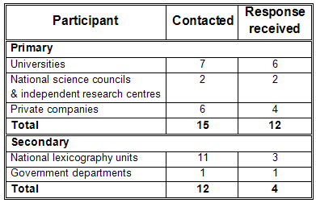
Response rate
Process
Notes:
The final inventory criteria framework described above the basis for the HLT audit questionnaire which gathered data on all 11 official languages of SA. Prior to roll-out the questionnaire was piloted with a few HLT experts, an exercise that helped to identify fields which could potentially be easily misinterpreted. To further aid participants (and stimulate response rate) example entries which illustrated how to record information for a HLT component, were provided for each category (data, modules, applications).
The South African HLT audit questionnaire was circulated in an electronic format amongst the identified major HLT players in the country. Organisations approached were classified as primary and secondary participants, in terms of their core HLT related activities. We contacted 15 primary organisations (universities, science councils, companies) and 12 secondary (national lexicography units, government departments) and received responses from 12 and 4 of these respectively.
The audit questionnaire was sent to all major HLT role-players in the country. Organisations approached were classified as primary or secondary participants, based on their historical core HLT competence in R&D (see Table 1). Participants were sent a list of the HLT components identified at their institution (as identified in the high-level inventory), and were requested to fill out all sections, and indicate its details for all eleven languages. All primary participants were paid a minimal honorarium to compensate for the considerable effort that was required from them.

Slide 42
Maturity Index
Results
Maturity stages:
  Under development (UD), Alpha version (AV), Beta version (BV) , Released (RV)
Maturity Index
  Measure of the maturity of HLT components in a language.
  Considers the maturity stage of item against the relative importance of each maturity stage
  MaturityInd = Σ (1.UD+2.AV+4.BV+8.RV)/
  Σ Weights of maturity stages
Notes:
Under development - items in the initial stages of being developed
Alpha version - items in a basic functioning stage
Beta version - items close to completion, usually a well-defined and built prototype that is in use.
Released - items which have been in released in the public domain often for use by other R&D community members or consumers.
The total maturity across all items i.e. data, modules, applications, available (both speech and text) in a language is illustrated in figure 5.13. This figure reveals that the highest maturity of the items across all the languages is in the ‘released’ stage, signifying a certain level of completion. This is closely followed by numerous items being in the ‘alpha version’ and ‘beta version’ stages where there is much work in the pipeline to create future HLT items. The smallest number of items are in the ‘under development’ stage.
This picture can be attributed to the fact that in the South African HLT landscape a few major projects have recently come to completion (thus released items) or are in the stage of being finalised (thus beta and alpha version items). A new wave of ‘under development’ is yet to build up as a national call for proposals for further HLT projects is currently underway.
Across all languages Afrikaans has the highest total maturity and English has the second highest. isiNdebele and Xitsonga have the lowest total maturity of all the eleven languages in the country. This could be attributed to the lesser use of these languages within the HLT domain.
The Maturity Index provides a measure of the maturity of HLT components in a language by taking into account the maturity stage of an item against the relative importance or contribution of each maturity stage. The ‘maturity sum’ per item grouping (e.g. ‘pronunciation resources’) for each language is calculated as:
Maturity sum = 1.UD + 2.AV + 4.BV + 8.RV (1)
where UD is the number of components in the ‘under development’ phase, AV is the number of ‘alpha version’ components, BV is the number of ‘beta version’ components, and RV is the number of ‘released version’ components; the weights for the different versions are relative weights, in order to give greater importance to the final, released versions of components. The weight assigned to a maturity stage is double that of the preceding maturity stage, i.e. an ‘alpha version’ item counts twice as much as an ‘under development’ item or a ‘beta version’ item counts twice as much as an ‘alpha version’ item. As an example, Table 3 illustrates the maturity sum calculation for ‘pronunciation resources’; the maturity sum for English will be 17, since English has one ‘under development’ item, no ‘alpha’ or ‘beta version’ items and two ‘released’ items; thus its maturity sum is calculated to be (1.1+ 0.2+ 0.4+ 2.8) 17.

Slide 43
Maturity Index
Results
Notes:
The ‘HLT Language Index’ provides a comparison on the overall status of HLT development for the eleven South African languages and was calculated by summation of the Maturity Index (Figure 1) and the Accessibility Index (Figure 2) for each language (across all HLT components):
HLT Language Index = Maturity Index + Accessibility Index (per language) (6)
This index allows the South African languages to be compared against each other based on the total quantity of HLT activity within a language whilst also taking into account the stage of maturity and accessibility of the outputs of the HLT activity in South Africa. In interpreting the results of the ‘HLT Language Index’, it is important to note that since there are a relatively small number of items available per language, it makes statistical data analysis methods unsuitable for the analysis. Thus rather an impressionistic representation of the HLT landscape is being portrayed through this index. Also, the limited number of items available per sub-category of the data, modules, and applications categories makes the data analysis subject to significant changes if additional items are identified for a language.
Figure 6 depicts the HLT Language Index for the South African languages. It shows that Afrikaans is by far the most developed language in South Africa with regard to HLT LRs and applications, followed by the local vernacular of South African English (with a significant difference between the two). This picture is slightly skewed by the fact that very little work on South African English is required within the text domain, which means that South African English will almost always only be measured in terms of activity related to speech technologies.
IsiZulu, isiXhosa, Sepedi, Setswana and Sesotho (the five African languages in SA with the most native speakers) follow behind English; the two Nguni languages (isiZulu and isiXhosa) have slightly more activity in the field of HLT, compared to the Sotho languages (Sepedi, Setswana and Sesotho). This can be attributed to the fact that isiZulu and isiXhosa are by far the two largest languages in SA, used in a variety of domains and in various provinces – and thus are often of larger commercial and/or academic interest. At the tail-end are the lesser-used languages, viz. Tshivenda, Siswati, isiNdebele and Xitsonga. (Language independent items are also included in the index, right at the end.) These four languages significantly lag behind in terms of HLT activity; the majority of items available for these languages were developed quite recently, and are mainly due to the South African government’s investment in these languages.
The Maturity Index and the Accessibility Index here is on a per language basis, taken across all data, modules, applications as discussed in section 4.2.1 and 4.2.2 respectively.
n order to compare the state of HLT development for all eleven languages, we created the ‘Final HLT index’, an impressionistic index that relatively ranks languages based on the total quantity of HLT activity within a language, as well as the stage of maturity and accessibility of their HLT resources and applications.
Figure 1 (see end of paper) depicts the ‘Final HLT Index’ for the South African languages. It shows that Afrikaans is by far the most developed language in South Africa with regard to HLT resources and applications, followed by the local vernacular of English (with a significant difference between the two). This picture is skewed by the fact that very little work on South African English is required within the text domain, which means that South African English will almost always only be measured in terms of activity related to speech technologies.
IsiZulu, isiXhosa, Sepedi, Setswana and Sesotho (the five African languages in South Africa with the most native speakers) follow behind English; the two Nguni languages (isiZulu and isiXhosa) have slightly more activity in the field of HLT, compared to the Sotho languages (Sepedi, Setswana and Sesotho). This can be attributed to the fact that isiZulu and isiXhosa are by far the two largest languages in South Africa, used in a variety of domains and in various provinces – and thus often of larger commercial and/or academic interest.
At the tail-end are the lesser-used languages such as Tshivenda, Siswati, isiNdebele, Xitsonga (language independent items are also included in the index, right at the end). These four languages significantly lag behind in terms of HLT activity; the majority of items available for these languages were developed quite recently, and are mainly due to the South African government’s investment in these languages.
In interpreting the results of the ‘Final HLT Index’, it is important to note that since there is a relatively small number of items available per language, it makes statistical data analysis methods unsuitable for the analysis. Thus rather an impressionistic representation of the HLT landscape is being portrayed through this index. Also, the limited number of items available per sub-category of the data, modules, and applications categories makes the data analysis subject to significant changes if additional items are identified for a language.

Slide 44
Accessibility Index
Results
Accessibility stages:
  Unspecified (UN), Not available (NA) (proprietary or contract R&D), Research and education (RE), Available for commercial purposes (CO), Available for commercial purposes and R&E (CRE)
Accessibility Index
  Measure of the accessibility of HLT components in a language
  Considers the accessibility stage of an item against the relative importance of each accessibility stage
  AccessInd = Σ (1.UN+2.NA+4.RE+8.CO+12.CRE)/
  Σ Weights of accessibility stages
Notes:
Under development - items in the initial stages of being developed
Alpha version - items in a basic functioning stage
Beta version - items close to completion, usually a well-defined and built prototype that is in use.
Released - items which have been in released in the public domain often for use by other R&D community members or consumers.
The total maturity across all items i.e. data, modules, applications, available (both speech and text) in a language is illustrated in figure 5.13. This figure reveals that the highest maturity of the items across all the languages is in the ‘released’ stage, signifying a certain level of completion. This is closely followed by numerous items being in the ‘alpha version’ and ‘beta version’ stages where there is much work in the pipeline to create future HLT items. The smallest number of items are in the ‘under development’ stage.
This picture can be attributed to the fact that in the South African HLT landscape a few major projects have recently come to completion (thus released items) or are in the stage of being finalised (thus beta and alpha version items). A new wave of ‘under development’ is yet to build up as a national call for proposals for further HLT projects is currently underway.
Across all languages Afrikaans has the highest total maturity and English has the second highest. isiNdebele and Xitsonga have the lowest total maturity of all the eleven languages in the country. This could be attributed to the lesser use of these languages within the HLT domain.
The Maturity Index provides a measure of the maturity of HLT components in a language by taking into account the maturity stage of an item against the relative importance or contribution of each maturity stage. The ‘maturity sum’ per item grouping (e.g. ‘pronunciation resources’) for each language is calculated as:
Maturity sum = 1.UD + 2.AV + 4.BV + 8.RV (1)
where UD is the number of components in the ‘under development’ phase, AV is the number of ‘alpha version’ components, BV is the number of ‘beta version’ components, and RV is the number of ‘released version’ components; the weights for the different versions are relative weights, in order to give greater importance to the final, released versions of components. The weight assigned to a maturity stage is double that of the preceding maturity stage, i.e. an ‘alpha version’ item counts twice as much as an ‘under development’ item or a ‘beta version’ item counts twice as much as an ‘alpha version’ item. As an example, Table 3 illustrates the maturity sum calculation for ‘pronunciation resources’; the maturity sum for English will be 17, since English has one ‘under development’ item, no ‘alpha’ or ‘beta version’ items and two ‘released’ items; thus its maturity sum is calculated to be (1.1+ 0.2+ 0.4+ 2.8) 17.

Slide 45
Accessibility Index
Results
Notes:
The ‘HLT Language Index’ provides a comparison on the overall status of HLT development for the eleven South African languages and was calculated by summation of the Maturity Index (Figure 1) and the Accessibility Index (Figure 2) for each language (across all HLT components):
HLT Language Index = Maturity Index + Accessibility Index (per language) (6)
This index allows the South African languages to be compared against each other based on the total quantity of HLT activity within a language whilst also taking into account the stage of maturity and accessibility of the outputs of the HLT activity in South Africa. In interpreting the results of the ‘HLT Language Index’, it is important to note that since there are a relatively small number of items available per language, it makes statistical data analysis methods unsuitable for the analysis. Thus rather an impressionistic representation of the HLT landscape is being portrayed through this index. Also, the limited number of items available per sub-category of the data, modules, and applications categories makes the data analysis subject to significant changes if additional items are identified for a language.
Figure 6 depicts the HLT Language Index for the South African languages. It shows that Afrikaans is by far the most developed language in South Africa with regard to HLT LRs and applications, followed by the local vernacular of South African English (with a significant difference between the two). This picture is slightly skewed by the fact that very little work on South African English is required within the text domain, which means that South African English will almost always only be measured in terms of activity related to speech technologies.
IsiZulu, isiXhosa, Sepedi, Setswana and Sesotho (the five African languages in SA with the most native speakers) follow behind English; the two Nguni languages (isiZulu and isiXhosa) have slightly more activity in the field of HLT, compared to the Sotho languages (Sepedi, Setswana and Sesotho). This can be attributed to the fact that isiZulu and isiXhosa are by far the two largest languages in SA, used in a variety of domains and in various provinces – and thus are often of larger commercial and/or academic interest. At the tail-end are the lesser-used languages, viz. Tshivenda, Siswati, isiNdebele and Xitsonga. (Language independent items are also included in the index, right at the end.) These four languages significantly lag behind in terms of HLT activity; the majority of items available for these languages were developed quite recently, and are mainly due to the South African government’s investment in these languages.
The Maturity Index and the Accessibility Index here is on a per language basis, taken across all data, modules, applications as discussed in section 4.2.1 and 4.2.2 respectively.
n order to compare the state of HLT development for all eleven languages, we created the ‘Final HLT index’, an impressionistic index that relatively ranks languages based on the total quantity of HLT activity within a language, as well as the stage of maturity and accessibility of their HLT resources and applications.
Figure 1 (see end of paper) depicts the ‘Final HLT Index’ for the South African languages. It shows that Afrikaans is by far the most developed language in South Africa with regard to HLT resources and applications, followed by the local vernacular of English (with a significant difference between the two). This picture is skewed by the fact that very little work on South African English is required within the text domain, which means that South African English will almost always only be measured in terms of activity related to speech technologies.
IsiZulu, isiXhosa, Sepedi, Setswana and Sesotho (the five African languages in South Africa with the most native speakers) follow behind English; the two Nguni languages (isiZulu and isiXhosa) have slightly more activity in the field of HLT, compared to the Sotho languages (Sepedi, Setswana and Sesotho). This can be attributed to the fact that isiZulu and isiXhosa are by far the two largest languages in South Africa, used in a variety of domains and in various provinces – and thus often of larger commercial and/or academic interest.
At the tail-end are the lesser-used languages such as Tshivenda, Siswati, isiNdebele, Xitsonga (language independent items are also included in the index, right at the end). These four languages significantly lag behind in terms of HLT activity; the majority of items available for these languages were developed quite recently, and are mainly due to the South African government’s investment in these languages.
In interpreting the results of the ‘Final HLT Index’, it is important to note that since there is a relatively small number of items available per language, it makes statistical data analysis methods unsuitable for the analysis. Thus rather an impressionistic representation of the HLT landscape is being portrayed through this index. Also, the limited number of items available per sub-category of the data, modules, and applications categories makes the data analysis subject to significant changes if additional items are identified for a language.

Slide 46
HLT Language Index
Results
Impressionistic index that relatively ranks languages based on the total quantity of HLT activity per language
Considers the stage of maturity and accessibility of all the HLT components
HLT Language Index = Maturity Index
+ Accessibility Index
(per language, all components)
Notes:
The ‘HLT Language Index’ provides a comparison on the overall status of HLT development for the eleven South African languages and was calculated by summation of the Maturity Index (Figure 1) and the Accessibility Index (Figure 2) for each language (across all HLT components):
HLT Language Index = Maturity Index + Accessibility Index (per language) (6)
This index allows the South African languages to be compared against each other based on the total quantity of HLT activity within a language whilst also taking into account the stage of maturity and accessibility of the outputs of the HLT activity in South Africa. In interpreting the results of the ‘HLT Language Index’, it is important to note that since there are a relatively small number of items available per language, it makes statistical data analysis methods unsuitable for the analysis. Thus rather an impressionistic representation of the HLT landscape is being portrayed through this index. Also, the limited number of items available per sub-category of the data, modules, and applications categories makes the data analysis subject to significant changes if additional items are identified for a language.
Figure 6 depicts the HLT Language Index for the South African languages. It shows that Afrikaans is by far the most developed language in South Africa with regard to HLT LRs and applications, followed by the local vernacular of South African English (with a significant difference between the two). This picture is slightly skewed by the fact that very little work on South African English is required within the text domain, which means that South African English will almost always only be measured in terms of activity related to speech technologies.
IsiZulu, isiXhosa, Sepedi, Setswana and Sesotho (the five African languages in SA with the most native speakers) follow behind English; the two Nguni languages (isiZulu and isiXhosa) have slightly more activity in the field of HLT, compared to the Sotho languages (Sepedi, Setswana and Sesotho). This can be attributed to the fact that isiZulu and isiXhosa are by far the two largest languages in SA, used in a variety of domains and in various provinces – and thus are often of larger commercial and/or academic interest. At the tail-end are the lesser-used languages, viz. Tshivenda, Siswati, isiNdebele and Xitsonga. (Language independent items are also included in the index, right at the end.) These four languages significantly lag behind in terms of HLT activity; the majority of items available for these languages were developed quite recently, and are mainly due to the South African government’s investment in these languages.
The Maturity Index and the Accessibility Index here is on a per language basis, taken across all data, modules, applications as discussed in section 4.2.1 and 4.2.2 respectively.
n order to compare the state of HLT development for all eleven languages, we created the ‘Final HLT index’, an impressionistic index that relatively ranks languages based on the total quantity of HLT activity within a language, as well as the stage of maturity and accessibility of their HLT resources and applications.
Figure 1 (see end of paper) depicts the ‘Final HLT Index’ for the South African languages. It shows that Afrikaans is by far the most developed language in South Africa with regard to HLT resources and applications, followed by the local vernacular of English (with a significant difference between the two). This picture is skewed by the fact that very little work on South African English is required within the text domain, which means that South African English will almost always only be measured in terms of activity related to speech technologies.
IsiZulu, isiXhosa, Sepedi, Setswana and Sesotho (the five African languages in South Africa with the most native speakers) follow behind English; the two Nguni languages (isiZulu and isiXhosa) have slightly more activity in the field of HLT, compared to the Sotho languages (Sepedi, Setswana and Sesotho). This can be attributed to the fact that isiZulu and isiXhosa are by far the two largest languages in South Africa, used in a variety of domains and in various provinces – and thus often of larger commercial and/or academic interest.
At the tail-end are the lesser-used languages such as Tshivenda, Siswati, isiNdebele, Xitsonga (language independent items are also included in the index, right at the end). These four languages significantly lag behind in terms of HLT activity; the majority of items available for these languages were developed quite recently, and are mainly due to the South African government’s investment in these languages.
In interpreting the results of the ‘Final HLT Index’, it is important to note that since there is a relatively small number of items available per language, it makes statistical data analysis methods unsuitable for the analysis. Thus rather an impressionistic representation of the HLT landscape is being portrayed through this index. Also, the limited number of items available per sub-category of the data, modules, and applications categories makes the data analysis subject to significant changes if additional items are identified for a language.

Slide 47
HLT Language Index
Results
Notes:
The ‘HLT Language Index’ provides a comparison on the overall status of HLT development for the eleven South African languages and was calculated by summation of the Maturity Index (Figure 1) and the Accessibility Index (Figure 2) for each language (across all HLT components):
HLT Language Index = Maturity Index + Accessibility Index (per language) (6)
This index allows the South African languages to be compared against each other based on the total quantity of HLT activity within a language whilst also taking into account the stage of maturity and accessibility of the outputs of the HLT activity in South Africa. In interpreting the results of the ‘HLT Language Index’, it is important to note that since there are a relatively small number of items available per language, it makes statistical data analysis methods unsuitable for the analysis. Thus rather an impressionistic representation of the HLT landscape is being portrayed through this index. Also, the limited number of items available per sub-category of the data, modules, and applications categories makes the data analysis subject to significant changes if additional items are identified for a language.
Figure 6 depicts the HLT Language Index for the South African languages. It shows that Afrikaans is by far the most developed language in South Africa with regard to HLT LRs and applications, followed by the local vernacular of South African English (with a significant difference between the two). This picture is slightly skewed by the fact that very little work on South African English is required within the text domain, which means that South African English will almost always only be measured in terms of activity related to speech technologies.
IsiZulu, isiXhosa, Sepedi, Setswana and Sesotho (the five African languages in SA with the most native speakers) follow behind English; the two Nguni languages (isiZulu and isiXhosa) have slightly more activity in the field of HLT, compared to the Sotho languages (Sepedi, Setswana and Sesotho). This can be attributed to the fact that isiZulu and isiXhosa are by far the two largest languages in SA, used in a variety of domains and in various provinces – and thus are often of larger commercial and/or academic interest. At the tail-end are the lesser-used languages, viz. Tshivenda, Siswati, isiNdebele and Xitsonga. (Language independent items are also included in the index, right at the end.) These four languages significantly lag behind in terms of HLT activity; the majority of items available for these languages were developed quite recently, and are mainly due to the South African government’s investment in these languages.
The Maturity Index and the Accessibility Index here is on a per language basis, taken across all data, modules, applications as discussed in section 4.2.1 and 4.2.2 respectively.
n order to compare the state of HLT development for all eleven languages, we created the ‘Final HLT index’, an impressionistic index that relatively ranks languages based on the total quantity of HLT activity within a language, as well as the stage of maturity and accessibility of their HLT resources and applications.
Figure 1 (see end of paper) depicts the ‘Final HLT Index’ for the South African languages. It shows that Afrikaans is by far the most developed language in South Africa with regard to HLT resources and applications, followed by the local vernacular of English (with a significant difference between the two). This picture is skewed by the fact that very little work on South African English is required within the text domain, which means that South African English will almost always only be measured in terms of activity related to speech technologies.
IsiZulu, isiXhosa, Sepedi, Setswana and Sesotho (the five African languages in South Africa with the most native speakers) follow behind English; the two Nguni languages (isiZulu and isiXhosa) have slightly more activity in the field of HLT, compared to the Sotho languages (Sepedi, Setswana and Sesotho). This can be attributed to the fact that isiZulu and isiXhosa are by far the two largest languages in South Africa, used in a variety of domains and in various provinces – and thus often of larger commercial and/or academic interest.
At the tail-end are the lesser-used languages such as Tshivenda, Siswati, isiNdebele, Xitsonga (language independent items are also included in the index, right at the end). These four languages significantly lag behind in terms of HLT activity; the majority of items available for these languages were developed quite recently, and are mainly due to the South African government’s investment in these languages.
In interpreting the results of the ‘Final HLT Index’, it is important to note that since there is a relatively small number of items available per language, it makes statistical data analysis methods unsuitable for the analysis. Thus rather an impressionistic representation of the HLT landscape is being portrayed through this index. Also, the limited number of items available per sub-category of the data, modules, and applications categories makes the data analysis subject to significant changes if additional items are identified for a language.

Slide 48
HLT Component Indexes
Results
Alternative perspective:
  Quantity of activity taking place within each of the data, modules, and applications on a HLT component grouping level (e.g. pronunciation resources)
Notes:
The HLT Component Index provides an alternative perspective on the quantity of activity taking place within each of the data, modules, and applications on a HLT component grouping level (e.g. pronunciation resources) and is calculated as follows:
HLT Component Index = Maturity Index (per item grouping) +
Accessibility Index (per item grouping) (5)
The HLT Component Indexes for all languages are plotted in a grid using a bubble plot (figures 3, 4 and 5). The value of the HLT Component Index for a particular component grouping determines the size of the bubble i.e. the higher the index the larger the bubble. However, it is important to note that the size of the bubbles plotted within a plot is proportional to the highest value of the HLT Component Index within the entire plot. Thus, this index provides a relative comparison of the HLT activity within the various groupings of data, modules or applications within a single plot, as opposed to an absolute comparison of languages.
Figure 3 depicts the plot for the HLT Component Indexes for data, where aligned multilingual text corpora have the highest HLT component index score (which implies the greatest quantity of mature and accessible activities), followed by ‘lexica’ and so forth. In general it can be seen that speech data resources (in red) have less activity compared to text resources (in blue). The figure also reveals that although there may be activity in many of the data sub-categories (e.g. ‘semantic networks and formalised grammars’), it is very small (implying less maturity and accessibility) or does not exist across all the languages.
The Maturity Index and Accessibility Index used here are calculated for each grouping of HLT components within data, modules and applications, for example, lexica, corpora, morphological analysis, translation, etc.
The HLT Component Index also allows HLT practitioners to ascertain areas where further work is required across the different languages. Figure 4 represents the plot of the HLT Component Indexes for modules. For example, from this figure, a funding agency could deduce that money should rather be invested in, for example, syntactic analysis, than in grapheme-to-phoneme conversion; or that special attention should be given to morphological analysis of Sesotho, Xitsonga and Tshivenda. It should be noted that the relative size of a bubble does not necessarily indicate that technologies in that component grouping or for that language is mature in itself (in comparison to maturity of HLT in the developed world) – it is rather an indication of the status of HLT activity within the South African languages relative to each other (and also not relative to other world languages).
Figure 4 reveals that the largest amount of activity is in the field of ‘morphological analysis’ in Afrikaans, as well as in text-based and speech-based tools which are language-independent. In general there is some medium-scale activity in the basic HLT modules for both the text (in blue) and speech (in red) domains, such as grapheme-to-phoneme converters, text processing, morphological analysis, speech recognition, and text-to-speech respectively, whilst the more advanced HLT modules are mostly non-existent or are barely available for a few languages or with very little activity.
Figure 5 illustrates the HLT Component Indexes for text (in blue) and speech (in red) applications. The greatest quantity of activity (more mature and accessible) is in the reference works (text) for Afrikaans and English, as well as in telephony-based services in English. There is some medium-scale activity in the document production, translation, CALL, and accessibility areas for the text and speech domains respectively. A number of speech-based applications have very few activities in English, Afrikaans and IsiXhosa, since these applications are in their early development phases.
Secondly, we also conducted an activity summary analysis that provides an alternative perspective of the quantity of activity taking place within each of the data, modules, and applications categories on a topical/area level; this allows HLT practitioners to ascertain areas where further work is required across the different languages. Figure 2 represents the results of the activity summary analysis for modules. In interpreting Figure 2, it is important to note that the size of the bubbles plotted is proportional to the highest value of the final HLT index within the entire modules category .
Thus, the activity summary analysis provides a relative comparison of the HLT activity within the various kinds of modules, as opposed to an absolute comparison of languages. For example, from Figure 2 a funding agency could deduce that money should rather be invested in, for example, syntactic analysis, than in grapheme-to-phoneme conversion; or that special attention should be given to morphological analysis of Sesotho, Xitsonga and Tshivenda. It should be noted that the relative size of a bubble does not necessarily indicate that technologies in that section or for that language is mature – it is merely an indication of technologies and languages relative to each other (and also not relative to other world languages).
Figure 5.30 depicts the summary of HLT activity for ‘Data’, which is based on the ‘Final HLT Index’ scores derived for item groupings of sub-categories within the Data category (in Appendix D). The HLT activity summary approach provides an alternative perspective of the quantity and quality of the activity taking place within the ‘Data’ category on a topical/area level, thus allowing HLT practitioners to ascertain areas where further work is required across the different languages. In the interpretation of this figure, it is important to note that the size of the bubbles plotted is proportional to the highest value of the final HLT index within the entire data category. Thus, the activity summary analysis provides a relative comparison of the HLT activity within the Data category in the different languages as opposed to an absolute comparison. Hence, for example, whilst Afrikaans when compared to other South African languages has the greatest amount of HLT activity (highest final HLT index score) but in comparison to the average HLT activity of other world languages Afrikaans is still in the infancy of its HLT development.
As can be observed from figure 5.30, within the data category ‘multilingual text corpora: aligned’ have the highest final HLT index score (which implies the greatest quantity of mature and accessible activities), followed by lexica and so forth. In general it can be seen that speech data resources (in red) are have less activity as compared to text resources (in blue). The figure also reveals that though there maybe activity in many of the data category’s sub-categories (e.g. ‘semantic networks and formalised grammars’), however it may be very small (implying less maturity and accessibility) or does not exist for all of the languages.
A similar activity summary analysis was performed for the HLT modules and is shown in figure 5.31. This reveals that the largest amount of activity is in the field (item grouping) of ‘morphological analysis’ in Afrikaans as well as in text-based tools and speech-based tools which are language independent. In general there is some medium scale activities in the basic HLT modules for both the text (in blue) and speech (in red) domains; for example; grapheme to phoneme converters, text processing, morphological analysis and basic speech recognition, text to speech respectively. Whilst the more advanced HLT modules are mostly non-existent or are barely available for a few languages or with very small activity.
Figure 5.32 illustrates the activity summary analysis for text (in blue) and speech (in red) HLT applications. The greatest quantity of activity (more mature and accessible) is in the reference works (text) for Afrikaans and English as well as in telephony-based services in English. There is some medium scale activity in the document production, translation, CALL areas and accessibility for the text and speech domains respectively. A number of speech based applications have very few activities in English, Afrikaans and IsiXhosa, since these applications are in their early development phases
In conclusion, the ‘maturity index’, ‘accessibility index’, ‘final HLT index’ and the ‘comparative HLT activity’ analysis present complementary perspectives to the HLT role-players and stakeholders for evaluating the status of the South African official languages. It was found that Afrikaans leads the HLT development, followed by English (South African), thereafter with isiZulu, isiXhosa, Sepedi, Setswana, Sesotho with almost similar development and finally Tshivenda, Siswati, isiNdebele and Xitsonga which have the least HLT development. Nonetheless, it is crucial to note that whilst Afrikaans and English may be leading in comparison to average HLT development of other world languages their activity is still in the very basic stages with barely any work in the advanced HLT areas (this is confirmed by the results in tables 5.30, 5.31 and 5.32).
Similar to the above results and representations, we have also developed a maturity index, an accessibility index, a detailed HLT inventory analysis (per sub-category within data, modules, applications), and a gap analysis on the current state versus the preliminary priorities (see Sharma (2009) for comprehensive details).
Based on these, our over-all impression of the South African HLT landscape is that very few basic LRs and applications exist across all eleven languages; it is especially the four smallest languages that lag far behind in terms of HLT development. It is also clear that there are a great many areas that lie fallow in terms of the variety, number and maturity of items, especially compared to other world languages.

Slide 49
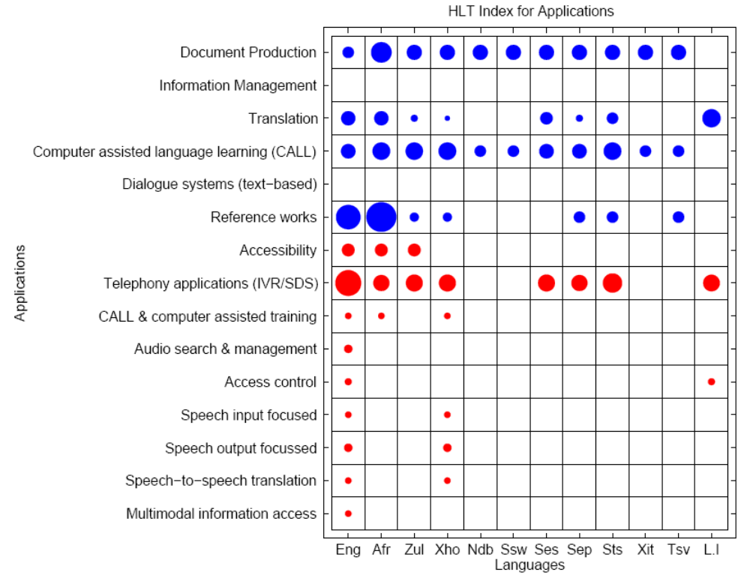
HLT Component Indexes
Results
Notes:
The HLT Component Index provides an alternative perspective on the quantity of activity taking place within each of the data, modules, and applications on a HLT component grouping level (e.g. pronunciation resources) and is calculated as follows:
HLT Component Index = Maturity Index (per item grouping) +
Accessibility Index (per item grouping) (5)
The HLT Component Indexes for all languages are plotted in a grid using a bubble plot (figures 3, 4 and 5). The value of the HLT Component Index for a particular component grouping determines the size of the bubble i.e. the higher the index the larger the bubble. However, it is important to note that the size of the bubbles plotted within a plot is proportional to the highest value of the HLT Component Index within the entire plot. Thus, this index provides a relative comparison of the HLT activity within the various groupings of data, modules or applications within a single plot, as opposed to an absolute comparison of languages.
Figure 3 depicts the plot for the HLT Component Indexes for data, where aligned multilingual text corpora have the highest HLT component index score (which implies the greatest quantity of mature and accessible activities), followed by ‘lexica’ and so forth. In general it can be seen that speech data resources (in red) have less activity compared to text resources (in blue). The figure also reveals that although there may be activity in many of the data sub-categories (e.g. ‘semantic networks and formalised grammars’), it is very small (implying less maturity and accessibility) or does not exist across all the languages.
The Maturity Index and Accessibility Index used here are calculated for each grouping of HLT components within data, modules and applications, for example, lexica, corpora, morphological analysis, translation, etc.
The HLT Component Index also allows HLT practitioners to ascertain areas where further work is required across the different languages. Figure 4 represents the plot of the HLT Component Indexes for modules. For example, from this figure, a funding agency could deduce that money should rather be invested in, for example, syntactic analysis, than in grapheme-to-phoneme conversion; or that special attention should be given to morphological analysis of Sesotho, Xitsonga and Tshivenda. It should be noted that the relative size of a bubble does not necessarily indicate that technologies in that component grouping or for that language is mature in itself (in comparison to maturity of HLT in the developed world) – it is rather an indication of the status of HLT activity within the South African languages relative to each other (and also not relative to other world languages).
Figure 4 reveals that the largest amount of activity is in the field of ‘morphological analysis’ in Afrikaans, as well as in text-based and speech-based tools which are language-independent. In general there is some medium-scale activity in the basic HLT modules for both the text (in blue) and speech (in red) domains, such as grapheme-to-phoneme converters, text processing, morphological analysis, speech recognition, and text-to-speech respectively, whilst the more advanced HLT modules are mostly non-existent or are barely available for a few languages or with very little activity.
Figure 5 illustrates the HLT Component Indexes for text (in blue) and speech (in red) applications. The greatest quantity of activity (more mature and accessible) is in the reference works (text) for Afrikaans and English, as well as in telephony-based services in English. There is some medium-scale activity in the document production, translation, CALL, and accessibility areas for the text and speech domains respectively. A number of speech-based applications have very few activities in English, Afrikaans and IsiXhosa, since these applications are in their early development phases.
Secondly, we also conducted an activity summary analysis that provides an alternative perspective of the quantity of activity taking place within each of the data, modules, and applications categories on a topical/area level; this allows HLT practitioners to ascertain areas where further work is required across the different languages. Figure 2 represents the results of the activity summary analysis for modules. In interpreting Figure 2, it is important to note that the size of the bubbles plotted is proportional to the highest value of the final HLT index within the entire modules category .
Thus, the activity summary analysis provides a relative comparison of the HLT activity within the various kinds of modules, as opposed to an absolute comparison of languages. For example, from Figure 2 a funding agency could deduce that money should rather be invested in, for example, syntactic analysis, than in grapheme-to-phoneme conversion; or that special attention should be given to morphological analysis of Sesotho, Xitsonga and Tshivenda. It should be noted that the relative size of a bubble does not necessarily indicate that technologies in that section or for that language is mature – it is merely an indication of technologies and languages relative to each other (and also not relative to other world languages).
Figure 5.30 depicts the summary of HLT activity for ‘Data’, which is based on the ‘Final HLT Index’ scores derived for item groupings of sub-categories within the Data category (in Appendix D). The HLT activity summary approach provides an alternative perspective of the quantity and quality of the activity taking place within the ‘Data’ category on a topical/area level, thus allowing HLT practitioners to ascertain areas where further work is required across the different languages. In the interpretation of this figure, it is important to note that the size of the bubbles plotted is proportional to the highest value of the final HLT index within the entire data category. Thus, the activity summary analysis provides a relative comparison of the HLT activity within the Data category in the different languages as opposed to an absolute comparison. Hence, for example, whilst Afrikaans when compared to other South African languages has the greatest amount of HLT activity (highest final HLT index score) but in comparison to the average HLT activity of other world languages Afrikaans is still in the infancy of its HLT development.
As can be observed from figure 5.30, within the data category ‘multilingual text corpora: aligned’ have the highest final HLT index score (which implies the greatest quantity of mature and accessible activities), followed by lexica and so forth. In general it can be seen that speech data resources (in red) are have less activity as compared to text resources (in blue). The figure also reveals that though there maybe activity in many of the data category’s sub-categories (e.g. ‘semantic networks and formalised grammars’), however it may be very small (implying less maturity and accessibility) or does not exist for all of the languages.
A similar activity summary analysis was performed for the HLT modules and is shown in figure 5.31. This reveals that the largest amount of activity is in the field (item grouping) of ‘morphological analysis’ in Afrikaans as well as in text-based tools and speech-based tools which are language independent. In general there is some medium scale activities in the basic HLT modules for both the text (in blue) and speech (in red) domains; for example; grapheme to phoneme converters, text processing, morphological analysis and basic speech recognition, text to speech respectively. Whilst the more advanced HLT modules are mostly non-existent or are barely available for a few languages or with very small activity.
Figure 5.32 illustrates the activity summary analysis for text (in blue) and speech (in red) HLT applications. The greatest quantity of activity (more mature and accessible) is in the reference works (text) for Afrikaans and English as well as in telephony-based services in English. There is some medium scale activity in the document production, translation, CALL areas and accessibility for the text and speech domains respectively. A number of speech based applications have very few activities in English, Afrikaans and IsiXhosa, since these applications are in their early development phases
In conclusion, the ‘maturity index’, ‘accessibility index’, ‘final HLT index’ and the ‘comparative HLT activity’ analysis present complementary perspectives to the HLT role-players and stakeholders for evaluating the status of the South African official languages. It was found that Afrikaans leads the HLT development, followed by English (South African), thereafter with isiZulu, isiXhosa, Sepedi, Setswana, Sesotho with almost similar development and finally Tshivenda, Siswati, isiNdebele and Xitsonga which have the least HLT development. Nonetheless, it is crucial to note that whilst Afrikaans and English may be leading in comparison to average HLT development of other world languages their activity is still in the very basic stages with barely any work in the advanced HLT areas (this is confirmed by the results in tables 5.30, 5.31 and 5.32).
Similar to the above results and representations, we have also developed a maturity index, an accessibility index, a detailed HLT inventory analysis (per sub-category within data, modules, applications), and a gap analysis on the current state versus the preliminary priorities (see Sharma (2009) for comprehensive details).
Based on these, our over-all impression of the South African HLT landscape is that very few basic LRs and applications exist across all eleven languages; it is especially the four smallest languages that lag far behind in terms of HLT development. It is also clear that there are a great many areas that lie fallow in terms of the variety, number and maturity of items, especially compared to other world languages.

Slide 50
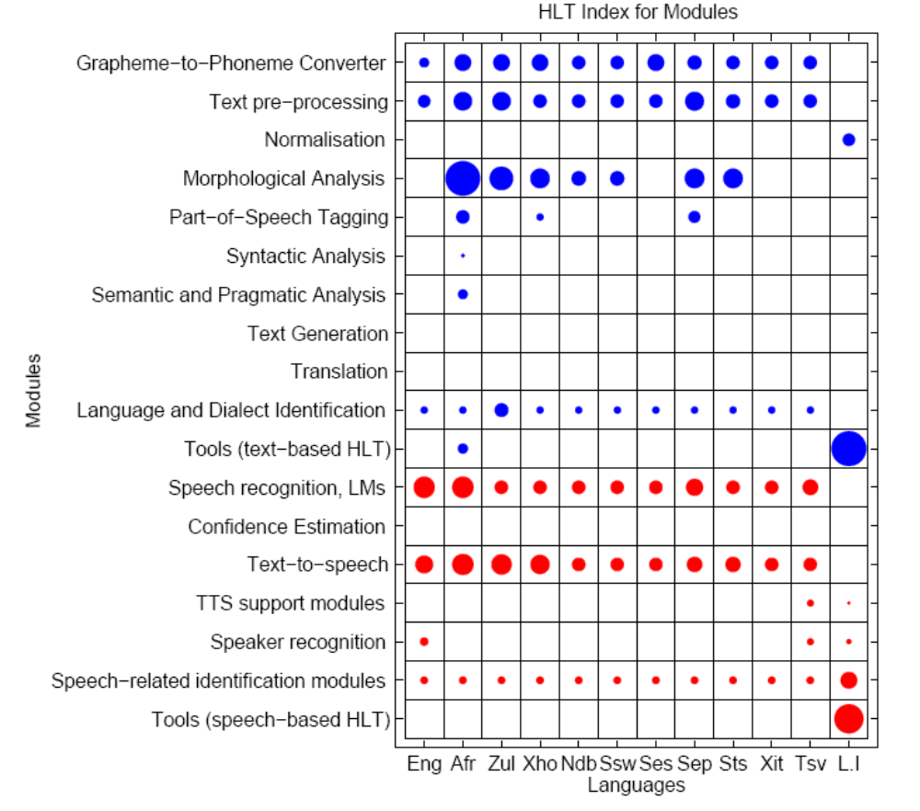
HLT Component Indexes: Modules
Results
Notes:
The HLT Component Index provides an alternative perspective on the quantity of activity taking place within each of the data, modules, and applications on a HLT component grouping level (e.g. pronunciation resources) and is calculated as follows:
HLT Component Index = Maturity Index (per item grouping) +
Accessibility Index (per item grouping) (5)
The HLT Component Indexes for all languages are plotted in a grid using a bubble plot (figures 3, 4 and 5). The value of the HLT Component Index for a particular component grouping determines the size of the bubble i.e. the higher the index the larger the bubble. However, it is important to note that the size of the bubbles plotted within a plot is proportional to the highest value of the HLT Component Index within the entire plot. Thus, this index provides a relative comparison of the HLT activity within the various groupings of data, modules or applications within a single plot, as opposed to an absolute comparison of languages.
Figure 3 depicts the plot for the HLT Component Indexes for data, where aligned multilingual text corpora have the highest HLT component index score (which implies the greatest quantity of mature and accessible activities), followed by ‘lexica’ and so forth. In general it can be seen that speech data resources (in red) have less activity compared to text resources (in blue). The figure also reveals that although there may be activity in many of the data sub-categories (e.g. ‘semantic networks and formalised grammars’), it is very small (implying less maturity and accessibility) or does not exist across all the languages.
The Maturity Index and Accessibility Index used here are calculated for each grouping of HLT components within data, modules and applications, for example, lexica, corpora, morphological analysis, translation, etc.
The HLT Component Index also allows HLT practitioners to ascertain areas where further work is required across the different languages. Figure 4 represents the plot of the HLT Component Indexes for modules. For example, from this figure, a funding agency could deduce that money should rather be invested in, for example, syntactic analysis, than in grapheme-to-phoneme conversion; or that special attention should be given to morphological analysis of Sesotho, Xitsonga and Tshivenda. It should be noted that the relative size of a bubble does not necessarily indicate that technologies in that component grouping or for that language is mature in itself (in comparison to maturity of HLT in the developed world) – it is rather an indication of the status of HLT activity within the South African languages relative to each other (and also not relative to other world languages).
Figure 4 reveals that the largest amount of activity is in the field of ‘morphological analysis’ in Afrikaans, as well as in text-based and speech-based tools which are language-independent. In general there is some medium-scale activity in the basic HLT modules for both the text (in blue) and speech (in red) domains, such as grapheme-to-phoneme converters, text processing, morphological analysis, speech recognition, and text-to-speech respectively, whilst the more advanced HLT modules are mostly non-existent or are barely available for a few languages or with very little activity.
Figure 5 illustrates the HLT Component Indexes for text (in blue) and speech (in red) applications. The greatest quantity of activity (more mature and accessible) is in the reference works (text) for Afrikaans and English, as well as in telephony-based services in English. There is some medium-scale activity in the document production, translation, CALL, and accessibility areas for the text and speech domains respectively. A number of speech-based applications have very few activities in English, Afrikaans and IsiXhosa, since these applications are in their early development phases.
Secondly, we also conducted an activity summary analysis that provides an alternative perspective of the quantity of activity taking place within each of the data, modules, and applications categories on a topical/area level; this allows HLT practitioners to ascertain areas where further work is required across the different languages. Figure 2 represents the results of the activity summary analysis for modules. In interpreting Figure 2, it is important to note that the size of the bubbles plotted is proportional to the highest value of the final HLT index within the entire modules category .
Thus, the activity summary analysis provides a relative comparison of the HLT activity within the various kinds of modules, as opposed to an absolute comparison of languages. For example, from Figure 2 a funding agency could deduce that money should rather be invested in, for example, syntactic analysis, than in grapheme-to-phoneme conversion; or that special attention should be given to morphological analysis of Sesotho, Xitsonga and Tshivenda. It should be noted that the relative size of a bubble does not necessarily indicate that technologies in that section or for that language is mature – it is merely an indication of technologies and languages relative to each other (and also not relative to other world languages).
Figure 5.30 depicts the summary of HLT activity for ‘Data’, which is based on the ‘Final HLT Index’ scores derived for item groupings of sub-categories within the Data category (in Appendix D). The HLT activity summary approach provides an alternative perspective of the quantity and quality of the activity taking place within the ‘Data’ category on a topical/area level, thus allowing HLT practitioners to ascertain areas where further work is required across the different languages. In the interpretation of this figure, it is important to note that the size of the bubbles plotted is proportional to the highest value of the final HLT index within the entire data category. Thus, the activity summary analysis provides a relative comparison of the HLT activity within the Data category in the different languages as opposed to an absolute comparison. Hence, for example, whilst Afrikaans when compared to other South African languages has the greatest amount of HLT activity (highest final HLT index score) but in comparison to the average HLT activity of other world languages Afrikaans is still in the infancy of its HLT development.
As can be observed from figure 5.30, within the data category ‘multilingual text corpora: aligned’ have the highest final HLT index score (which implies the greatest quantity of mature and accessible activities), followed by lexica and so forth. In general it can be seen that speech data resources (in red) are have less activity as compared to text resources (in blue). The figure also reveals that though there maybe activity in many of the data category’s sub-categories (e.g. ‘semantic networks and formalised grammars’), however it may be very small (implying less maturity and accessibility) or does not exist for all of the languages.
A similar activity summary analysis was performed for the HLT modules and is shown in figure 5.31. This reveals that the largest amount of activity is in the field (item grouping) of ‘morphological analysis’ in Afrikaans as well as in text-based tools and speech-based tools which are language independent. In general there is some medium scale activities in the basic HLT modules for both the text (in blue) and speech (in red) domains; for example; grapheme to phoneme converters, text processing, morphological analysis and basic speech recognition, text to speech respectively. Whilst the more advanced HLT modules are mostly non-existent or are barely available for a few languages or with very small activity.
Figure 5.32 illustrates the activity summary analysis for text (in blue) and speech (in red) HLT applications. The greatest quantity of activity (more mature and accessible) is in the reference works (text) for Afrikaans and English as well as in telephony-based services in English. There is some medium scale activity in the document production, translation, CALL areas and accessibility for the text and speech domains respectively. A number of speech based applications have very few activities in English, Afrikaans and IsiXhosa, since these applications are in their early development phases
In conclusion, the ‘maturity index’, ‘accessibility index’, ‘final HLT index’ and the ‘comparative HLT activity’ analysis present complementary perspectives to the HLT role-players and stakeholders for evaluating the status of the South African official languages. It was found that Afrikaans leads the HLT development, followed by English (South African), thereafter with isiZulu, isiXhosa, Sepedi, Setswana, Sesotho with almost similar development and finally Tshivenda, Siswati, isiNdebele and Xitsonga which have the least HLT development. Nonetheless, it is crucial to note that whilst Afrikaans and English may be leading in comparison to average HLT development of other world languages their activity is still in the very basic stages with barely any work in the advanced HLT areas (this is confirmed by the results in tables 5.30, 5.31 and 5.32).
Similar to the above results and representations, we have also developed a maturity index, an accessibility index, a detailed HLT inventory analysis (per sub-category within data, modules, applications), and a gap analysis on the current state versus the preliminary priorities (see Sharma (2009) for comprehensive details).
Based on these, our over-all impression of the South African HLT landscape is that very few basic LRs and applications exist across all eleven languages; it is especially the four smallest languages that lag far behind in terms of HLT development. It is also clear that there are a great many areas that lie fallow in terms of the variety, number and maturity of items, especially compared to other world languages.

Slide 51
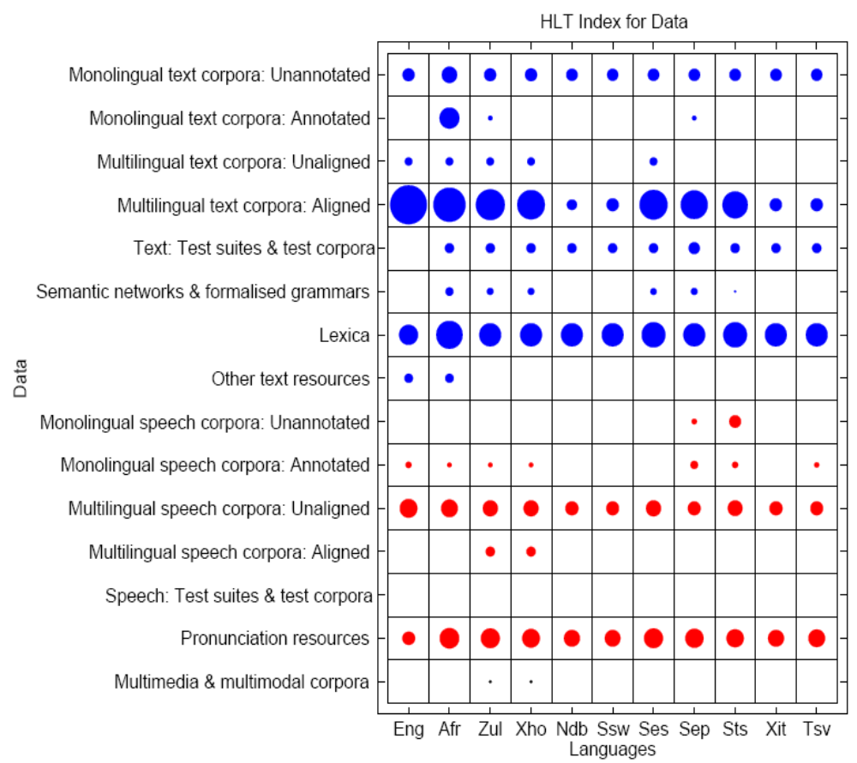
HLT Component Indexes
Results
Notes:
The HLT Component Index provides an alternative perspective on the quantity of activity taking place within each of the data, modules, and applications on a HLT component grouping level (e.g. pronunciation resources) and is calculated as follows:
HLT Component Index = Maturity Index (per item grouping) +
Accessibility Index (per item grouping) (5)
The HLT Component Indexes for all languages are plotted in a grid using a bubble plot (figures 3, 4 and 5). The value of the HLT Component Index for a particular component grouping determines the size of the bubble i.e. the higher the index the larger the bubble. However, it is important to note that the size of the bubbles plotted within a plot is proportional to the highest value of the HLT Component Index within the entire plot. Thus, this index provides a relative comparison of the HLT activity within the various groupings of data, modules or applications within a single plot, as opposed to an absolute comparison of languages.
Figure 3 depicts the plot for the HLT Component Indexes for data, where aligned multilingual text corpora have the highest HLT component index score (which implies the greatest quantity of mature and accessible activities), followed by ‘lexica’ and so forth. In general it can be seen that speech data resources (in red) have less activity compared to text resources (in blue). The figure also reveals that although there may be activity in many of the data sub-categories (e.g. ‘semantic networks and formalised grammars’), it is very small (implying less maturity and accessibility) or does not exist across all the languages.
The Maturity Index and Accessibility Index used here are calculated for each grouping of HLT components within data, modules and applications, for example, lexica, corpora, morphological analysis, translation, etc.
The HLT Component Index also allows HLT practitioners to ascertain areas where further work is required across the different languages. Figure 4 represents the plot of the HLT Component Indexes for modules. For example, from this figure, a funding agency could deduce that money should rather be invested in, for example, syntactic analysis, than in grapheme-to-phoneme conversion; or that special attention should be given to morphological analysis of Sesotho, Xitsonga and Tshivenda. It should be noted that the relative size of a bubble does not necessarily indicate that technologies in that component grouping or for that language is mature in itself (in comparison to maturity of HLT in the developed world) – it is rather an indication of the status of HLT activity within the South African languages relative to each other (and also not relative to other world languages).
Figure 4 reveals that the largest amount of activity is in the field of ‘morphological analysis’ in Afrikaans, as well as in text-based and speech-based tools which are language-independent. In general there is some medium-scale activity in the basic HLT modules for both the text (in blue) and speech (in red) domains, such as grapheme-to-phoneme converters, text processing, morphological analysis, speech recognition, and text-to-speech respectively, whilst the more advanced HLT modules are mostly non-existent or are barely available for a few languages or with very little activity.
Figure 5 illustrates the HLT Component Indexes for text (in blue) and speech (in red) applications. The greatest quantity of activity (more mature and accessible) is in the reference works (text) for Afrikaans and English, as well as in telephony-based services in English. There is some medium-scale activity in the document production, translation, CALL, and accessibility areas for the text and speech domains respectively. A number of speech-based applications have very few activities in English, Afrikaans and IsiXhosa, since these applications are in their early development phases.
Secondly, we also conducted an activity summary analysis that provides an alternative perspective of the quantity of activity taking place within each of the data, modules, and applications categories on a topical/area level; this allows HLT practitioners to ascertain areas where further work is required across the different languages. Figure 2 represents the results of the activity summary analysis for modules. In interpreting Figure 2, it is important to note that the size of the bubbles plotted is proportional to the highest value of the final HLT index within the entire modules category .
Thus, the activity summary analysis provides a relative comparison of the HLT activity within the various kinds of modules, as opposed to an absolute comparison of languages. For example, from Figure 2 a funding agency could deduce that money should rather be invested in, for example, syntactic analysis, than in grapheme-to-phoneme conversion; or that special attention should be given to morphological analysis of Sesotho, Xitsonga and Tshivenda. It should be noted that the relative size of a bubble does not necessarily indicate that technologies in that section or for that language is mature – it is merely an indication of technologies and languages relative to each other (and also not relative to other world languages).
Figure 5.30 depicts the summary of HLT activity for ‘Data’, which is based on the ‘Final HLT Index’ scores derived for item groupings of sub-categories within the Data category (in Appendix D). The HLT activity summary approach provides an alternative perspective of the quantity and quality of the activity taking place within the ‘Data’ category on a topical/area level, thus allowing HLT practitioners to ascertain areas where further work is required across the different languages. In the interpretation of this figure, it is important to note that the size of the bubbles plotted is proportional to the highest value of the final HLT index within the entire data category. Thus, the activity summary analysis provides a relative comparison of the HLT activity within the Data category in the different languages as opposed to an absolute comparison. Hence, for example, whilst Afrikaans when compared to other South African languages has the greatest amount of HLT activity (highest final HLT index score) but in comparison to the average HLT activity of other world languages Afrikaans is still in the infancy of its HLT development.
As can be observed from figure 5.30, within the data category ‘multilingual text corpora: aligned’ have the highest final HLT index score (which implies the greatest quantity of mature and accessible activities), followed by lexica and so forth. In general it can be seen that speech data resources (in red) are have less activity as compared to text resources (in blue). The figure also reveals that though there maybe activity in many of the data category’s sub-categories (e.g. ‘semantic networks and formalised grammars’), however it may be very small (implying less maturity and accessibility) or does not exist for all of the languages.
A similar activity summary analysis was performed for the HLT modules and is shown in figure 5.31. This reveals that the largest amount of activity is in the field (item grouping) of ‘morphological analysis’ in Afrikaans as well as in text-based tools and speech-based tools which are language independent. In general there is some medium scale activities in the basic HLT modules for both the text (in blue) and speech (in red) domains; for example; grapheme to phoneme converters, text processing, morphological analysis and basic speech recognition, text to speech respectively. Whilst the more advanced HLT modules are mostly non-existent or are barely available for a few languages or with very small activity.
Figure 5.32 illustrates the activity summary analysis for text (in blue) and speech (in red) HLT applications. The greatest quantity of activity (more mature and accessible) is in the reference works (text) for Afrikaans and English as well as in telephony-based services in English. There is some medium scale activity in the document production, translation, CALL areas and accessibility for the text and speech domains respectively. A number of speech based applications have very few activities in English, Afrikaans and IsiXhosa, since these applications are in their early development phases
In conclusion, the ‘maturity index’, ‘accessibility index’, ‘final HLT index’ and the ‘comparative HLT activity’ analysis present complementary perspectives to the HLT role-players and stakeholders for evaluating the status of the South African official languages. It was found that Afrikaans leads the HLT development, followed by English (South African), thereafter with isiZulu, isiXhosa, Sepedi, Setswana, Sesotho with almost similar development and finally Tshivenda, Siswati, isiNdebele and Xitsonga which have the least HLT development. Nonetheless, it is crucial to note that whilst Afrikaans and English may be leading in comparison to average HLT development of other world languages their activity is still in the very basic stages with barely any work in the advanced HLT areas (this is confirmed by the results in tables 5.30, 5.31 and 5.32).
Similar to the above results and representations, we have also developed a maturity index, an accessibility index, a detailed HLT inventory analysis (per sub-category within data, modules, applications), and a gap analysis on the current state versus the preliminary priorities (see Sharma (2009) for comprehensive details).
Based on these, our over-all impression of the South African HLT landscape is that very few basic LRs and applications exist across all eleven languages; it is especially the four smallest languages that lag far behind in terms of HLT development. It is also clear that there are a great many areas that lie fallow in terms of the variety, number and maturity of items, especially compared to other world languages.

Slide 52
⑤ Questionnaire
Process
Outcomes:
  Various indexes
  Gap analysis
Notes:
The final inventory criteria framework described above the basis for the HLT audit questionnaire which gathered data on all 11 official languages of SA. Prior to roll-out the questionnaire was piloted with a few HLT experts, an exercise that helped to identify fields which could potentially be easily misinterpreted. To further aid participants (and stimulate response rate) example entries which illustrated how to record information for a HLT component, were provided for each category (data, modules, applications).
The South African HLT audit questionnaire was circulated in an electronic format amongst the identified major HLT players in the country. Organisations approached were classified as primary and secondary participants, in terms of their core HLT related activities. We contacted 15 primary organisations (universities, science councils, companies) and 12 secondary (national lexicography units, government departments) and received responses from 12 and 4 of these respectively.
The audit questionnaire was sent to all major HLT role-players in the country. Organisations approached were classified as primary or secondary participants, based on their historical core HLT competence in R&D (see Table 1). Participants were sent a list of the HLT components identified at their institution (as identified in the high-level inventory), and were requested to fill out all sections, and indicate its details for all eleven languages. All primary participants were paid a minimal honorarium to compensate for the considerable effort that was required from them.

Slide 53
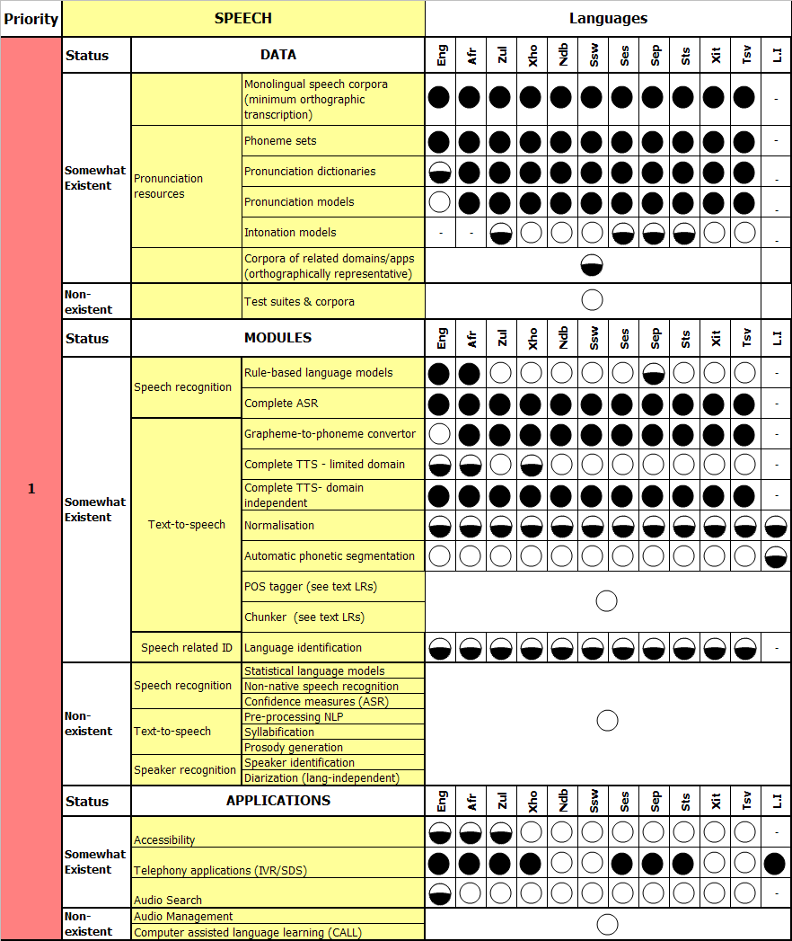
Gap Analysis
(speech)
Results
: Item exists, is accessible,
  released & of fairly
  adequate quality
: Item may exist but
available for restricted
use or not released/
limited quality
: Items do not exist
‘–’: Category not
applicable to
the language
Notes:
gap analysis reveals that although all of the data resources identified as priority 1 are somewhat existent, many of them have restricted use due to insufficient maturity or accessibility (level B) and are not always available for all languages. In terms of the majority of the core modules (in priority 1) although somewhat existent are only available for one or a few languages and in most cases are of level B or the category and approximately a third of the priority 1 modules are completely non-existent.
For the text applications, proofing/authoring tools seem to be adequately addressed, translation related applications are still in the early exploratory stages and information management related applications (retrieval and extraction) are non-existent.
Figure 5.34 depicts the gap analysis for priority 2 and 3 data, modules and applications. The general trend found in priority 1 LRs is further magnified in the priority 2 and 3 scenarios where most items are non-existent and if somewhat existent they are of a very basic nature (level B). These findings highlight that the majority of the activities in text-based HLT in South Africa are currently focussed on building basic and core LRs and applications (priority 1) and not so much advanced LRs and applications (priority 2 and 3).
A similar gap analysis was performed for speech-based HLT components across all 11 languages and is illustrated in figure 5.35 for priority 1 HLT speech components. In slight contrast to the text domain, majority of priority 1 data resources and speech modules; such as pronunciation dictionaries, speech recognition and text-to-speech (TTS) technologies; exist, though mostly in a very basic state. This is as a result of a large, government sponsored three-year project in this domain which has recently made these basic speech domain modules and data available. However, a significant number of core data and modules – such as the more advanced speech recognition and TTS related modules – are still non-existent across the 11 languages. Telephony-based services (IVR/SDS) is the only priority 1 speech application that has some significant activity (though not equally so in all languages), other applications such as accessibility and audio search are in their very early stages, whilst priority 1 applications like audio management and computer assisted language learning (CALL) are non-existent.
In terms of priority 2 and 3 LRs and applications a similar scenario as with text-based HLT is observed; many items are non-existent and where an HLT item does exist, it is only in a few languages or in early stages of its development. In terms of the speech domain, it should be noted that some core (priority 1) data and modules (e.g. basic speech recognition, text-to-speech and speech corpora) have only recently come into existence, thus the activities under this domain are still very much in their formative years.
Across both speech and text-based HLT the per-language gap analysis of the HLT inventory reveals that:
Many of the core data and modules (priority 1 LRs) required are non-existent and if existent are of a very basic nature (in terms of maturity, accessibility and quality).
Many African languages lag far behind although some of the more popular African languages such as IsiZulu, IsiXhosa, Setswana, Sesotho and Sepedi have more advancement in terms of HLT development.

Slide 54
⑤ Questionnaire
Process
Outcomes:
  Various indexes
  Gap analysis
  Detailed inventory
    SAHLTA online database of LRs and applications (alpha)
    www.meraka.org.za/nhnaudit
Notes:
The final inventory criteria framework described above the basis for the HLT audit questionnaire which gathered data on all 11 official languages of SA. Prior to roll-out the questionnaire was piloted with a few HLT experts, an exercise that helped to identify fields which could potentially be easily misinterpreted. To further aid participants (and stimulate response rate) example entries which illustrated how to record information for a HLT component, were provided for each category (data, modules, applications).
The South African HLT audit questionnaire was circulated in an electronic format amongst the identified major HLT players in the country. Organisations approached were classified as primary and secondary participants, in terms of their core HLT related activities. We contacted 15 primary organisations (universities, science councils, companies) and 12 secondary (national lexicography units, government departments) and received responses from 12 and 4 of these respectively.
The audit questionnaire was sent to all major HLT role-players in the country. Organisations approached were classified as primary or secondary participants, based on their historical core HLT competence in R&D (see Table 1). Participants were sent a list of the HLT components identified at their institution (as identified in the high-level inventory), and were requested to fill out all sections, and indicate its details for all eleven languages. All primary participants were paid a minimal honorarium to compensate for the considerable effort that was required from them.

Slide 55
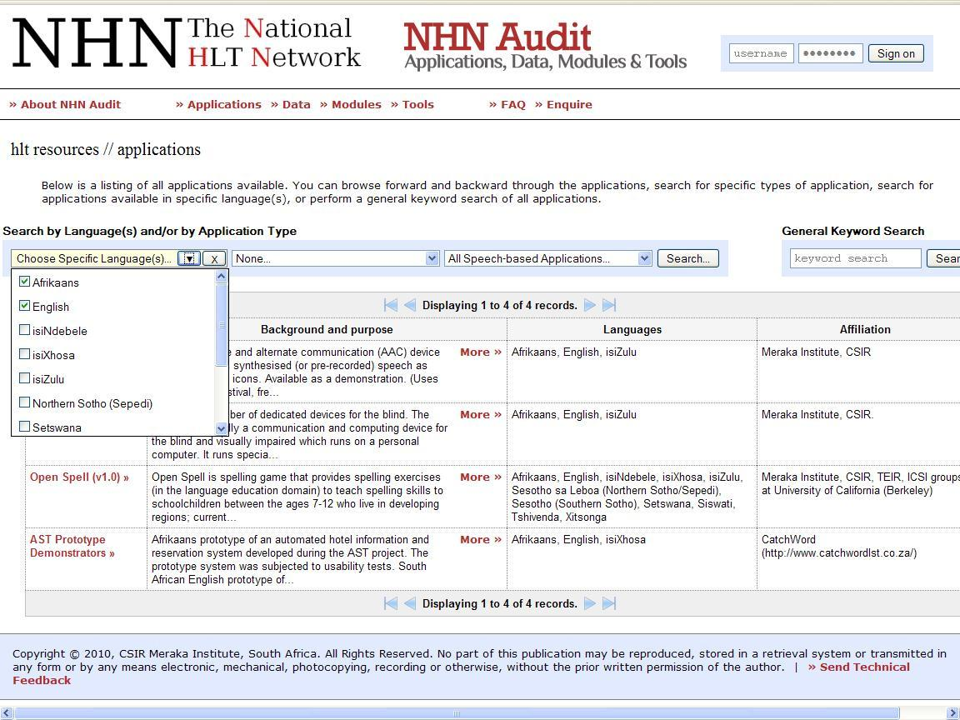
SAHLTA Outcomes
Results
Notes:
Recommendations
South African HLT role-players and stakeholders are faced with the challenging task of balancing the need to address all official languages, for socio-economic and political reasons, with the need to create an economically viable and thriving HLT industry, where there is return on investment on the HLT outputs produced for a certain language. Based on the research study findings and experiences, a number of recommendations can be made for accelerating HLT development in SA as detailed on the following pages. These have been classified as pertaining to the South African HLT landscape and the HLT audit process
Resource development – based on the HLT audit findings, it is easily discernible that basic core language resources need to be built for all languages as identified by the gap analysis. It was also observed in the results that licensing agreements were often not defined for a number of the language resources identified (often for government funded projects). Thus, although some of these LRs maybe declared as accessible (commercial and R&E) the ambiguity around the licensing leads to delays and obstacles in using that particular LR. Thus, in order to encourage innovation, LRs should preferably be made freely available or where subject to any intellectual property rights for commercial use, LRs should be available at a price which does not prohibit their purchase. In this regard we can take heed from lessons learnt by other international LR agencies such the Dutch Language Union’s LR agency, and the European Language Resources Agency (ELRA) to name a few, since South Africa is currently moving towards establishing its own national HLT resource agency. It is important to note the whilst building basic LRs should be prioritised, the South African HLT community needs to start building experience in developing more advanced LRs (priority 2 and 3) for future fast-tracking of HLT applications. In addition, market needs and trends should be a prime consideration in the development of LRs.
Funding – the principal sponsor of HLT development in the country thus far has been the government. In contrast, the South African HLT industry really only comprises of a handful of companies which only focus on a few languages since the initial investment required does not cover the potential income from the projected market needs for most languages. Thus, first and foremost in these formative years the government needs to continue to invest in HLT efforts to build a strong foundation of HLT outputs which can enable the creation of thriving HLT industry in South Africa and ensure that HLT in all 11 languages continues to progress.
Industry stimulation programmes – besides funding, the government needs to ensure that there are more initiatives to encourage existing industry’s participation in the national HLT activity and mobilise the creation of new HLT-based companies. To this end it has been noted that there is little awareness in the South African commercial sector about the opportunities and positive impact that HLT can have in the business environment e.g. the financial sector, the ICT sector, etc. Initiatives could take the form of consortiums comprising of existing R&D HLT players (who source the technology) with companies from business sectors such as banks and mobile network providers (who have an existing customer base and a greater understanding of market needs) to simple contract R&D partnerships between academia and industry. In addition, industry participation in lesser resourced languages may need to be motivated proactively by the government.
It has also been observed that currently the government departments that primarily fund HLT development in the country are the Department of Arts & Culture and the Department of Science & Technology. Synergy between the HLT community, the DAC, the DST and other government departments such as the Department of Trade & Industry and the Department of Communications should be cultivated to bring about a concerted effort in taking HLT forth in the South African economy.
Collaborations – closely related to the above-mentioned stimulation programmes is the need for greater collaborations within the local HLT community and the larger international community. One of the challenges that lie ahead is to harness the knowledge and skills developed in the pockets of excellent South African HLT activity into a collaborative South African endeavour. Thus, a more coordinated effort across the HLT community is required in order to ensure that there is a well-mapped trajectory for LR creation and HLT market development in South Africa. Here it may also be beneficial to take lessons from other international efforts such as the EUROMAP study (section 2.5.2) and the Dutch Language Union’s STEVIN programme (section 1.2).
Human capital development (HCD) – the shortage of linguistic expertise and general scientific human capital is a prohibitive factor in the progress of HLT, thus HCD efforts within the field of HLT should be accelerated. To the author’s knowledge there is only one undergraduate HLT degree programme of its kind targeted to tertiary students and, most other training courses are at the postgraduate level. The general sentiment amongst HLT academia is that more awareness needs to be created, about the field, in undergraduate and secondary school students and greater investment needs to be made in generating HLT practitioners who can feed into the emergent HLT industry’s pipeline.
Also, to close the gap in the fund of limited linguistic knowledge in the lesser resourced African languages the government could encourage academia with incentives to promote HCD in those languages. However, we should note that the development of the leading South African languages such as Afrikaans, English, isiZulu, etc has generated numerous ‘lessons learnt’ from which the development of the lesser resourced languages has benefitted and thus the former group’s development should also not be sidetracked. A final noteworthy point is that collaboration across departments (e.g. linguistics, engineering, mathematics) should be encouraged since HLT involves crossing silos of academic disciplines.
Cultivation of niche expertise – it was observed from the audit results that a number of language independent methods have been adopted in creating HLT components for SA. This approach (depending on the HLT LR in question) has the potential to fast track the development of HLT across SA’s languages and already a number of achievements have been made in producing HLT items in South African languages with limited language resources. The local HLT community should continue to enhance this capability of producing portable language independent HLT, to create a niche expertise area for itself in producing HLT for under-resourced languages. This capability could result in technology transfer to other countries with under-resourced languages e.g. other African languages and the smaller European languages. Thus, due credit should be given to the South African HLT R&D community for facing the challenge of HLT development in 11 languages, where most other countries where HLT activity is flourishing are generally based on one or a few languages.

Slide 56
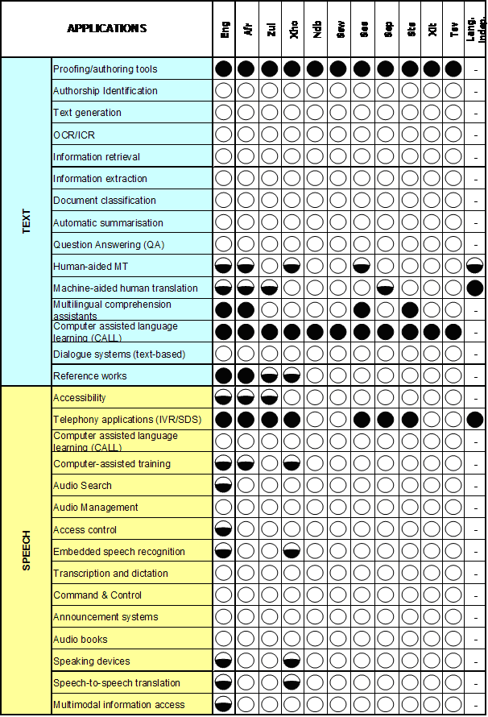

HLT Detailed
Inventory
Results
: Item exists, is accessible,
released & of fairly
  adequate quality
: Item may exist but
available for restricted use
not released/limited quality
: Items do not exist
‘–’: Category is not
applicable to the language

Slide 57
Lessons to learn
Conclusion
Optimise data collection
  Questionnaire should be simple
  Portable, online format
    Not a complex xls like ours
  Guided (hand-held) fill-out with fieldworkers might be better, but expensive
  Pay the respondents (?)
Notes:
Recommendations
South African HLT role-players and stakeholders are faced with the challenging task of balancing the need to address all official languages, for socio-economic and political reasons, with the need to create an economically viable and thriving HLT industry, where there is return on investment on the HLT outputs produced for a certain language. Based on the research study findings and experiences, a number of recommendations can be made for accelerating HLT development in SA as detailed on the following pages. These have been classified as pertaining to the South African HLT landscape and the HLT audit process
Resource development – based on the HLT audit findings, it is easily discernible that basic core language resources need to be built for all languages as identified by the gap analysis. It was also observed in the results that licensing agreements were often not defined for a number of the language resources identified (often for government funded projects). Thus, although some of these LRs maybe declared as accessible (commercial and R&E) the ambiguity around the licensing leads to delays and obstacles in using that particular LR. Thus, in order to encourage innovation, LRs should preferably be made freely available or where subject to any intellectual property rights for commercial use, LRs should be available at a price which does not prohibit their purchase. In this regard we can take heed from lessons learnt by other international LR agencies such the Dutch Language Union’s LR agency, and the European Language Resources Agency (ELRA) to name a few, since South Africa is currently moving towards establishing its own national HLT resource agency. It is important to note the whilst building basic LRs should be prioritised, the South African HLT community needs to start building experience in developing more advanced LRs (priority 2 and 3) for future fast-tracking of HLT applications. In addition, market needs and trends should be a prime consideration in the development of LRs.
Funding – the principal sponsor of HLT development in the country thus far has been the government. In contrast, the South African HLT industry really only comprises of a handful of companies which only focus on a few languages since the initial investment required does not cover the potential income from the projected market needs for most languages. Thus, first and foremost in these formative years the government needs to continue to invest in HLT efforts to build a strong foundation of HLT outputs which can enable the creation of thriving HLT industry in South Africa and ensure that HLT in all 11 languages continues to progress.
Industry stimulation programmes – besides funding, the government needs to ensure that there are more initiatives to encourage existing industry’s participation in the national HLT activity and mobilise the creation of new HLT-based companies. To this end it has been noted that there is little awareness in the South African commercial sector about the opportunities and positive impact that HLT can have in the business environment e.g. the financial sector, the ICT sector, etc. Initiatives could take the form of consortiums comprising of existing R&D HLT players (who source the technology) with companies from business sectors such as banks and mobile network providers (who have an existing customer base and a greater understanding of market needs) to simple contract R&D partnerships between academia and industry. In addition, industry participation in lesser resourced languages may need to be motivated proactively by the government.
It has also been observed that currently the government departments that primarily fund HLT development in the country are the Department of Arts & Culture and the Department of Science & Technology. Synergy between the HLT community, the DAC, the DST and other government departments such as the Department of Trade & Industry and the Department of Communications should be cultivated to bring about a concerted effort in taking HLT forth in the South African economy.
Collaborations – closely related to the above-mentioned stimulation programmes is the need for greater collaborations within the local HLT community and the larger international community. One of the challenges that lie ahead is to harness the knowledge and skills developed in the pockets of excellent South African HLT activity into a collaborative South African endeavour. Thus, a more coordinated effort across the HLT community is required in order to ensure that there is a well-mapped trajectory for LR creation and HLT market development in South Africa. Here it may also be beneficial to take lessons from other international efforts such as the EUROMAP study (section 2.5.2) and the Dutch Language Union’s STEVIN programme (section 1.2).
Human capital development (HCD) – the shortage of linguistic expertise and general scientific human capital is a prohibitive factor in the progress of HLT, thus HCD efforts within the field of HLT should be accelerated. To the author’s knowledge there is only one undergraduate HLT degree programme of its kind targeted to tertiary students and, most other training courses are at the postgraduate level. The general sentiment amongst HLT academia is that more awareness needs to be created, about the field, in undergraduate and secondary school students and greater investment needs to be made in generating HLT practitioners who can feed into the emergent HLT industry’s pipeline.
Also, to close the gap in the fund of limited linguistic knowledge in the lesser resourced African languages the government could encourage academia with incentives to promote HCD in those languages. However, we should note that the development of the leading South African languages such as Afrikaans, English, isiZulu, etc has generated numerous ‘lessons learnt’ from which the development of the lesser resourced languages has benefitted and thus the former group’s development should also not be sidetracked. A final noteworthy point is that collaboration across departments (e.g. linguistics, engineering, mathematics) should be encouraged since HLT involves crossing silos of academic disciplines.
Cultivation of niche expertise – it was observed from the audit results that a number of language independent methods have been adopted in creating HLT components for SA. This approach (depending on the HLT LR in question) has the potential to fast track the development of HLT across SA’s languages and already a number of achievements have been made in producing HLT items in South African languages with limited language resources. The local HLT community should continue to enhance this capability of producing portable language independent HLT, to create a niche expertise area for itself in producing HLT for under-resourced languages. This capability could result in technology transfer to other countries with under-resourced languages e.g. other African languages and the smaller European languages. Thus, due credit should be given to the South African HLT R&D community for facing the challenge of HLT development in 11 languages, where most other countries where HLT activity is flourishing are generally based on one or a few languages.

Slide 58
Lessons to learn
Conclusion
Follow bottom-up approach
  Get buy-in from community
    HLT community must express the need and understand the benefit of the process
  Make info available to community
Repeat the process
  Should be updated regularly, organically, bottom-up
Notes:
Recommendations
South African HLT role-players and stakeholders are faced with the challenging task of balancing the need to address all official languages, for socio-economic and political reasons, with the need to create an economically viable and thriving HLT industry, where there is return on investment on the HLT outputs produced for a certain language. Based on the research study findings and experiences, a number of recommendations can be made for accelerating HLT development in SA as detailed on the following pages. These have been classified as pertaining to the South African HLT landscape and the HLT audit process
Resource development – based on the HLT audit findings, it is easily discernible that basic core language resources need to be built for all languages as identified by the gap analysis. It was also observed in the results that licensing agreements were often not defined for a number of the language resources identified (often for government funded projects). Thus, although some of these LRs maybe declared as accessible (commercial and R&E) the ambiguity around the licensing leads to delays and obstacles in using that particular LR. Thus, in order to encourage innovation, LRs should preferably be made freely available or where subject to any intellectual property rights for commercial use, LRs should be available at a price which does not prohibit their purchase. In this regard we can take heed from lessons learnt by other international LR agencies such the Dutch Language Union’s LR agency, and the European Language Resources Agency (ELRA) to name a few, since South Africa is currently moving towards establishing its own national HLT resource agency. It is important to note the whilst building basic LRs should be prioritised, the South African HLT community needs to start building experience in developing more advanced LRs (priority 2 and 3) for future fast-tracking of HLT applications. In addition, market needs and trends should be a prime consideration in the development of LRs.
Funding – the principal sponsor of HLT development in the country thus far has been the government. In contrast, the South African HLT industry really only comprises of a handful of companies which only focus on a few languages since the initial investment required does not cover the potential income from the projected market needs for most languages. Thus, first and foremost in these formative years the government needs to continue to invest in HLT efforts to build a strong foundation of HLT outputs which can enable the creation of thriving HLT industry in South Africa and ensure that HLT in all 11 languages continues to progress.
Industry stimulation programmes – besides funding, the government needs to ensure that there are more initiatives to encourage existing industry’s participation in the national HLT activity and mobilise the creation of new HLT-based companies. To this end it has been noted that there is little awareness in the South African commercial sector about the opportunities and positive impact that HLT can have in the business environment e.g. the financial sector, the ICT sector, etc. Initiatives could take the form of consortiums comprising of existing R&D HLT players (who source the technology) with companies from business sectors such as banks and mobile network providers (who have an existing customer base and a greater understanding of market needs) to simple contract R&D partnerships between academia and industry. In addition, industry participation in lesser resourced languages may need to be motivated proactively by the government.
It has also been observed that currently the government departments that primarily fund HLT development in the country are the Department of Arts & Culture and the Department of Science & Technology. Synergy between the HLT community, the DAC, the DST and other government departments such as the Department of Trade & Industry and the Department of Communications should be cultivated to bring about a concerted effort in taking HLT forth in the South African economy.
Collaborations – closely related to the above-mentioned stimulation programmes is the need for greater collaborations within the local HLT community and the larger international community. One of the challenges that lie ahead is to harness the knowledge and skills developed in the pockets of excellent South African HLT activity into a collaborative South African endeavour. Thus, a more coordinated effort across the HLT community is required in order to ensure that there is a well-mapped trajectory for LR creation and HLT market development in South Africa. Here it may also be beneficial to take lessons from other international efforts such as the EUROMAP study (section 2.5.2) and the Dutch Language Union’s STEVIN programme (section 1.2).
Human capital development (HCD) – the shortage of linguistic expertise and general scientific human capital is a prohibitive factor in the progress of HLT, thus HCD efforts within the field of HLT should be accelerated. To the author’s knowledge there is only one undergraduate HLT degree programme of its kind targeted to tertiary students and, most other training courses are at the postgraduate level. The general sentiment amongst HLT academia is that more awareness needs to be created, about the field, in undergraduate and secondary school students and greater investment needs to be made in generating HLT practitioners who can feed into the emergent HLT industry’s pipeline.
Also, to close the gap in the fund of limited linguistic knowledge in the lesser resourced African languages the government could encourage academia with incentives to promote HCD in those languages. However, we should note that the development of the leading South African languages such as Afrikaans, English, isiZulu, etc has generated numerous ‘lessons learnt’ from which the development of the lesser resourced languages has benefitted and thus the former group’s development should also not be sidetracked. A final noteworthy point is that collaboration across departments (e.g. linguistics, engineering, mathematics) should be encouraged since HLT involves crossing silos of academic disciplines.
Cultivation of niche expertise – it was observed from the audit results that a number of language independent methods have been adopted in creating HLT components for SA. This approach (depending on the HLT LR in question) has the potential to fast track the development of HLT across SA’s languages and already a number of achievements have been made in producing HLT items in South African languages with limited language resources. The local HLT community should continue to enhance this capability of producing portable language independent HLT, to create a niche expertise area for itself in producing HLT for under-resourced languages. This capability could result in technology transfer to other countries with under-resourced languages e.g. other African languages and the smaller European languages. Thus, due credit should be given to the South African HLT R&D community for facing the challenge of HLT development in 11 languages, where most other countries where HLT activity is flourishing are generally based on one or a few languages.

Slide 59
Lessons to learn
Conclusion
Capitalise on results and findings
  Audit presents a current snapshot of technological development of a language/region
  Equip all stakeholders with information required to motivate and direct further development
  Highly informative for and interpretable by government officials and funders
    Inform decisions on future strategies
Notes:
Recommendations
South African HLT role-players and stakeholders are faced with the challenging task of balancing the need to address all official languages, for socio-economic and political reasons, with the need to create an economically viable and thriving HLT industry, where there is return on investment on the HLT outputs produced for a certain language. Based on the research study findings and experiences, a number of recommendations can be made for accelerating HLT development in SA as detailed on the following pages. These have been classified as pertaining to the South African HLT landscape and the HLT audit process
Resource development – based on the HLT audit findings, it is easily discernible that basic core language resources need to be built for all languages as identified by the gap analysis. It was also observed in the results that licensing agreements were often not defined for a number of the language resources identified (often for government funded projects). Thus, although some of these LRs maybe declared as accessible (commercial and R&E) the ambiguity around the licensing leads to delays and obstacles in using that particular LR. Thus, in order to encourage innovation, LRs should preferably be made freely available or where subject to any intellectual property rights for commercial use, LRs should be available at a price which does not prohibit their purchase. In this regard we can take heed from lessons learnt by other international LR agencies such the Dutch Language Union’s LR agency, and the European Language Resources Agency (ELRA) to name a few, since South Africa is currently moving towards establishing its own national HLT resource agency. It is important to note the whilst building basic LRs should be prioritised, the South African HLT community needs to start building experience in developing more advanced LRs (priority 2 and 3) for future fast-tracking of HLT applications. In addition, market needs and trends should be a prime consideration in the development of LRs.
Funding – the principal sponsor of HLT development in the country thus far has been the government. In contrast, the South African HLT industry really only comprises of a handful of companies which only focus on a few languages since the initial investment required does not cover the potential income from the projected market needs for most languages. Thus, first and foremost in these formative years the government needs to continue to invest in HLT efforts to build a strong foundation of HLT outputs which can enable the creation of thriving HLT industry in South Africa and ensure that HLT in all 11 languages continues to progress.
Industry stimulation programmes – besides funding, the government needs to ensure that there are more initiatives to encourage existing industry’s participation in the national HLT activity and mobilise the creation of new HLT-based companies. To this end it has been noted that there is little awareness in the South African commercial sector about the opportunities and positive impact that HLT can have in the business environment e.g. the financial sector, the ICT sector, etc. Initiatives could take the form of consortiums comprising of existing R&D HLT players (who source the technology) with companies from business sectors such as banks and mobile network providers (who have an existing customer base and a greater understanding of market needs) to simple contract R&D partnerships between academia and industry. In addition, industry participation in lesser resourced languages may need to be motivated proactively by the government.
It has also been observed that currently the government departments that primarily fund HLT development in the country are the Department of Arts & Culture and the Department of Science & Technology. Synergy between the HLT community, the DAC, the DST and other government departments such as the Department of Trade & Industry and the Department of Communications should be cultivated to bring about a concerted effort in taking HLT forth in the South African economy.
Collaborations – closely related to the above-mentioned stimulation programmes is the need for greater collaborations within the local HLT community and the larger international community. One of the challenges that lie ahead is to harness the knowledge and skills developed in the pockets of excellent South African HLT activity into a collaborative South African endeavour. Thus, a more coordinated effort across the HLT community is required in order to ensure that there is a well-mapped trajectory for LR creation and HLT market development in South Africa. Here it may also be beneficial to take lessons from other international efforts such as the EUROMAP study (section 2.5.2) and the Dutch Language Union’s STEVIN programme (section 1.2).
Human capital development (HCD) – the shortage of linguistic expertise and general scientific human capital is a prohibitive factor in the progress of HLT, thus HCD efforts within the field of HLT should be accelerated. To the author’s knowledge there is only one undergraduate HLT degree programme of its kind targeted to tertiary students and, most other training courses are at the postgraduate level. The general sentiment amongst HLT academia is that more awareness needs to be created, about the field, in undergraduate and secondary school students and greater investment needs to be made in generating HLT practitioners who can feed into the emergent HLT industry’s pipeline.
Also, to close the gap in the fund of limited linguistic knowledge in the lesser resourced African languages the government could encourage academia with incentives to promote HCD in those languages. However, we should note that the development of the leading South African languages such as Afrikaans, English, isiZulu, etc has generated numerous ‘lessons learnt’ from which the development of the lesser resourced languages has benefitted and thus the former group’s development should also not be sidetracked. A final noteworthy point is that collaboration across departments (e.g. linguistics, engineering, mathematics) should be encouraged since HLT involves crossing silos of academic disciplines.
Cultivation of niche expertise – it was observed from the audit results that a number of language independent methods have been adopted in creating HLT components for SA. This approach (depending on the HLT LR in question) has the potential to fast track the development of HLT across SA’s languages and already a number of achievements have been made in producing HLT items in South African languages with limited language resources. The local HLT community should continue to enhance this capability of producing portable language independent HLT, to create a niche expertise area for itself in producing HLT for under-resourced languages. This capability could result in technology transfer to other countries with under-resourced languages e.g. other African languages and the smaller European languages. Thus, due credit should be given to the South African HLT R&D community for facing the challenge of HLT development in 11 languages, where most other countries where HLT activity is flourishing are generally based on one or a few languages.

Slide 60
Future view
Conclusion
Based on audit results, South African National Centre for HLT could:
  Identify gaps and fund two large-scale projects towards filling some gaps
  Identify the need to maintain and distribute existing and future language resources
Notes:
Recommendations
South African HLT role-players and stakeholders are faced with the challenging task of balancing the need to address all official languages, for socio-economic and political reasons, with the need to create an economically viable and thriving HLT industry, where there is return on investment on the HLT outputs produced for a certain language. Based on the research study findings and experiences, a number of recommendations can be made for accelerating HLT development in SA as detailed on the following pages. These have been classified as pertaining to the South African HLT landscape and the HLT audit process
Resource development – based on the HLT audit findings, it is easily discernible that basic core language resources need to be built for all languages as identified by the gap analysis. It was also observed in the results that licensing agreements were often not defined for a number of the language resources identified (often for government funded projects). Thus, although some of these LRs maybe declared as accessible (commercial and R&E) the ambiguity around the licensing leads to delays and obstacles in using that particular LR. Thus, in order to encourage innovation, LRs should preferably be made freely available or where subject to any intellectual property rights for commercial use, LRs should be available at a price which does not prohibit their purchase. In this regard we can take heed from lessons learnt by other international LR agencies such the Dutch Language Union’s LR agency, and the European Language Resources Agency (ELRA) to name a few, since South Africa is currently moving towards establishing its own national HLT resource agency. It is important to note the whilst building basic LRs should be prioritised, the South African HLT community needs to start building experience in developing more advanced LRs (priority 2 and 3) for future fast-tracking of HLT applications. In addition, market needs and trends should be a prime consideration in the development of LRs.
Funding – the principal sponsor of HLT development in the country thus far has been the government. In contrast, the South African HLT industry really only comprises of a handful of companies which only focus on a few languages since the initial investment required does not cover the potential income from the projected market needs for most languages. Thus, first and foremost in these formative years the government needs to continue to invest in HLT efforts to build a strong foundation of HLT outputs which can enable the creation of thriving HLT industry in South Africa and ensure that HLT in all 11 languages continues to progress.
Industry stimulation programmes – besides funding, the government needs to ensure that there are more initiatives to encourage existing industry’s participation in the national HLT activity and mobilise the creation of new HLT-based companies. To this end it has been noted that there is little awareness in the South African commercial sector about the opportunities and positive impact that HLT can have in the business environment e.g. the financial sector, the ICT sector, etc. Initiatives could take the form of consortiums comprising of existing R&D HLT players (who source the technology) with companies from business sectors such as banks and mobile network providers (who have an existing customer base and a greater understanding of market needs) to simple contract R&D partnerships between academia and industry. In addition, industry participation in lesser resourced languages may need to be motivated proactively by the government.
It has also been observed that currently the government departments that primarily fund HLT development in the country are the Department of Arts & Culture and the Department of Science & Technology. Synergy between the HLT community, the DAC, the DST and other government departments such as the Department of Trade & Industry and the Department of Communications should be cultivated to bring about a concerted effort in taking HLT forth in the South African economy.
Collaborations – closely related to the above-mentioned stimulation programmes is the need for greater collaborations within the local HLT community and the larger international community. One of the challenges that lie ahead is to harness the knowledge and skills developed in the pockets of excellent South African HLT activity into a collaborative South African endeavour. Thus, a more coordinated effort across the HLT community is required in order to ensure that there is a well-mapped trajectory for LR creation and HLT market development in South Africa. Here it may also be beneficial to take lessons from other international efforts such as the EUROMAP study (section 2.5.2) and the Dutch Language Union’s STEVIN programme (section 1.2).
Human capital development (HCD) – the shortage of linguistic expertise and general scientific human capital is a prohibitive factor in the progress of HLT, thus HCD efforts within the field of HLT should be accelerated. To the author’s knowledge there is only one undergraduate HLT degree programme of its kind targeted to tertiary students and, most other training courses are at the postgraduate level. The general sentiment amongst HLT academia is that more awareness needs to be created, about the field, in undergraduate and secondary school students and greater investment needs to be made in generating HLT practitioners who can feed into the emergent HLT industry’s pipeline.
Also, to close the gap in the fund of limited linguistic knowledge in the lesser resourced African languages the government could encourage academia with incentives to promote HCD in those languages. However, we should note that the development of the leading South African languages such as Afrikaans, English, isiZulu, etc has generated numerous ‘lessons learnt’ from which the development of the lesser resourced languages has benefitted and thus the former group’s development should also not be sidetracked. A final noteworthy point is that collaboration across departments (e.g. linguistics, engineering, mathematics) should be encouraged since HLT involves crossing silos of academic disciplines.
Cultivation of niche expertise – it was observed from the audit results that a number of language independent methods have been adopted in creating HLT components for SA. This approach (depending on the HLT LR in question) has the potential to fast track the development of HLT across SA’s languages and already a number of achievements have been made in producing HLT items in South African languages with limited language resources. The local HLT community should continue to enhance this capability of producing portable language independent HLT, to create a niche expertise area for itself in producing HLT for under-resourced languages. This capability could result in technology transfer to other countries with under-resourced languages e.g. other African languages and the smaller European languages. Thus, due credit should be given to the South African HLT R&D community for facing the challenge of HLT development in 11 languages, where most other countries where HLT activity is flourishing are generally based on one or a few languages.

Slide 61
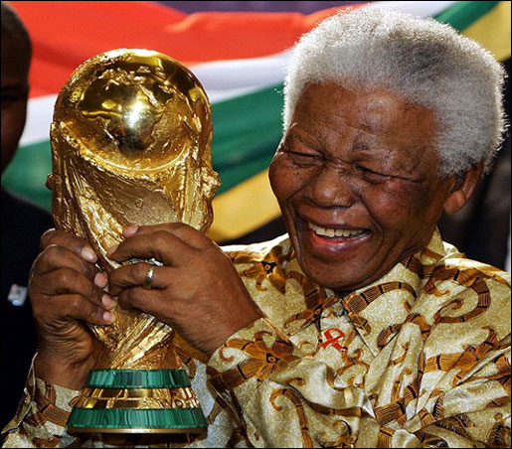

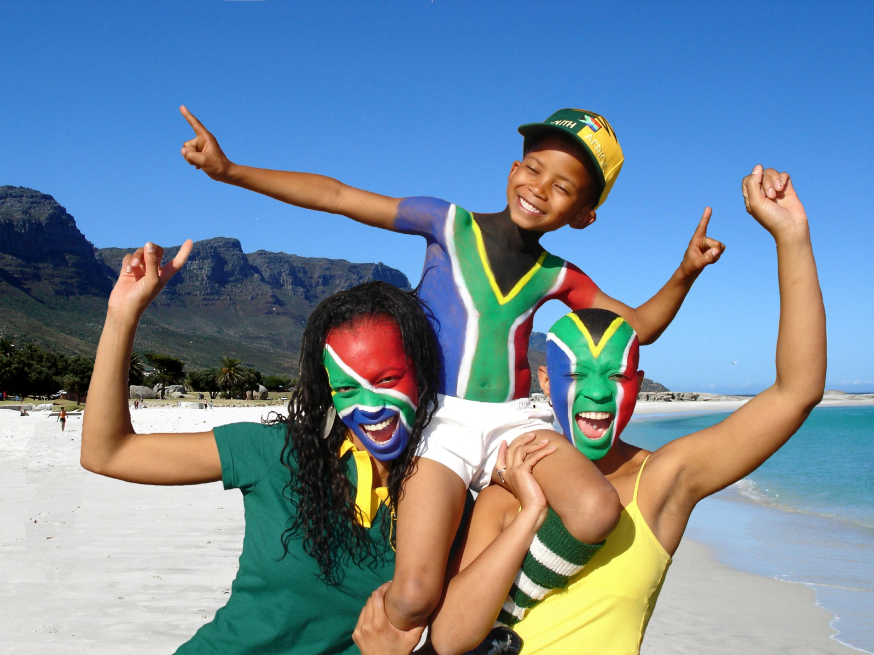
Lot’s of opportunities...
Notes:
South Africa (SA), often called the “rainbow nation”, is a country that epitomises diversity in various forms, the most prominent of which are ethnicity and language. There are roughly twenty five languages spoken in South Africa, of these 11 have been declared as official languages based on the grounds that their usage includes about 98% of the total population (DAC, 2002). The eleven official languages are isiNdebele, isiXhosa, isiZulu and siSwati, Sesotho, Sepedi and Setswana, Tshivenda, Xitsonga, English and Afrikaans.
Human language technologies (HLT) can be described as the set of technologies that apply the knowledge of language for the development of computer systems; that can recognise, understand, interpret and generate human language in all forms. It includes technologies as automatic speech recognition, text-to-speech and machine translation.
The HLT landscape in South Africa is made up of a relatively young research and development (R&D) community (universities and science councils) and a handful of companies in the private sector. Numerous local R&D activities have been taking place with many instances of international recognition for the quality and impact of work and South Africa has invested a reasonable amount of capital into the development of HLT. However, in contrast, the potential for impact that HLT has, as an enabling technology, across various application domains is not aligned with the current scale of HLT activities in the country. Service delivery, disabled, economic development, cultural diversity, skills creation, jobs.
Over the past few years, a number of planning activities have been undertaken (including a series of consultations involving government, industry, national research laboratories, and academics) to develop the HLT field as a national collaborative activity. These include:
The DAC confirmed the need to advance HLT in the South African context by developing and establishing the national HLT Strategy.
The Department of Science and Technology (DST) also identified HLT as a key technology during its ‘DST Technology Roadmapping’ process (Davel, Barnard & Kuun, 2007).
The DST sponsored a national workshop on HLT in 2005 where a national HLT roadmap was developed to guide research and development in HLT for the next ten years (2005-2015).
The workshop also led to discussions around national collaborative working groups to focus efforts around core technologies and resources. The workshop also acquainted HLT researchers and stakeholders with national initiatives which were likely to support the development of HLT in South Africa (Barnard, 2005).
In order to align and strengthen the national HLT research activities, DST provided financial support for the establishment of the National HLT Network (NHN) in 2006/7. The NHN is a collaborative effort which aims to strengthen synergies between HLT research practitioners in South Africa (SA). Currently, the members of the NHN are most of the major South African tertiary institutions and research councils who are actively involved in HLT R&D activities.
In November 2008, a workshop titled The “HLT Collaboration between South Africa and the Low Countries” was organised by NHN and the Dutch Language Union. Various aspects of HLT were discussed ranging from policy-making, R&D status, industry activities, educational & training opportunities and HLT road-mapping. The workshop aimed to stimulate and strengthen the cooperation between South Africa and the Dutch-speaking region in the field of HLT. Attendees included representatives from the South African, Dutch and Flemish HLT communities (science, business and government).
Much recently, in 2009 the DAC has initiated the process of establishing a National Centre for HLT (NCHLT) which will support and enable the development of HLT resources for all the official languages of South Africa.

Slide 62
Acknowledgments
Conclusion
DST – project sponsorship
Prof Sonja Bosch & Prof Laurette Pretorius – results of the 2008 BLaRK survey
Audit mini-workshop contributors
  Prof. Danie Prinsloo (UP), Prof. Sonja Bosch (UNISA), Mr. Martin Puttkammer (NWU), Prof. Gerhard van Huyssteen (CSIR), Prof. Etienne Barnard (CSIR), Dr. Febe de Wet (US), Dr. Marelie Davel (CSIR)
Numerous audit participants
Various HLT RG members – guidance and support
  www.meraka.org.za/nhnaudit

Slide 63

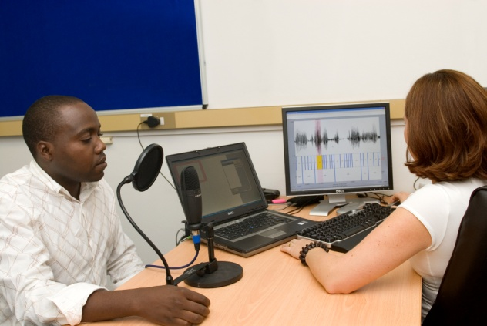
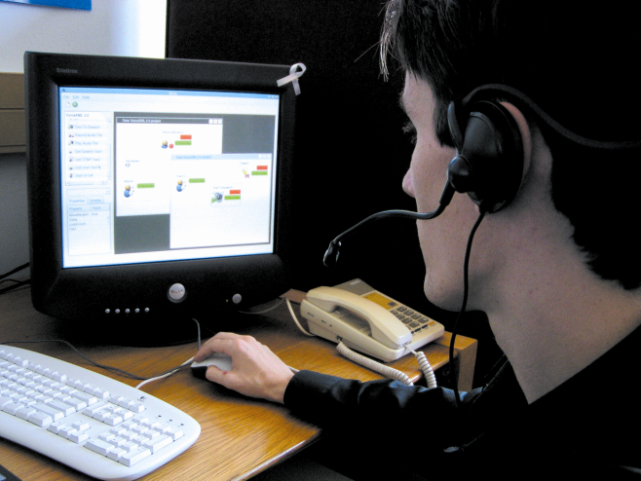
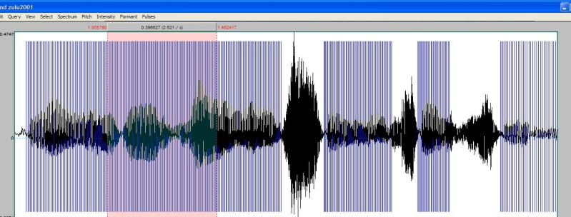
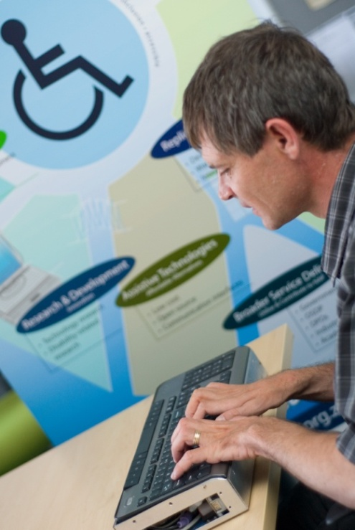
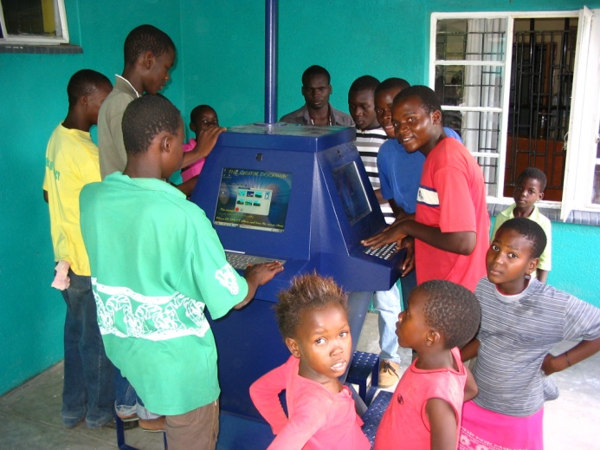
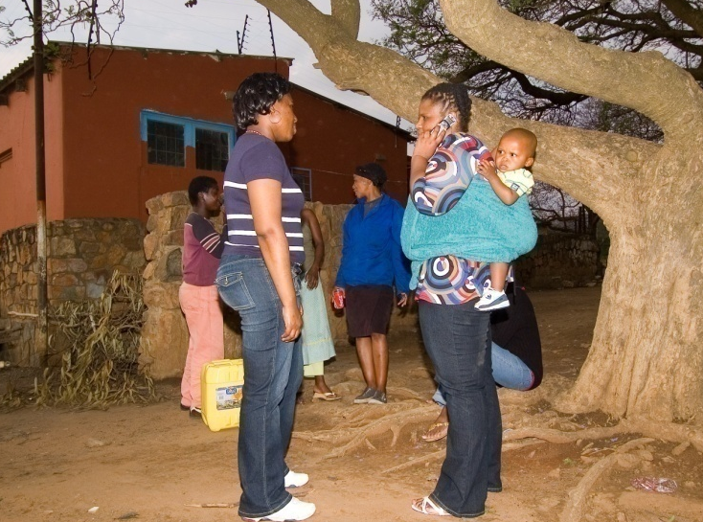
Next Steps
Conclusion
Notes:
Language is a deep-rooted aspect of our lives and the back-bone of all our communication. Technology on the other hand is also fast becoming a daily part of our lives; human language technologies (HLT) can serve as the bridge between the two. The potential for HLT in a multilingual South Africa is even more so, where a thriving HLT industry could be built by leveraging on the linguistic diversity of the country and truly using HLT to serve its citizens through multilingual information access & service delivery and enhance communication between South Africans.

Slide 64
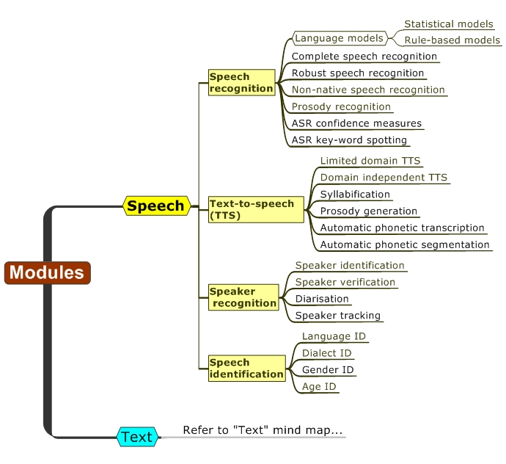
Modules

Slide 65
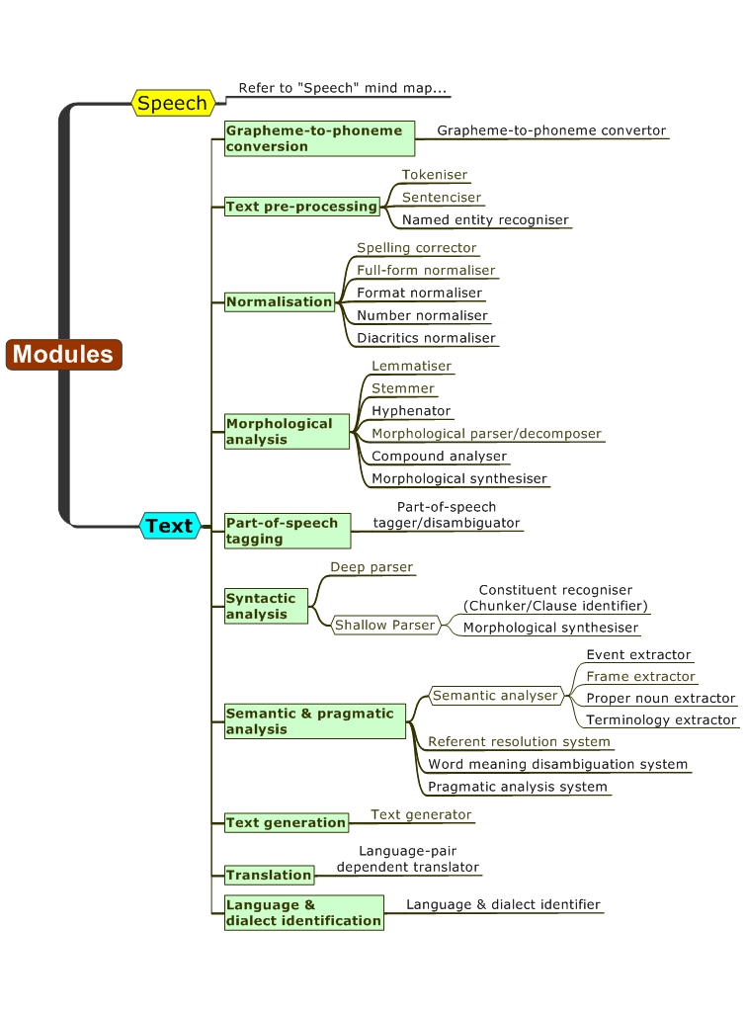
Modules

Slide 66
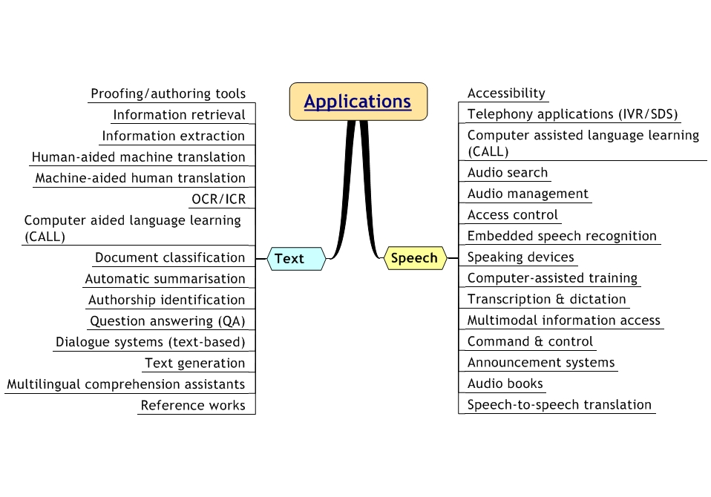
Applications

Slide 67
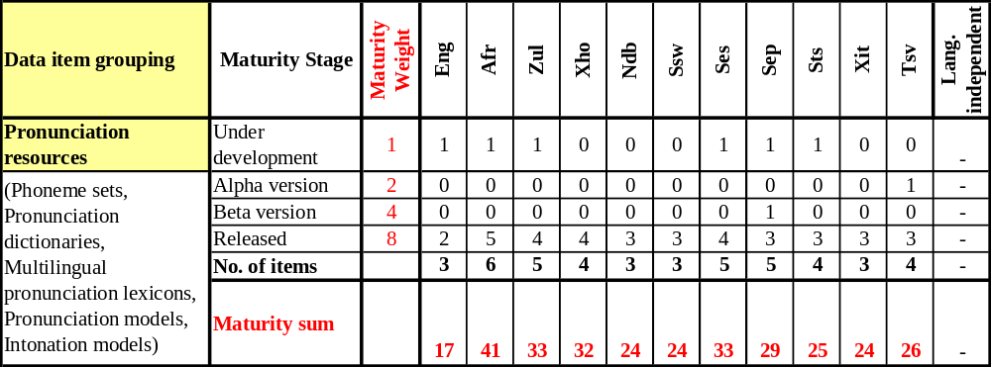
Maturity Index Calculation

Slide 68
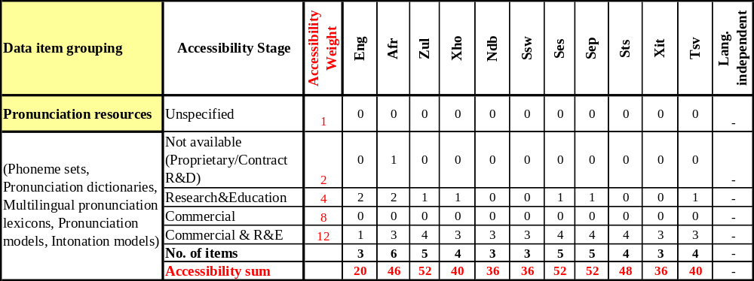
Accessibility Index Calculation

