Slide 1
Tag Dictionaries Accelerate Manual Annotation
Marc Carmen*, Paul Felt†, Robbie Haertel†,
Deryle Lonsdale*, Peter McClanahan†, Owen Merkling†,
Eric Ringger†, Kevin Seppi†
*Department of Linguistics and †Department of Computer Science
Brigham Young University
Provo, Utah, USA

Slide 2
Outline
Problem and its Significance
Possible Solutions
Research Question:
Does Annotation Re-use Help?
User Study
Our larger project
Highlight: CCASH Framework

Slide 3
Expense of Corpus Annotation
As we know,
Manual annotation of large corpora is often cost-prohibitive.
The HLT community has developed many tools to assist in annotation and to accelerate the process.
  Knowtator (Ogren, 2006)
  Word-Freak (Morton & LaCivita, 2003)
  Gate (Cunningham et al., 1995+)
  …
Context for this talk: under-resourced languages

Slide 4
Possible Solutions
Annotation re-use
  e.g., Translation memories
  “Tag dictionaries”
Option enumeration
Automatic pre-annotation
Active learning
  Selective sampling
Multi-user collaboration

Slide 5
Validation
Each method requires quantitative validation.
We cannot assume that any of these methods will reduce annotation cost for our problem in practice.
Validation method: user studies
Open question: Must we validate any method on every new task before deploying?

Slide 6
Recent Studies
Palmer, Moon, and Baldridge (2009)
  Pre-annotation and AL for Uspanteko annotation
Ringger et al. (2008)
  Word-at-a-time versus Sentence-at-a-time in Active Learning setting
Culotta et al. (2005)
  Pre-annotation and correction effort
We would welcome reports of other such annotation user studies.

Slide 7
Our Task
Penn Treebank POS tagging as a pilot study
(For the moment, pretend that English is under-resourced.)
Measure:
  Annotation time – focus on cost
  Annotation accuracy – focus on quality
To follow this Summer: Syriac morphological annotation

Slide 8
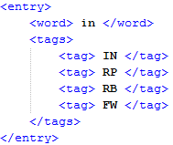
Annotation Aided by Tag Dictionaries
A collection of lists of possible tags for word types to be annotated
Collected during annotation
Facilitates annotation re-use

Slide 9
Idea #1
The cuts will be made half in Germany and half abroad .
(JJ) Adjective
(RB) Adverb
[select different tag]
If the subset of tags in this tag dictionary is substantially smaller than the full list and it contains the correct tag,
Then we might expect the tag dictionary to reduce the amount of time it takes to find and select the correct answer.
Furthermore, …

Slide 10
Idea #2
The cuts will be made half in Germany and half abroad .
(JJ) Adjective
(NN) Noun, singular or mass
(RB) Adverb
[select different tag]
Having fewer options may also improve the annotator’s ability to select the correct one.
On the other hand, …

Slide 11
Idea #3
If the tag dictionary does not contain the correct tag, it may take more effort to
  Recognize the absence of the desired tag
  Take the necessary steps to show a complete list of tags
  Select the answer from that list instead

Slide 12
Research Question
At what point – in terms of coverage – do tag dictionaries help?
The cuts will be made half in Germany and half abroad .
(JJ) Adjective
(RB) Adverb
[select different tag]
(DT) Determiner
(JJ) Adjective
(NN) Noun, singular or mass
(PDT) Pre-determiner
(RB) Adverb
[select different tag]
?

Slide 13
Tools
Such studies require a tool that can
  Track time
  Manage users / subjects
  Be available over the web
CCASH = Cost-Conscious Annotation Supervised by Humans
  With the emphasis on CA$H for cost.
  See paper from yesterday’s poster in the proceedings for more detail.

Slide 14
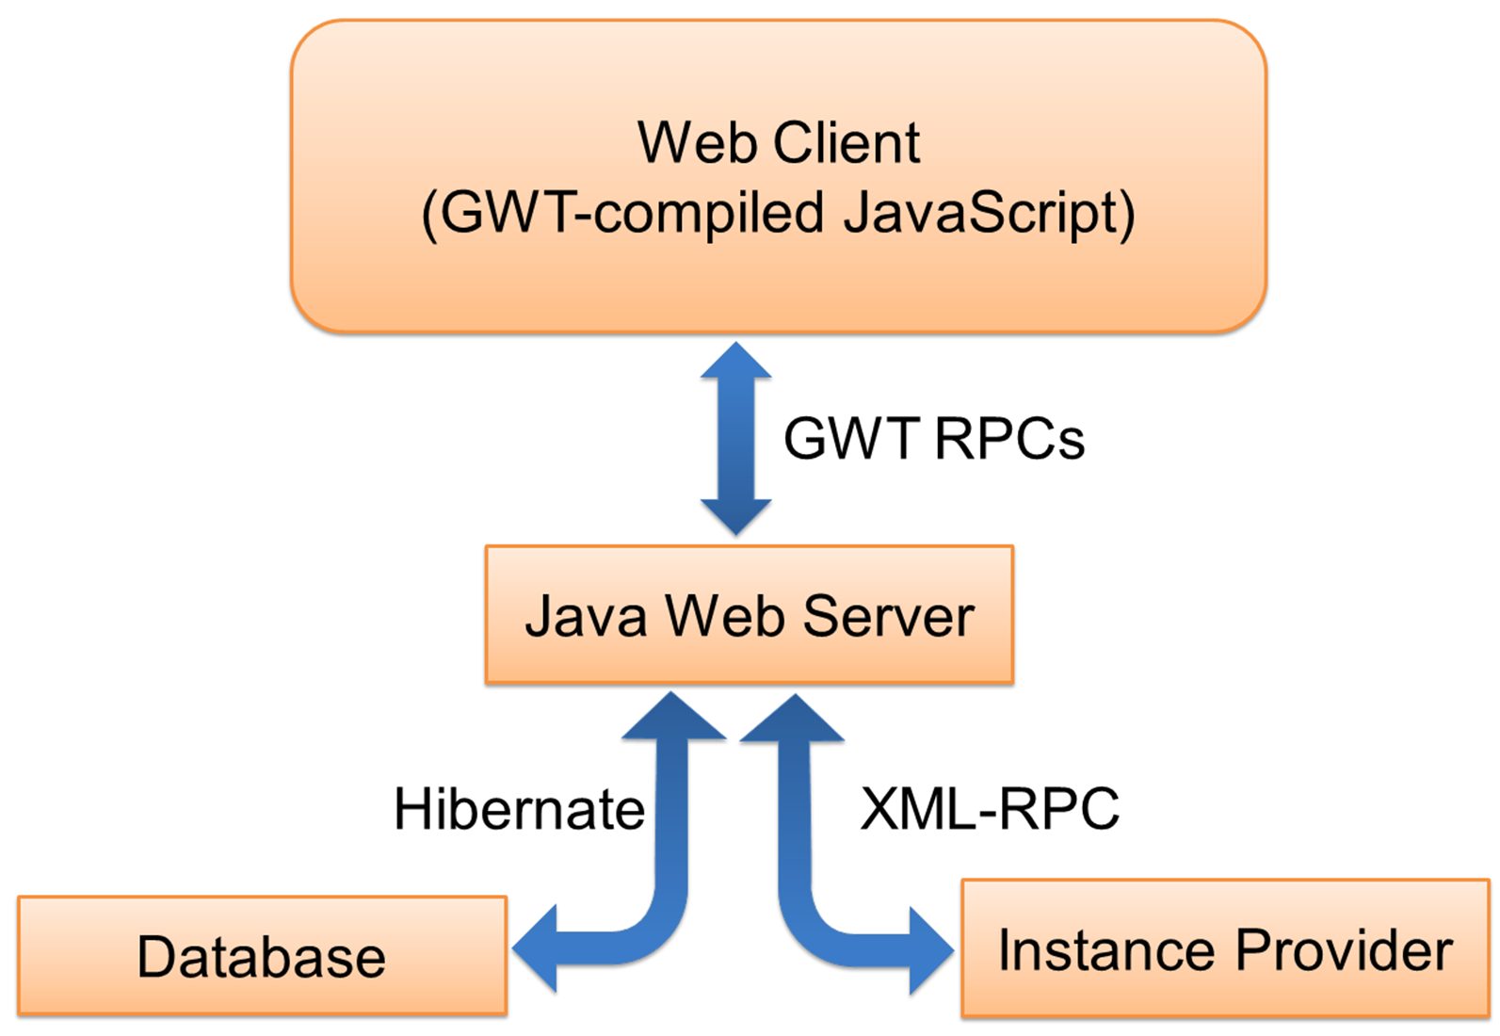
CCASH

Slide 15
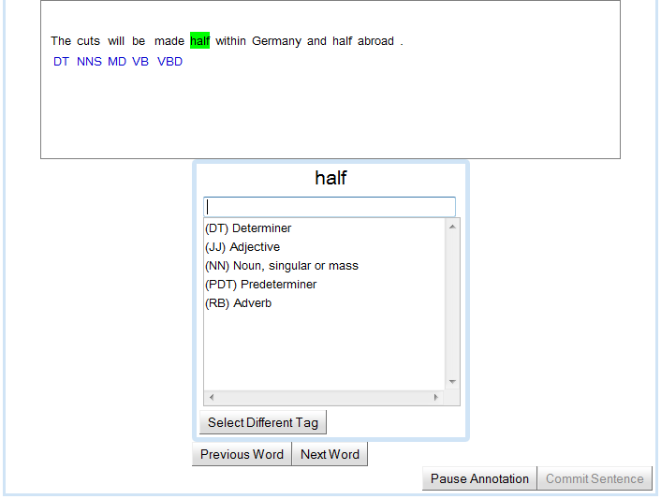
CCASH for Tagging

Slide 16
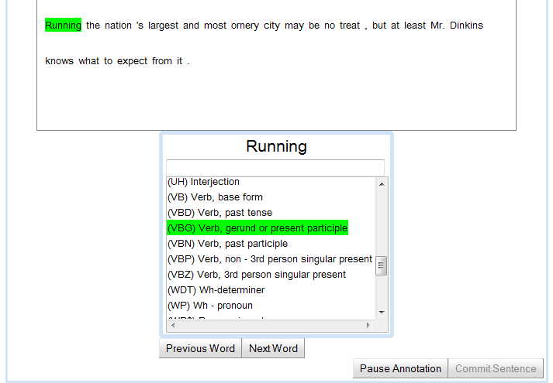
Select Different Tag

Slide 17
Study Description
Variables under study:
  time
  accuracy
Controlling for:
  sentence length
  tag dictionary coverage level
3 Sentence buckets
  Short (12)
  Medium (23)
  Long (36)
  6 sentences per bucket
6 Coverage levels
  0%, 20%, 40%, 60%, 80%, 100%
Coverage level of the dictionary was randomized for each sentence presented to each participant, under the following constraint:
  a given user was assigned a unique coverage level for each of the
  6 sentences in every length bucket
Notes:
Regress:
subject responses to the various data and tag dictionary coverage conditions
onto both time and accuracy

Slide 18
Subjects
33 beginning graduate students in Linguistics
  in a required syntax and morphology course
Introduced with instructions, a questionnaire, and a tutorial
Participants were told that both accuracy and time were important for the study

Slide 19
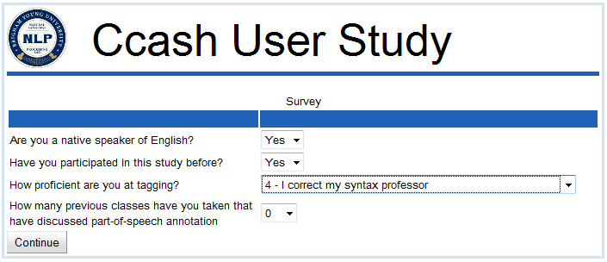
Initial Questionnaire
Twenty-three of the participants are native English speakers.
Over 50% of the students had taken one or fewer previous courses that cover POS tagging.
Over 50% of the participants rated themselves with a 1 (lowest proficiency) or 2 out of 5 (highest).

Slide 20
Null Hypotheses
Tag dictionaries have no impact on annotation time.
Tag dictionaries have no impact on annotation accuracy.
Tested using:
  t-Test
  Permutation test (Menke & Martinez, 2004)

Slide 21
Do Tag Dictionaries Help?
 |  |  | Time |  |  |  |  | Accuracy
Length | Coverage | Num | Min | Mean | Max | p-val | Perm | Min | Mean | Max | p-val | Perm
12 | Full Dict | 31 | 54 | 106 | 174 | 0.50 | 1.00 | 0.50 | 0.80 | 1.00 | 0.50 | 1.00
 | 20 | 31 | 48 | 136 | 238 | 0.79 | 0.41 | 0.58 | 0.81 | 1.00 | 0.43 | 0.87
 | 40 | 33 | 39 | 94 | 204 | 0.35 | 0.71 | 0.50 | 0.83 | 1.00 | 0.21 | 0.40
 | 60 | 29 | 40 | 100 | 139 | 0.01 | 0.02 | 0.67 | 0.83 | 1.00 | 0.18 | 0.37
 | 80 | 32 | 30 | 94 | 204 | 0.24 | 0.49 | 0.75 | 0.86 | 1.00 | 0.00 | 0.01
 | 100 | 31 | 26 | 85 | 133 | 0.00 | 0.01 | 0.75 | 0.86 | 1.00 | 0.01 | 0.01
23 | Full Dict | 27 | 64 | 258 | 264 | 0.50 | 1.00 | 0.70 | 0.87 | 1.00 | 0.50 | 1.00
 | 20 | 31 | 88 | 191 | 309 | 0.86 | 0.31 | 0.70 | 0.86 | 0.96 | 0.76 | 0.50
 | 40 | 29 | 88 | 191 | 253 | 0.22 | 0.44 | 0.74 | 0.88 | 1.00 | 0.30 | 0.62
 | 60 | 30 | 66 | 160 | 257 | 0.07 | 0.17 | 0.83 | 0.87 | 0.96 | 0.08 | 0.18
 | 80 | 30 | 54 | 130 | 225 | 0.00 | 0.00 | 0.83 | 0.89 | 0.96 | 0.01 | 0.03
 | 100 | 31 | 52 | 121 | 202 | 0.00 | 0.00 | 0.83 | 0.90 | 1.00 | 0.06 | 0.13
36 | Full Dict | 33 | 121 | 265 | 533 | 0.50 | 1.00 | 0.75 | 0.88 | 1.00 | 0.50 | 1.00
 | 20 | 32 | 113 | 248 | 465 | 0.15 | 0.32 | 0.72 | 0.87 | 0.97 | 0.71 | 0.57
 | 40 | 32 | 93 | 282 | 577 | 0.32 | 0.65 | 0.75 | 0.90 | 1.00 | 0.16 | 0.33
 | 60 | 30 | 82 | 219 | 353 | 0.00 | 0.00 | 0.81 | 0.92 | 0.97 | 0.00 | 0.00
 | 80 | 28 | 85 | 204 | 310 | 0.00 | 0.00 | 0.81 | 0.93 | 1.00 | 0.00 | 0.00
 | 100 | 31 | 90 | 191 | 318 | 0.00 | 0.00 | 0.78 | 0.93 | 1.00 | 0.00 | 0.00
Notes:
Full Dict → “No dict”; 0
Hide min, max, p-val, perm
Bold means that are significant

Slide 22
Do Tag Dictionaries Help?
Length | Coverage | Mean Time | Mean Accuracy
12 | 0 | 106 | 0.80
 | 20 | 136 | 0.81
 | 40 | 94 | 0.83
 | 60 | 100 | 0.83
 | 80 | 94 | 0.86
 | 100 | 85 | 0.86
23 | 0 | 258 | 0.87
 | 20 | 191 | 0.86
 | 40 | 191 | 0.88
 | 60 | 160 | 0.87
 | 80 | 130 | 0.89
 | 100 | 121 | 0.90
36 | 0 | 265 | 0.88
 | 20 | 248 | 0.87
 | 40 | 282 | 0.90
 | 60 | 219 | 0.92
 | 80 | 204 | 0.93
 | 100 | 191 | 0.93
Notes:
Full Dict → “No dict”; 0
Hide min, max, p-val, perm
Bold means that are significant

Slide 23
Impact on Time
Mean Time
Sentence Length
Coverage Level (%)
Notes:
Outcome: reject the null hypothesis with p>=95% for coverage > 60%

Slide 24
Impact on Accuracy
Mean Accuracy
Sentence Length
Coverage Level (%)

Slide 25
Big Picture
Answer questions about methods for annotation acceleration
Quantitatively validate the answers
Do so in the same framework to be used for annotation
  To control for distracting factors

Slide 26
Ongoing / Future Work
Validate other promising acceleration methods
  Automatic pre-annotation
  Active learning
  Multi-user collaboration
    c.f., Carbonell’s Pro-active Learning (this morning’s talk)
    c.f., Carpenter’s Bayesian models (this week’s annotation tutorial)
    Carroll et al. (2007)
Machine-assisted Morphological Annotation for Semitic languages
  Focus on Comprehensive Corpus of Syriac

Slide 27
Grazzi hafna!

