Slide 1
Political Statement by Kyle Duarte
(Signed in American Sign Language)
It is shameful that as a community of signed language linguists we continually exploit the Deaf people whose languages we study, without providing any accessible means for them to understand the experiments and opinions garnered from their generosity.
Signed language interpreters are skilled individuals who are trained to facilitate communication between Deaf and hearing; we must ensure that interpreters are available at all scientific conferences for which Deaf people are present.
It is only through making these sessions accessible to our target audience that we will distance ourselves from the very historical oppression that we shun and manage to retain the well-wishes of the Deaf community to continue our research.
I regretfully present this work in English and hope that I will soon have the opportunity to present it to Deaf linguists.

Slide 2
Heterogeneous Data Sources for Signed Language Analysis and Synthesis: The SignCom Project
Kyle Duarte and Sylvie Gibet
Université de Bretagne-Sud, Laboratoire VALORIA
Vannes, France
LREC 2010, Valletta, Malta

Slide 3
Contents
Heterogeneous Data Sources
Data Collection: MOCAP + vidéo + annotations
Data Annotation
The SignCom Project Goals
  Signed Language Analysis
  Signed Language Animation

Slide 4
“Heterogeneous Data Sources”
Video
  1 – 6+ cameras
  2D (3D ?) phonological data
  Standard definition (SD - noise) or high definition (HD)
Text annotations
  ELAN coder popular among signed language linguists
  Rich semantic data
  Makes video text-searchable
  Metadata tags give information about signer, topic, etc.
Motion capture

Slide 5
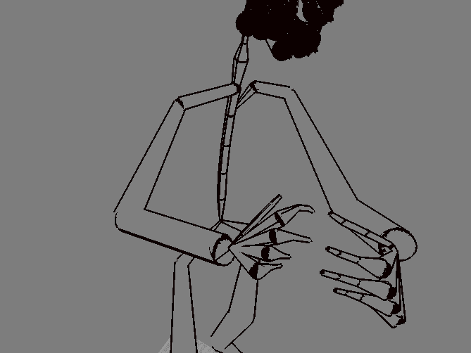
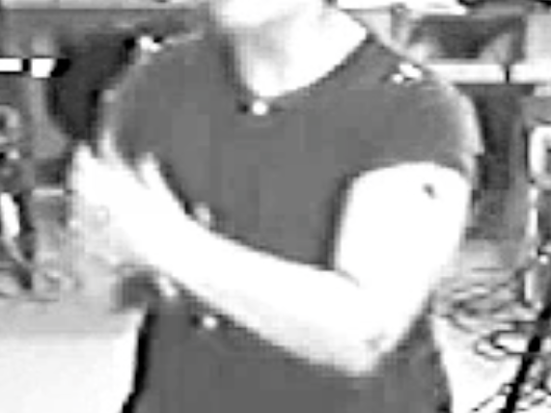
Data Collection: Motion Capture (mocap)
12 cameras placed around the subject capture the placement of body markers:
  41 facial markers
  43 body markers
  12 hand markers (6/hand)
Compute 3D body points
  Position & rotation
  Accuracy up to 1 mm
  Skeleton reconstructed from points

Slide 6
Data Collection: Benefits of Motion Capture
Mocap data does not degrade like video data
Higher capture rate:
from 25-30 Hz to 100 Hz
  Or more! (1000 Hz)
Smaller file size compared to high-quality video
Mocap skeleton can expose hidden articulators

Slide 7
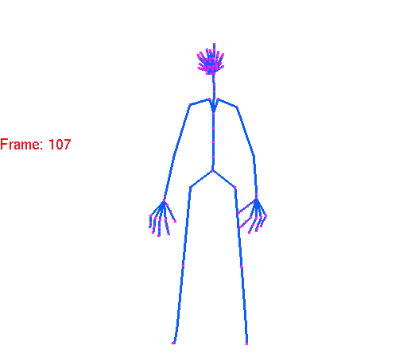
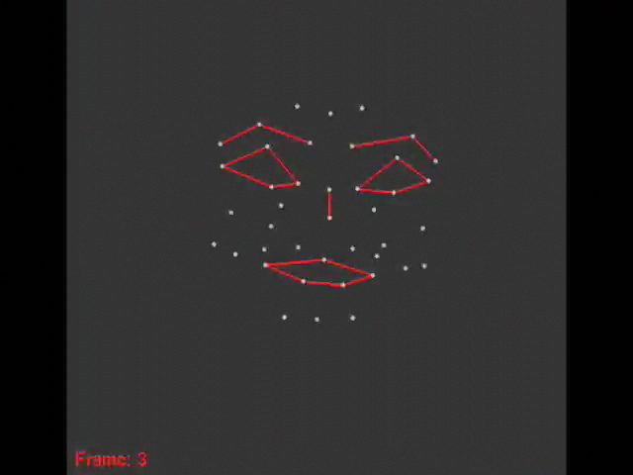
Data Collection: Motion Capture Processing
Occlusions
      Hand: Inverse kinematics to compute the missing articulators
      Face: Filtering (for noise too)
Anthropometric Models
  Hand
  Body
Data format: BVH
  Hierarchical information (skeleton)
  Raw data: motion

Slide 8
“The SignCom Project” Data Collection
Corpus (presented in weekend workshop)
  3 stories about a cocktail party, and recipes for salads and galettes
  ~ 10 dialogues/story; 2 roles per dialog; each performed 2x
Recordings: mocap data + video
  ~ 35 min for all the scenarios
  ~ 1 Gb data
  Post-processing: ~ 3 months
    Mocap post-processing
    Hand inverse kinematics
    Facial morphtarget extraction
Notes:
Robea is more signal processing; SignCom has linguists. Continuity between the two.

Slide 9
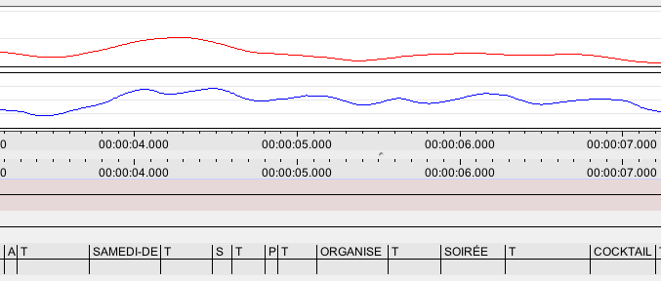
Data Annotation
ELAN encodes video and signal data:

Slide 10
Data Annotation
Traditionally:
  Linguistics
    Many tiers (phonetic, semantic, grammatical, etc.)
    Synchronicity of signs
  Gesture
    Fewer tiers (prosodic)
    Asynchronicity of event
We include:
  Multi-level linguistic annotation (many tiers)
Annotation
  Hands
    GlossesR
      HC_R
      PL_R
      GramCls_R
    GlossesL
      HC_L
      PL_L
      GramCls_L
    FR_FR Translation
    EN_US Translation
    Comments: Glosses
    Mouthing
  Facial Expression
    Clausal
    Adjectival
    Affective
  Gaze
    Gaze Target
  Head
  Shoulder

Slide 11
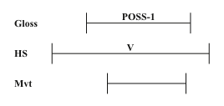
Data Annotation
We include:
  Asynchronous segmentation along different tracks
1st Person Possessive (LSF):

Slide 12
“The SignCom Project” Goals
Pair signed language data (video & linguistic annotations) with biometric (mocap) data
  First interdisciplinary attempts, with mocap recordings
    Robea Project (CNRS, 2003-2007): without facial expression
    SignCom Project (National Research Agency 2008-2011): 4 academic teams, 1 private firm
“Signed Language Analysis”
  Phonological analysis with mocap data
  Recognition of signs from video and/or mocap (not discussed)
“Signed Language Animation”
  Animate new sequences from stored signs using an avatar
Notes:
Robea is more signal processing; SignCom has linguists. Continuity between the two.

Slide 13
Phonological Analysis: Articulator Velocity
Quickly-repeated signs (Liddell and Johnson)
  1st iteration is the largest (distance traveled)
  2nd iteration > ½ 1st iteration
  3rd and subsequent iterations – smaller than 2nd
Notes:
EXAMPLE CAN PROVE LAW

Slide 14
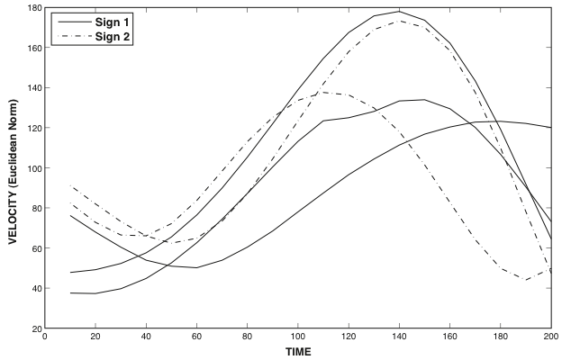
Phonological Analysis: Articulator Velocity
Notes:
SIGN 1 “PUSH”

Slide 15
Phonological Analysis: Timing
Sign components:
  Learned as synchronized wholes
  Often seem disjointed
Notes:
EXAMPLE

Slide 16
Phonological Analysis: Future Extensions
Invariant linguistic features
  Phonological phenomena
    ✓ and * phonological structures
      Sign components (handshape, position, facial expression, etc.)
      Whole signs
  Prosodic laws
    Head nod, eye blink, etc. related to transitions, etc.
Invariant movement features
  Motion laws for separate tracks
    Characteristics of hand movements (Isochrony, Fitts’s law?)
    Other laws for hand configuration, etc.
  Temporal relationship between tracks
Notes:
FITTS LAW APPLY? NOT APPLY?

Slide 17
Signed Language Animation
Key-frame animation:
  Parkhurst, Braffort, etc.
Procedural animation:
  Lebourque (1999), Heunerfauth (2006), Kennaway (2001), etc.
Data-driven animation is a new field:
  Generating expressive FSL gestures (Héloir & al 2006),
  Database of stored signs (Awad et al. 2009)
  Multichannel animation engine (future publication)
Notes:
PROBLEM FIRST-2

Slide 18
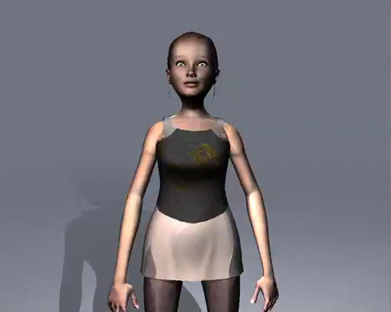
Signed Language Animation

Slide 19

The SignCom Project is funded by

