Slide 1
U-Compare
An Integrated Language Resource Evaluation Platform Including a Comprehensive UIMA Resource Library

Slide 2
We do the annoying bits
concentrate on your task.

Slide 3
U-Compare Aims at …
Achieve your task with less human works, concentrate on the essential tasks!
U-Compare is
  an integrated text mining / NLP system
  and the world largest UIMA component repository
For any UIMA component, U-Compare allows users to …

Slide 4
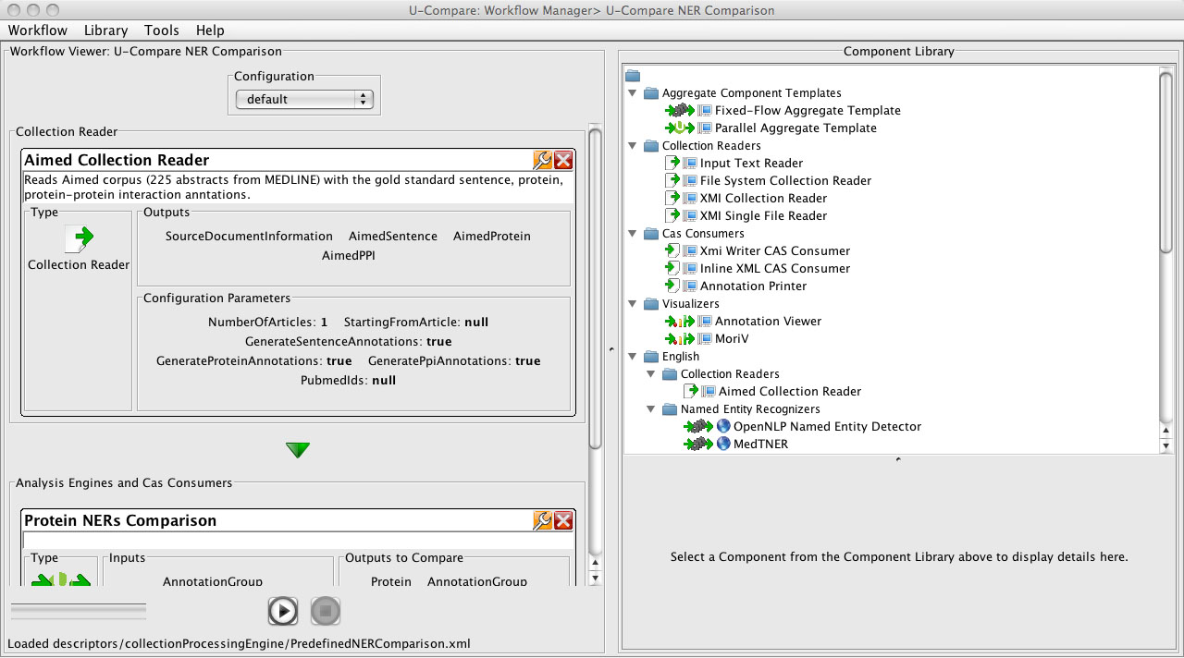
Screenshot #1
Drag and drop workflow creation
Drag & Drop
Workflow Configuration
Click to Run

Slide 5
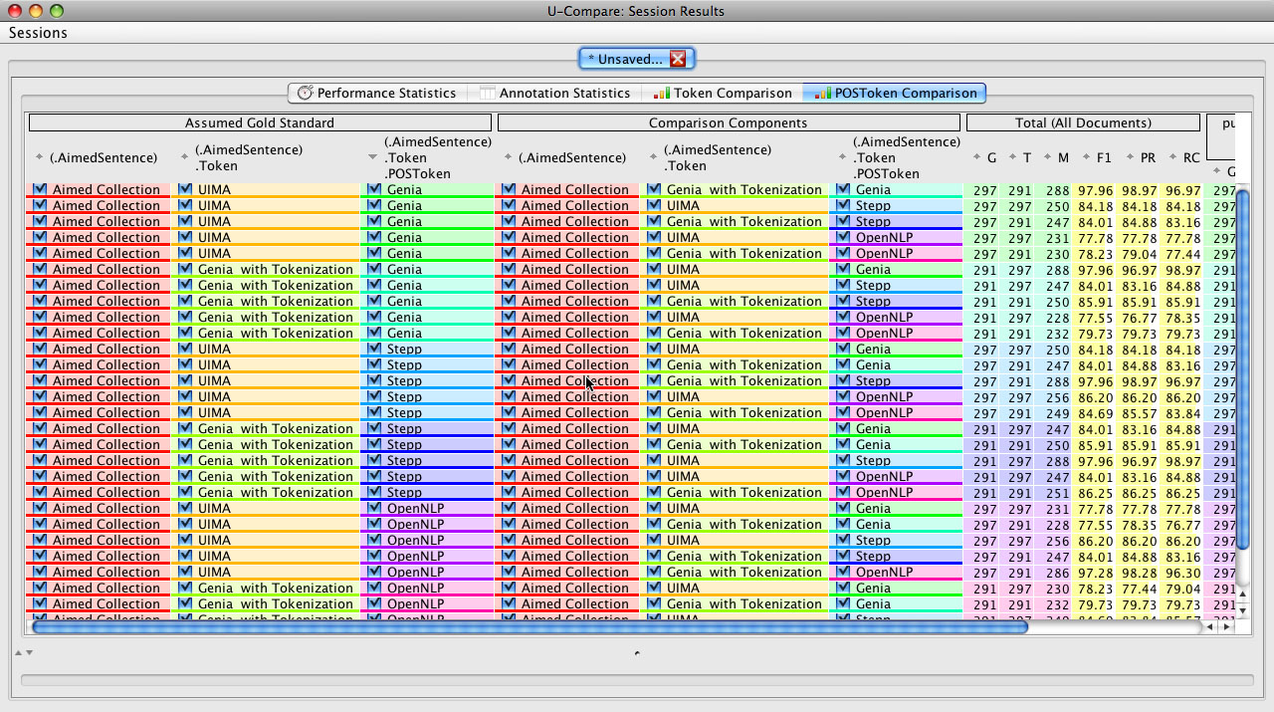
Screenshot #2
Comparison/Evaluation Statistics

Slide 6
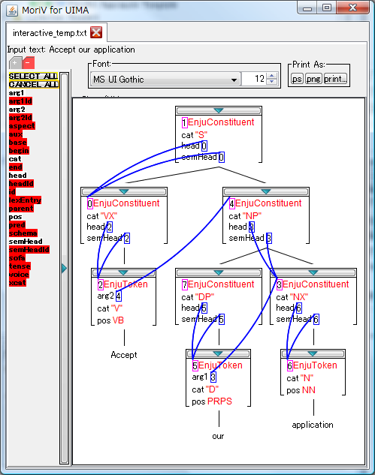
Screenshot #3
Visualizations e.g. tree/feature structure viewer and annotation viewer

Slide 7
Topics
UIMA
  Interoperability of UIMA
U-Compare
  World largest UIMA component repository
    U-Compare type system and web/local services
  Integrated NLP platform for any UIMA component
    Visual workflow creation, statistics, comparison, pluggable evaluation, visualizations
    Developer APIs
  New and ongoing enhancements
  U-Tokyo, UK NaCTeM and U-Colorado

Slide 8
UIMA

Slide 9
Interoperability Required
Cumbersome to connect arbitrary two tools
  Make a specific interface for each time?
    Not generic; time consuming
  Open common framework is ideal
    To achieve the interoperability
Format?
Data Type?
Tool A
Tool B

Slide 10
UIMA Overview
UIMA, Unstructured Information Management Architecture
  Originally developed by IBM
  Currently an open project in OASIS and Apache
Developers should make UIMA wrappers
  for their existing tools to be UIMA compliant
  which converts original I/O to/from UIMA I/O
UIMA wrapper
UIMA wrapper
Tool A
Tool B
Interoperable

Slide 11
UIMA Basic Architecture
UIMA Specification
XMI
(sort of XML)
Deserialize
Aggregate Analysis Engine
Serialize
Input Capability
Primitive Analysis Engine
Aggregate AE
……
Output
Capability
CAS
Raw Text
Annotations
Collection Reader
Type Definition
Flow Controller
Type System
~Ecore/UML
Local or Web Service(SOAP/JMS)

Slide 12
UIMA Interoperability Levels
Once to be UIMA, receive the whole benefit
Not just formats, but many levels of interoperability/features provided
UIMA Interoperability Levels
Data
Representation
Data Structure
Type System
Work Flow
Data Format
Network Services
SOAP Web Service
Vinci Service
Type
Capability
Component

Slide 13
UIMA: Stand-off Annotation
Raw Information ＋ Feature Structures
  For text: Raw Text ＋ Stand-off Annotations
  Raw Information is supposed not to be changed
  Annotations are added incrementally
Feature Structure can be Primitive Value or links to another Feature Structure
  General graph structure
XMI Serialize/Deserialize

Slide 14
UIMA: Type System
Every Feature Value should have Type
  Primitive Types: int, String, Array…
  User defined types
Type “Annotation” with begin/end features is predefined
  Specific types are not provided
  Users should define their own types
Type System is a hierarchical group of Types
  Types have parent-child relations to form a type system

Slide 15
UIMA: Workflow
Component is a basic processing unit
  Collection Reader: reads corpus (and generate annotations)
  Analysis Engine: corresponds to a tool
    Primitive: local or web service
      An Analysis Engine can be easily deployed as a SOAP/JMS service
    Aggregate: nested Analysis Engine(s)
Capability: input and output annotation type
Flow Controller: controls aggregate component order
  Fully programmable, default is a FixedFlow (pipeline)

Slide 16
UIMA Basic Architecture
UIMA Specification
XMI
(sort of XML)
Deserialize
Aggregate Analysis Engine
Serialize
Input Capability
Primitive Analysis Engine
Aggregate AE
……
Output
Capability
CAS
Raw Text
Annotations
Collection Reader
Type Definition
Flow Controller
Type System
~Ecore/UML
Local or Web Service(SOAP/JMS)

Slide 17
UIMA: What is missing
Developers should:
  make their tools compliant to UIMA
  define a type system for their tools
Type system compatibility
  To be UIMA-compliant is not enough
    Type systems should also be compatible
    No common type system from UIMA officials
Basic NLP functionalities
  Statistics, Comparison and Evaluation
User Interfaces for Humans

Slide 18
U-Compare

Slide 19









U-Compare Initiative
Royal Society of
Chemistry (UK)
JISC (UK)
Prof. Larry Hunter
Prof. Sophia Ananiadou
NIH (US)
Lead: Yoshinobu Kano
UIMA Innovation
Award
Prof. Jun’ichi Tsujii
OASIS UIMA TC
Member
Kakenhi, MEXT (JP)

Slide 20


U-Compare Initiative
Royal Society of
Chemistry (UK)
BootStrep (EU)
University of Colorado
University of Manchester
NIH (US)
UIMA Innovation
Award
情報大航海プロジェクト
METI (JP)
Research Assistants
OASIS UIMA TC
Member
University of Tokyo
科研費, MEXT (JP)

Slide 21
U-Compare System
All-in-one integrated NLP platform
  Single-click-to-launch, GUI mode
  Command line mode with developer APIs
UIMA Component Repository with the U-Compare Type System, w or w/o the platform
U-Compare Components
the world largest
Visualizations
Annotation, etc.
Statistics
Evaluation/Comparison
U-Compare Type System
sharable
Workflow GUI
import/export
Combinatorial Comparison Generator
UIMA Framework (and third party UIMA components)
U-Compare Integrated Platform

Slide 22
UIMA Missing Common Type System
A common type system required for the real interoperability
Maintain local type systems and bridge them by a sharable type system
A single common type system is ideal,
but almost impossible to pose such a single common type system to different developers.
bridging
bridging
Local Type System A
U-Compare
Sharable Type System
Local Type System B

Slide 23
Sharable Type System
Unique representation as much as possible
  Types rather than String fields (e.g. POS tags)
Hierarchical as much as possible to capture the differences of local type systems
  E.g. when a proper POS tag corresponding to the local POS tag is not found, middle level types like Verb, Noun, etc. are the better options
  Possible to use both sharable and local type system hierarchies at the same time, if the multiple inheritance is allowed

Slide 24
U-Compare Type System (1/2)
BaseAnnotation
<AnnotationMetadata>
Syntactic Types (right)
Semantic Types (bottom)
SyntacticAnnotation
Sentence
Dependency
<DependencyLabel>
Token
TreeNode
<TOP>parent
<FSArray>children
POSToken
<POS>
ReferenceAnnotation
TOP
SemanticAnnotation
LinkingAnnotationSet
<ExternalReference>
<FSArray:SemanticAnnotation>
RichToken
<String>base
SemanticClassAnnotation
<FSArray:LinkedAnnotationSet>
AbstractConstituent
Constituent
<ConstituentLabel>
NullElement
<NullElementLabel>
<Constituent>
CoreferenceAnnotation
DiscourseEntity
NamedEntity
EventAnnotation
NormalizedEntity
Proper
Name
Title
CellLine
CellType
DNA
GeneOrGeneProduct
RNA
Expression
FunctionTaggedConstituent
<FunctionLabel>
TOP
Person
Place
DNARegion
Protein
Gene
Negation
Speculation
TemplateMappedConstituent
<Constituent>
Coordinations
<FSArray>
ProteinRegion
Semantic types
Syntactic Types

Slide 25
U-Compare Type System (2/2)
Document Types
TOP
ReferenceAnnotation
DocumentAttribute
<ExternalReference>
DocumentAnnotation
DocumentClassAnnotation
<FSArray:DocumentAttribute>
<FSArray:ReferenceAnnotation>
DocumentValueAttribute
<String>value
DocumentReferenceAttribute
<ReferenceAnnotation>
Structure
Text
Fragment
Abstract
Article
Appendix
Section
TextBody
Heading
Keyword
Affiliation
Authors
Paragraph
AbstractText
Title
Caption
FIgureCaption
TableCaption
Document Types

Slide 26
U-Compare Components
The world largest UIMA component repository
  U-Compare type system compatible
Ready-to-use, no installation required
  Pure Java components are locally deployed
  Native tools are running as SOAP web services
    If binaries available, easy to deploy locally as well
Local Services
Web Services

Slide 27
Comprehensive Toolkit: more than 50
Corpus Readers (Collection Readers) and Writers
  Biological Entity Annotated Corpora: Bio1, BioIE, Texas, Yapex Reference/Test, NLPBA, BioCreative1a
  Biological Event Annotated Corpora: AImed, BioNLP '09 Shared Task
  General Format Readers: Input Text, Plain Text Files, XMI, BIO
  Writers: XMI, Inline XML, Annotation Printer, BIO
Syntactic Tools
  Sentence Detectors: GENIA, LingPipe, NaCTeM, OpenNLP, UIMA
  Tokenizers: GENIA, OpenNLP, UIMA, PennBio
  POS Taggers: GENIA, LingPipe, OpenNLP, Stepp
  Lemmatizers: morpha, GENIA, Enju
  CFG Parsers: OpenNLP CFG Parser
  Dependency Parsers: Stanford
  Deep Parsers: Enju, Mogura
Semantic Tools
  Biological Named Entity Recognizers: ABNER (NLPBA/BioCreative/User Model), GENIA Tagger, NaCTeM Species Word Detector, NeMine,, MedTNER-M, LingPipe Entity Tagger (Genia, Genia-NLPBA, GeneTag), Moara CBR Tagger (BC2/BC2 and BC1 yeast, mouse and fly)
  General Named Entity Recognizers: OpenNLP NER
  Named Entity Normalizers: NaCTeM Species Disambiguator, MedTNER
  Biological Event Recognizers: See Bio Event Server page (upcoming)
  Abbreviation Detector: extractabbrev
Others
  statistical tools, visualizers, writers, developer tools, etc.
  U-Compare Annotation Viewer, MoriV, and Annotation Comparator (integrated to the system)

Slide 28
Comparison of Tools is Beneficial
Many tools available for similar purposes
For specific data:
  Select the best (set of) tool(s) by the gold standard corpus
  Grasp characteristics of a tool
  Observe similarity and difference between tools
  Observe domain adaptability of tools
Tools or Gold Standard Data
Input Data
Compare similar tools for different set of input data

Slide 29
Combinatorial Comparison
An NLP application tends to be consist of a combination of tools
Many and complex possible combinations
Sentence
Detector
POS Tagger
Named Entity Recognizer
Tokenizer
UIMA SD
OpenNLP SD
GENIA SD
GENIA Tagger
Stepp Tagger
OpenNLP Tagger
ABNER
MedT-NER
GENIA Tagger as NER
UIMA Tokenizer
OpenNLP Tokenizer
GENIA Tagger as Tokenizer

Slide 30
U-Compare Parallel Workflow
Special components to achieve the combinatorial comparison
  Assuming that the I/O capabilities are properly set
  Automatically calculates possible combinations
Users should only specify
  which components to compare
  which output types to compare
  which evaluation metrics to be used
(Demo)

Slide 31
Pluggable Evaluation Metrics
Evaluation/Comparison has varieties
  Evaluation and comparison are essentially same
  Impossible to cover all of the metrics by ourselves
U-Compare Pluggable Evaluation System
  performed in a UIMA component
    custom evaluation metrics pluggable
  Using I/O capability to decide which evaluation metric to apply

Slide 32
Comparable Type System
Type system should be well formed to allow the automatic combinations
  Distinct types for each component
  Hierarchy to specify which types are comparable
  Should not be cyclic (acyclic) to allow the automatic combinations
U-Compare type system is designed in both sharable and comparable way

Slide 33
Cluster Service Deployment
Deploy any UIMA component in clusterized servers
  based on UIMA SOAP (AXIS + Tomcat) web service
  deploy the same component for each server
  pretend as a single service via a load balancer gateway
  effective since most NLP workflows are independent between input documents
    UIMA AS not effective for such purposes
Host12core
Service1
Service2
Host2 2core
Service3
Service4
Host3 4core
Service5
Service6
Service7
Service8
Gateway
Load Balancer

Slide 34
U-Compare System (again)
All-in-one integrated NLP platform
  Single-click-to-launch, GUI mode
  Command line mode with developer APIs
UIMA Component Repository with the U-Compare Type System, w or w/o the platform
U-Compare Components
the world largest
Visualizations
Annotation, etc.
Statistics
Evaluation/Comparison
U-Compare Type System
sharable
Workflow GUI
import/export
Combinatorial Comparison Generator
UIMA Framework (and third party UIMA components)
U-Compare Integrated Platform

Slide 35
U-Compare: demo
Create HPSG parsing workflow and run
Predefined Workflows

Slide 36
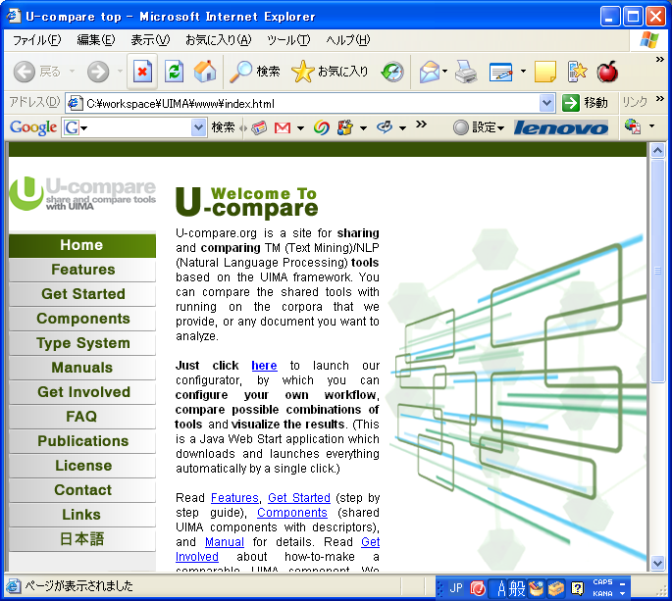
U-Compare: Launching
Just click in your web browser

Slide 37
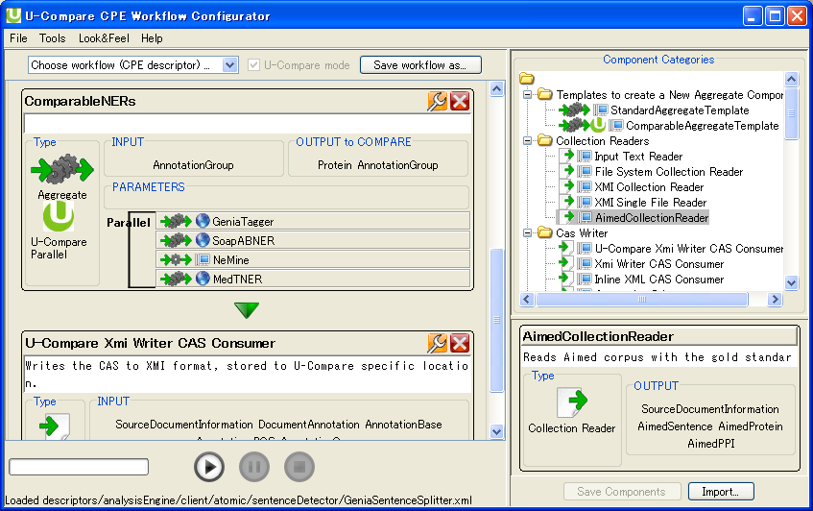
U-Compare: Flow Creation
Workflow Configuration
Drag & Drop
Click to Run

Slide 38
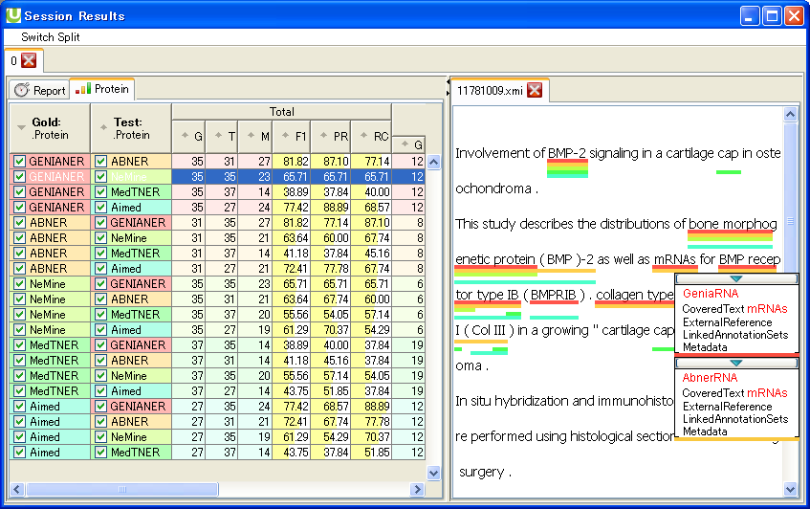
U-Compare: Statistics
Output Statistics
Comparison/Evaluation
Instance Base
Annotation Viewer

Slide 39
How to make your tool into U-Compare compatible
Requirements
  Should be UIMA compliant
    Stand-off annotation style
    Server like behavior, wait for a document and process
    Component descriptor xml file
  compatible the U-Compare type system
Three options depending on the tool type
options | language | type system | overhead | startup learning | portability
UIMA Java | Java | API | None | Needed | Fully
UIMA C++ | C++ | API | Little | Needed | Native
U-Compare Standard I/O | Any | Manual | Somewhat | Less | Native

Slide 40
Using Official UIMA API
Java or C++
Everything accessible via UIMA API
  Get and use the type system as objects
Complete but somewhat long official document
Eclipse plugin for development
  GUI for generating component descriptor and type system
Basically recommended when
  you are a Java programmer, I think no other option
  your annotations are complex/highly nested
  you need your own types extending the U-Compare types
  you need to use programmable flow controller and other UIMA features

Slide 41
Using U-Compare STDIO wrapper
Developer should prepare I/O interface of
  Input: character count + raw text + annotations
    20
    This is raw text part.
    0 4 Token id=“t0”
    …..
  Output: generated annotations
    0 4 PosToken id=“p0” pos=“NN”
    …..
  Annotations should use proper UIMA types

Slide 42
Using U-Compare STDIO wrapper
U-Compare provides wrapper part (yellow)
  Everything’s ready, now your tool is a UIMA component
Native Libraries (planned)
U-Compare STDI/O wrapper (Java)
Native Tool STDI/O
Receive and parse text+standoffs
Interpret standoffs
Process something
Generate new standoffs if any
#need to preserve id references
#modifications not recommended
Conversion
CAS:
Raw text
+
standoffs
Call wrapper
for each CAS
Conversion
UIMA runtime

Slide 43
Applications and Ongoing Projects

Slide 44
New Launchers
Java web start (JWS) version (obsolute)
  On-demand library download mechanism
  Very slow when connected from outside Japan
UCLoader by Goran (published)
  Command line tool
  Almost compatible with JWS
    faster
    but download all at startup
UCLoader Launcher (published)
  Easy launcher of executable jar
  calls UCLoader within inside

Slide 45
BioNLP ‘09 Shared Task
BioNLP ‘09 Shared Task on Event Extraction
  U-Compare officially supported the shared task
    as an organizer
    By providing the toolkit and visualization tool
  Performed ensembling by majority voting
    F1 score 4 points better (world best!) than 20+ participants results (see table below)
    Visualization and interoperability were important for the error analysis
Ensemble | Equal | Averaged | Event Type
(Top Participant) | (51.95)
Ensemble Top 6 | 55.13 | 55.77 | 55.96

Slide 46
Bio-Event Server
Collect the BioNLP shared task tools
  as U-Compare components (mainly as web services)
  by providing a wrapper package
Nine state-of-the-art systems participating
  currently under experiments
  public services upcoming
Possible to run event extraction tools with
  protein taggers for any text
  protein annotated corpus
  gold standard corpus with evaluation

Slide 47
Architecture
Simple interface (TXT+a1 -> a2) is the only requirement
  a1, a2 are the shared task format
U-Compare provides everything rest
Web Service
txt/a1 format
protein tagger + any text
annotated corpus
U-Compare
Platform
(Conversion,
Statistics,
Visualization)
Tomcat + AXIS + UIMA SOAP
Conversion
U-Compare UIMA Wrapper
Conversion
Conversion
Input: txt a1
Event Extracter
(your tool)
a2 format
stand-off annotation, etc.
Output: a2
UIMA
Workflow
Local Service

Slide 48
Cheta Project
OSCAR3
  Chemical NLP tools developed in U-Cambridge
Cheta funded by JISC
  Refactor, decompose and wrap into U-Compare components
  Nactem and U-Cambridge
  UK OMII partially performed refactoring

Slide 49
Taverna Integration (1)
Taverna is a workflow construction platform
  Generic but mainly used for bioinformatics
    Useful if text mining services available
  Connect services into workflows
    huge number of web services available (1000+?)
  Complex workflow but simple data structure
    Flat data structure assumed
      No type definition for data
      write format conversion everytime
    Not fitting to text mining / NLP

Slide 50
Taverna Integration (2)
U-Compare linked with Taverna
  (upcoming)
  GUI mode as a Taverna plugin and command line mode
  the first text mining system in Taverna
  working with Taverna myGrid team @ U-Manchester
Seamless integration for easy use
  Specify workflow, make post-process script
  But technically separate Taverna and U-Compare

Slide 51
New Workflow GUI
Refactoring the code and enhance the GUI
  By Luke and Pontus
  Tabbed workflow pane
  Better component view
  etc.

Slide 52
Migration to UIMA AS
Two workflow architecture in UIMA
  CPE, collection processing engine
    Still supported but an old one
  UIMA-AS, Asynchronous UIMA
    New, will be included in the UIMA main library
    Seem like stable now
    Asynchronous component processing supported with JMS
    Not effective for NLP scaleout (discuss later)
    But better in its technical design

Slide 53
Remote App Deployment
Deploy U-Compare application in remote server
  Originally designed for such usages
  RMI interface implemented as a part of Taverna integration
  Just to specify the server name (assuming there is a user account)
  Not for scale-out but for running heavy services

Slide 54
Connection w GuideLink/XConc
GuideLink/Xconc is an annotation tool
  made by Oouchida-kun and Miwa-san
Calls U-Compare workflows
  include as an automatic annotations
  to help annotators
U-Compare provides the APIs
GuideLink as a UIMA collection reader
  Active learning in future

Slide 55
BioCreative II.5 participation
BioCreative II.5
  Bio-Event extraction for the full text papers
  5 workflow variations for the same task (see next slide)
  Running the whole workflows using U-Compare
    Two components are web services to share resources
    Other components are locally deployed
    All of the components are wrapped using the U-Compare standard I/O wrapper
  Launched via a command line call

Slide 56
BioCreative II.5 workflow
Legend:
Component Name
Training Data
Sentence Splitter
GENIA corpus
Genia Sentence splitter
All
Tokenizer and POS tagger
Penn Treebank
Retokenizer
Stepp Tokenizer
and POS Tagger
3,4
All
All
Parser
Gdep Dependency Parser
Mogura HPSG Parser
All
Swissprot DataBase
Named Entity Normalizer
1,3
2,4
5
Tremble Database
SwissProt
Threasholded
SwissProt
All
5 Tremble
All
AIMED
PPI Detector and Reranker
AKANE PPI
BioCreative
Training Data
Reranker

Slide 57
New Components Planned
More syntactic resources
  POS taggers and dependency, CFG, HPSG parsers
  Annotated corpora readers and evaluation metrics included
More BioNLP resources
Japanese/Chinese and resources of other languages
etc.

Slide 58
Machine Learning Integration
Ongoing task
Creating new tools with ML
  Not just using existing tools
  Fund supported by Kakenhi (MEXT. Japan)
Use ClearTK, a UIMA-ML API by U-Colorado
  Supports SVM, CRF, MaxEnt as pure Java library
Supports easy feature extraction
Visualizations to help iterative improvement
  Includes feature effect analysis

Slide 59
Summary
U-Compare is
  based on UIMA
    UIMA is a widely used, excellent framework for the interoperability
  to provide what UIMA is missing
  world largest component repository
    U-Compare type system
U-Compare Integrated NLP Platform
  workflow creation, import/export/save/recover results…
  automatic combinatorial comparison
  pluggable evaluation
  statistics, visualizations, developer APIs
  everything available in http://u-compare.org/
Notes:
スライドのコピーを樽川さんに送付、印刷してもらう：水曜日～木曜早朝まで

Slide 60
We do the annoying bits
concentrate on your task.

Slide 61

U-Compare
http://u-compare.org

Slide 62
U-Compare Roadmap
2009
2010
2011
2012
Machine Learning Integration
Connection with ML Tools
Dataset Manager and Utilities
More Components
Cover all of the popular resources
English (including Biological/Chemical)
Machine Translation
Japanese
Chinese
System Enhancements
Visualizations focusing on NLP and ML
Developer APIs
Cluster Deployment
Search Engine and Interactive Filtering

Slide 63
U-Compare Tasks
2010
2011
2012
Machine Learning Integration
Connection with ML Tools
Dataset Manager and Utilities
More Components
Cover all of the popular resources
Syntactic Resources
Japanese, Chinese
Machine Translation
Generic (XML etc.)
System Enhancements
Visualizations focusing on NLP and ML
Workflow GUI Refactoring
Component Management and New Forum
Cluster Deployment

