Slide 1
GernEdiT – The GermaNet Editing Tool
Verena Henrich and Erhard Hinrichs
University of Tübingen
Department of Linguistics
LREC 2010, Malta, May 2010

Slide 2
Introduction
GernEdiT (GermaNet Editing Tool)
  User-friendly visual editing tool for GermaNet
  To facilitate internal consistency
Traditional development of GermaNet
  Based on lexicographer files
  Error prone due to a complex data format
  No automatic consistency checks
Notes:
Traditional development:
time-consuming
Difficult to detect syntax errors or inconsistencies
GernEdiT:
Navigation through the GemaNet graph
To facilitate internal consistency, appropriate linking of lexical units with synsets, connectedness of the synset graph, automatic closure
GernEdiT overcomes shortcomings

Slide 3
GermaNet
GermaNet is a lexical semantic wordnet that is modeled after the Princeton WordNet for English
Covers 3 word categories: adjectives, nouns, and verbs
Word meanings are represented by lexical units
Lexical units are grouped into semantic concepts (synsets) according to their meaning
A synset is a set of (near-)synonymous words

Slide 4
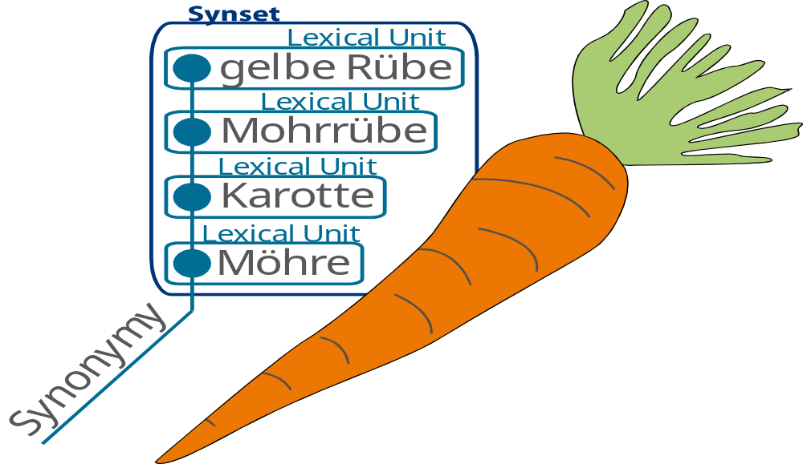
GermaNet: Lexical Units and Synsets

Slide 5
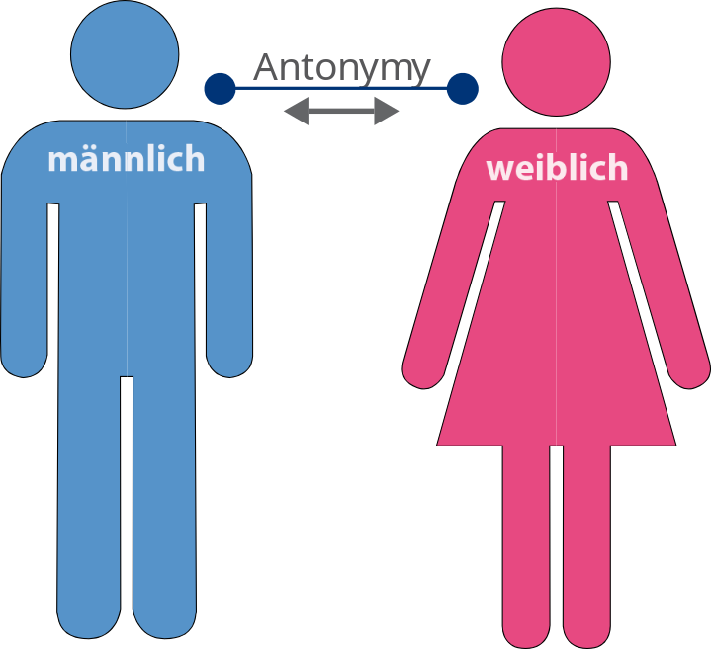
GermaNet: Relations
Two types of semantic relations: conceptual and lexical relations
Lexical relations hold between two lexical units, e.g., synonymy, antonymy, or pertonymy

Slide 6
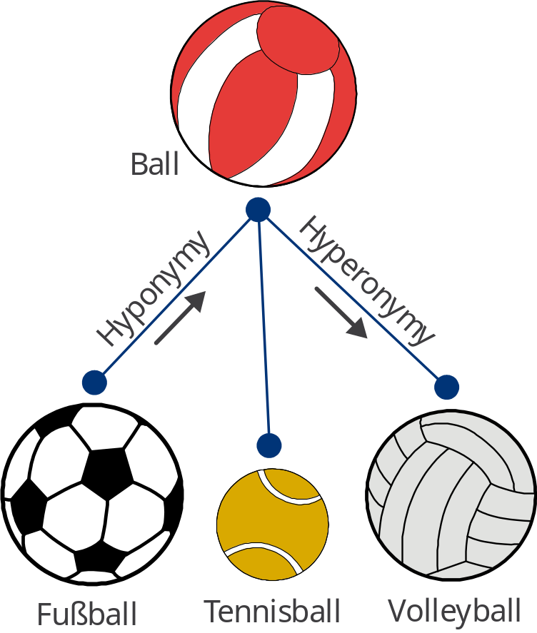
GermaNet: Relations
Conceptual relations hold between two synsets, e.g., hyperonymy, part-whole relations, entailment, or causation
GermaNet is hierarchically
structured in terms of the
hyperonymy-hyponymy
relation of synsets

Slide 7
Lexicographer Files Example
(*** Nüsse ***)
{Nuss, Nuß*o, Nusskern, ?festes_Nahrungsmittel,@ nomen.Pflanze:Nuss,@ ('der essbare Kern einer Nuss')}
{Haselnuss, Haselnuß*o, Haselnusskern, Haselnußkern*o, Nuss,@ nomen.Pflanze:Haselstrauch,#}
{Kokosnuss, Kokosnuß*o, Nuss,@ nomen.Pflanze:Kokospalme,#}
{Betelnuss, Betelnuß*o, Nuss,@ Genussmittel,@}
{Erdnuss, Erdnuß*o, Erdnusskern, Erdnußkern*o, Nuss,@ nomen.Pflanze:Erdnusspflanze,#}
{Cashewkern, Cashewnuss, Cashewnuß*o, Nuss,@ nomen.Pflanze:Acajubaum,#}
...
Notes:
Lexicographer files:
initially developed for the Princeton WordNet for English
plain text
contain synsets for a particular semantic domain and part of speech
Example from: nomen.Nahrung (nouns.food)

Slide 8
Lexicographer Files: Shortcomings
Three main problems
No visualization
  → Difficult to insert new items
Complex data format
  → Syntax errors and semantic inconsistencies
No versioning
  → Impossible to track back changes
Notes:
No visualization
→ Difficult to identify the appropriate anchor point for inserting new lexical units and synsets
Complex data format
semantic inconsistencies often remained unnoticed
No versioning
→ Impossible to track back changes or to undo specific edits that were introduced erroneously

Slide 9
GernEdiT – The GermaNet Editing Tool
Developed to overcome these shortcomings
No visualization
  →
Complex data format
  →
No versioning
  →

Slide 10
GernEdiT – The GermaNet Editing Tool
Developed to overcome these shortcomings
No visualization
  → Graphical tool (search and browse GermaNet)
Complex data format
  →
No versioning
  →

Slide 11
GernEdiT – The GermaNet Editing Tool
Developed to overcome these shortcomings
No visualization
  → Graphical tool (search and browse GermaNet)
Complex data format
  → User-friendly tool (with internal consistency checks)
No versioning
  →

Slide 12
GernEdiT – The GermaNet Editing Tool
Developed to overcome these shortcomings
No visualization
  → Graphical tool (search and browse GermaNet)
Complex data format
  → User-friendly tool (with internal consistency checks)
No versioning
  → Editing history
Notes:
1. No visualization
- Several ways to search data and browse through the GermaNet graph
- Finding the appropriate place in the hierarchy for the insertion of new synsets and lexical units
2. User-friendly tool
- To facilitate internal consistency, appropriate linking of lexical units with synsets, connectedness of the synset graph, automatic closure
3. Versioning
- collaborative annotation

Slide 13
GernEdiT – The GermaNet Editing Tool
Notes:
Relational database technology
Supports (XML) export formats

Slide 14
GernEdiT: Conceptual Relations Editor

Slide 15
GernEdiT: Examples and Frames

Slide 16
Conclusion
More efficient and accurate work
The tasks of the lexicographers are simplified
  No more need for syntactic work
  Navigation through the GermaNet graph
Additional functionalities
  Search functionalities
  Consistency checks
  Collaborative annotation and trace back changes
  Export formats
Notes:
- GernEdiT overcomes several shortcomings
More efficient and accurate work
- Less time is needed to extend the coverage of GermaNet
- The lexicographers‘ work has become significantly more accurate
- No more need for syntactic work → Concentration on lexical work
- Navigation through the GermaNet graph is much easier
- Trace back changes and verify who was responsible for them
Collaborative annotation by several lexicographers working in parallel

Slide 17
References
Kunze, C., Lemnitzer, L. (2002). GermaNet – representation, visualization, application. Proceedings of LREC 2002, main conference, Vol V. pp. 1485-1491.
Fellbaum, C. (ed.) (1998). WordNet – An Electronic Lexical Database. The MIT Press.

