Slide 1


Active Learning and Crowd-Sourcing for Machine Translation
Vamshi Ambati | Stephan Vogel | Jaime Carbonell
Language Technologies Institute
Carnegie Mellon University

Slide 2
Outline
Introduction
  Active Learning
  Crowd Sourcing
Density-Based AL Methods
Active Crowd Translation
  Sentence Selection
  Translation Selection
Experimental Results
Conclusions

Slide 3
Motivation
About 6000 languages in the world
  About 4000 endangered languages
  One going extinct every 2 weeks
Machine Translation can help
  Document endangered languages
  Increase awareness and interest and education
State of affairs today
  Statistical Machine Translation is state-of-art MT
  Requires large parallel corpora to train models
  Limited to high-resource top 50 languages only (< 0.01 % of world languages)

Slide 4
Our Goal and Contributions
Our Goal : Provide automatic MT systems for low-resource languages at reduced time, effort and cost
Contributions:
  Reduce time: Actively select only those sentences that have maximal benefit in building MT models
  Reduce cost: Elicit translations for the sentences using crowd-sourcing techniques
Active Learning
Crowd-Sourcing
+

Slide 5
Active Learning Review
Definition
  A suite of query strategies, that optimize performance by actively selecting the next training instance
  Example: Uncertainty, Density, Max-Error Reduction, Ensemble methods etc. (e.g. Donmez & Carbonell, 2007)
In Natural Language Processing
  Parsing (Tang et al, 2001, Hwa 2004)
  Machine Translation (Haffari et.al 2008)
  Text Classification (Tong and Koller 2002, Nigam et.al 2000)
  Information Extraction (McCallum 2002, Ngyuen & Smeulders, 2004)
  Search-Engine Ranking (Donmez & Carbonell, 2008)

Slide 6
Active Learning (formally)
Training data:
  Special case:
Functional space:
Fitness Criterion:
  a.k.a. loss function
Sampling Strategy:

Slide 7
Crowd Sourcing Review
Definition
  Broadcasting tasks to a broad audience
  Voluntary (Wikipedia), for fun (ESP) or pay (Mechanical Turk)
In Natural Language Processing
  Information Extraction (Snow et al 2008)
  MT Evaluation (Callison-Burch 2009)
  Speech Processing (Callison-Burch 2010)
AMT and crowd sourcing in general hot topic in NLP

Slide 8
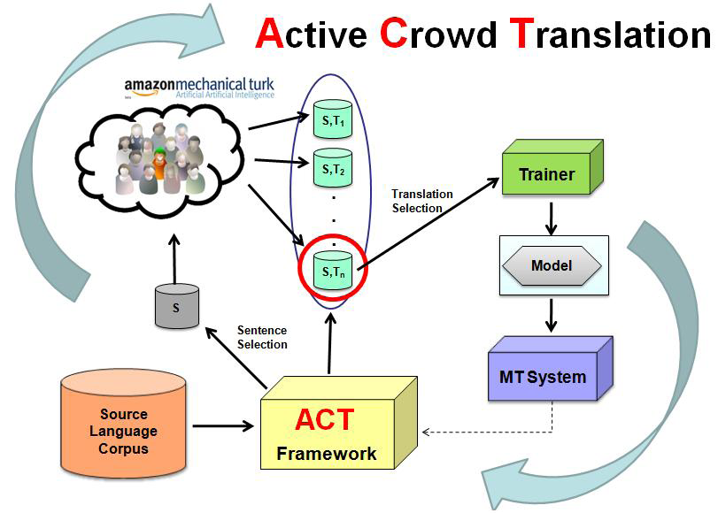
ACT Framework

Slide 9
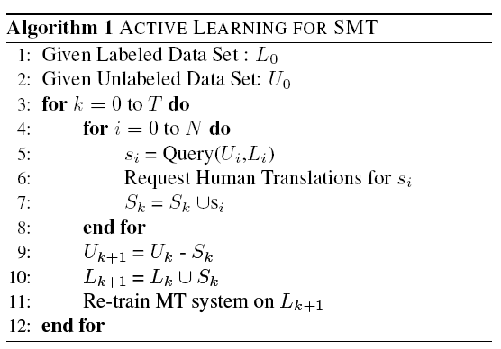
Sentence Selection for Translation via Active Learning

Slide 10
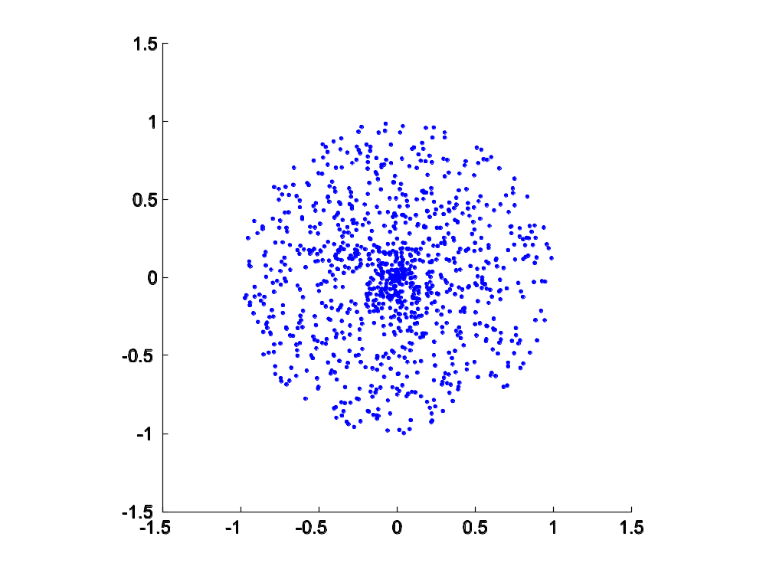
Density-Based Methods Work Best for MT
In general for Active Learning
Ensemble methods
Operating ranges
Specifically for AL in MT
Density-based dominates
Only one operating range
Beyond Eliciting Translations
S/T Alignments
  Lexical
  Constituent
Morphological rules
Syntactic constraints
Syntactic priors
Sample here

Slide 11
Density-Based Sampling
Carrier density: kernel density estimator
To decouple the estimation of different parameters
  Decompose
  Relax the constraint such that

Slide 12
Density Scoring Function
The estimated density
Scoring function: norm of the gradient
where

Slide 13
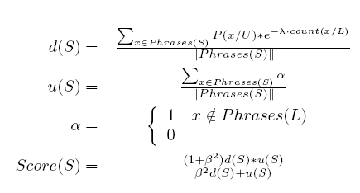
Sentence Selection via Active Learning
Baseline Selection Strategies:
  Diversity sampling: Select sentences that provide maximum number of new phrases per sentence
  Random: Select sentences at random (hard baseline to beat)
Our Strategy: Density-Based Diversity Sampling
  With a diminishing diversity component for batch selection

Slide 14



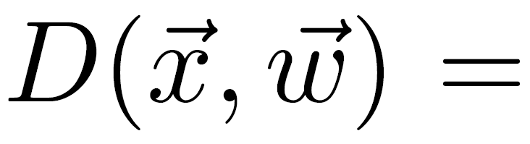
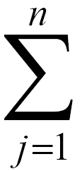
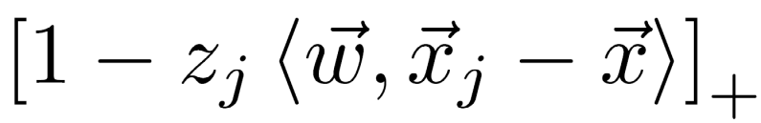

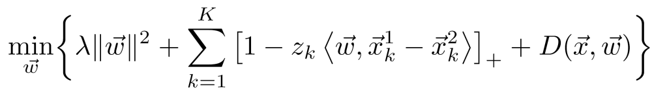
Active Sampling for Choice Ranking
Consider a candidate
Assume is added to training set with
Total loss on pairs that include is:
n is the # of training instances with a different label than
Objective function to be minimized becomes:
Notes:
We develop two active sampling methods, one for RankSVM and one for RankBoost.
We will start with active sampling for RankSVM.
Consider an unlabeled instance x. And assume it is added into the training set with the label y.
The total hinge loss on the pairs that include x then becomes this formula here. Jy is the # of instances in the training set with a different label than the label of x.
Then, the objective function for RankSVM to minimize can be written as follows where K is the current number of training pairs and we have this extra term here:

Slide 15
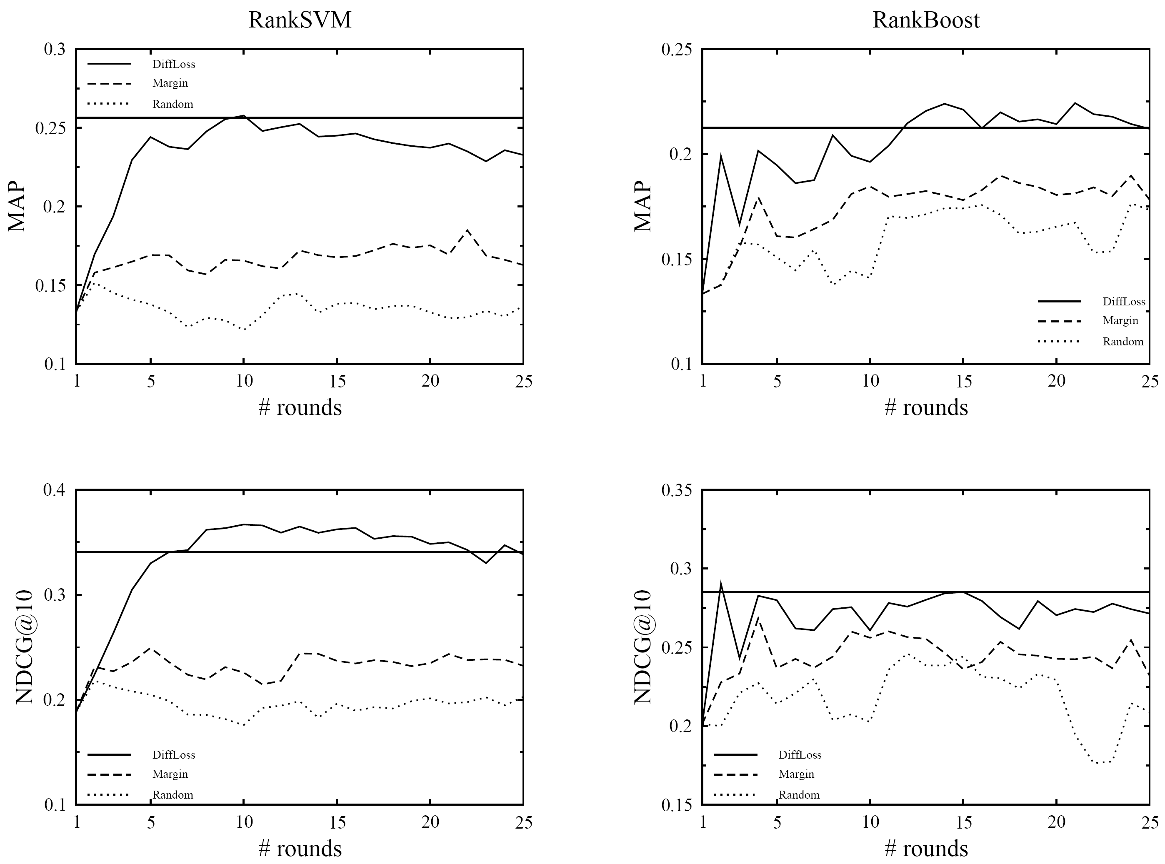
Aside: Rank Results on TREC03
Notes:
These are the comparative results on TREC03. In this graph, we plot the results on RankSVM on the left column, and the results
on RankBoost on the right column both in MAP and NDCG.
Our method is the solid line. We compared our method against margin based sampling and random sampling baselines.
The horizontal line indicates the optimal performance in the sense that the performance you could get if you used
the entire training data. Clearly, our method quickly reaches the optimal performance based on both metrics.

Slide 16
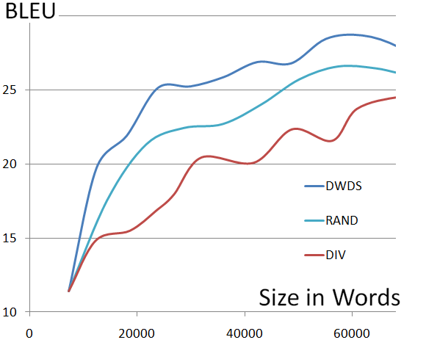
Simulated Experiments for Active Learning
Language Pair: Spanish-English
Corpus: BTEC
Domain: Travel domain
Data Size: 121 K
Dev set: 500 sentences (IWSLT)
Test set: 343 sentences (IWSLT)
LM: 1M words, 4-gram srilm
Decoder: Moses
* We re-train system after selecting every 1000 sentences
Spanish-English Sentence Selection results in a simulated AL Setup

Slide 17

Translation via Crowd Sourcing
Crowd-sourcing Setup
  Requester
  Turker
  HIT
Challenges
  Expert vs. Non-Experts: How do we identify good translators from bad ones
  Pricing: Optimal pricing for inviting genuine turkers and not greedy ones
  Gamers: Countermeasures for gamers who provide random output or use automatic translation services for copy-pasting translations

Slide 18
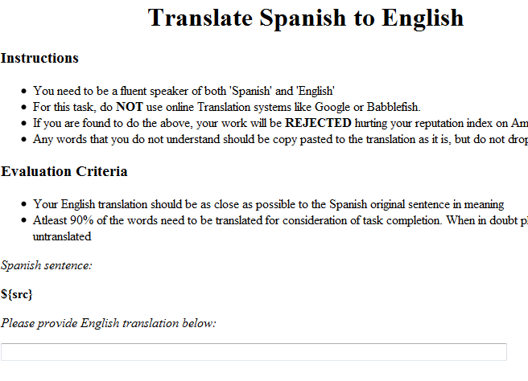
Sample HIT template on MTurk
Statistics for a batch of1000 sentences:
Eliciting 3 translations per sentence
Short sentences (7 word long)
Price: 1 cents per translation
Total Duration: 17 man hours
Total cost: 45 USD
No. of participants: 71
Experience
Simple Instructions
Clear Evaluation guidelines
Entire task no more than half page
Check for gamers, random turkers early

Slide 19
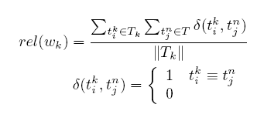
Translation via Crowd-Sourcing
Translation Reliability Estimation
Translator Reliability Estimation
One Best Translation
Summary:
Weighted majority vote translation
Weights for each annotator are learnt based on how well he agrees with other annotators

Slide 20
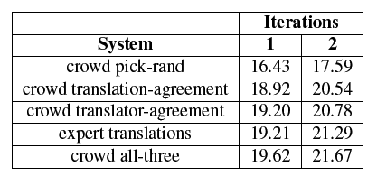
Crowd-sourcing Experiments for Spanish-English
Random hurts !
Using all three works better !
Iteration 1 : 1000 sentences translated by 3 Turkers each
Iteration 2 : 1000 sentences translated by 3 Turkers each

Slide 21
Ongoing and Future Work
Active Learning methods for Word Alignment (Ambati, Vogel and Carbonell ACL 2010)
Model-driven and Decoding-based Active Learning strategies for sentence selection
Explore crowd-landscape on Mechanical Turk for Machine Translation (Ambati and Vogel, Mturk Workshop at NAACL 2010)
Cost and Quality trade-off working with multiple annotators in crowd-sourcing
  Untrained annotators (many, inexpensive)
  Linguistically trained (few, expensive)
Working with linguistic priors and constraints

Slide 22
Conclusion
Machine Translation for low-resource languages can benefit from Active Learning and Crowd-Sourcing techniques
  Active learning helps optimal selection of sentences for translation
  Crowd-Sourcing with intelligent algorithms for quality can help elicit translations in a less-expensive manner
Active Learning
Faster and Cheaper Machine Translation Systems
+ =
Crowd Sourcing

Slide 23
Q&A
Thank You!

