Slide 1
Resource Creation for Training and Testing of Transliteration Systems for Indian Languages
Sowmya V.B.*, Monojit Choudhury*, Kalika Bali*, Tirthankar Dasgupta◊, Anupam Basu◊
*Microsoft Research Lab India, Bangalore, India
◊Society for Natural language Technology Research, Kolkata, India

Slide 2
Outline
Transliteration for Indic Languages
  Back transliteration for IME
The Methodology for Collection and Transcription
Data Analysis
  Spelling Variation
  Code-Mixing
Conclusion

Slide 3
Transliteration
Transliteration is the process of mapping a written word from a language-script pair to another language-script pair.
Back-transliteration used for Indic Input Method Editors
Example:
  “परम” → “param” Forward Transliteration
  “शेयर” →“share” Backward/Reverse Transliteration

Slide 4
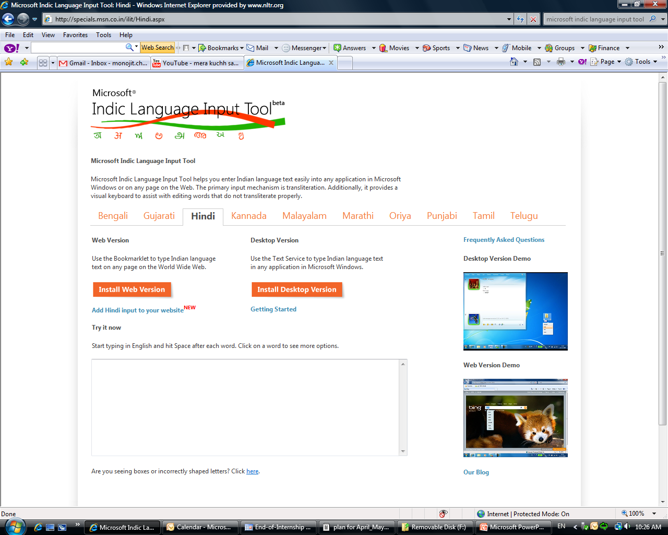
MS Indic Language Input Tool

Slide 5
Methodology for Collection
Three Languages: Hindi, Bangla and Telugu
18-20 near-native speakers for each language
Users of Roman script for Indic language for email, chat, text etc
For Hindi, regional variations represented in the demographics
Mode of Collection
  No “look and type”
  controlled and uncontrolled
  Collect natural user data

Slide 6
Methodology for Collection
Dictation (Controlled) :
  a set of 550 sentences for each language ranging from news corpus to blogs and other web content.
  The selected sentences covered as many of the valid letter-letter combinations for that particular language as possible.
  Recorded by native speakers of the language.
  Every user was given 75 sentences for transcription. 50 sentences were common to all users and 25 were unique to a given user.

Slide 7
Methodology for Collection
Scenario Writing (Uncontrolled) :
  Users asked to choose two from topics ranging from popular movies to current news
  Mimics blogging or email
  Can edit and no time constraint
  100 words per user

Slide 8
Methodology for Collection
Chat (Uncontrolled) :
  Users asked to chat with researcher on topics like plan of the day, the weather, etc
  Real-time communications
  No scope for intensive editing
  75 words per user

Slide 9
Methodology for Transcription
Back-transliterated manually
Transcribers were instructed to mark
  Code-mixing
  Numerals
Transcribed Unicode data aligned at word-level with User data (ASCII) semi-automatically
Mismatches aligned manually using a simple UI

Slide 10
Data Analysis
Total of ~2600 words per language
Mode of Data Collection | Bangla | Hindi | Telugu
Dictation (Common) | 6427 | 12934 | 13360
Dictation (Unique) | 4016 | 6592 | 6030
Scenario | 3377 | 4044 | 4279
Chat | 2648 | 2698 | 2276
Total | 16468 | 26268 | 25945

Slide 11
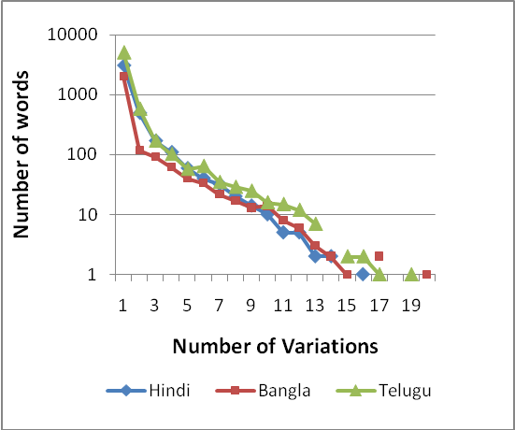
Spelling Variation
A significant percentage of words show spelling variation
Zipf’s law: number of variants of high frequency words will be large, whereas that of the low frequency words will be fewer
No. of variations of word (x-axis) vs No. of words having that much variation

Slide 12
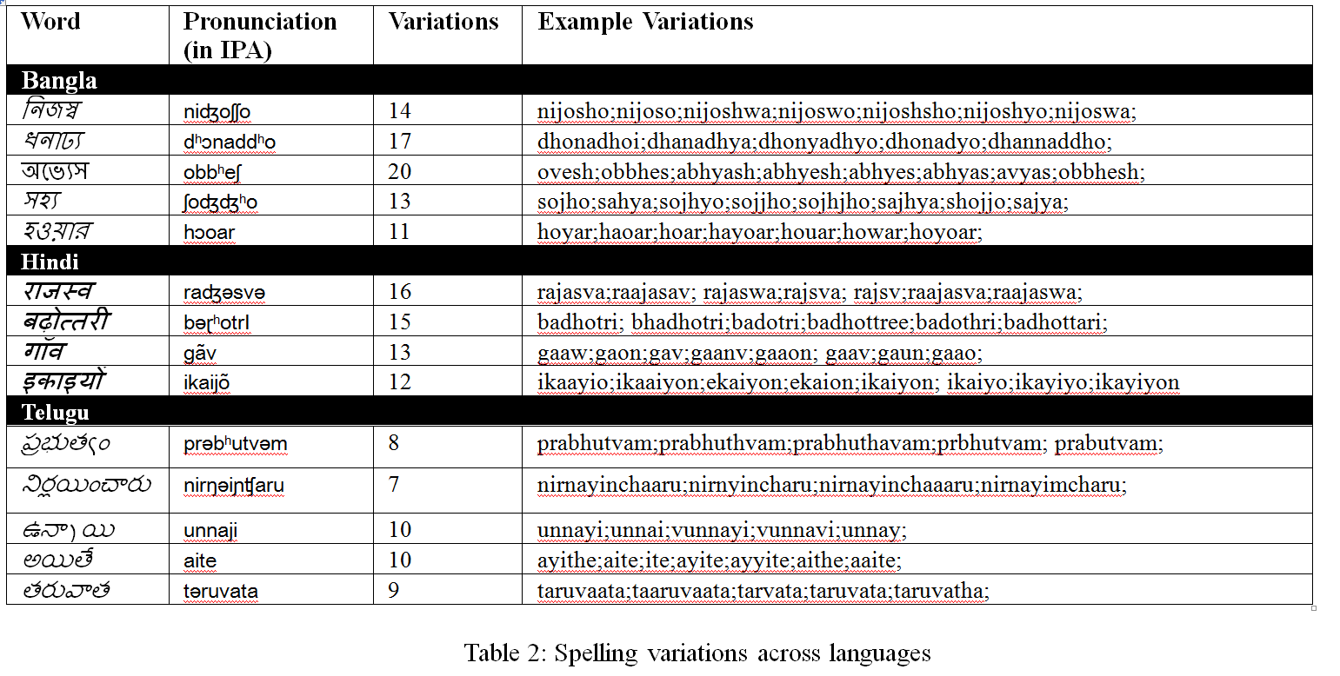
Spelling Variation

Slide 13
Spelling Variation
Mapping >50 graphemes to 26 alphabets
Consonants show less variation than vowels
  राज being written raj, raaj, raja, raaja
Regional conventions
  ప్రభుత్వం being written as prabhutvam, prabutvam, prabhuthvam

Slide 14

Code-Mixing
Code-mixing, or the interspersing of English words in Indian language, is frequently observed in chat, blog and email texts
“This is a cricket ball”
yaha kriket ball hai
Potential code-mixing
Genuine code-mixing

Slide 15
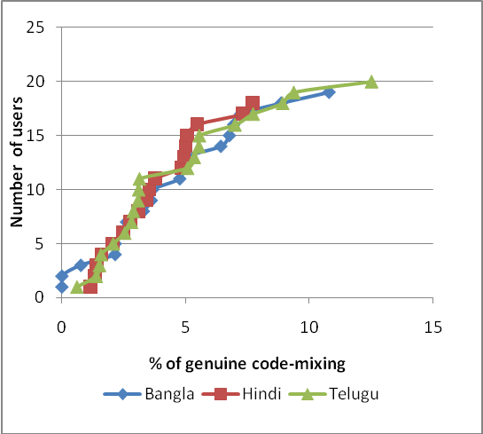
Code-Mixing
The average %age of genuine code-mixing for Bangla, Hindi and Telugu 8%, 11% and 12%, respectively
13 users for Bangla, 15 for Hindi and 16 for Telugu show less than 6% genuine code-mixing.
10 users for Hindi and 2 for Telugu had 100% genuine-to-potential code-mixing.

Slide 16
Code-Mixing
Chat data had more cases of genuine code mixing compared to scenario data – across all languages.
The extent of genuine code-mixing across users have a similar trend for all the languages.
The ratio of genuine to potential code-mixing is less than 50% for a considerable number of Bangla users. This indicates that there is a high tendency for Bangla users to type in non-English sound-based spellings for English words.

Slide 17
Conclusion
Design and creation of a dataset for Hindi, Bangla and Telugu transliteration data
Can be used for systematic evaluation as well as training of Machine Transliteration based systems, IMEs and others
Methodology can be used for transliteration dataset creation
Currently in the process of expanding this to other languages like Kannada and Tamil
Initial analysis shows certain linguistic and socio-linguistic basis for user variations
Deeper analysis to understand the effect of these features on user data

Slide 18
Questions?
Thank-You

