Slide 1
Indexing Methods for Faster and More Effective Person Name Search
Mark Arehart
MITRE Corporation
marehart@mitre.org

Slide 2
Goals
Not about NER per se.
Assume NER is already done.
Make output useful to users
  Searchable with approximate matching
  Not an offline process: fast response time
Balance search effectiveness and speed.

Slide 3
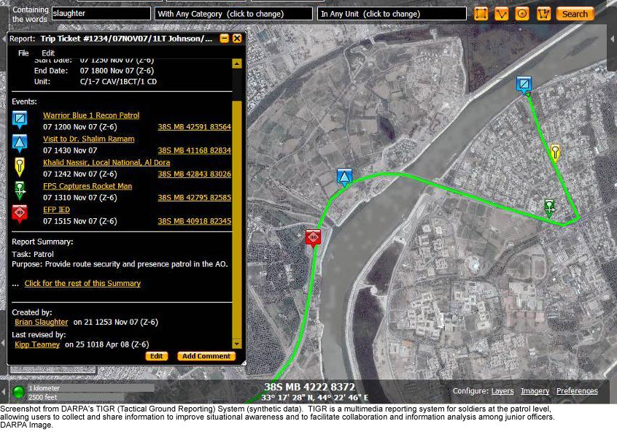
Context: DARPA TIGR system
Notes:
Tactical Ground Reporting (TIGR) System, a ``multimedia geospatial information management system''\footnote{See http://www.darpa.mil/ipto/programs/assist/assist\_tigr.asp}. The goal was to supplement a generic text search capability with intelligent fuzzy matching of Romanized names. Because the reports contained in the system are unstructured, names must first be extracted from the text and indexed, a process described by \cite{miller10}.

Slide 4
Person Names in TIGR
Entered by soldiers in reports.
Users lack linguistic expertise.
Spelling/transliteration variation.
Data entry errors.
Generic text search provided by IR system does not compensate.
Name index created by NER (Miller et al 10).

Slide 5
Approximate Name Matching
Research community:
  phonetic keys
  n-gram matching
  edit-based measures (with fixed, variable, or learned edit costs)
  Frequency-based measures
  String based and token-based
  Refs: Winkler 90, Zobel and Dart95, Ristad and Yianilos 98, Bilenko and Mooney 03, Cohen et al 03, Christen 06.
Commercial systems (expensive)

Slide 6
Performance Problem
Fuzzy-matching is slow.
2000 comps/sec sounds fast, right?
Match query to every database name:
query_time = size_db * avg_match_time
0.5 ms times db size of 100,000 = 50 seconds per query.
Not fast.

Slide 7
Solution Part 1
Make comparison function faster.
Say you more than double the speed through code optimization.
0.18ms * 100,000 records = 18 seconds.
Much better, but…

Slide 8
Solution Part 2
Pass 1: blocking
  developed in record linkage (Winkler 06 for overview)
  quick (dumb) retrieval of candidates.
Pass 2: matching
  slow (smart) comparison function.
Blocking function must:
  Retrieve a small subset of the db.
  Do so quickly.
  Include all the true matches.
Notes:
Blocking: dividing the records into groups (blocks) based on one more more shared attribute values, such as postal code or surname \cite{newcombe88,winkler99,winkler06,baxter03,christen07,devries09} in a database context.
Matching strings rather than structured records, blocks can be based on substrings or phonetic keys, e.g.\ \cite{zobeldart95,cohen03tasks}, which is the approach taken here. Closely related are statistical techniques for clustering records, which can be based on fast but approximate distance measures \cite{mccallum00}.
IR: related problem of performing approximate matching of short query strings against large texts or vocabularies, using indexes constructed from substrings \cite{pfeifer95,navarro01}.

Slide 9
Two-Pass Matching
Create text index of database names.
Each name is indexed by one or more keys.
At query time, generate keys for query name.
Retrieve candidates using direct key lookup.
Apply comparison function to candidates.

Slide 10
Ways to Make Keys
Original name = Saddam Hussein Al Tikriti
Exact → [SADDAM, HUSSEIN, (AL), TIKRITI]
Substring → [SADD, HUSS, (AL), TIKR]
Phonetic → [STM, HSN, (AL), TKRT]
Better to not index particles like AL, ABU, BIN

Slide 11
Key-based Index
STM → [Saddam Hussein Al Tikriti,
Saddam Husein, …]
HSM → [Saddam Hussein Al Tikriti,
Hosein Mohamed,
Ahmed Hassan, …]
TKRT → [Saddam Hussein Al Tikriti,
Uday Hussein Al Tikriti, …]

Slide 12
Retrieval Using Keys
Generate keys from query name.
  Refinement: don’t index particles (using stoplist).
Return names associated with each key.
  Refinement: for longer names, require more than one key match.
Do fuzzy matching on the retrieved candidates.

Slide 13
Evaluation
Existing datasets not appropriate.
  String matching research: too small or not right kinds of variations (Pfeifer 95, Zobel and Dart 95, Cohen et al 03, Bilenko and Mooney 03)
  Record linkage: multiple data fields (Winkler 06)
Our test set (previously developed) of approx 700 queries run against 70,000 names.
  Test data is noisy and multicultural.
  Contains many kinds of Arabic name variants.
Runs evaluated for accuracy and speed.
Notes:
Many previous evaluations of name matching algorithms have been based on data sets that are not appropriate for our use case. These sets are too small, include only surnames, contain too few sources of variation, or include strings other than person names. Some examples are 14K surnames \cite{pfeifer95}, 32K surnames with primarily typographical errors \cite{zobeldart95}, 13K strings including names of restaurants, businesses, and birds \cite{cohen03tasks,cohen03records}, and fewer than 4K restaurant and citation records \cite{bilenkomooney03}. Data sets used in record linkage research, while larger, usually contain multiple fields such as name, address, and SSN \cite{winkler06} and are not directly applicable here.

Slide 14
Matching Functions
JaroWinkler: generic string matching baseline
Level 2 JaroWinkler: tokenized
Romarabic: custom algorithm (Freeman 06)
  dictionary of common variants
  name part similarity backs off to edit distance
  aware of multi-segment name parts
  finds optimal alignment
Notes:
comparison algorithms: phonetic keys, n-gram matching, edit-based measures (with fixed, variable, or learned edit costs), and frequency-based measures \cite{winkler90,zobeldart95,ristadyianilos98,bilenkomooney03,cohen03tasks,cohen03records,christen06}. The algorithms evaluated in the research community are typically derived from generic string-matching techniques. Commercial products employ proprietary algorithms that may be highly knowledge intensive, for example by incorporating hand-compiled dictionaries of nicknames and spelling variants. Various U.S.\ government agencies have developed their own in-house algorithms as well, such as the U.S.\ National Security Agency's Aladdin Name Matcher\footnote{See http://www.nsa.gov/research/tech\_transfer/fact\_sheets/ aladdin\_name\_matcher.shtml}.
Three comparison functions were tested. JaroWinkler \cite{jaro89,winkler90} and Level 2 JaroWinkler \cite{mongeelkan96} represent generic string-matching baselines\footnote{JaroWinkler implementations from SecondString: http://secondstring.sourceforge.net/.}. JaroWinkler compares two names as single strings, whereas Level 2 JaroWinkler tokenizes them, using the JaroWinkler metric to compare token pairs. For the Level 2 metric, each query token is compared to all the index tokens, and for each query token the maximum pairwise score is saved. The overall similarity score is the average pairwise score. This algorithm has peculiar properties in the context of matching names. For example, a single token in the index name may be matched to more than one token in the query name. Also, because the names are treated as bags of tokens, there is no penalty for reordering of name segments.
In addition to these generic routines, a previously developed custom name-matching algorithm was tested. The custom algorithm, Romarabic \cite{freeman06}, is specialized for Romanized Arabic names, which are heavily represented in the test set and important to the end users of the information retrieval system. It identifies multi-segment name parts like \textit{Bin Mohammed}, as discussed in the previous section, and matches them as units. It also employs a dictionary of similarity values for common transliteration variants. The algorithm backs off to Levenshtein edit distance for unrecognized name segments. After computing the similarity values among all the name parts in two names, it finds the optimal alignment (the most computationally intensive part of the algorithm). The alignment depends both on the pairwise similarity scores and the amount of reordering. The details of the algorithm and its implementation are beyond the scope of this paper. For present purposes, it can be viewed as a black box that offers higher effectiveness at the cost of slower performance, which must be ameliorated by one of the blocking techniques evaluated here.

Slide 15
JaroWinkler
Indexing | Stopwords | ms per query | p | r | f
None | n/a | 326 | 0.82 | 0.26 | 0.39
Substring | no | 11 | 0.83 | 0.25 | 0.39
 | yes | 10 | 0.83 | 0.25 | 0.39
Custom phon | no | 26 | 0.83 | 0.25 | 0.39
 | yes | 21 | 0.83 | 0.25 | 0.39
Exact | no | 10 | 0.84 | 0.25 | 0.39
 | yes | 9 | 0.84 | 0.25 | 0.39
Metaphone | no | 17 | 0.83 | 0.25 | 0.39
 | yes | 14 | 0.83 | 0.25 | 0.39

Slide 16
Level 2 JaroWinkler
Indexing | Stopwords | ms per query | p | r | f
None | n/a | 1148 | 0.47 | 0.36 | 0.40
Substring | no | 35 | 0.47 | 0.39 | 0.40
 | yes | 30 | 0.47 | 0.39 | 0.41
Custom phon | no | 79 | 0.47 | 0.36 | 0.40
 | yes | 61 | 0.47 | 0.36 | 0.41
Exact | no | 33 | 0.46 | 0.35 | 0.40
 | yes | 27 | 0.70 | 0.33 | 0.45
Metaphone | no | 53 | 0.47 | 0.36 | 0.40
 | yes | 45 | 0.47 | 0.36 | 0.40

Slide 17
Romarabic
Indexing | Stopwords | ms per query | p | r | f
None | n/a | 13,419 | 0.58 | 0.56 | 0.57
Substring | no | 379 | 0.60 | 0.59 | 0.60
 | yes | 279 | 0.60 | 0.59 | 0.60
Custom phon | no | 985 | 0.61 | 0.56 | 0.59
 | yes | 667 | 0.62 | 0.56 | 0.59
Exact | no | 349 | 0.61 | 0.58 | 0.60
 | yes | 244 | 0.65 | 0.54 | 0.59
Metaphone | no | 639 | 0.62 | 0.56 | 0.59
 | yes | 488 | 0.62 | 0.56 | 0.59
Notes:
Among all indexing methods, the average time is 3.8\% of the time required without indexing. The use of stopwords reduces time per query by an average of 28\% compared to the same indexing method without stopwords. The best-performing method in terms of speed and effectiveness was prefix-based indexing with stopwords, which scored three F1 points higher than the exhaustive matching while taking just 2.1\% as long. This improvement in F1 is statistically significant, with a p-value $<$ 0.01. All of the indexed runs had significantly higher F1 scores than the baseline run: the metaphone and custom keys at the 0.05 significance level, and exact and prefix keys at the 0.01 level. The differences bewteen the indexing methods were not significant. The significance levels were determined by using 5000 trials of bootstrap resampling, as described in previous work \cite{AREHART08.647}. That the simple prefix method performed as well as the more knowledge-intensive phonetic codings was an unexpected result.

Slide 18
Conclusion
For NER to be useful, system performance must be considered.
  Most accurate matcher may be impractical
Multiple pass algorithm
  Speed/accuracy not a tradeoff here.
Very simple methods are often the best.
  custom phonetic key did worse than prefix
Important to use large and realistic test set.

