Slide 1
MULTEXT-East Version 4:
Multilingual
Morphosyntactic Specifications, Lexicons and
Corpora
Tomaž Erjavec
Department of Knowledge Technologies
Jožef Stefan Institute
Ljubljana
Slovenia
LREC 2010
Malta

Slide 2
Overview
Specifications (comprehensive)
(define features and MSD tagsets)
Ncmsn ≡ [Noun, Type=common, Gender=masculine, Number=singular, Case=nominative]
Lexicons (medium sized)
(wordform/lemma/MSD triplets)
abstinent abstinent Ncmsn
Corpora (small)
(part annotated & sentence aligned)
<w xml:id="Osl.1.5.25.8.4"
lemma="abstinent“
ana="#Ncmsn">abstinent</w>

Slide 3
Motivation
Interoperability for multilingual applications:
  tagsets developed for various languages (or even for the same language) have no connection with each other and are often poorly documented
BLARK best practice:
  many languages do not yet have a morphosyntactic tagset and associated resources and could benefit from an operational framework in which to model them

Slide 4
Background
EAGLES: Expert Advisory Group for Language Engineering Standards
(1993-1996)
MULTEXT: Multilingual Text Tools and Corpora (1995)
MULTEXT-East: MULTEXT for Central and Eastern European Languages:
  Version 1: TELRI edition (1998)
  Version 2: Concede edition (2002)
  Version 3: TEI edition (2004)
  Version 4: MondiLex edition (2010)

Slide 5
Multilingual
Morphosyntactic Specifications, Lexicons and Corpora
Polish (West Slavic)
Czech (West Slavic)
Slovak (West Slavic)
Slovene (South West Slavic)
Resian (dialect of Slovene)
Croatian (South West Slavic)
Serbian (South West Slavic)
Russian (East Slavic)
Ukrainian (East Slavic)
Macedonian (South East Slavic)
Bulgarian (South East Slavic)
added in V4
updated in V4
English
Romanian
Estonian
Hungarian
Persian

Slide 6
MULTEXT-East morphosyntactic specifications in Version 4
Encoded in XML TEI P5 (in Version 3: LaTeX)
In form still follow the original MULTEXT specs
but add many extensions:
  localisation of feature names and MSDs
  language specific MSDs
  Vm-----d → Vmd
XSLT scripts:
  for adding new languages (consistency checking)
  for HTML display
  for creating tabular files of various mappings
  → HTML and tabular files part of the distribution

Slide 7
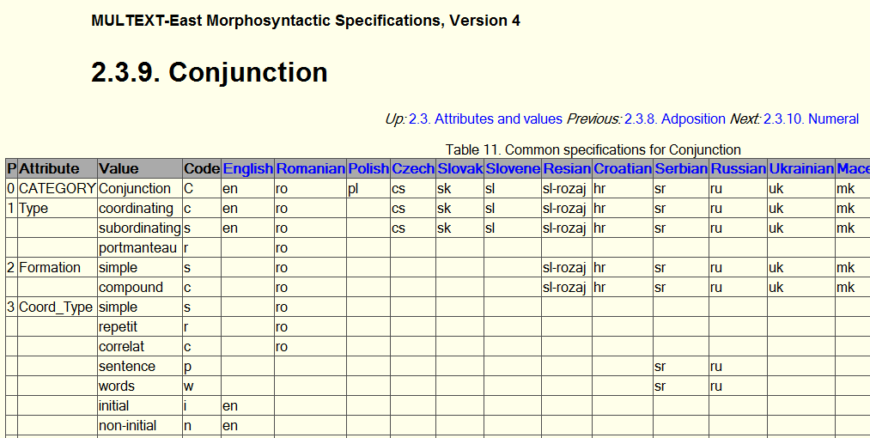
Common tables (HTML)

Slide 8
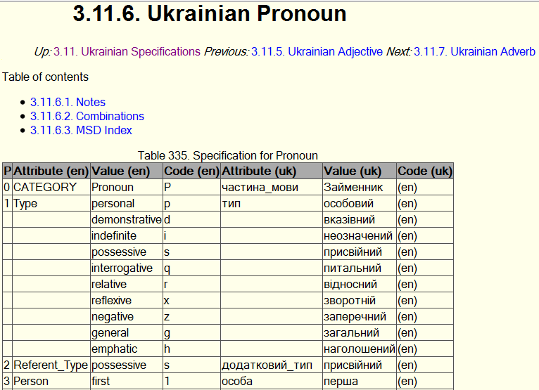
Language particular tables

Slide 9
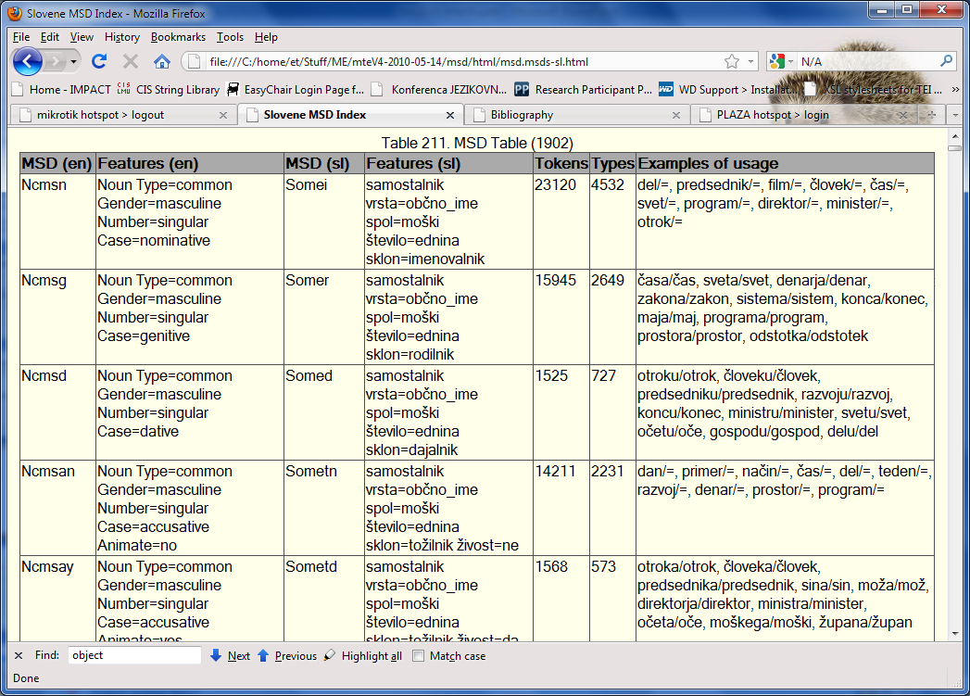
MSD tag lists

Slide 10
Related work
Vocabularies of linguistic features:
  GOLD, http://linguistics-ontology.org/
  ISO TC 37 / LMF / isoCat: http://www.isocat.org/
…connecting MULTEXT-East features with isoCat and GOLD

Slide 11
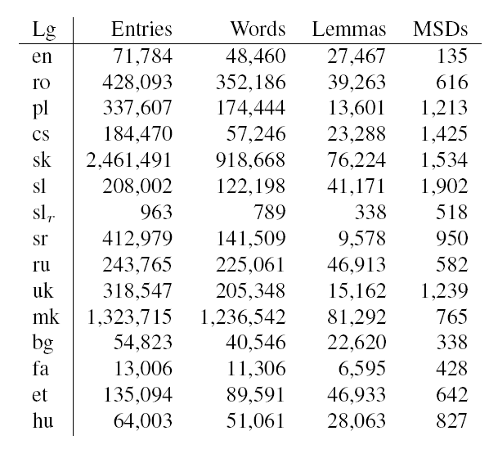
MULTEXT-East lexica

Slide 12
MULTEXT-East corpora
in V4: XML TEI P5
small parallel corpus of spoken texts taken from the EUROM-1 speech corpus
comparable corpus (2x100.000 words)
  fiction
  newspaper articles
parallel corpus, Orwell’s “1984”

Slide 13
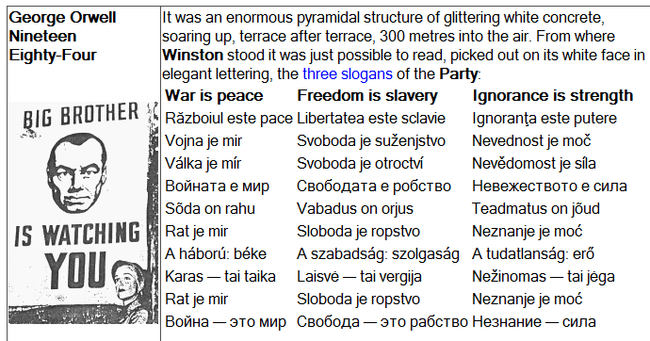
tagged with morphosyntactic descriptions and lemmas
sentence aligned
nice (if small) dataset for various experiments

Slide 14
Distribution
http://nl.ijs.si/ME/V4
Documentation, browsing and download
Specifications & speech corpus:
Creative Commons BY SA
Lexica and text corpora:
freely avaialable for research use
(after filling out a web agreement form)

Slide 15
Further work
Correct mistakes..
Other East European languages
Add missing resources for current languages
Relation to standards (isoCat)
Unify (Slavic) features
Western European languages?

Slide 16
Conclusions
Presented MULTEXT-East V4
Covers most Slavic languages
Resources uniformly encoded in XML TEI P5
As freely available as possible
Up to V3 over hundred registered users,
hopefully many more to come..

Slide 17
Acknowledgements
Adam Radziszewski
Aleksandar Petrovski
Anna Feldman
Behrang QasemiZadeh
Csaba Oravecz
Cvetana Krstev
Dagmar Divjak
Igor Shevchenko
Ivan Derzhanski
Katerina Čundeva
Marcin Woliński
Mikhail Kopotev
Natalia Kotsyba
Radovan Garabík
Serge Sharoff
EU FP7 Capacities - Research Infrastructures project MONDILEX "Conceptual Modelling of Networking of Centres for High-Quality Research in Slavic Lexicography and Their Digital Resources"

