Slide 1

WITcHCRafT: A Workbench for Intelligent exploraTion of Human ComputeR conversations
Alexander Schmitt, Gregor Bertrandt, Tobias Heinroth, Wolfgang Minker
LREC Conference, Valletta, Malta | May 2010

Slide 2
Overview
Motivation
Prediction and Classification Models
Features
Demo

Slide 3
Motivation I: Interactive Voice Response Development
Informational
Transactional
Problem Solving
How to handle, explore and mine corpora of 100k dialogues with 50 exchanges and more?
Banking
Customer Care
Package Tracking
Stock Trading
Technical Support
Weather Information
Flight Reservation
low
medium
high
Complexity
Vision:
Create a framework that allows an exploration and mining of huge dialog corpora
Notes:
Source: Roberto

Slide 4
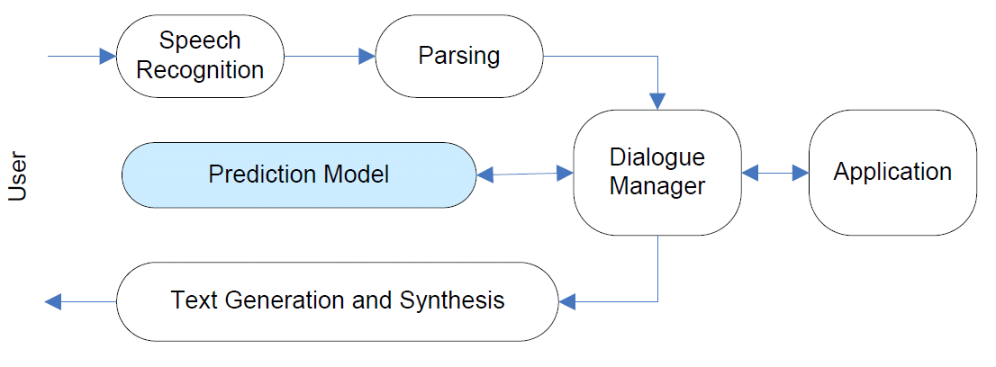
Motivation II: Towards Intelligent IVRs
Strive for “intelligent” Voice User Interfaces
Many studies that explore
  Emotional State, Gender, Age, Native/Non-”Nativeness”, Dialect etc. (Metze et al., Burkhardt et al., Lee & Narayanan, Polzehl et al.)
  Probability of Task Completion (Walker et al., Levin & Pieraccini, Paek & Horvitz, Schmitt et al.)
  …
Evaluation takes place on corpus level, i.e. Batch-Testing
What does it mean for the user when we deploy an anger detection system that reaches 78% accuracy?
Vision:
Create a framework that simulates the deployment of prediction models on specific dialogs
Notes:
two billion subscribers in 2005
to approximately 3.3 billion in 2010
10 % growth each year (market research firm Market Intelligence Center (MIC))
Such growth will come mainly from Asia,the Middle East and Africa.The Middle East is expected to chalk up the highest growth rate,followed by,in descending order,Africa,Asia,Eastern Europe,Latin America,North America and Western Europe.
The user interface of the Mobile phone was intended for calls, not for sophisticated applications.

Slide 5
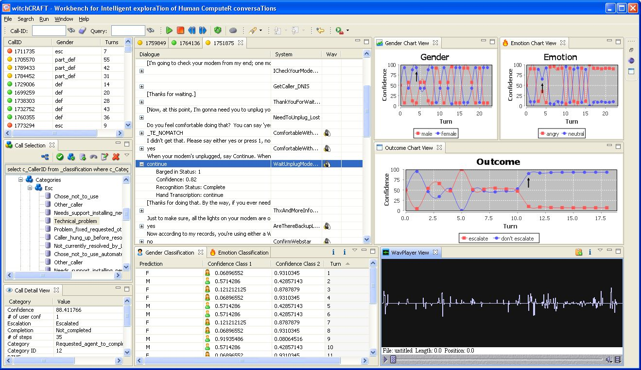
Introducing Witchcraft
Would you trigger escalation to an operator based on a classifier with 78% accuracy?

Slide 6
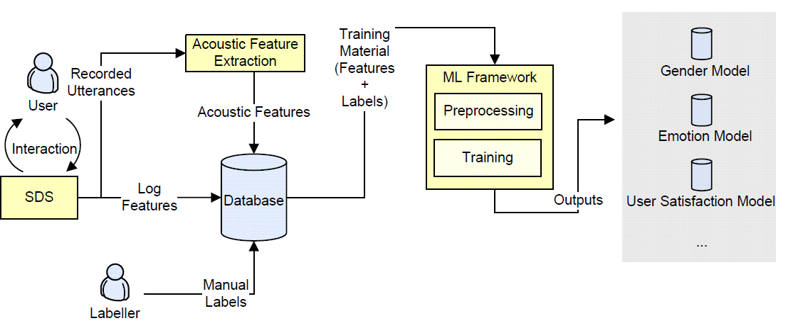
Training Prediction and Classification Models

Slide 7

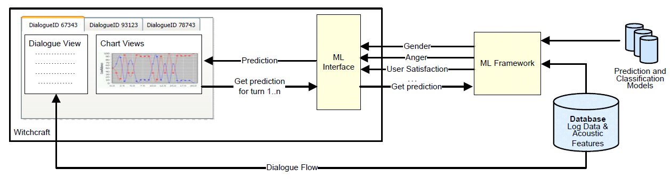
Employing Prediction Models in Witchcraft
Procedure
Define model in Witchcraft, e.g. “Age Model”, „Cooperativity Model“ etc.
Determine which type it belongs to
  Discriminative binary classification
  Discriminative multi-class classification
  Regression
Define Machine Learning Framework and Process Definition
  currently RapidMiner or XML interface
“Brain” the call

Slide 8

What can Witchcraft do for you?
Exploring and Mining
Manage large dialog corpora
Group different calls by category
Simulate the interaction between user and system based on interaction logs
Listen to
  full recordings
  concatenated user utterances
Implement own plugins
Model Testing
Analyze the impact of your classifiers on an ongoing interaction
Evaluate discriminative classification and regression models
Retrieve precision, recall, f-score, accuracy, least mean squared error etc. on call level
Search for calls with low performance
Tune your model
Technical Things | …and…
Based on Java and Eclipse RCP Database: MySQL Currently connected Machine Learner: RapidMiner | Get your download at witchcraftwb.sourceforge.org

Slide 9
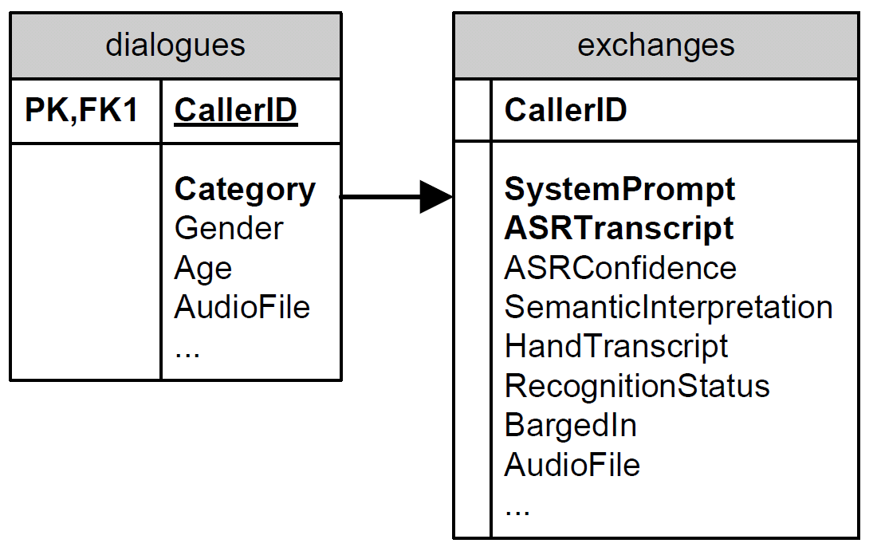
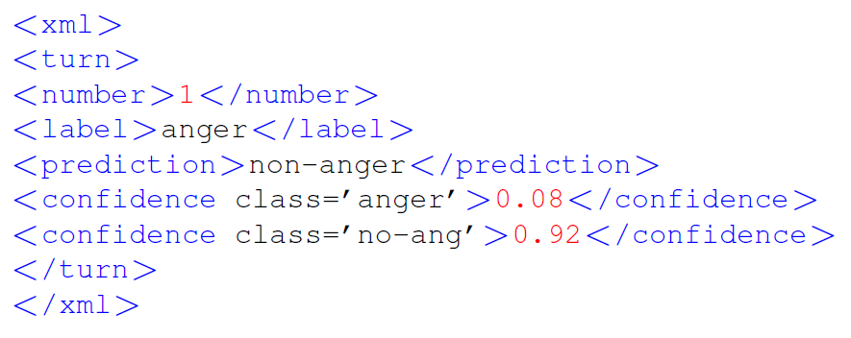
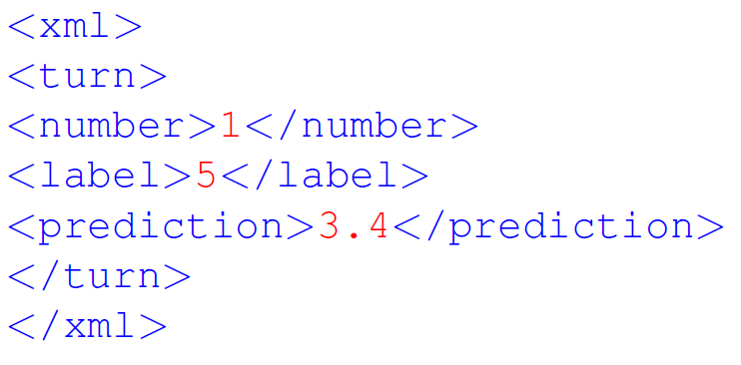
Adaptability to Your Corpus
  Exploring, Mining and Managing straight-forward
    Parse your interaction logs into Witchcraft DB structure
    Provide path to WAVs
    Play
  Model testing
    Create a process that delivers one XML per turn as prediction
Discriminative Classification
Regression

Slide 10
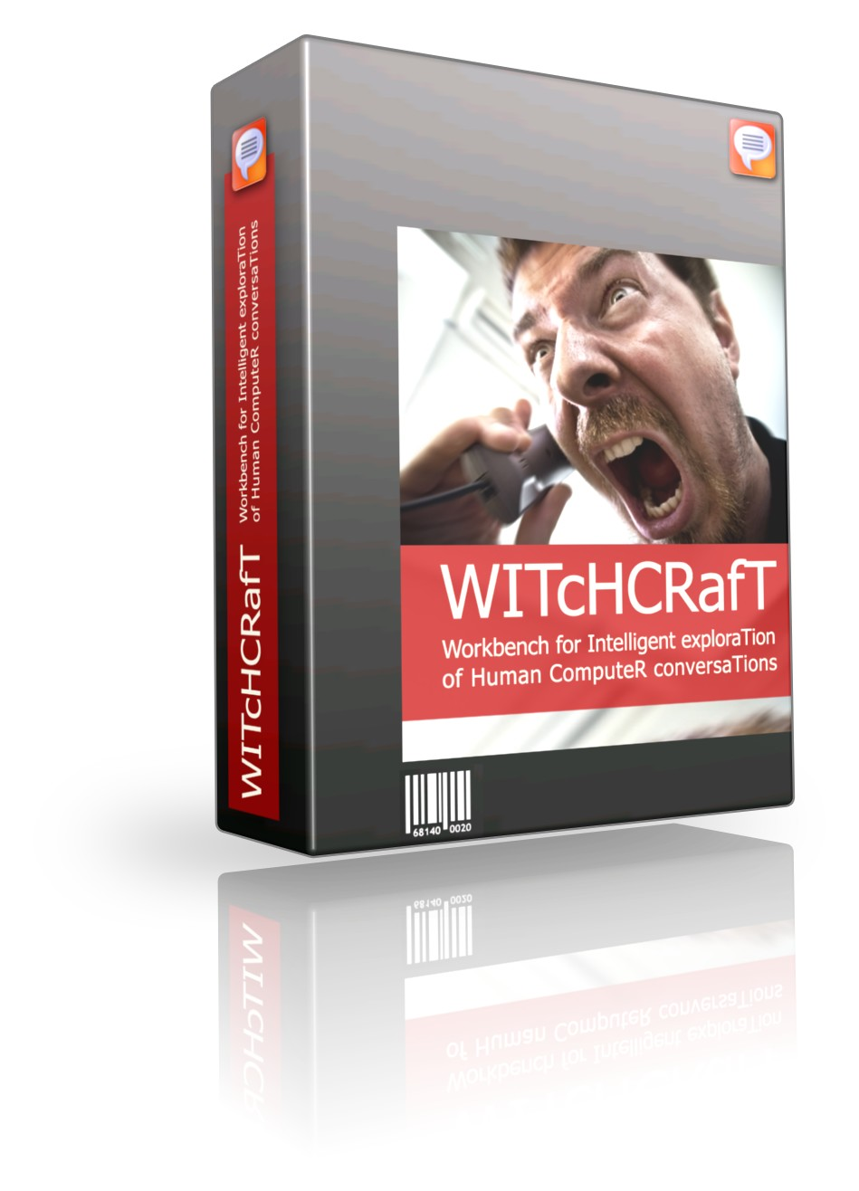

Thank you for your attention!
See you at witchcraftwb.sourceforge.net

Slide 11
References
[1] A. Batliner and R. Huber. Speaker characteristics and emotion classification. pages 138–151, 2007.
[2] P. Boersma. Praat, a System for Doing Phonetics by Computer. Glot International, 5(9/10):341–345,
2001.
[5] F. Burkhardt, A. Paeschke, M. Rolfes,W. F. Sendlmeier, and B.Weiss. A Database of German Emotional
Speech. In European Conference on Speech and Language Processing (EUROSPEECH), pages 1517–
1520, Lisbon, Portugal, Sep. 2005.
[8] R. Leonard and G. Doddington. TIDIGITS speech corpus. Texas Instruments, Inc, 1993.
[9] F. Metze, J. Ajmera, R. Englert, U. Bub, F. Burkhardt, J. Stegmann, C. Müller, R. Huber, B. Andrassy,
J. Bauer, and B. Littel. Comparison of four approaches to age and gender recognition. In Proceedings of
the International Conference on Acoustics, Speech, and Signal Processing (ICASSP), volume 1, 2007.
[10] F. Metze, R. Englert, U. Bub, F. Burkhardt, and J. Stegmann. Getting closer: tailored human computer
speech dialog. Universal Access in the Information Society.
[11] I. Mierswa, M. Wurst, R. Klinkenberg, M. Scholz, and T. Euler. Yale: Rapid prototyping for complex
data mining tasks. In L. Ungar, M. Craven, D. Gunopulos, and T. Eliassi-Rad, editors, KDD ’06, New York, NY, USA, August 2006. ACM.
[13] A. Schmitt and J. Liscombe. Detecting Problematic Calls With Automated Agents. In 4th IEEE Tutorial
and Research Workshop Perception and Interactive Technologies for Speech-Based Systems, Irsee
(Germany), June 2008.

