Slide 1
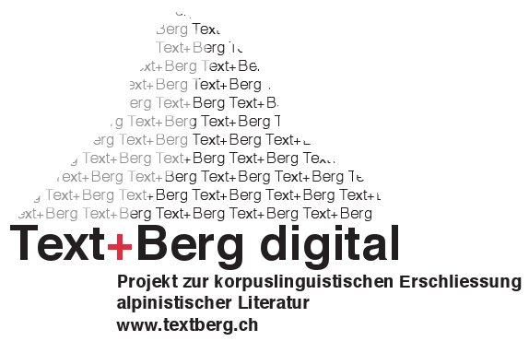
Challenges in Building a Multilingual Alpine Heritage Corpus
Martin Volk
Noah Bubenhofer, Adrian Althaus, Maya Bangerter, Lenz Furrer, Beni Ruef
University of Zurich

Slide 2
Goal
Build a corpus of “Alpine” texts:
  Mountaineering and travel reports
in multiple languages
For studies on language development, culture, technology, …
For geo-tagging, machine translation, …
First step: the yearbooks of the Swiss Alpine Club

Slide 3
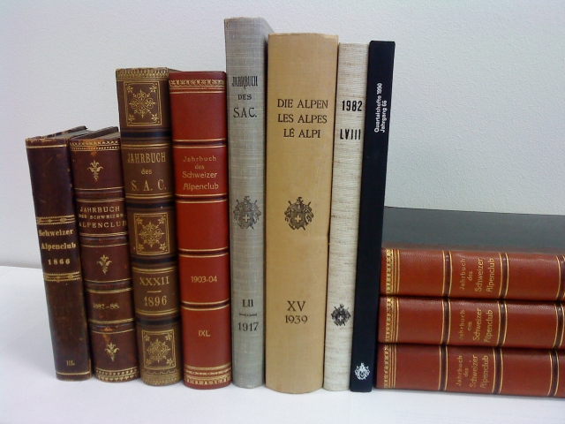
Text+Berg Project
Text+Berg digital
146 years of alpinism in Switzerland:
→ 143 yearbooks
  Since 1864
  1925: New concept: „Die Alpen“
  today: monthly journal „Die Alpen“
Notes:
14.04.09
3
Natural science articles about the Alps
Biology, geology, geography, climate, …
Cultural studies about the Alps
Tourism, languages,

Slide 4
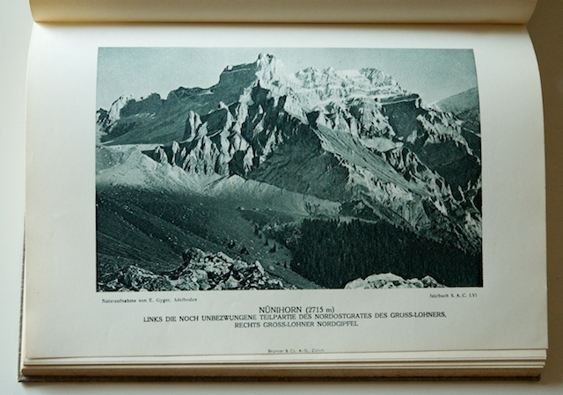
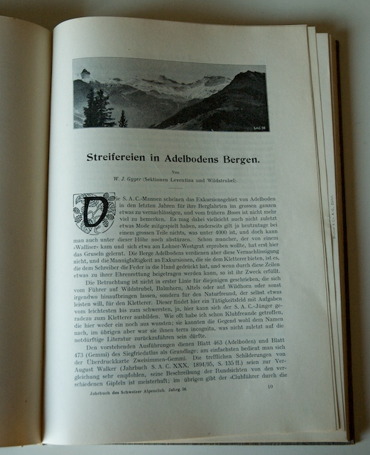
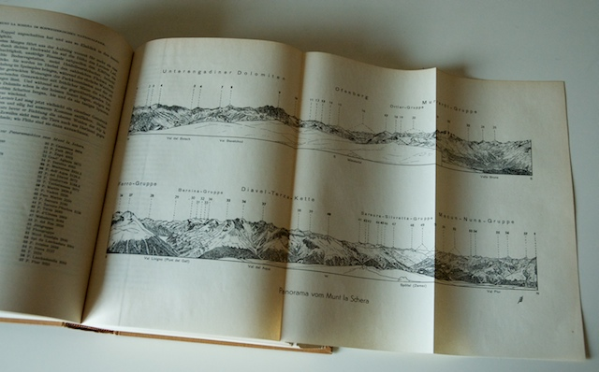
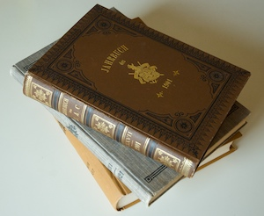
Beispiele
Notes:
14.04.09
4

Slide 5
Number of Words per Language per Book

Slide 6
Text+Berg Corpus
Current Release “118” (1864-1982)
118 years – 142 books (~ 70,000 pages)
  90 books from 1864 – 1956
  52 books in parallel DE-FR 1957 – 1982
Articles (including duplicates)
  6101 in German 17 million tokens
  2659 in French 8 million tokens
  155 in Italian 0.3 million tokens
  13 in Romansch
  3 in Swiss-German

Slide 7
Text+Berg Corpus
Articles (including duplicates)
  6101 in German
  2659 in French
  458 of the articles in the parallel books are duplicates
Our parallel corpus currently contains 701 articles
  2.6 million tokens in French
  2.3 million tokens in German

Slide 8
Challenge: Language Identification
Identification per sentence
Tool: Lingua-Ident: character n-gram based identification
Reliable for French, German, Italian, English IF the input sentence is long enough (> 75 chars)
  For short sentences set language of article
Problematic for
  Romansch → 6 variants, little training material
  Swiss German Dialects → no standard spelling

Slide 9
Challenge: OCR Accuracy
No Gothic font, Antiqua since the start in 1864
German spelling variants
  1800s: Nachtheil, passiren, successive
  1900s: Nachteil, passieren, sukzessive
  Swiss variants:
    parken vs. parkieren
    große vs. grosse

Slide 10
Challenge: OCR Accuracy
Geographic names abound
Example from SAC Jahrbuch 1900:
Nach kurzer Rast in der Hütte packten Onésime und ich unsere Siebensachen zusammen und sprangen in jugendlichem Übermut in einer Stunde und 50 Minuten nach <GEO type= "town" alti="1477">Champex</GEO> hinab.
Ich kam noch gerade recht zum Diner, das mir nach dem Morgenspaziergang auf den <GEO type= "summit" alti="3344">Portalet</GEO> doch etwas besser mundete als die Konservenkost in der <GEO type="cabin" alti="2826">Cabane d'Orny</GEO>.

Slide 11
Improving OCR
Add words to OCR lexicon
  1500 words with specific 1800s spelling
  ~ 5000 Swiss variants
  14,800 toponyms
Pattern-based OCR correction
  ii → ü IF the resulting word occurs in the corpus more often than the recognized word
  Example: iiberein → überein (EN: in agreement)

Slide 12
Fixing OCR Errors
Merge the output from two OCR systems
  Abbyy FineReader 7
  OmniPage 17
  If OmiPage differs from FineReader, take the candidate word that occurs more frequently in the corpus.
  Results from a small manual evaluation:
    92 improvements
    52 worsenings
    60 neutral changes

Slide 13
Geo-Tagging
Idea: Use a large gazetteer
This will solve the problem!?

Slide 14
SwissNames
All names from the 1:25‘000 topographical maps by the Swiss Federal Office of Topography
156,755 names in 61 categories.
Each name is in the list as often as it appears on the map. For example „Rhein“ occurs 28 times.

Slide 15
Example Entries
Field | Example 1 | Example 2
Coordinates | 679521.48590 212267.54790 | 620031.00001 99707.00003
Altitude | 1797 m | 3198 m
Object Id | 18299745 | 7350545
Origin | LK25 | LK25
Category | Massiv | Huette
Year | 2006 | 2000
Name | Rigi | Rothornhütte SAC
City number | 1362 | 6300
City name | Arth | Zermatt
Canton | SZ | VS

Slide 16
Name-Noun Ambiguities
Creation of a noun list for comparison
Take the TIGER corpus (treebank)
  888,299 tokens from a German newspaper with manually checked Part-of-Speech tags and lemmas.
  incl.184,000 noun tokens (tagged as NN) = 37,846 unique noun lemmas.
SwissTopo name list
  contains 105,000 name types.
  only 495 name types are ambiguous with noun lemmas in the TIGER corpus.
  These 495 name types account for 4024 entries in the name list.
  The most frequent ones are Bad (269), Berg (192), Brand (153), Loch (140) and Feld (136).

Slide 17
Name-Noun Ambiguities Study
Limitations
The TIGER corpus does not cover all DE nouns.
There will also be FR, IT and RM ambiguities.
Occasional cross-language homographs.
  Example:
  FR Plage (= EN “beach”) is listed in SwissTopo as sports facility.
  is a homograph with a DE noun which means “menace, trouble”.

Slide 18
First Experiment: Finding Mountain Names
Article from SAC yearbook 1900: „Bergfahrten im Clubgebiet“
After tokenisation (incl. the splitting of punctuation symbols): 9380 tokens.

Slide 19
Precision
SwissTopo mountain names of the 4 highest mountain classes = 5588 mountain names.
Using exact matching
→ 54 mountain names (20 different mountain names)
including 6 errors:
  Gendarm, Haupt, Kamm, Stand, Stein, Turm

Slide 20
Recall
How many mountain names have we missed?
On manual inspection:
another 92 mountain names (35 different mountain names) missing.
So recall of the naive exact matching is still below 40% despite the large gazetteer.

Slide 21
Problems
Mountains outside of Switzerland are not in the SwissTopo list (e.g. Mont Blanc).
Spelling variations necessitate fuzzy matching. For example
  the book: Tour Salière and Aiguille de la Neuva
  the SwissTopo list: Tour Sallière and Aiguille de l'A Neuve.

Slide 22
Problems
OCR errors (e.g. Aiguille duTour with a missing blank).
Substitutions of French name parts by German translations.
  Grand Combin → Großen Combin.
Partial repetitions
  Grand Combin → Combin or
  Le Catogne → Catogne
  lead to missed matches and need to be handled in a coreference resolution module.

Slide 23
Domain-specific SMT
funded by the Swiss National Science Foundation
2010-2011
Goals:
  SMT systems for Alpine texts (DE-FR, DE-EN)
  Parallel Treebank: 1000 Trees DE-FR

Slide 24
Conclusions
Multilingual corpora pose special problems in language identification
OCR errors in heritage corpora can be partially corrected via
  correction patterns and corpus frequencies
  merging of two OCR systems
Geo-Tagging in Alpine texts cannot be solved by gazetteer size alone

Slide 25
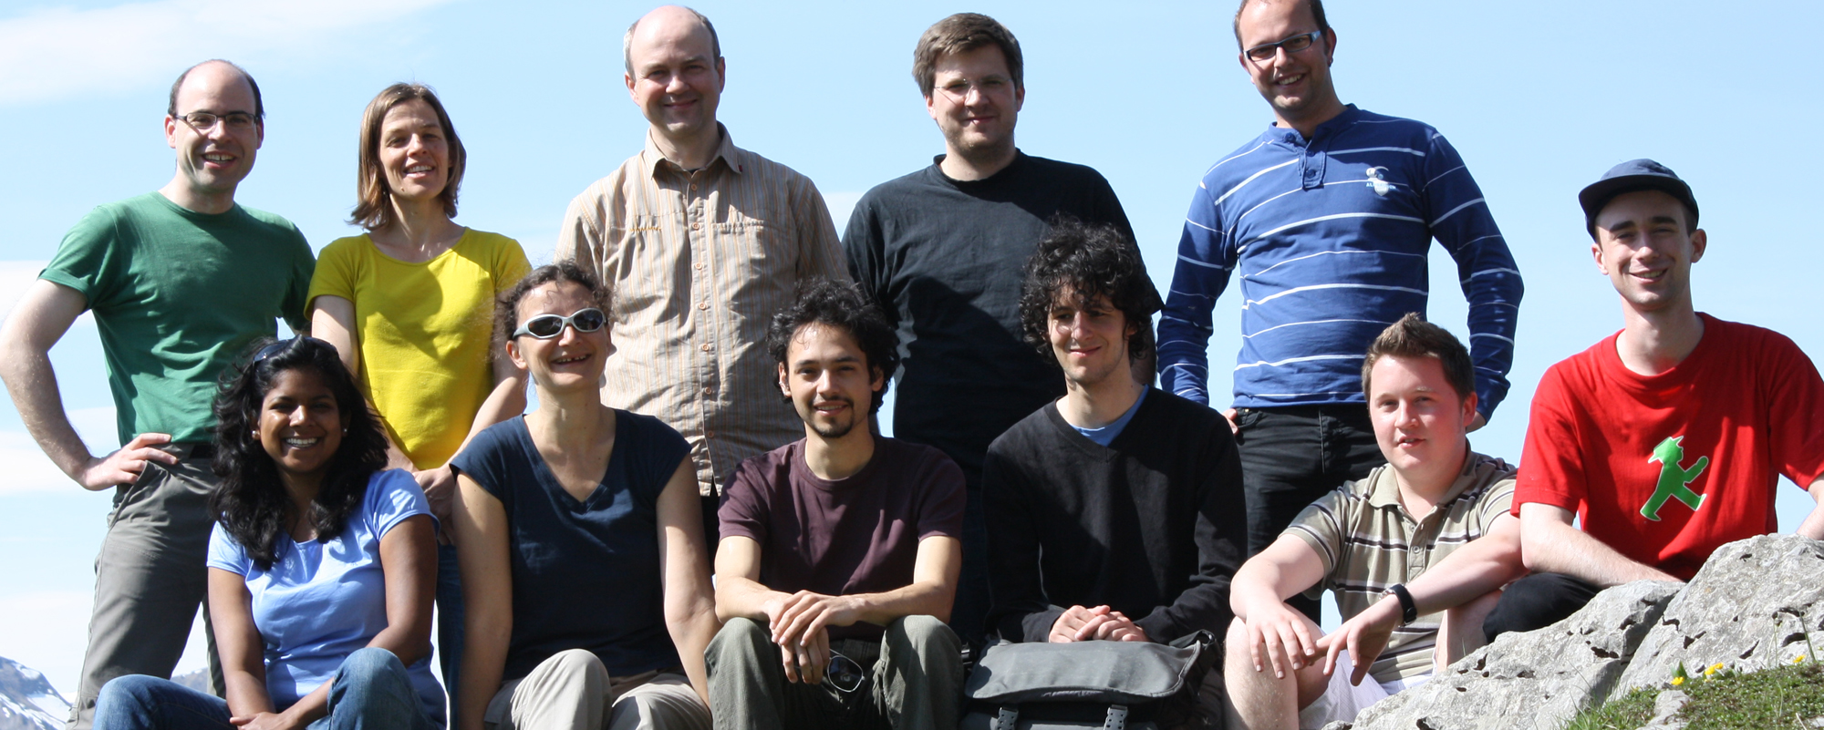
Our Team
www.textberg.ch
noah@bubenhofer.com, volk@cl.uzh.ch

