Slide 1
MT and Resource Collection for Low-Density Languages: From new MT Paradigms to Proactive Learning and Crowd Sourcing
Jaime Carbonell (www.cs.cmu.edu/~jgc)
With Vamshi Ambati and Pinar Donmez
Language Technologies Institute
Carnegie Mellon University
20 May 2010

Slide 2
Low Density Languages
6,900 languages in 2000 – Ethnologue www.ethnologue.com/ethno_docs/distribution.asp?by=area
77 (1.2%) have over 10M speakers
  1st is Chinese, 5th is Bengali, 11th is Javanese
3,000 have over 10,000 speakers each
3,000 may survive past 2100
5X to 10X number of dialects
# of L’s in some interesting countries:
  Afghanistan: 52, Pakistan: 77, India 400
  North Korea: 1, Indonesia 700

Slide 3
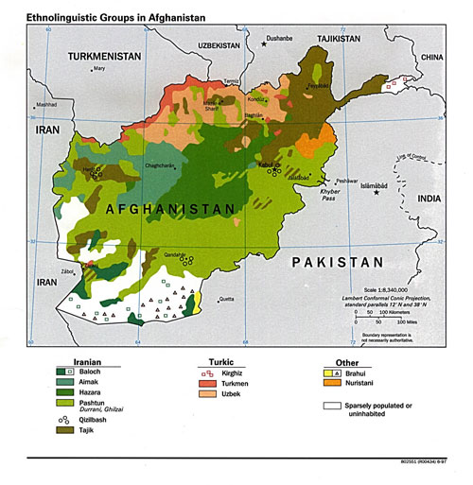
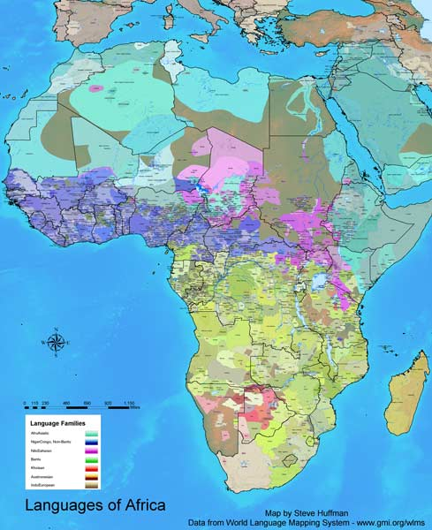
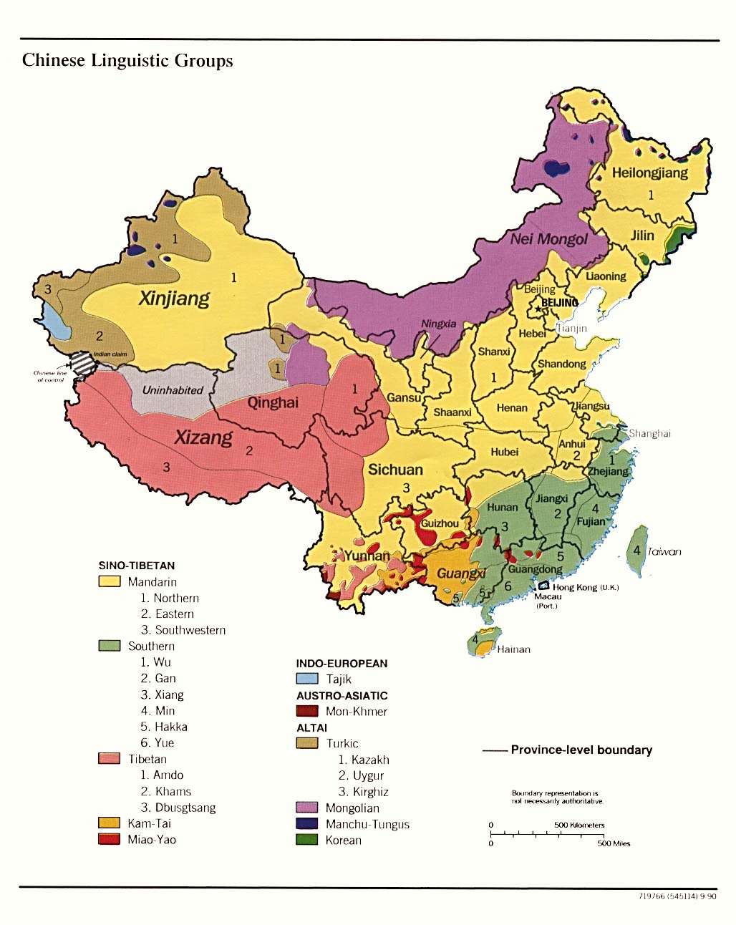
Some Linguistics Maps

Slide 4
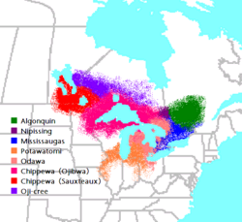
Some (very) LD Languages in the US
Anishinaabe (Ojibwe, Potawatame, Odawa)
Great Lakes

Slide 5
Challenges for General MT
Ambiguity Resolution
  Lexical, phrasal, structural
Structural divergence
  Reordering, vanishing/appearing words, …
Inflectional morphology
  Spanish 40+ verb conjugations, Arabic has more.
  Mapudungun, Anupiac, … → agglomerative
Training Data
  Bilingual corpora, aligned corpora, annotated corpora, bilingual dictionaries
Human informants
  Trained linguists, lexicographers, translators
  Untrained bilingual speakers (e.g. crowd sourcing)
Evaluation
  Automated (BLEU, METEOR, TER) vs HTER vs …

Slide 6
Context Needed to Resolve Ambiguity
Example: English → Japanese
Power line – densen (電線)
Subway line – chikatetsu (地下鉄)
(Be) on line – onrain (オンライン)
(Be) on the line – denwachuu (電話中)
Line up – narabu (並ぶ)
Line one’s pockets – kanemochi ni naru (金持ちになる)
Line one’s jacket – uwagi o nijuu ni suru (上着を二重にする)
Actor’s line – serifu (セリフ)
Get a line on – joho o eru (情報を得る)
Sometimes local context suffices (as above) → n-grams help
. . . but sometimes not

Slide 7
CONTEXT: More is Better
Examples requiring longer-range context:
  “The line for the new play extended for 3 blocks.”
  “The line for the new play was changed by the scriptwriter.”
  “The line for the new play got tangled with the other props.”
  “The line for the new play better protected the quarterback.”
Challenges:
  Short n-grams (3-4 words) insufficient
  Requires more general syntax & semantics

Slide 8
Additional Challenges for LD MT
Morpho-syntactics is plentiful
  Beyond inflection: verb-incorporation, agglomeration, …
Data is scarce
  Insignificant bilingual or annotated data
Fluent computational linguists are scarce
  Field linguists know LD languages best
Standardization is scarce
  Orthographic, dialectal, rapid evolution, …

Slide 9
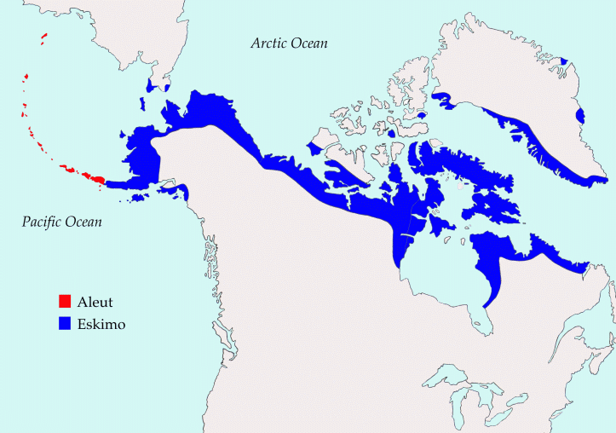
Morpho-Syntactics & Multi-Morphemics
Iñupiaq (North Slope Alaska, Lori Levin)
  Tauqsiġñiaġviŋmuŋniaŋitchugut.
  ‘We won’t go to the store.’
Kalaallisut (Greenlandic, Per Langaard)
  Pittsburghimukarthussaqarnavianngilaq
  Pittsburgh+PROP+Trim+SG+kar+tuq+ssaq+qar+naviar+nngit+v+IND+3SG
  "It is not likely that anyone is going to Pittsburgh"

Slide 10
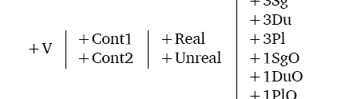
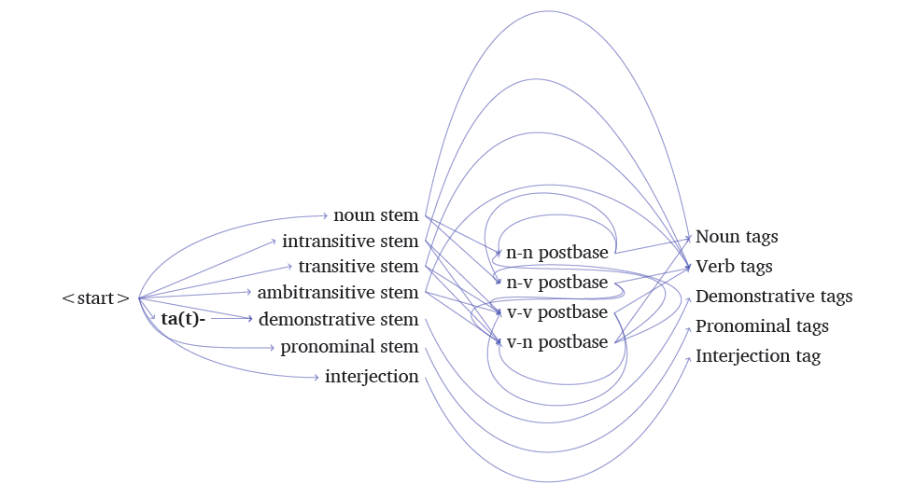
Morphotactics in Iñupiaq

Slide 11
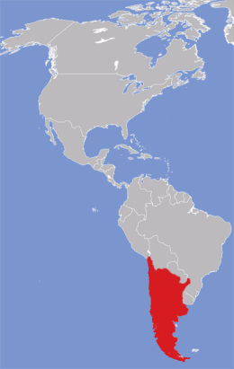
Type-Token Curve for Mapudungun
400,000+ speakers
Mostly bilingual
Mostly in Chile
  Pewenche
  Lafkenche
  Nguluche
  Huilliche

Slide 12
Paradigms for Machine Translation
Interlingua
Semantic Analysis
Sentence Planning
Syntactic Parsing
Transfer Rules
Text Generation
Source
(e.g. Pashto)
Target
(e.g. English)
Direct: SMT, EBMT CBMT, …
5/20/2010
12

Slide 13
Which MT Paradigms are Best?
Towards Filling the Table
Target
 | Large T | Med T | Small T
Large S | SMT | ??? | ???
Med S | ??? | ??? | ???
Small S | ??? | ??? | ???
Source
DARPA MT: Large S → Large T
  Arabic → English; Chinese → English

Slide 14
Evolutionary Tree of MT Paradigms
Large-scale TMT
Large-scale TMT
Transfer MT
Transfer MT w stat phrases
Interlingua MT
Context-Based MT
Analogy MT
Example-based MT
Stat MT on syntax struct.
DecodingMT
Statistical MT
Phrasal SMT
1950
1980
2010

Slide 15
Parallel Text: Requiring Less is Better (Requiring None is Best ☺)
Challenge
  There is just not enough to approach human-quality MT for major language pairs (we need ~100X to ~10,000X)
  Much parallel text is not on-point (not on domain)
  LD languages or distant pairs have very little parallel text
CBMT Approach [Abir, Carbonell, Sofizade, …]
  Requires no parallel text, no transfer rules . . .
  Instead, CBMT needs
    A fully-inflected bilingual dictionary
    A (very large) target-language-only corpus
    A (modest) source-language-only corpus [optional, but preferred]

Slide 16
CMBT System
Source Language
N-gram Segmenter
Parser
Parser
INDEXED RESOURCES
N-GRAM BUILDERS
(Translation Model)
Bilingual
Dictionary
Flooder
(non-parallel text method)
CACHE DATABASE
Target Corpora
Cross-Language
N-gram Database
Edge Locker
[Source Corpora]
TTR
Stored
N-gram
Pairs
Approved
N-gram
Pairs
Gazetteers
N-gram Candidates
Substitution Request
N-GRAM CONNECTOR
Overlap-based Decoder
Target Language

Slide 17
Step 1: Source Sentence Chunking
Segment source sentence into overlapping n-grams via sliding window
Typical n-gram length 4 to 9 terms
Each term is a word or a known phrase
Any sentence length (for BLEU test: ave-27; shortest-8; longest-66 words)
S1 S2 S3 S4 S5 S6 S7 S8 S9
S1 S2 S3 S4 S5
S2 S3 S4 S5 S6
S3 S4 S5 S6 S7
S4 S5 S6 S7 S8
S5 S6 S7 S8 S9

Slide 18
Step 2: Dictionary Lookup
Using bilingual dictionary, list all possible target translations for each source word or phrase
Source Word-String
S2 S3 S4 S5 S6
Inflected Bilingual Dictionary
Target Word Lists
T2-a
T2-b
T2-c
T2-d
T3-a
T3-b
T3-c
T4-a
T4-b
T4-c
T4-d
T4-e
T5-a
T6-a
T6-b
T6-c
Flooding Set

Slide 19
Step 3: Search Target Text (Example)
T2-a
T2-b
T2-c
T2-d
T3-a
T3-b
T3-c
T4-a
T4-b
T4-c
T4-d
T4-e
T5-a
T6-a
T6-b
T6-c
Flooding Set
T(x) T(x) T(x) T(x) T(x) T(x) T(x)
T(x) T3-b T(x) T2-d T(x) T(x) T6-c
T(x) T(x) T(x) T(x) T(x) T(x) T(x)
T(x) T(x) T(x) T(x) T(x) T(x) T(x)
T(x) T(x) T(x) T(x) T(x) T(x) T(x)
T(x) T(x) T(x) T(x) T(x) T(x) T(x)
T(x) T(x) T(x) T(x) T(x) T(x) T(x)
T(x) T3-b T(x) T2-d T(x) T(x) T6-c
T(x) T(x) T(x) T(x) T(x) T(x) T(x)
T(x) T(x) T(x) T(x) T(x) T(x) T(x)
T(x) T(x) T(x) T(x) T(x) T(x) T(x)
T(x) T(x) T(x) T(x) T(x) T(x) T(x)
T3-b T(x) T2-d T(x) T(x) T6-c
Target Corpus
Target
Candidate 1

Slide 20
Step 3: Search Target Text (Example)
T2-a
T2-b
T2-c
T2-d
T3-a
T3-b
T3-c
T4-a
T4-b
T4-c
T4-d
T4-e
T5-a
T6-a
T6-b
T6-c
Flooding Set
T(x) T(x) T(x) T(x) T(x) T(x) T(x)
T(x) T(x) T(x) T(x) T(x) T(x) T(x)
T(x) T(x) T(x) T(x) T(x) T(x) T(x)
T(x) T(x) T(x) T(x) T(x) T(x) T(x)
T(x) T(x) T(x) T(x) T(x) T(x) T(x)
T(x) T(x) T(x) T(x) T(x) T(x) T(x)
T(x) T(x) T(x) T(x) T(x) T(x) T(x)
T(x) T(x) T(x) T(x) T(x) T(x) T(x)
T(x) T(x) T(x) T(x) T(x) T(x) T(x)
T(x) T(x) T4-a T6-b T(x) T2-c T3-a
T(x) T(x) T(x) T(x) T(x) T(x) T(x)
T(x) T(x) T(x) T(x) T(x) T(x) T(x)
Target Corpus
T4-a T6-b T(x) T2-c T3-a
Target
Candidate 2

Slide 21
Step 3: Search Target Text (Example)
T2-a
T2-b
T2-c
T2-d
T3-a
T3-b
T3-c
T4-a
T4-b
T4-c
T4-d
T4-e
T5-a
T6-a
T6-b
T6-c
Flooding Set
T(x) T(x) T(x) T(x) T(x) T(x) T(x)
T(x) T(x) T(x) T(x) T(x) T(x) T(x)
T(x) T(x) T(x) T(x) T(x) T(x) T(x)
T(x) T(x) T(x) T(x) T(x) T(x) T(x)
T(x) T(x) T(x) T(x) T(x) T(x) T(x)
T(x) T(x) T(x) T(x) T(x) T(x) T(x)
T(x) T(x) T(x) T(x) T(x) T(x) T(x)
T(x) T(x) T(x) T(x) T(x) T(x) T(x)
T(x) T(x) T(x) T(x) T(x) T(x) T(x)
T(x) T(x) T(x) T(x) T(x) T(x) T(x)
T3-c T2-b T4-e T5-a T6-a T(x) T(x)
T(x) T(x) T(x) T(x) T(x) T(x) T(x)
Target Corpus
T3-c T2-b T4-e T5-a T6-a
Target
Candidate 3
Reintroduce function words after initial match (T5)

Slide 22
Step 4: Score Word-String Candidates
Scoring of candidates based on:
  Proximity (minimize extraneous words in target n-gram ≈ precision)
  Number of word matches (maximize coverage ≈ recall))
  Regular words given more weight than function words
  Combine results (e.g., optimize F₁ or p-norm or …)
Target Word-String Candidates
Total Scoring
3rd
2nd
1st
T3-b T(x) T2-d T(x) T(x) T6-c
T4-a T6-b T(x) T2-c T3-a
T3-c T2-b T4-e T5-a T6-a

Slide 23
Step 5: Select Candidates Using Overlap
(Propagate context over entire sentence)
T(x1) T2-d T3-c T(x2) T4-b
Word-String 1
Candidates
T(x1) T3-c T2-b T4-e
T(x1) T3-c T2-b T4-e
T(x2) T4-a T6-b T(x3) T2-c
T(x2) T4-a T6-b T(x3) T2-c
T3-b T(x3) T2-d T(x5) T(x6) T6-c
T3-b T(x3) T2-d T(x5) T(x6) T6-c
T3-b T(x3) T2-d T(x5) T(x6) T6-c
Word-String 2
Candidates
T4-a T6-b T(x3) T2-c T3-a
T4-a T6-b T(x3) T2-c T3-a
T4-a T6-b T(x3) T2-c T3-a
T3-c T2-b T4-e T5-a T6-a
T3-c T2-b T4-e T5-a T6-a
T3-c T2-b T4-e T5-a T6-a
T2-b T4-e T5-a T6-a T(x8)
T2-b T4-e T5-a T6-a T(x8)
Word-String 3
Candidates
T6-b T(x11) T2-c T3-a T(x9)
T6-b T(x3) T2-c T3-a T(x8)
T6-b T(x3) T2-c T3-a T(x8)

Slide 24
Step 5: Select Candidates Using Overlap
Best translations selected via maximal overlap
T(x2) T4-a T6-b T(x3) T2-c
Alternative 1
T4-a T6-b T(x3) T2-c T3-a
T6-b T(x3) T2-c T3-a T(x8)
T(x2) T4-a T6-b T(x3) T2-c T3-a T(x8)
T(x1) T3-c T2-b T4-e
Alternative 2
T3-c T2-b T4-e T5-a T6-a
T2-b T4-e T5-a T6-a T(x8)
T(x1) T3-c T2-b T4-e T5-a T6-a T(x8)

Slide 25
A (Simple) Real Example of Overlap
Flooding → N-gram fidelity
Overlap → Long range fidelity
A United States soldier
N-grams generated from Flooding
United States soldier died
soldier died and two others
died and two others were injured
two others were injured Monday
N-grams connected via Overlap
A United States soldier died and two others were injured Monday
Systran
A soldier of the wounded United States died and other two were east Monday

Slide 26
Which MT Paradigms are Best?
Towards Filling the Table
Target
 | Large T | Med T | Small T
Large S | SMT | ??? | ???
Med S | ??? CBMT | ??? | ???
Small S | CBMT | ??? | ???
Source
Spanish → English CBMT without parallel text = best Sp → Eng SMT with parallel text

Slide 27
Stat-Transfer (STMT): List of Ingredients
Framework: Statistical search-based approach with syntactic translation transfer rules that can be acquired from data but also developed and extended by experts
SMT-Phrasal Base: Automatic Word and Phrase translation lexicon acquisition from parallel data
Transfer-rule Learning: apply ML-based methods to automatically acquire syntactic transfer rules for translation between the two languages
Elicitation: use bilingual native informants to produce a small high-quality word-aligned bilingual corpus of translated phrases and sentences
Rule Refinement: refine the acquired rules via a process of interaction with bilingual informants
XFER + Decoder:
  XFER engine produces a lattice of possible transferred structures at all levels
  Decoder searches and selects the best scoring combination
5/20/2010

Slide 28
Stat-Transfer (ST) MT Approach
Interlingua
Semantic Analysis
Sentence Planning
Syntactic Parsing
Transfer Rules
Text Generation
Statistical-XFER
Source
(e.g. Urdu)
Target
(e.g. English)
Direct: SMT, EBMT
5/20/2010
28

Slide 29
Avenue/Letras STMT Architecture
Elicitation
Morphology
Rule Learning
Run-Time System
Rule Refinement
Learning
Module
Word-Aligned Parallel Corpus
INPUT TEXT
Translation
Correction
Tool
Learned Transfer Rules
Run Time Transfer System
Rule
Refinement
Module
Elicitation Corpus
Learning Module
Handcrafted
rules
Decoder
Elicitation Tool
Morphology
Analyzer
Lexical Resources
OUTPUT TEXT
AVENUE/LETRAS
Notes:
29

Slide 30
Syntax-driven Acquisition Process
5/20/2010
Automatic Process for Extracting Syntax-driven Rules and Lexicons from sentence-parallel data:
  Word-align the parallel corpus (GIZA++)
  Parse the sentences independently for both languages
  Tree-to-tree Constituent Alignment:
    Run our new Constituent Aligner over the parsed sentence pairs
    Enhance alignments with additional Constituent Projections
  Extract all aligned constituents from the parallel trees
  Extract all derived synchronous transfer rules from the constituent-aligned parallel trees
  Construct a “data-base” of all extracted parallel constituents and synchronous rules with their frequencies and model them statistically (assign them relative-likelihood probabilities)

Slide 31
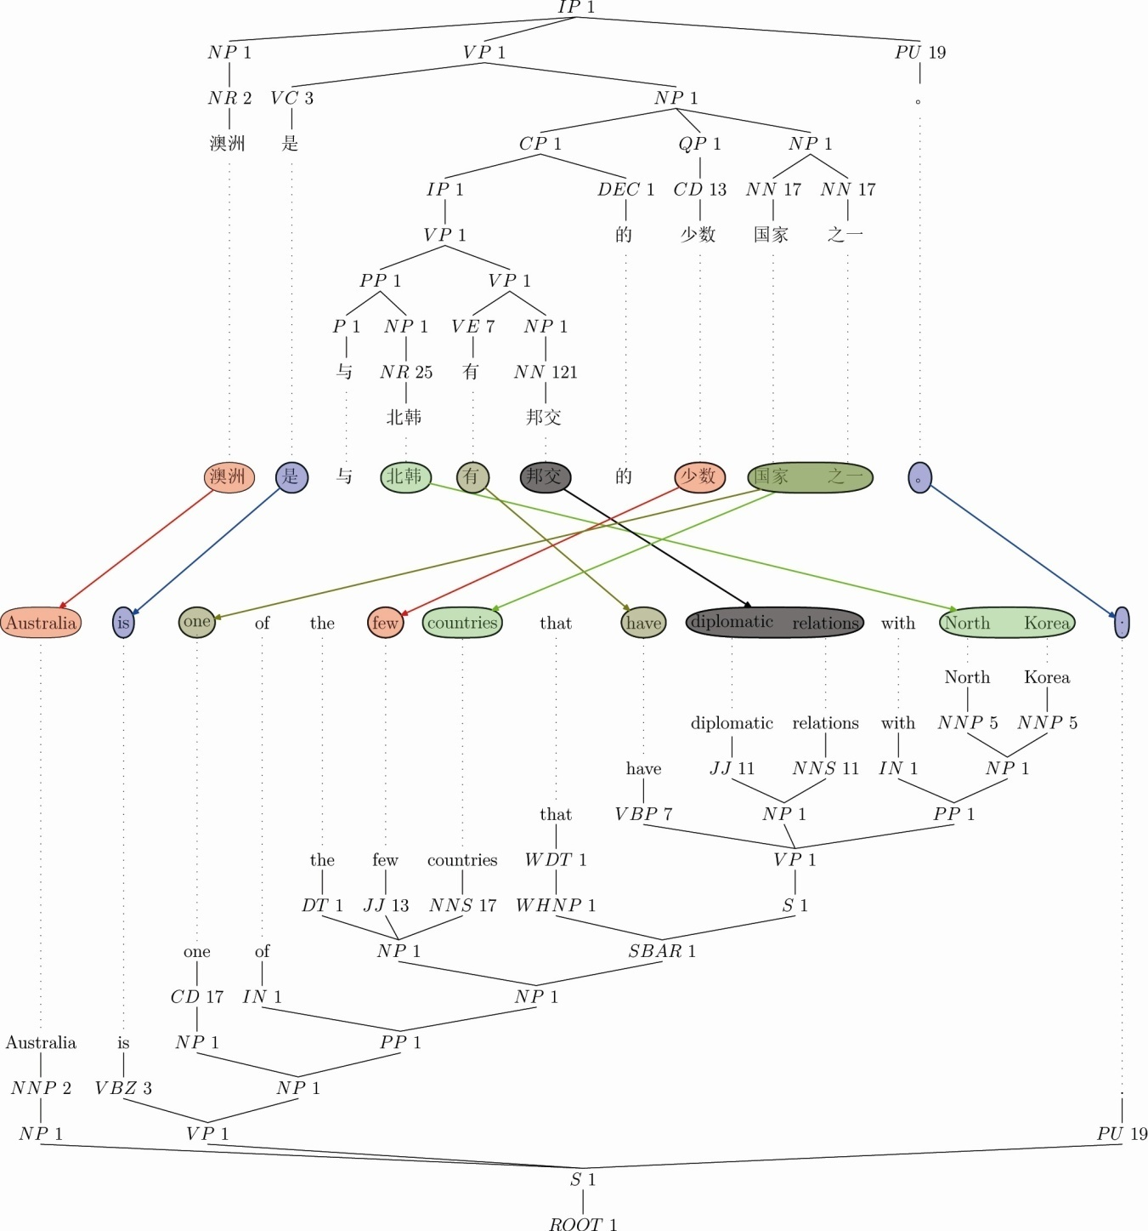
PFA Node Alignment Algorithm Example
Any constituent or sub-constituent is a candidate for alignment
Triggered by word/phrase alignments
Tree Structures can be highly divergent
Notes:
31

Slide 32
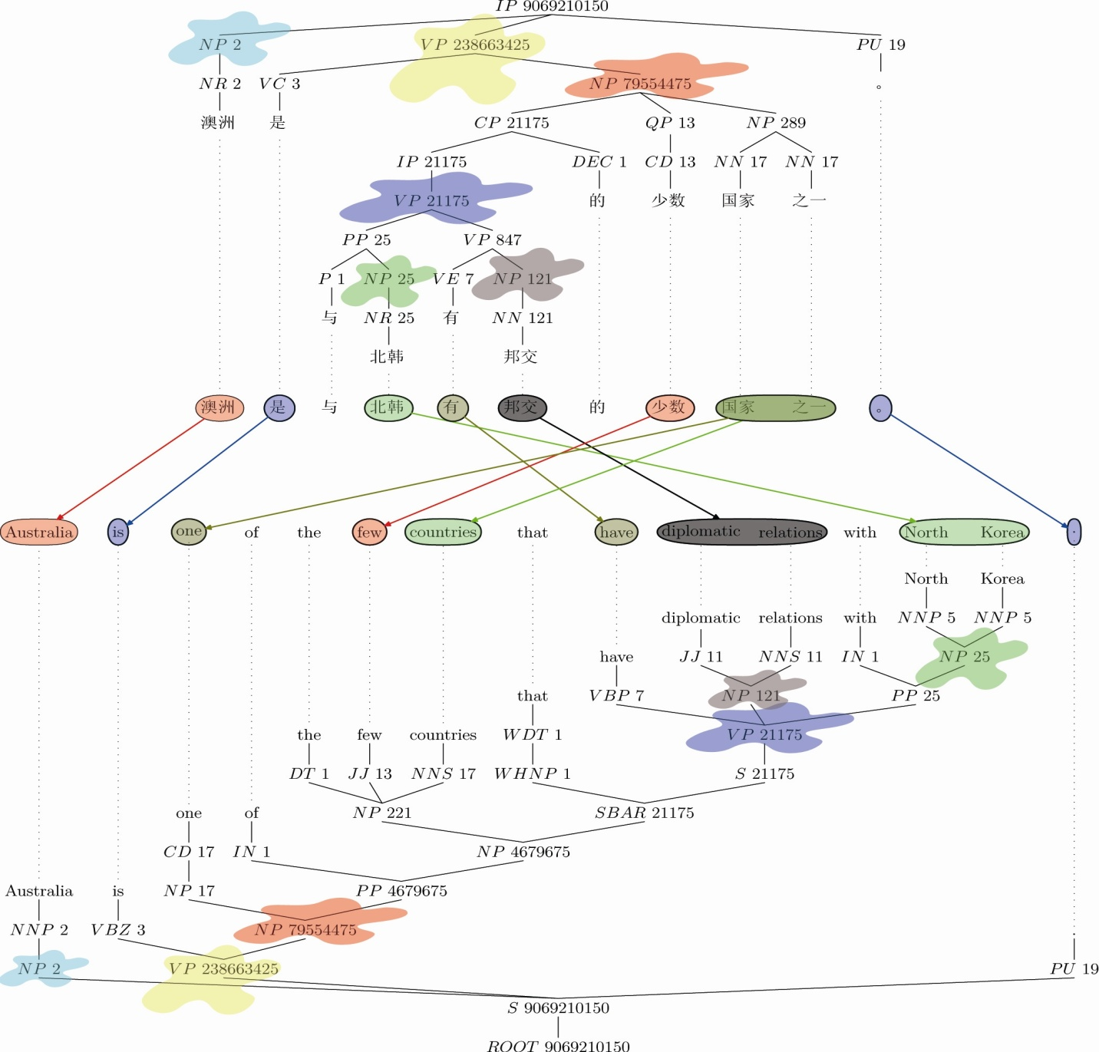
PFA Node Alignment Algorithm Example
Tree-tree aligner enforces equivalence constraints and optimizes over terminal alignment scores (words/phrases)
Resulting aligned nodes are highlighted in figure
Transfer rules are partially lexicalized and read off tree.
Notes:
32

Slide 33
Which MT Paradigms are Best?
Towards Filling the Table
Target
 | LargeT | Med T | Small T
Large S | SMT | STMT | ???
Med S | STMT CBMT | ??? (STMT) | ???
Small S | CBMT | ??? | ???
Source
Urdu ←→English MT (top performer)

Slide 34
Active Learning for Low Density Language Annotation MT
What types of annotations are most useful?
  Translation: monolingual → bilingual training text
  Morphology/morphosyntax: for rare language
  Parses: Treebank for rare language
  Alignment: at S-level, at W-level, at C-level
What instances (e.g. sentences) to annotate?
  Which will have maximal coverage
  Which will maximally amortized MT error
  Which depend on MT paradigm
  → Active and Proactive Learning

Slide 35
Why is Active Learning Important?
Labeled data volumes << unlabeled data volumes
  1.2% of all proteins have known structures
  < .01% of all galaxies in the Sloan Sky Survey have consensus type labels
  < .0001% of all web pages have topic labels
  << E-10% of all internet sessions are labeled as to fraudulence (malware, etc.)
  < .0001 of all financial transactions investigated w.r.t. fraudulence
  < .01% of all monolingual text is reliably bilingual
If labeling is costly, or limited, select the instances with maximal impact for learning

Slide 36
Active Learning
Training data:
  Special case:
Functional space:
Fitness Criterion:
  a.k.a. loss function
Sampling Strategy:

Slide 37
Sampling Strategies
Random sampling (preserves distribution)
Uncertainty sampling (Lewis, 1996; Tong & Koller, 2000)
  proximity to decision boundary
  maximal distance to labeled x’s
Density sampling (kNN-inspired McCallum & Nigam, 2004)
Representative sampling (Xu et al, 2003)
Instability sampling (probability-weighted)
  x’s that maximally change decision boundary
Ensemble Strategies
  Boosting-like ensemble (Baram, 2003)
  DUAL (Donmez & Carbonell, 2007)
    Dynamically switches strategies from Density-Based to Uncertainty-Based by estimating derivative of expected residual error reduction

Slide 38
Which point to sample?
Grey = unlabeled
Red = class A
Brown = class B

Slide 39
Density-Based Sampling
Centroid of largest unsampled cluster

Slide 40
Uncertainty Sampling
Closest to decision boundary

Slide 41
Maximal Diversity Sampling
Maximally distant from labeled x’s

Slide 42
Ensemble-Based Possibilities
Uncertainty + Diversity criteria
Density + uncertainty criteria

Slide 43
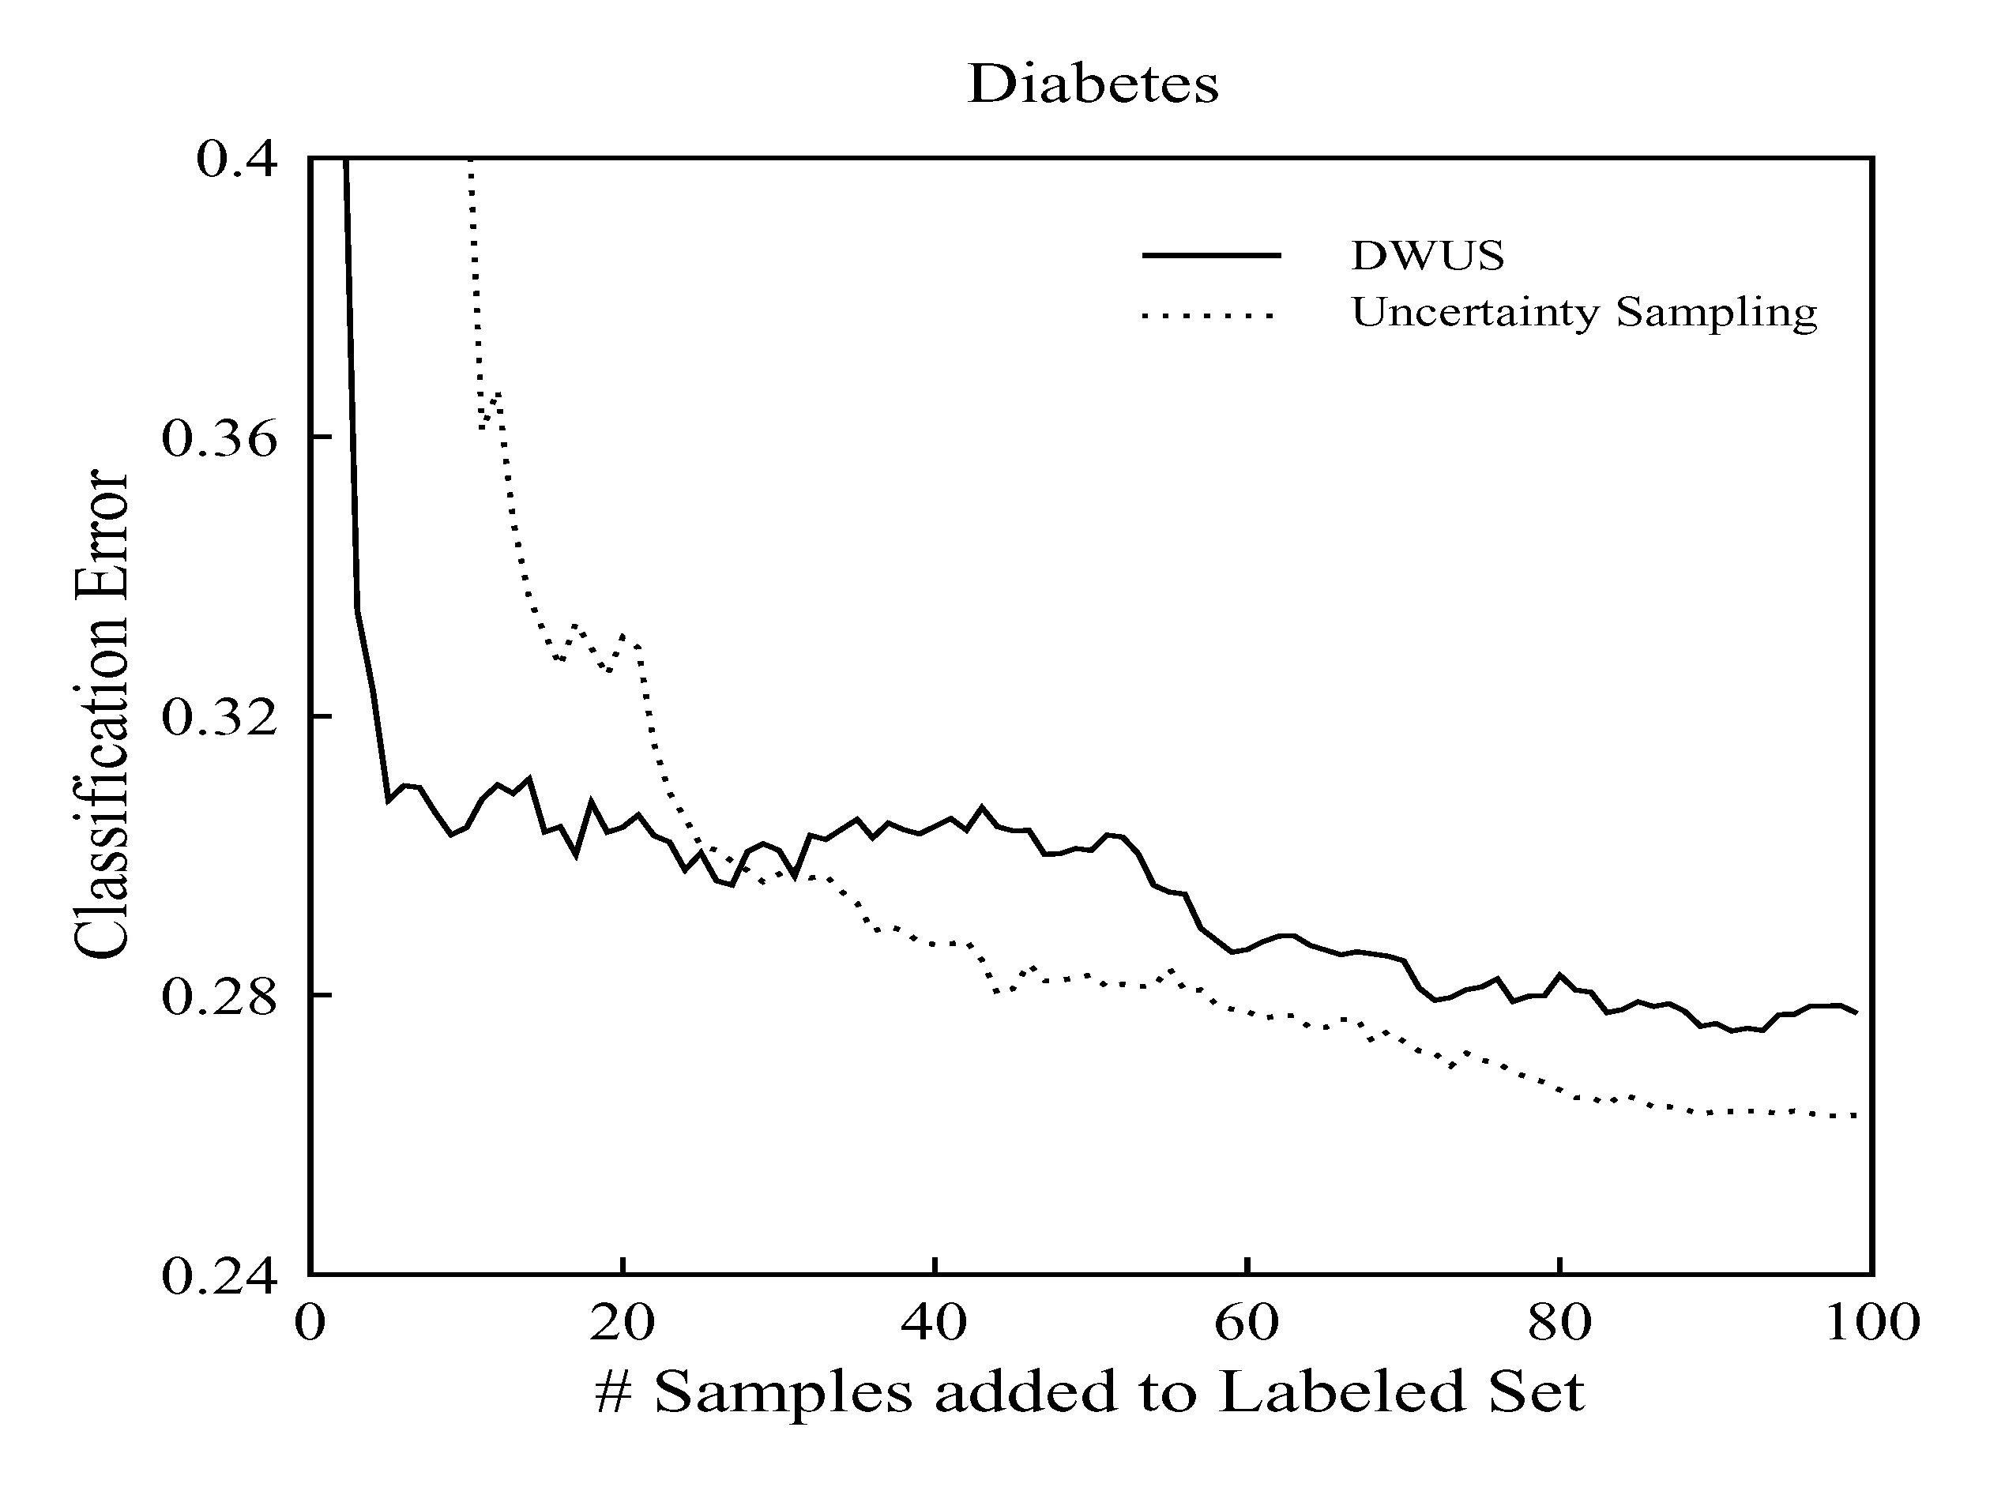
Strategy Selection:
No Universal Optimum
Optimal operating range for AL sampling strategies differs
How to get the best of both worlds?
(Hint: ensemble methods, e.g. DUAL)

Slide 44



How does DUAL do better?
Runs DWUS until it estimates a cross-over
Monitor the change in expected error at each iteration to detect when it is stuck in local minima
DUAL uses a mixture model after the cross-over ( saturation ) point
Our goal should be to minimize the expected future error
  If we knew the future error of Uncertainty Sampling (US) to be zero, then we’d force
  But in practice, we do not know it
Notes:
Given the motivation, we can now talk about DUAL. We said before that DUAL combines the best of both worlds. And here we see how.
DUAL runs DWUS until it estimates that it has stabilized. It does so by estimating when the derivative of the expected error
becomes zero because it tells us the error is not changing anymore
It monitors the change in the expected error at each iteration. and when it becomes close to zero then it switches criteria.
After deciding to switch, its sampling strategy becomes a linear combination of density and uncertainty.
Pi is the weight of the uncertainty score and 1-pi is the weight of the density score. At the end of the day, all we want is to minimize the expected future error.
If we knew that in the future uncertainty sampling will have a zero error, then we’d force pi to be equal to 1 so that we’d sample acc. to uncertainty of each point. Unfortunately, we don’t know the future error.

Slide 45

More on DUAL [ECML 2007]
After cross-over, US does better => uncertainty score should be given more weight
should reflect how well US performs
  can be calculated by the expected error of
US on the unlabeled data* =>
Finally, we have the following selection criterion for DUAL:
* US is allowed to choose data only from among the already sampled instances, and is calculated on the remaining unlabeled set to
Notes:
The catch here is that the weight of uncertainty sampling should reflect how well it performs. We don’t know truly how it performs on the
future data, but we can estimate how it performs on the unlabeled data by calculating the expected error and use it as an indicator of its performance.
So, we arrive at this selection criterion where density and uncertainty is linearly combined and the weight of uncertainty is substituted
by 1 - its expected error.
An important note in this scheme is the following:
We shouldn’t request additional labeled data for US to estimate its expected error over time. Therefore, we restrict US s.t. it can only sample from among the already sampled points
and we calculate the expected error on the remaining unlabeled data. This way, estimating the performance of US introduces no additional cost of labeling

Slide 46
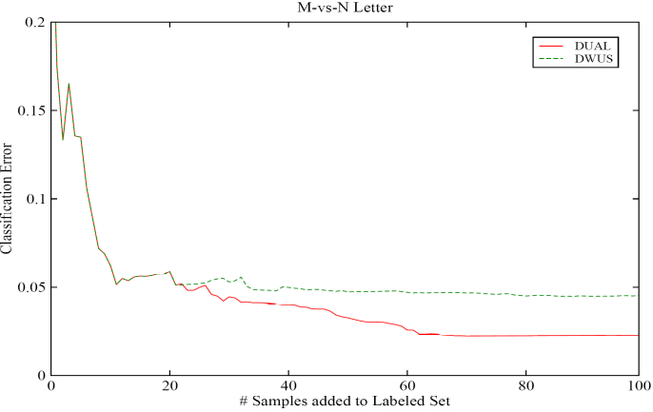
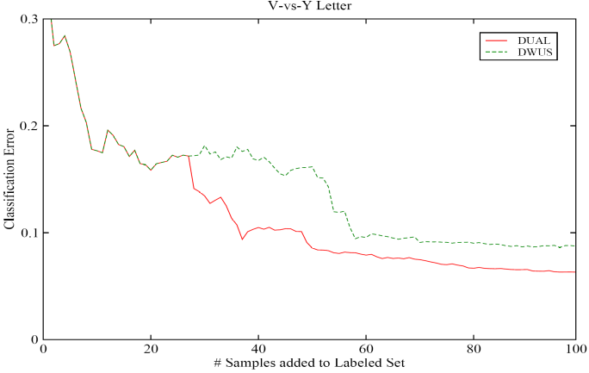
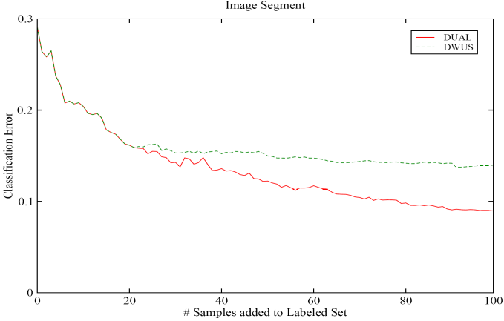
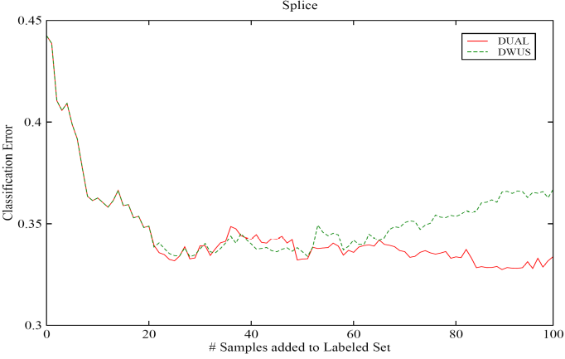
Results: DUAL vs DWUS
Notes:
Even though we conducted tests on 6 datasets, today I show you only four because of the time constraints.
For instance, this figure compares DUAL vs DWUS. We see that DUAL reduces the error to a lower level.

Slide 47
Active Learning Beyond Dual
Paired Sampling with Geodesic Density Estimation
  Donmez & Carbonell, SIAM 2008
Active Rank Learning
  Search results: Donmez & Carbonell, WWW 2008
  In general: Donmez & Carbonell, ICML 2008
Structure Learning
  Inferring 3D protein structure from 1D sequence
  Dependency parsing (e.g. Random Markov Fields)
Learning from crowds of amateurs
  AMT → MT (reliability or volume?)

Slide 48
Active vs Proactive Learning
 | Active Learning | Proactive Learning
Number of Oracles | Individual (only one) | Multiple, with different capabilities, costs and areas of expertise
Reliability | Infallible (100% right) | Variable across oracles and queries, depending on difficulty, expertise, …
Reluctance | Indefatigable (always answers) | Variable across oracles and queries, depending on workload, certainty, …
Cost per query | Invariant (free or constant) | Variable across oracles and queries, depending on workload, difficulty, …
Note: “Oracle” ∈ {expert, experiment, computation, …}

Slide 49
Reluctance or Unreliability
2 oracles:
  reliable oracle: expensive but always answers with a correct label
  reluctant oracle: cheap but may not respond to some queries
Define a utility score as expected value of information at unit cost
Notes:
Let us start with discussing First scenario. In this scenario, we assume there exist 2 oracles: one is a perfectly reliable oracle which always answers with the correct label
the other is a reluctant oracle that may not respond to all queries. Obviously, the reliable oracle costs more than the reluctant one but both charge uniform fees over instances.
We define utility of instance-oracle pair as the expected value of information to the learner if the label of x is queried from oracle k at unit cost. There are two components
in this formula to be estimated. One is the value of information for labeling the instance, and the second is the probability of actually obtaining the information from the oracle for that
particular instance. Value function can be substituted with your favorite active sampling criterion. We used a density-weighted uncertainty scoring function we developed in one
of our earlier work. I will not go into the details of that since it is not essential for this work here. If you’re interested you can read it in the paper. I’d rather spend time on the discussion for the unreliability of the oracle which is defined in terms of reluctance in this scenario. There are two issues with oracle reluctance. One is how we can simulate it since we do not currently have any benchmark collection that provides us with oracle properties. The second is how we can learn it since we don’t know in advance for what types of queries the oracle becomes reluctant to.

Slide 50
How to estimate ?
Cluster unlabeled data using k-means
Ask the label of each cluster centroid to the reluctant oracle. If
  label received: increase of nearby points
  no label: decrease of nearby points
equals 1 when label received, -1 otherwise
# clusters depend on the clustering budget and oracle fee
Notes:
Now, let us see how we can estimate the oracle reliability. We assume we are not given this information in advance. Hence, we dont know when the oracle becomes reluctant although we know which oracle is perfect and which one is reluctant. The way we estimate it is as follows:
First we cluster the data using k-means. Then, we query the label of each cluster centroid to the reluctant oracle. We assume that the oracle will be unreliable for
similar points. So, we propagate the information we obtain by querying the centroid to nearby points. If we receive a label, then we increase... othwerwise we decrease it
using this formula here. Everything starts with random guess, .5 probability and then if the indicator function h is 1 (meaning that we receive the label of the centroid) then this probability increases proportional to the proximity to the centroid.
The number of clusters depends on the clustering budget allocated for this exploration phase and the cost of the oracle.

Slide 51
Underlying Sampling Strategy
Conditional entropy based sampling, weighted by a density measure
Captures the information content of a close neighborhood
close neighbors of x

Slide 52
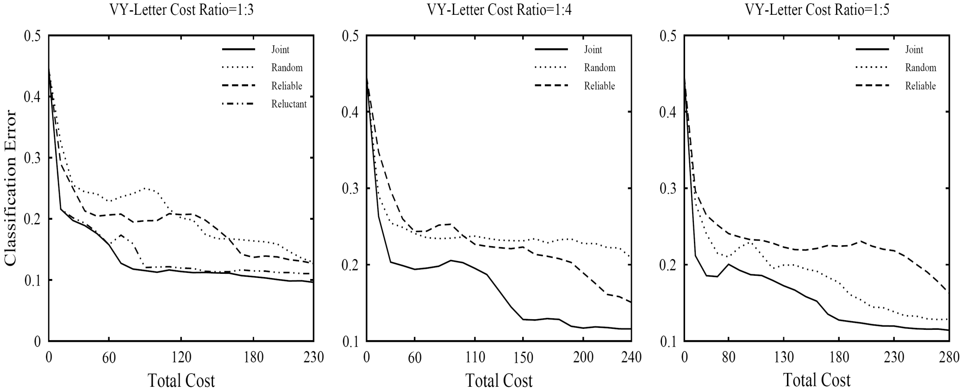
Results: Reluctance

Slide 53
Proactive Learning in General
Multiple Informants (a.k.a. Oracles)
  Different areas of expertise
  Different costs
  Different reliabilities
  Different availability
What question to ask and whom to query?
  Joint optimization of query & informant selection
  Scalable from 2 to N oracles
  Learn about infromant capabilities as well as solving the Active Learning problem at hand
  Cope with time-varying oracles

Slide 54
New Steps in Proactive Learning
Large numbers of oracles [Donmez, Carbonell & Schneider, KDD-2009]
  Based on multi-armed bandit approach
Non-stationary oracles [Donmez, Carbonell & Schneider, SDM-2010]
  Expertise changes with time (improve or decay)
  Exploration vs exploitation tradeoff
What if labeled set is empty for some classes?
  Minority class discovery (unsupervised) [He & Carbonell, NIPS 2007, SIAM 2008, SDM 2009]
  After first instance discovery → proactive learning, or → minority-class characterization [He & Carbonell, SIAM 2010]
Learning Differential Expertise → Referral Networks

Slide 55
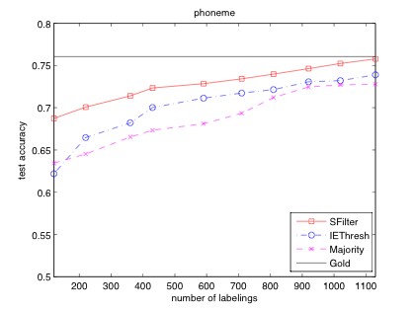
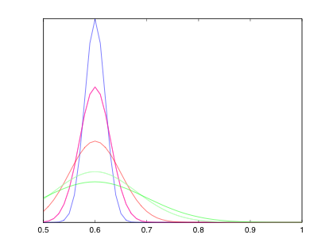
What if Oracle Reliability “Drifts”?
Resample Oracles if Prob(correct )> θ
t=1
Drift ~ N(µ,f(t))
t=10
t=25
Notes:
One of the advantages of using this framework is that we can predict the true label at any time t by using the estimated expected accuracy of each source selected at time t and the noisy labels they omit. And train a logistic regression classifier on the data labeled by each method and tested the classifier on a held-out test set. The y-axis shows the test accuracy and the x-axis shows the number of source queries issued. We compared our method against two baselines that uses majority voting to predict the true label. The purple line uses all sources and take their majority vote and the blue line is our IE method that selects a subset of sources and use only their majority vote. None of these techniques take the time-varying accuracy into account. The horizontal black line is the performance of a classifier trained on the true labels. Clearly, we get close to the gold standard level and significantly outperform the baselines. That means we can produce clean and reliable datasets even when we do not know what the true labels are.

Slide 56

Active Learning for MT
Expert
Translator
Parallel corpus
S,T
Trainer
S
Monolingual source corpus
Model
MT System
Source
Language
Corpus
Active
Learner

Slide 57


Active Crowd Translation
S,T₁
S,T₂
Trainer
.
.
.
Translation
Selection
S,T_{n}
Model
S
Sentence
Selection
MT System
Source
Language
Corpus
ACT
Framework

Slide 58
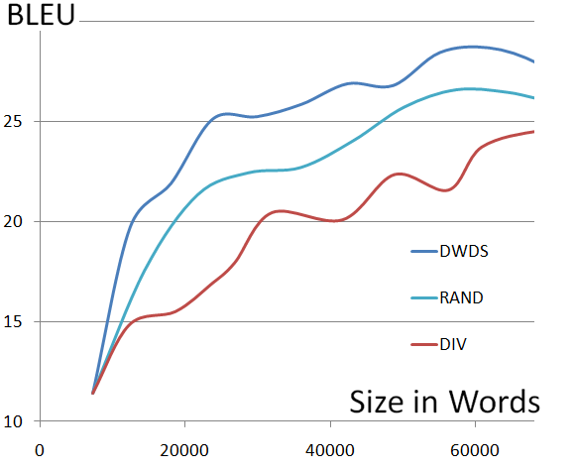
Active Learning Strategy:
Diminishing Density Weighted Diversity Sampling
Experiments:
Language Pair: Spanish-English
Batch Size: 1000 sentences each
Translation: Moses Phrase SMT
Development Set: 343 sens
Test Set: 506 sens
Graph:
X: Performance (BLEU )
Y: Data (Thousand words)

Slide 59
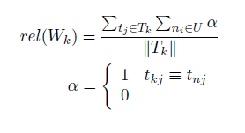
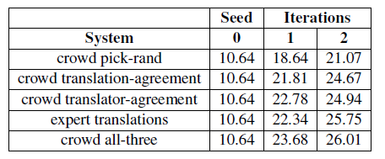
Translation Selection from Mechanical Turk
Translator Reliability
Translation Selection:

Slide 60
Conclusions and Directions
Match the MT method to language resources
  SMT → L/L, CMBT → S/L, STMT → M/M, …
(Pro)active learning for on-line resource elicitation
  Density sampling, crowd sourcing are viable
Open Challenges abound
  Corpus-based MT methods for L/S, S/S, etc.
  Proactive learning with mixed-skill informants
  Proactive learning for MT beyond translations
    Alignments, morpho-syntax, general lingustic features (e.g. SOV, vs SVO), …

Slide 61

THANK YOU!

