Slide 1
A Corpus for Cross-Document Co-Reference
D. Day¹, J. Hitzeman¹, M. Wick², K. Crouch¹
and M. Poesio³
¹The MITRE Corporation
²University of Massachusetts, Amherst
³Universities of Essex and Trento
Approved for public release. Distribution unlimited. MITRE case number # 08-0489

Slide 2
Within-doc Coreference
The LDC has developed a corpus for within-doc coreference, i.e., when a phrase in a document refers back to a previously mentioned entity
“Smith succeeded Jones as CEO of the company. He started his career at IBM….”

Slide 3
Cross-doc Coreference
In order to determine a chain of events, the movements of a person, changes in ownership of a company, etc., we need a corpus that identifies co-referring mentions of entities appearing in different documents
“Smith succeeded Jones as CEO of the company. He started his career at IBM….”
“Smith is currently the vice-president of IBM. He was hired in 1972 in order to improve profits.”

Slide 4
The Johns Hopkins Workshop
Johns Hopkins hosted a summer workshop
  To investigate the use of lexical and encyclopedic resources to improve coreference resolution
  To build a cross-doc corpus
  To build systems to perform cross-doc coreference
One question was how far the techniques we use on within-doc coreference would work with cross-doc coreference
Our team was in charge of building the corpus
We intend to release this corpus for unlimited use and distribution

Slide 5
The Technique
We began with the within-doc corpus developed by the LDC for the Automated Content Extraction competition (ACE)
We built the Callisto/EDNA annotation tool
  A specialized annotation task plug-in for the Callisto annotation tool (http://callisto.mitre.org)
  A Callisto client plug-in that uses a web server (Tomcat) and search/indexing web services plug-ins that support multiple simultaneous annotators

Slide 6
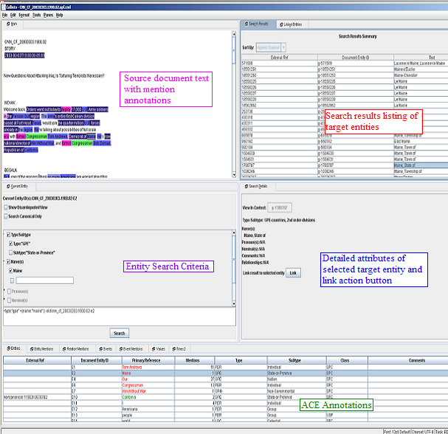

Slide 7
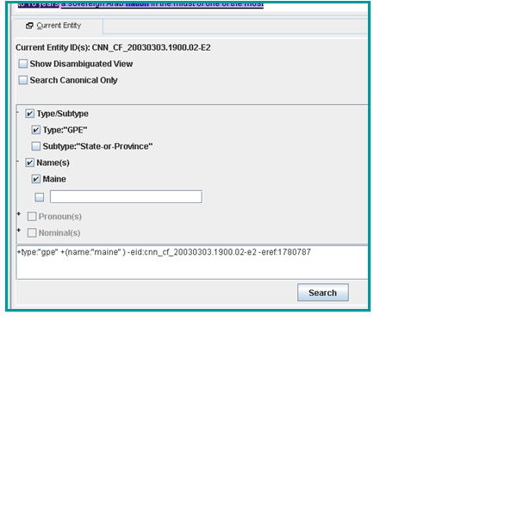
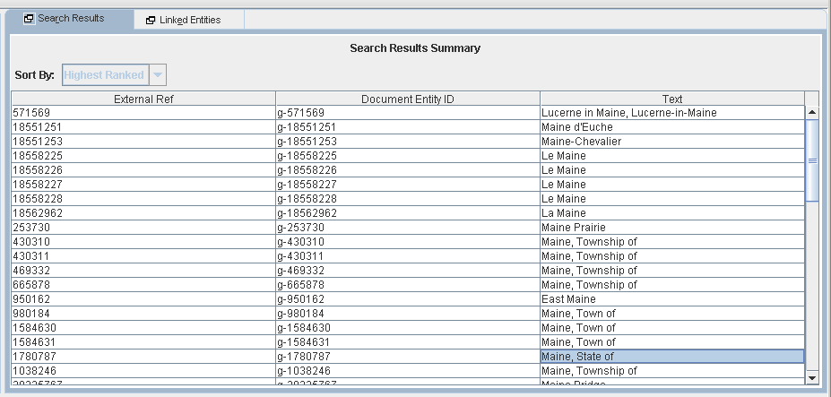
The Search Query and
Search Results Panes

Slide 8
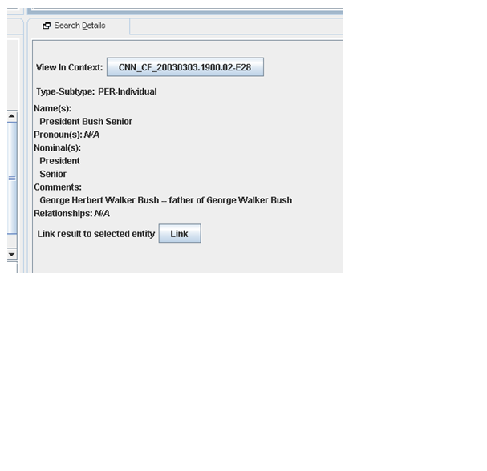
Search Results Details Pane

Slide 9
The Annotation Process
Criteria for considering cross-referencing entities
  It has at least one mention of type NAME within a document
  It is of type PER, ORG, GPE or LOC
To expedite the process, we applied an initial automated cross-doc linking prior to manual annotation
  E.g., all mentions of “Tony Blair” were coreferenced
  When a NAME is common, this pre-linking saved the annotator many mouse clicks

Slide 10
The Pre-Linking Process
The pre-linked entities had to have at least one identical NAME mention and to be of the same TYPE and SUBTYPE
We were concerned that the automatic pre-linking would produce errors but it produced very few
The errors were largely due to errors in the within-doc data, e.g., within-doc coreferencing of
  “anonymous speaker” with other anonymous speakers
  “Scott Peterson” and “Laci Peterson”

Slide 11
The ACE2005 English EDT Corpus
1.5 million characters
257,000 words
18,000 distinct document-level entities (prior to cross-doc linking)
  PER 9.7K
  ORG 3K
  Geo-Political entity (GPE) 3K
  FAC 1K
  LOC 897
  Weapon 579
  Vehicle 571
55,000 entity mentions
  Pronoun 20K
  Name 18K
  Nominal 17K

Slide 12
Resulting Entities
7,129 entities satisfied the constraints required for cross-doc annotation
Automatic and manual annotation resulted in 3,660 entities
Of these, 2,390 entities were mentioned in only one document

Slide 13
Comparison to Previous Work
John Smith corpus (Bagga, et al, 1998)
  Baldwin and Bagga created a cross-doc corpus and evaluated it for the common name “John Smith”
Benefits of our work
  By using an existing within-doc corpus, we have high-quality co-reference information for both within-doc and cross-doc
The size of this corpus is significantly larger than previous data sets

Slide 14
Data Format
The output is similar to the ACE APF format
<entity CLASS="SPC"
ID="AFP_ENG_20030323.0020-E62"
SUBTYPE="Individual" TYPE="PER">
<entity_mention
ID="AFP_ENG_20030323.0020-E62-86"
LDCTYPE="NAMPRE" TYPE="NAM">
<extent><charseq END="3161"
START="3152">John Wayne</charseq> ...
<external_link EID="1772"
RESOURCE="elerfed-ed-v1"/>
</entity>

Slide 15
Observations
One side effect of performing cross-doc coreference is that it showed errors in the within-doc annotation
  E.g., “Scott Peterson” and “Laci Peterson” are coreferenced because there is a misannotated reference to “Peterson”
It allowed us to cross-reference names with nicknames which will not be found in a gazetteer
  E.g., “Bama” with “Alabama”
  “Q”, “Qland”, “Queensland”
  This co-referencing allows nicknames to be mapped using a gazetteer

Slide 16
Scoring
To test the ambiguity of the dataset, we implemented a discriminatively trained clustering algorithm similar to Culotta et all (2007)
We measured cross-doc coreference performance on a reserve test set of gold standard documents
F=.96 (Bcubed)
F=.91 (Pairwise)
F=.89 (MUC)

