Slide 1

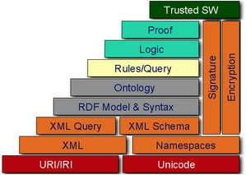
A Web Browser Extension for growing-up
Ontological Knowledge from Traditional Web Content
Maria Teresa Pazienza¹,
Marco Pennacchiotti²,
Armando Stellato¹
¹ University of Rome, Tor Vergata
{pazienza, stellato}@info.uniroma2.it
² Saarland University
pennacchiotti@coli.uni-sb.de

Slide 2
Outline
Objectives
Semantic Turkey: a Semantic Bookmarking tool
  Semantic Bookmarking
  Semantic Turkey Architecture
  Semantic Turkey Main Functionalities
Extending Semantic Turkey: Ontology Learning
  Learning Ontological Content from Tables
  Learning Semantics Relation from Text
Future Work

Slide 3
Objectives
Turn out the usual tool for Web Navigation, the Web Browser, into a mean for:
  collecting information from web pages, be it:
    Domain terminology
    Factual information (objects)
  organizing collected content to:
    create a new ontology and/or to extend existing ones with new axioms
    populate ontologies with new instance data
Main contribution
  Unify worlds of:
    traditional ontology editing (Protege, TopBraid Composer etc…)
    Semantic annotation (Melita, Gate, Magpie, Annotea)
  To give life to a unique environment for knowledge acquisition and management
Requirements
  Extendible architecture
  Easy-to-perform knowledge acquisition process
  Robustness wrt different web technologies

Slide 4
Semantic Turkey
A Semantic Bookmarking tool

Slide 5
Semantic Turkey Objective for improving the
Web Navigation Experience
Focused on the “I’ve already seen X somewhere else in the Web, but…where?” problem:
  Did I keep track of X?
  If yes, where did I put the link to a web document about X? In which folder of my bookmarks should I check for presence of these links and, will I recognize them from their name with a short glimpse at my bookmarks?
Our approach
  Obtain a clear separation between pure knowledge data (the WHAT) and web links (the WHERE)
  Offer innovative navigation of both the acquired information and of the pages where it has been collected

Slide 6
Semantic Bookmarking:
Requirements and Design Goals
capturing information from web pages, both by considering the pages as a whole, as well as by annotating portions of their text
Editing of a personal ontology for categorization of the annotated information and, possibly, to exchange data with other users
Navigation of the structured information as an underlying semantic net, with links to the web sources where it has been annotated
Clear separation between business model and user interface

Slide 7
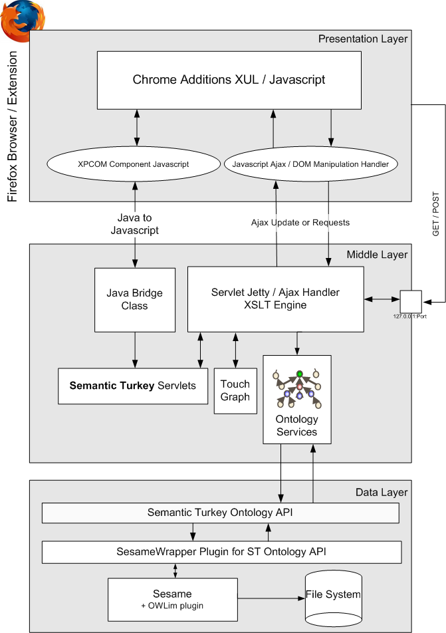
Semantic Turkey Architecture
Three layered architecture
  Presentation Layer
    An extension to the Firefox browser. The User Interface has been created through a combined use of the XUL, XBL and Javascript technologies
  Services Layer
    Enables communication between the client (Firefox browser extension) and the ontology persistence layer. Deployed as services which may be invoked through http requests submitted according to the Ajax paradigm
  Persistence Layer
    Access to ontological knowledge. Based on dedicated ontology API, which can be implemented through use of different technologies.

Slide 8
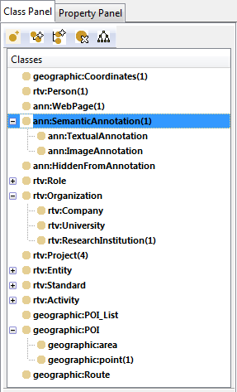
Knowledge Model
Application Layer
Contains ontologies needed by the application for coordinating and organizing its services
These ontologies are hidden by default from the user (their schema and related content can be shown for administrative purposes)
In the core version of ST, it includes the Semantic Annotation ontology, which provides concepts and relations for keeping track of user semantic bookmarks, like:
  SemanticAnnotation
  Document
  WebPage
and the required properties for relating the instances
User/Domain Layer
ST is now as an (almost) complete ontology editing tool, with functionalities for importing ontologies from the web, creating local caches, editing new ontologies by adding concepts, instances, instantiating attributive (datatype) or relational (object) properties etc… new objects can be added independently from semantic annotations.

Slide 9
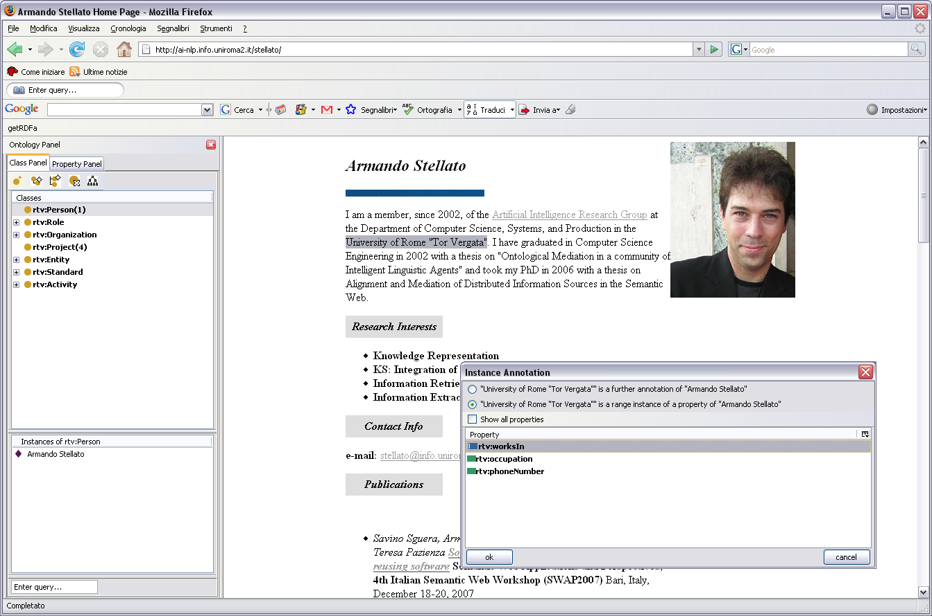
Semantic Turkey in Action:
Semantic Annotation

Slide 10
Semantic Turkey in Action:
Semantic Annotation
No automatic ontology building from text but…
with just one intuitive drag’n’drop operation (and few HC interactions), the system:
  Creates a new Domain Object instance
    (and/or builds a new lexicalization for the already existing instance on the annotate page)
  Creates a new SemanticAnnotation instance
  Creates a new WebPage instance
  Relates all of them through dedicated properties
  …(depending on the specific operation)

Slide 11
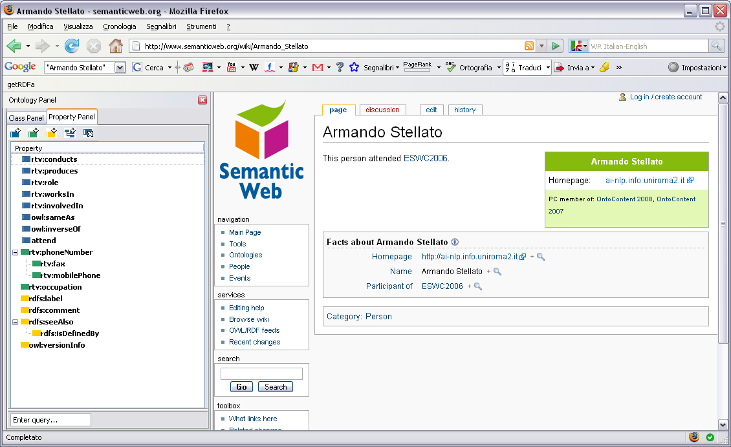
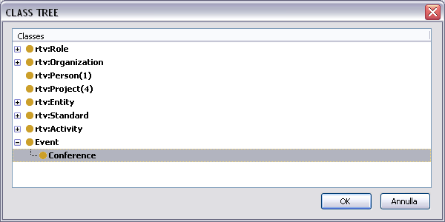
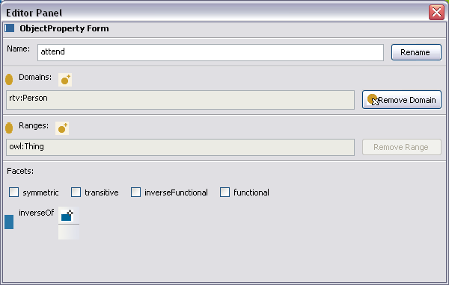
Semantic Turkey in Action:
Ontology Editing

Slide 12
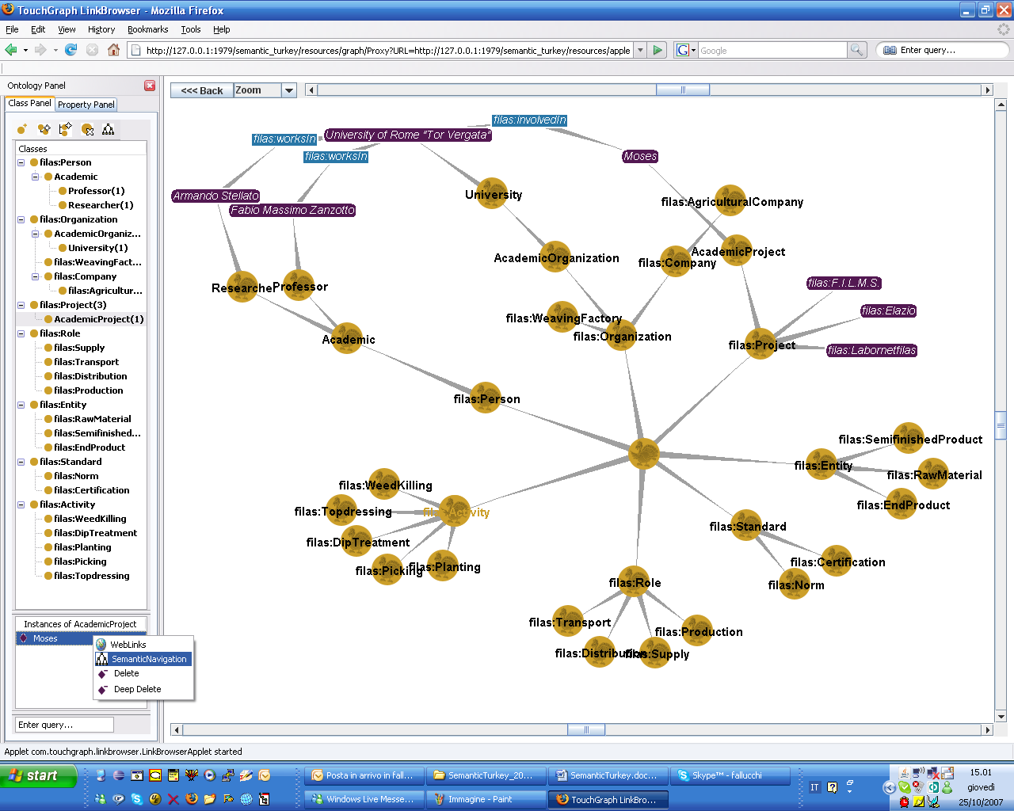
Semantic Turkey in Action:
Semantic Navigation
12

Slide 13
Automating the Turkey…
Can we speed-up ontology building by (semi)-automatically learning ontological content from web pages?
  Ontology learning from text is a rich area of NLP [Buitelaar and Cimiano,2008]
  We need to adapt classical methods, in order to comply to the Turkey’s requirements:
    Low computational cost (no deep parsing and complex algorithms)
    Easy-to-useness
    Focus on web content
  Two ling modules : (1) ontology learning form tables
  (2) relation extraction from texts
Notes:
FINE ARMANDO

Slide 14
Learning ontological content from tables
Notes:
INIZIO MARCO

Slide 15
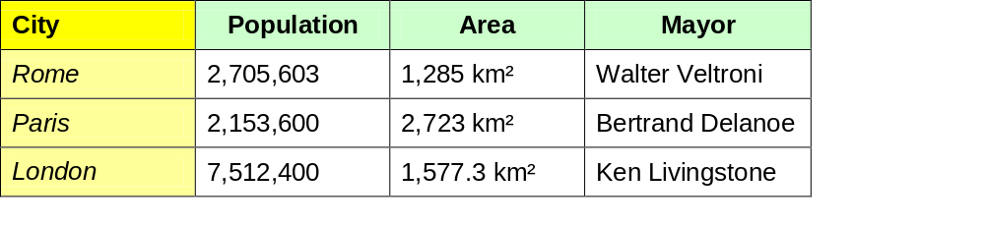
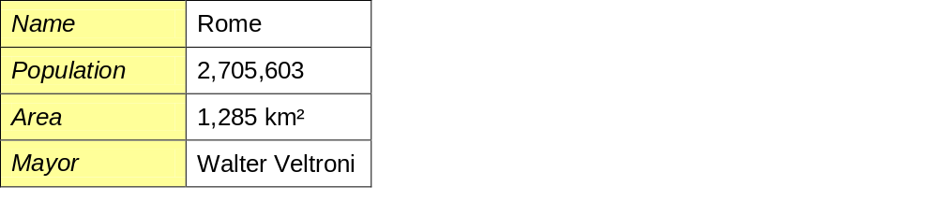
Web Tables
A preferential way to convey knowledge on the Web
Contain dense meaningful knowledge
Highly structured: internal organization reveals ontological content
Three layered
Column Header
Two layered
Row Header
Internal cells

Slide 16
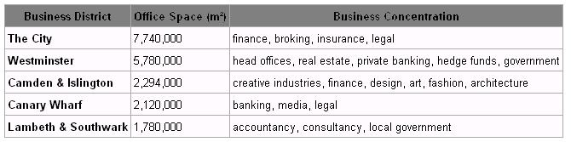
Table ontological model
Class tables
  Contain information on a class (property names, property values, instance names)
  3-layered

Slide 17
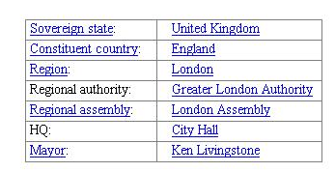
Table ontological model
Class tables
  Contain information on a class (property names, property values, instance names)
  3-layered
Instance tables
  Contain information on a single instance (property names and values)
  2-layered (2-columns)
(Instance: London)

Slide 18

Knowledge Extraction from tables
(Input: table ; Output: table ontol. interpretation)
Table identification (class vs. instance table)
  IF |columns| > 2 three-layered → class table
  ELSE IF (∃ column-header) three-layered → class table
  ELSE two-layered → instance table
Table ontological analysis (identify ontol. entites)
IF (instance table) column-1 = property names
column-2 = property values
IF (class table) decide how row /column headers map to property names / instance names according to internal cell data type.
Apply Style-based heuristics
Value-based heuristics

Slide 19
Evaluation
Corpus :100 Wikipedia pages on cities, 207 tables
Evaluation : Accuracy on a Gold Standard created by an expert ontology engineer
Good performance, especially on table identification
(Indirectly) comparable to other tools: Tartar accuracy on similar task is 0.85 [Pivk et al.,2007]
Task | Accuracy
Table identification | 0.91
Ontological analysis | 0,77

Slide 20
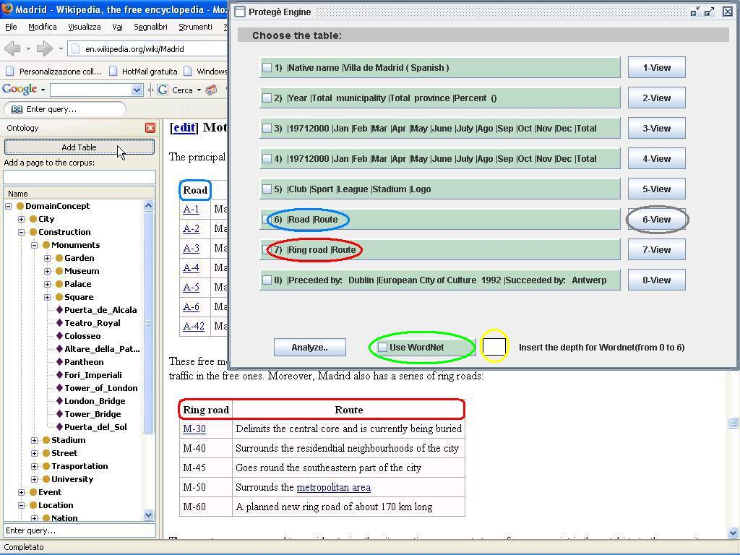
Module Interface
Extract tables from web pages

Slide 21
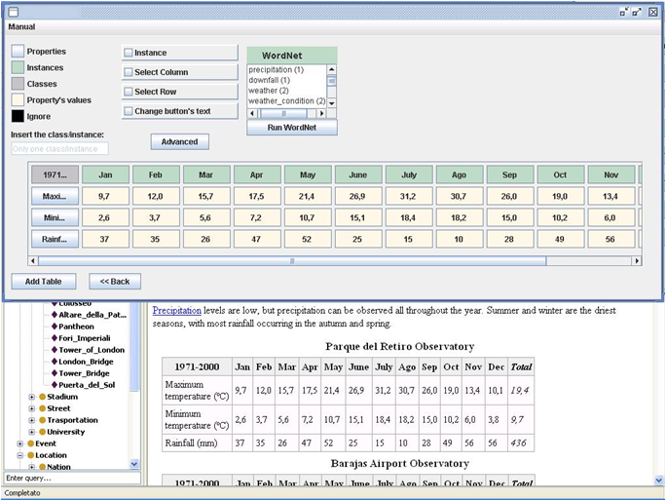
Module Interface
Extract tables from web pages
Suggest interpretation for each table in the page

Slide 22
Module Interface
Extract tables from web pages
Suggest interpretation for each table in the page
Ask user for validation
Upload data into the ontology

Slide 23
Learning semantic relations from text
Notes:
INIZIO MARCO

Slide 24
Relation Extraction
Relational knowledge is central to ontologies: is_a(X,Y), located_in(X,Y)…
Relation extraction aims at (semi-)automatically extract relation instances from texts
Most successful are pattern-based approaches [Hearst,1992] ( e.g. “X is in Y” for located_in(X,Y) )
We adopt a simple pattern-based approach with instance weighting and pattern generalization for refining the returned instances
Given a seed instance(s) entered by the user, the system suggests new instances extracted from the Web, and uploads after user’s validation

Slide 25
Architecture
TARGET RELATION:
CAPITAL_OF(X,Y)
Pattern induction algorithm similar to [Ravic&Hovy,2002]
Retrieve all sentences containing seeds (X,Y)
Analyze with a dependency parser
Induce patters as paths between X and Y
(Madrid,Spain)
"X is capital of Y„
“Y, whose capital is X"

Slide 26
Architecture
Rank and select best instances
Reliability measure R(i) scores higher instances that:
  Are fired by many patterns
  Have same PoS as seeds
  Having semantic classes similar to seeds
TARGET RELATION:
CAPITAL_OF(X,Y)
1 (Rome, Italy)
1 (Paris, France)
0.8 (London, England)
0.3 (Milan, fashion)
(Madrid,Spain)
"X is capital of Y„
“Y, whose capital is X"
(Rome, Italy)
(Paris, France)
(Milan, fashion)
(London, England)

Slide 27
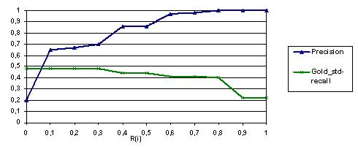
Evaluation
Corpus : 80 Wikipedia pages on capital city
Relations : Capital-of and Located-in
Evaluation : Prec /Rec on a Gold Standard set of instances manually extracted from corpus
Precision close to state of the art
Recall can be improved using different
strategies (e.g. generic patterns, feedback)
Capital-of | Located-in
* Antananarivo ; University | district ; center
Belmopan ; Belize | * Internationals ; Amsterdam
* Open ; Masterplan | town ; province
Budapest ; Hungary | City ; Kazakihstan
* It ; America | * Exchange ; Bangkok
Hargeisa ; Somaliland | Beirut ; coastline
Honiara ; Solomon Islands | National Bank ; city
Islamabad ; Pakistan | Berlin ; Germany
* Kingston ; United States | mall ; Jakarta
Manama ; Bahrain | * It ; E

Slide 28
Conclusions and Future Work
Notes:
INIZIO MARCO

Slide 29
Future Work
Table Analysis: improve user interaction in change&commit of proposed results
Relation Extraction: use iterative algorithms to improve Recall
Use of external resources to augment common sense knowledge of the tool
Development of a dedicated extension framework for hosting different ling modules
Include new NLP-based ontology learning modules (e.g. NER, complex event extractor)

Slide 30
Thanks!
Questions?

Slide 32
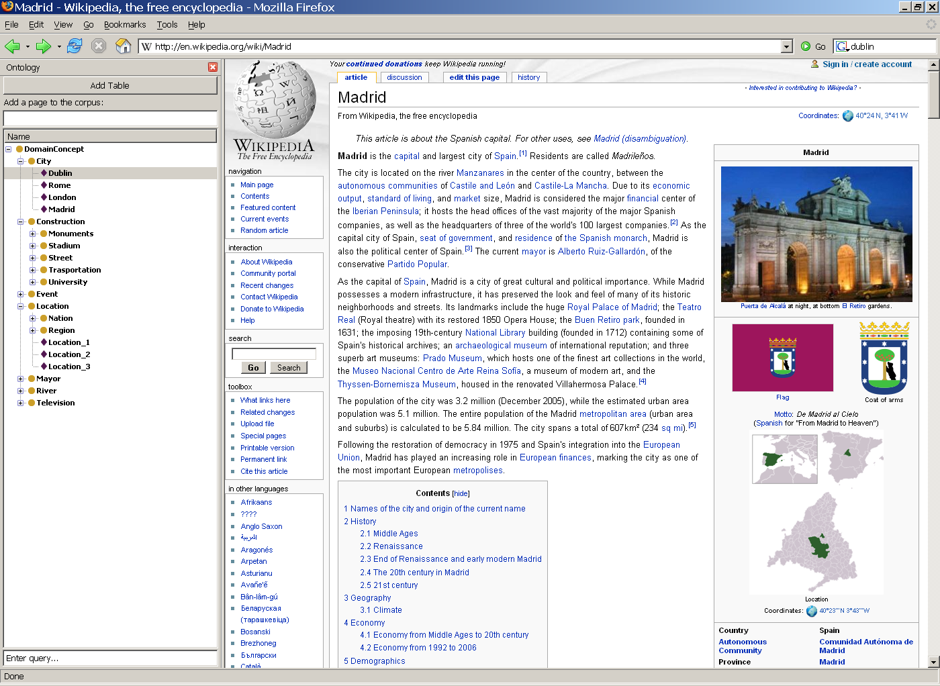

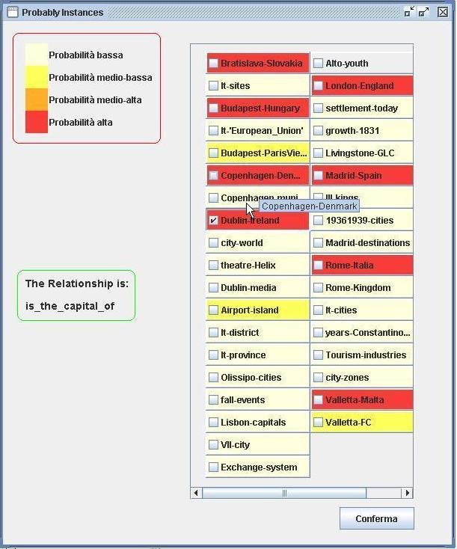
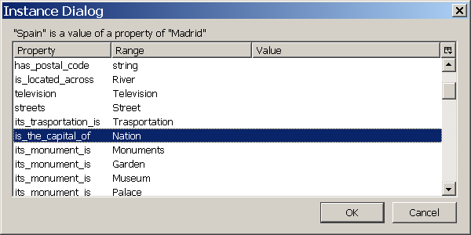
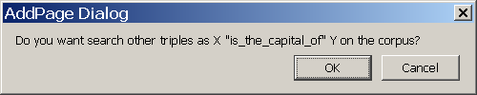
Module interface
32

Slide 33
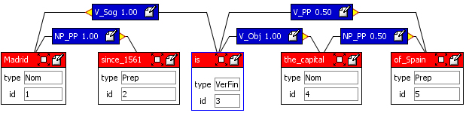
RelEx : pattern induction
Patterns are induced from the set of input instances
We use an induction algorithm similar to (Ravichandran and Hovy 2002)
  All sentences containing the input instances are retrieved
  Sentences are parsed with the Chaos dependency parser (Basili&Zanzotto,2002)
  Patterns are induced from sentences ( “meaningful patterns” wrt surface approaches )
  Patterns are generalized to ease data sparseness (small corpora)
capital_of(Madrid,Spain)
“Madrid since 1561 is the capital of Spain”
PATTERN INDUCTION
“X is the capital of Y”
“X of Y”
PATTERN GENERALIZATION
“X is the capital of Y”
“X has been the capital of Y”
“X was the capital of Y”
“X of Y”
(dependencies omitted)

Slide 34
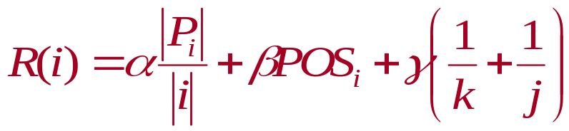
RelEx : instance ranking
Instances are ranked according to a reliability measure R(i)
Intuition: a reliable instance is one :
  that is fired by many patterns
  whose PoS are the same as the seed
  in which the semantic classes of X and Y are similar to those of the seed (e.g. “New Delhi” and “Madrid” are both cities)

Slide 35
RelEx : evaluation setup
CORPUS: European and Asian Cities
  80 Wikipedia pages (≈210.000 tokens)
RELATIONS: Capital_of(X,Y), Located_in(X,Y)
PARAM. SET: Reliability params set on a dev corpus of 10 pages (α=0.05 β=0.25 γ=0.74)
EVALUATION: Gold Standard: instances I_{gs} manually extracted from the corpus
PRECISION RELATIVE-RECALL F-MEASURE GS-RECALL
|I_{τ} ∩ I_{gs}|
R_{τ}=
|I ∩ I_{gs}|

Slide 36
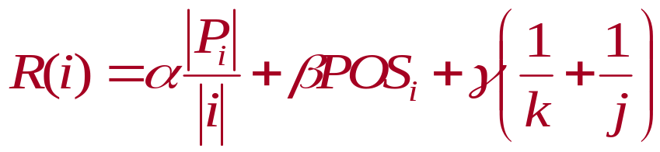
RelEx : instance ranking
Reliability measure is a combination of the three intuition:
Semantic similairity with seed slots (depths of l.c.s. of X and Y)
Generality across patterns
POS matching
Instances with different weights are differently highlighted in the user interface

Slide 37
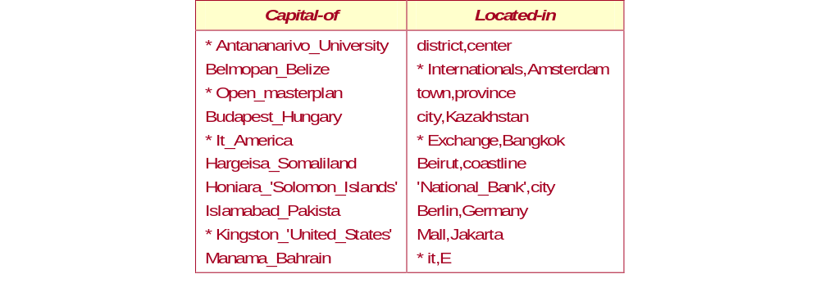
RelEx : evaluation results
Metrics variation on R(i)
(graph for capital_of)
Increasing R(i) good trends of Precision and Recall
Precision up to state-of-the-art systems
Recall is comparably low (no use of generic patterns)
Should improve by using more seeds

