Slide 1
Applying Automated Metrics to Speech Translation Dialogs
Sherri Condon, Jon Phillips, Christy Doran, John Aberdeen, Dan Parvaz, Beatrice Oshika, Greg Sanders, and Craig Schlenoff
LREC 2008

Slide 2
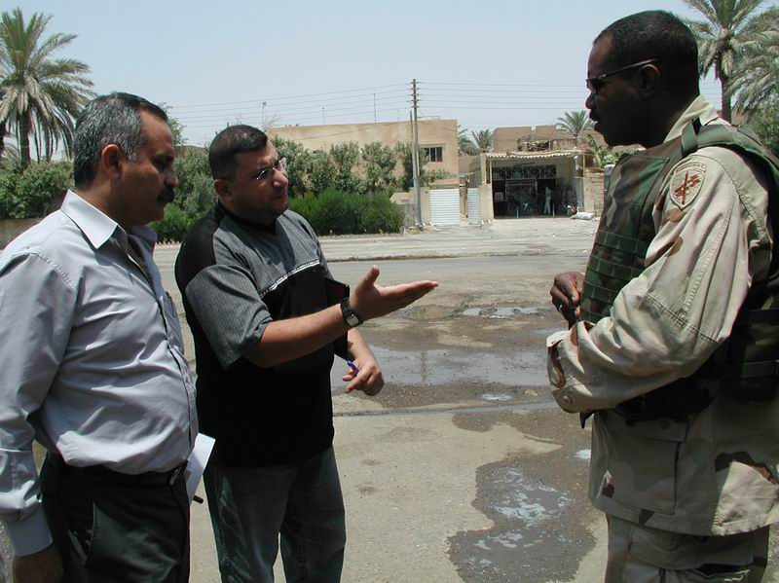
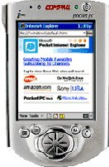
DARPA TRANSTAC: Speech Translation for Tactical Communication
DARPA Objective: rapidly develop and field two-way translation systems for spontaneous communication in real-world tactical situations
Speech Recognition
Machine Translation
Speech Synthesis
“How many men did you see?”
Iraqi
Arabic
Speaker
English
Speaker
“There were four men”

Slide 3
Evaluation of Speech Translation
Few precedents for speech translation evaluation compared to machine translation of text
High level human judgments
  CMU (Gates et al., 1996)
  Verbmobil (Nübel, 1997)
  Binary or ternary ratings combine assessments of accuracy and fluency
Humans score abstract semantic representations
  Interlingua Interchange Format (Levin et al., 2000)
  Predicate-argument structures (Belvin et al, 2004)
  Fine-grained, low-level assessments

Slide 4
Automated Metrics
High correlation with human judgments for translation of text, but dialog is different than text
  Relies on context vs. explicitness
  Variability: contractions, sentence fragments
  Utterance length: TIDES average 30 words/sentence
Studies have primarily involved translation to English and other European languages, but Arabic is different than Western languages
  Highly inflected
  Variability: orthography, dialect, register, word order

Slide 5
TRANSTAC Evaluations
Directed by NIST with support from MITRE (see Weiss et al. for details)
Live evaluations
  Military users
  Iraqi Arabic bilinguals (English speaker is masked)
  Structured interactions (Information is specified)
Offline evaluations
  Recorded dialogs held out from training data
  Military users and Iraqi Arabic bilinguals
  Spontaneous interactions elicited by scenario prompts

Slide 6
TRANSTAC Measures
Live evaluations
  Global binary judgments of ‘high level concepts’
  Speech input was or was not adequately communicated
Offline evaluations
  Automated measures
    WER for speech recognition
    BLEU for translation
    TER for translation
    METEOR for translation
  Likert-style human judgments for sample of offline data
  Low-level concept analysis for sample of offline data

Slide 7
Issues for Offline Evaluation
Initial focus was similarity to live inputs
  Scripted dialogs are not natural
  Wizard methods are resource intensive
Training data differs from use of device
  Disfluencies
  Utterance lengths
  No ability to repeat and rephrase
  No dialog management
    I don’t understand
    Please try to say that another way
Same speakers in both training and test sets

Slide 8
Training Data Unlike Actual Device Use
then %AH how is the water in the area what's the -- what's the quality how does it taste %AH is there %AH %breath sufficient supply?
the -- the first thing when it comes to %AH comes to fractures is you always look for %breath %AH fractures of the skull or of the spinal column %breath because these need to be these need to be treated differently than all other fractures.
and then if in the end we find tha- -- that %AH -- that he may be telling us the truth we'll give him that stuff back.
would you show me what part of the -- %AH %AH roughly how far up and down the street this %breath %UM this water covers when it backs up?

Slide 9
Selection Process
Initial selection of representative dialogs (Appen)
  Percentage of word tokens and types that occur in other scenarios: mid range (87-91% in January)
  Number of times a word in the dialog appears in the entire corpus: average for all words is maximized
  All scenarios are represented, roughly proportionately
  Variety of speakers and genders are represented
Criteria for selecting dialogues for test set
  Gender, speaker, scenario distribution
  Exclude dialogs with weak content or other issues such as excessive disfluencies and utterances directed to interpreter
    “Greet him” “Tell him we are busy”

Slide 10
July 2007 Offline Data
About 400 utterances for each translation direction
  From 45 dialogues using 20 scenarios
  Drawn from entire set held back from data collected in 2007
Two selection methods from held out data (200 each)
  Random: select every n utterances
  Hand: select fluent utterances (1 dialogue per scenario)
5 Iraqi Arabic dialogues selected for rerecording
  About 140 utterances for each language
  Selected from the same dialogues used for hand selection

Slide 11
Human Judgments
High-level adequacy judgments (Likert-style)
  Completely Adequate
  Tending Adequate
  Tending Inadequate
  Inadequate
  Proportion judged completely adequate or tending adequate
Low-level concept judgments
  Each content word (c-word) in source language is a concept
  Translation score based on insertion, deletion, substitution errors
  DARPA score is represented as an odds ratio
  For comparison to automated metrics here, it is given as total correct c-words / (total correct c-words) + (total errors)

Slide 12
Measures for Iraqi Arabic to English
Automated Metrics
Human Judgments
TRANSTAC Systems:
A
B
C
D
E

Slide 13
Measures for English to Iraqi Arabic
Automated Metrics
Human Judgments
TRANSTAC Systems:
A
B
C
D
E

Slide 14
Directional Asymmetries in Measures
BLEU Scores
Human Adequacy Judgments
English to Arabic
Arabic to English

Slide 15
Normalization for Automated Scoring
Normalization for WER has become standard
  NIST normalizes reference transcriptions and system outputs
  Contractions, hyphens to spaces, reduced forms (wanna)
  Partial matching on fragments
  GLM mappings
Normalization for BLEU scoring is not standard
  Yet BLEU depends on matching n-grams
  METEOR’s stemming addresses some of the variation
    Can communicate meaning in spite of inflectional errors
    two book, him are my brother, they is there
English-Arabic translation introduces much variation

Slide 16
Orthographic Variation: Arabic
Short vowel / shadda inclusions: جَمهُورِيَّة, جمهورية
Variations by including explicit nunation: أحيانا , أحياناً
Omission of the hamza: شي, شيء
Misplacement of the seat of the hamza: الطوارئ or الطوارىء
Variations where the taa martbuta should be used: بالجمجمة, بالجمجمه
Confusions between yaa and alif maksura: شي, شى
Initial alif with or without hamza/madda/wasla: اسم, إسم
Variations in spelling of Iraqi words: وياي, ويايا

Slide 17
Data Normalization
Two types of normalization were applied for both ASR/MT system outputs & references
  Rule based: simple diacritic normalization
    e.g. آ,أ,إ => ا
  GLM based: lexical substitution
    e.g. doesn’t => does not
    e.g. ﺂﺑﺍی => ﺂﺒﻫﺍی

Slide 18
Normalization for English to Arabic Text: BLEU Scores
 | Norm0 | Norm1 | Norm2
Average | 0.227 | 0.240 | 0.241
*CS = Statistical MT version of CR, which is rule-based

Slide 19
Normalization for Arabic to English Text: BLEU Scores
 | Norm0 | Norm1 | Norm2
Average | 0.412 | 0.414 | 0.440

Slide 20
Summary
For Iraqi Arabic to English MT, there is good agreement on the relative scores among all the automated measures and human judgments of the same data
For English to Iraqi Arabic MT, there is fairly good agreement among the automated measures, but relative scores are less similar to human judgments of the same data
Automated MT metrics exhibit a strong directional asymmetry with Arabic to English scoring higher than English to Arabic in spite of much lower WER for English
Human judgments exhibit the opposite asymmetry
Normalization improves BLEU scores.

Slide 21
Future Work
More Arabic normalization, beginning with function words orthographically attached to a following word
Explore ways to overcome Arabic morphological variation without perfect analyses
Arabic WordNet?
Resampling to test for significance, stability of scores
Systematic contrast of live inputs and training data

Slide 22
Rerecorded Scenarios
Scripted from dialogs held back for training
  New speakers recorded reading scripts
  Based on the 5 dialogs used for hand selection
Dialogues are edited minimally
  Disfluencies, false starts, fillers removed from transcripts
  A few entire utterances deleted
  Instances of قل له “tell him” removed
Scripts recorded at DLI
  138 English utterances, 141 Iraqi Arabic utterances
  89 English and 80 Arabic utterances have corresponding utterances in the hand and randomly selected sets

Slide 23
WER Original vs. Rerecorded Utterances
 | English Offline | English Rerecorded | Arabic Offline | Arabic Rerecorded
Average | 26.36 | 23.7 | 50.76 | 35.54

Slide 24
English to Iraqi Arabic BLEU Scores: Original vs. Rerecorded Utterances
*E2 = Statistical MT version of E, which is rule-based
 | Original | Rerecorded
Average | 0.178 | 0.187

Slide 25
Iraqi Arabic to English BLEU Scores: Original vs. Rerecorded Utterances
 | Original | Rerecorded
Average | 0.260 | 0.334

