Slide 1
BABYLON
Parallel Text Builder:
Gathering Parallel Texts for Low-Density Languages
  Michael Mohler, Rada Mihalcea
  Department of Computer Science
  University of North Texas
  mgm0038@unt.edu, rada@cs.unt.edu

Slide 2
Three Categories of Languages
High-density
  used globally (especially on the Web)‏
  well integrated with technology
  e.g., English, Spanish, Chinese, Arabic
Medium-density
  fewer resources globally
  dominant language in certain regions or fields
Low-density
  majority of all languages
  regional media (e.g., radio, newspapers) often in higher-density languages

Slide 3
The Web as a Parallel Text Repository
PROS
Data is free, plentiful, and omni-lingual
NLP tools have achieved good results with little supervision
Many websites are multilingual with translated content
CONS
  Data on the Web is not formatted consistently
  Some languages are poorly represented
  The quality of translations is questionable

Slide 4
The Questions
Can existing techniques to build parallel texts using the Web be successfully applied in a low-density language context?
To what extent do parallel texts discovered from the Web enhance the quality (or coverage) of existing parallel texts?

Slide 5
Goals of the Babylon Project
  Apply existing parallel text gathering techniques to low-density languages paired with higher-density pages
  Remain as language- and resource-independent as possible
  Discover pages that contain “on-page” translations
  Existing systems would typically miss these translations
  Analyze the usability of Web-gathered parallel texts in a machine translation environment
  Note: The language pair used in our experiments is Quechua-Spanish

Slide 6
Babylon System Overview
Stage 1: Discover seed URLs for Web crawl
Stage 2: Find pages with minor-language content through a Web crawl
Stage 3: Categorize pages
Stage 4: Find major-language pages near minor-language pages
Stage 5: Filter out non-parallel texts
Stage 6: Align remaining texts
Stage 7: Evaluate the texts in a machine translation environment

Slide 7
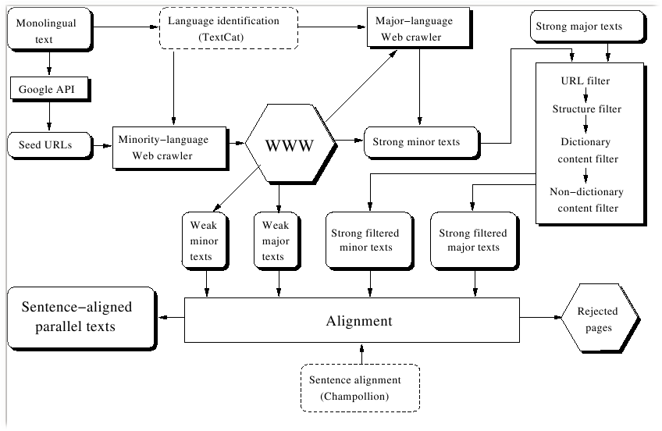
System Flow

Slide 8
Stage 1: Where to start?
Find data in the minor language somewhere on the Web
Starting from a monolingual text, up to 1,000 words are selected automatically
  Try to find a balance between frequently occurring words and less common words
Use these words to query Google using the SOAP API
Use the pages returned by these queries as starting points

Slide 9
Stage 2: Find Minor-Language Pages
Perform a modified BFS (Somboonviwat et al. 2006) starting from the seed pages from Stage 1
  Outlinks from a page in the target language are preferred
  The search is limited to the first one million pages downloaded
  Pages are analysed if they were in any of the following formats: html, pdf, txt, doc, rtf
Perform language identification using the text_cat tool

Slide 10
Stage 3: Categorization
Categorize all the minor-language pages into one of two categories: “weak” or “strong”
  “Weak” pages: primarily written with major-language content and suggest an “on-page” translation
  “Strong” pages: primarily written in the minor language

Slide 11
Stage 4: Find Major-Language Pages
There are two categories of major-language pages that are considered:
  First: Pages that contain a translation “on-page”
    The major-language translation has already been stored
    These pages will not be revisited until stage 6.
  Second: Pages that are near the “strong” minor-language page
    Webmasters design sites so that one translation is easily accessible from another.
Download all the pages within two hyperlinks (undirected) from each “strong” minor-language page and keep all major-language pages for comparison

Slide 12
Stage 5: Find Possible Translations
Determine if the minor and major language pairs are translations of one another:
  URL matching: Webmasters frequently follow naming conventions with translation pages (e.g. index_es.html & index_qu.html)‏
  Structure matching: The HTML tags for translation pages are often similar; only the content changes.
  Content matching (without dictionary): Uses vectorial model to find overlap among proper nouns, numbers, some punctuation, etc.
  Content matching (with dictionary): Same as above but with dictionary entries as well.
Any pair that fails all four tests is discarded

Slide 13
Stage 5: URL Matching
Previous work used a list of string pairs that webmasters use to indicate the language of a page
  “spanish” vs “english”, “_en” vs “_de”, etc.
  requires specific knowledge about how webmasters describe languages (e.g. “big5” for Chinese)‏
Circumvent the need for a general-purpose list by using an edit distance based approach
Two URL strings match if the number of additions, substitutions, and deletions required to change one string into another is below a threshold

Slide 14
Stage 5: Structure Matching
Following STRAND (Resnik 2003), convert each page to a tag-chunk representation for comparison
Find the edit distance between each pair assuming that text chunks with similar length are equivalent
If the edit distance is below a threshold, the pair is considered a match

Slide 15
Stage 5: Content Matching
Following the PTI System (Chen, Chau, and Yeh 2004), generate the term frequency (tf) vector
  If a dictionary is used, each word in language B is mapped to its corresponding language A word
  Additionally, all language B words are mapped to themselves to account for numbers, proper nouns, punctuation, etc.
The process is repeated after performing light stemming
  reduce each word in the text and in the dictionary to its first four letters. (“apple” -> “manzilla” becomes “appl” -> “manz”)‏
Jaccard coefficients are found for the vectors for both mappings
  scores are recombined by weighting the non-stemmed score at 75% of the final score

Slide 16
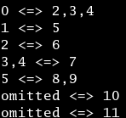
Stage 6: Alignment
The final phase uses the alignment tool champollion
  attempts to align the paragraphs of two files considering sentence length, numbers, cognates, and (optionally) dictionary entries.
From this output, a final alignment score is computed:
(one_to_one + 0.5 * one_to_many)/num_paragraphs
The score favours alignments with many one-to-one matchings and disfavours alignments with many dropped paragraphs.
For each minor-language text, the major-language text that has the highest alignment score above a given threshold is kept as its match.

Slide 17
Stage 7: Machine Translation Evaluation - Experiment Setup
Use the Moses machine translation toolkit with the crawled parallel texts, alone and in conjunction with other parallel texts, to translate a set of texts
Training data
  Crawled parallel texts AND/OR
  Machine-readable verse-aligned Bibles in both languages
  Four Bible translations available in Spanish and one in Quechua

Slide 18
Stage 7 (cont)‏
Test data (removed from training)‏
  Three complete books (Exodus, Proverbs, and Hebrews)‏
  A subset of the crawled parallel text
    To determine the effect of domain transfer on translation needs
Translation models
  Six translation models are created
  A cross product parallel text composed of all Spanish Bibles (4) matched against all Quechua Bibles (1) is also used
  For each quantity of Biblical data (“none”, “Bible”, and “4 Bibles”), two translation models are created by including the crawled texts or not

Slide 19
Evaluation
Translation models are evaluated using BLEU
  measures the N-gram overlap between the translated text and a reference gold-standard translation
  Each translation model is tested against both evaluation sets: “Bible” and “Crawled”
Note: an expert-quality translation receives a BLEU score of around 30

Slide 20
Results
Spanish to Quechua Quechua to Spanish

Slide 21
Conclusions
The crawled texts do not contaminate the translation models
  Little improvement for the Bible test set
  Do not seem to degrade the translation quality
Crawled texts are necessary for improving coverage
  The Bible training set alone is insufficient for translating the crawled test set
The crawled training set evaluated against the crawled test set outperforms all other training-test combinations

Slide 22
References
Jiang Chen and Jian-Yun Nie, “Parallel Web Text Mining for Cross-Language IR,” Proceedings of RIAO-2000: Content-Based Multimedia Information Access, 2000.
Jisong Chen, Rowena Chau, and Chung-Hsing Yeh, “Discovering Parallel Text from the World Wide Web,” ACSW Frontiers ‘04: Proceedings of the second workshop on Australasian information security, Data Mining and Web Intelligence, and Software Internationalization, 2004.
Xiaoyi Ma and Mark Y. Liberman, “BITS: A Method for Bilingual Text Search over the Web”, 1999.
Philip Resnik, “Parallel Strands: A Preliminary Investigation into Mining the Web for Bilingual Text,” AMTA ‘98: Proceedings of the Third Conference of the Association for Machine Translation in the Americas on Machine Translation and Information Soup, 1998.
Philip Resnik and Noah A. Smith, “The Web as a Parallel Corpus,” Computational Linguistics 29 (2003).
Kulwadee Sombooonviwat, Takayuki Tamura, and Masaru Kitsuregawa, “Finding Thai Web Pages in Foreign Web Spaces”, ICDEW ‘06: Proceedings of the 22nd International Conference on Data Engineering Workshops, 2006.
J. Tomás, E. Sánchez-Villamil, L. Lloret, and F. Casacuberta, “WebMining: An Unsupervised Parallel Corpora Web Retrieval System,” Proceedings from the Coprus Linguistics Conference, 2005.

