Slide 1
TAP-ET:
Translation Adequacy and Preference Evaluation Tool
Mark Przybocki, Kay Peterson, Sébastien Bronsart
Notes:
My name is Kay Peterson.
I will present work performed at the National Institute of Standard and Technology’s Speech Group, by Mark Przybocki, myself, and Sebastien Bronsart, on developing a new tool, the TAP-ET tool, for performing human assessments of machine translation technology.
We take this talk as an opportunity to announce the availability of the tool to the community, so the focus here is more on the tool than on analysis of data obtained.

Slide 2
Outline
Background
  NIST Open MT evaluations
  Human assessment of MT
NIST’s TAP-ET tool
  Software design & implementation
  Assessment tasks
Example: MT08
Conclusions & Future Directions
Notes:
To give you a brief outline:
I will first introduce our work by giving you some background information for this work.
Then I will introduce the TAP-ET tool we developed.
I will then present exemplary results from using TAP-ET for NIST’s Open MT08 evaluation, and finally present our conclusions and future directions.

Slide 3
NIST Open MT Evaluations
Purpose:
  To advance the state of the art of MT technology
Method:
  Evaluations at regular intervals since 2002
  Open to all who wish to participate
  Multiple language pairs, two training conditions
  Metrics:
    Automatic metrics (primary: BLEU)
    Human assessments
Notes:
Let me briefly introduce NIST’s Open MT evaluations that form the background of this work.
This evaluation series has the purpose of supporting research in, and advancing the state of the art of, MT technology.
A very brief look at how we run these:
We have run them at regular intervals since 2002.
They are open to all who wish to participate.
We offer multiple translation language pairs and two training conditions.
As far as metrics are concerned, a suite of automatic metrics is run on the output. One of these metrics is the designated primary metric. This has historically been BLEU.
Additionally, human assessments are performed on a subset of the data.

Slide 4
Human Assessment of MT
Uses
Challenges
Accepted standard for measuring MT quality
Validation of automatic metrics
System error analysis
Labor-intensive both in set-up and execution
Time limitations mean assessment of:
  Less systems
  Less data
Assessor consistency
Choice of assessment protocols
Notes:
Let us take a closer look at human assessments of MT.
What are they used for?
Human assessments remain the accepted standard for measuring MT quality.
They can validate the use of automatic metrics.
They can also be useful for system error analysis.
But human assessments of MT are not trivial to implement. What are some of the challenges?
First of all, human assessments are labor-intensive in both set-up and execution. Data selection and preparation takes time, and the assessments themselves are time-consuming as well.
These time costs often present a challenge for large-scale evaluations such as NIST Open MT; the number of systems and the amount of data that can be assessed by humans in a timely manner remains much more limited than for scoring with automatic metrics.
Another problem is assessor consistency. It is not self-evident that assessors perform reliable judgments, agreeing both with other judges and against themselves over time. It takes careful assessor selection and training to ensure meaningful human judgments.
Finally, the choice of assessment protocols presents a challenge. What aspect of MT quality do we attempt to measure with human judgments, and how?

Slide 5
NIST Open MT Human Assessment:
History
 | 2002 – 2006 | 2008
Funding | Funded (paid assessors) | Not funded (volunteer assessors)
Organizer | LDC | NIST
System inclusion criteria | To span a range of BLEU scores | Participants’ decision
 | 2002 – 2006 | 2008
Funding | Funded (paid assessors) | Not funded (volunteer assessors)
Organizer | LDC | NIST
System inclusion criteria | To span a range of BLEU scores | Participants’ decision
Assessment tasks | Adequacy (5-point scale)¹ | Adequacy (7-point scale plus Yes/No global decision)
 | Fluency (5-point scale)¹ | Preference (3-way decision)
¹Assessment of Fluency and Adequacy in Translations, LDC, 2005
Notes:
Let us take a look at how human assessments were done for NIST Open MT evals in the past, and this year. You will notice that 2008 saw some changes.
In 2002-2006, human assessments were funded. Assessors were paid, and the assessment effort was organized by the LDC. A limited number of systems was included in the assessments, the selection made such that the included systems presented the full range of BLEU scores seen.
In 2008, we did not have funding for this task, but everybody agreed it was important to continue human assessments. We decided to implement a volunteer model. MT08 participants had to volunteer judges in order to have their systems included in the human assessments.
Most importantly, the assessment tasks changed. Assessment tasks in the past included assessment of adequacy and fluency, both judged on a five-point scale. For MT08, adequacy assessments were performed on a 7-point scale with an additional global Yes/No quality decision, and Preference judgments were introduced.

Slide 6
Opportunity knocks…
New assessment model provided opportunity for human assessment research
  Application design
    How do we best accommodate the requirements of an MT human assessments evaluation?
  Assessment tasks
    What exactly are we to measure, and how?
  Documentation and assessor training procedures
    How do we maximize the quality of assessors’ judgments?
Notes:
Why did we make those changes in assessment tasks?
We realized that the need to move to the new volunteer human assessment model provided opportunity for research on meaningful human assessments, which we view as an integral part of MT research.
Specifically, we saw the opportunity to:
Revisit the software design, asking how to best accommodate the needs of an MT human assessments evaluation
Revisit the assessments task, asking what exactly we are trying to measure and how
Revisit the issue of documentation and assessor training procedures necessary to ensure quality judgments, asking how we can make sure we get the highest quality judgments from assessors.

Slide 7
NIST’s TAP-ET Tool
Translation Adequacy and Preference Evaluation Tool
PHP/MySQL application
  Allows quick and easy setup of a human assessments evaluation
  Accommodates centralized data with distributed judges
  Flexible to accommodate uses besides NIST evaluations
  Freely available
Aims to address previous perceived weaknesses
  Lack of guidelines and training for assessors
  Unclear definition of scale labels
  Insufficient granularity on multipoint scales
Notes:
TAP-ET stands for “Translation Adequacy and Preference Evaluation Tool”.
It is a PHP/MySQL application with these main features:
It allows for quick and easy setup of a human assessments of MT evaluation.
It accommodates centralized data with distributed judges, a common requirement.
It has the flexibility to accommodate uses outside of NIST evaluations.
It is (will be) freely available to everybody.
In the design of TAP-ET, we had some specific perceived weaknesses from previous human assessment evaluations in mind that we wanted to address, among them:
A lack of guidelines and training for assessors.
Some unclear definitions of the multipoint scale anchor points used.
Potentially insufficient granularity on the multipoint scales used.
They are addressed in more detail in the full paper.

Slide 8
TAP-ET: Implementation Basics
Administrative interface
  Evaluation set-up (data and assessor accounts)
  Progress monitoring
Assessor interface
  Tool usage instructions
  Assessment instructions and guidelines
  Training set
  Evaluation tasks
Adjudication interface
  Allows for adjudication over pairs of judgments
  Helps identify and correct assessment errors
  Assists in identifying “adrift” assessors
Notes:
Let us take a brief look at the implementation basics of TAP-ET.
TAP-ET has three main interfaces:
An administrative interface that allows the organizer to set up the evaluation by selecting data and judges and assigning data packages.
The assessor interface. This gives assessors access to instructions for using the tool, a carefully developed set of assessment guidelines and examples, a training set to be completed before actual judgments, and the actual evaluation tasks.
Finally, there is an adjudication interface which allows for adjudication over pairs of judgments on the same segment by different judges. This can help identify and correct potential assessment errors and can also assist in identifying “adrift” judges.

Slide 9
Assessment Tasks
Adequacy
  Measures semantic adequacy of a system translation compared to a reference translation
Preference
  Measures which of two system translations is preferable compared to a reference translation
Notes:
Moving on to the assessment tasks. We decided on two different human assessment tasks to be performed for MT08.
The first task, “Adequacy”, is judgment of semantic adequacy of a system translation compared to a human reference translation.
The second task, “Preference”, consists of measuring which of two system translations is preferable compared to a human reference translation.
Let us look at these two tasks, and at how they look in TAP-ET, in turn.

Slide 10
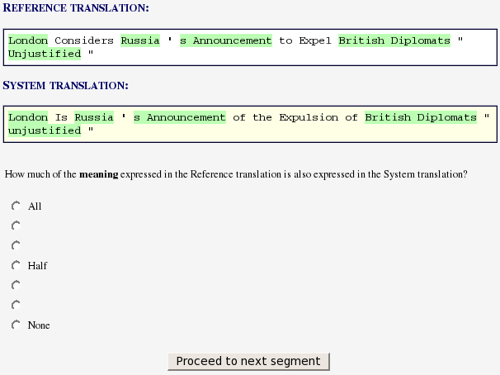
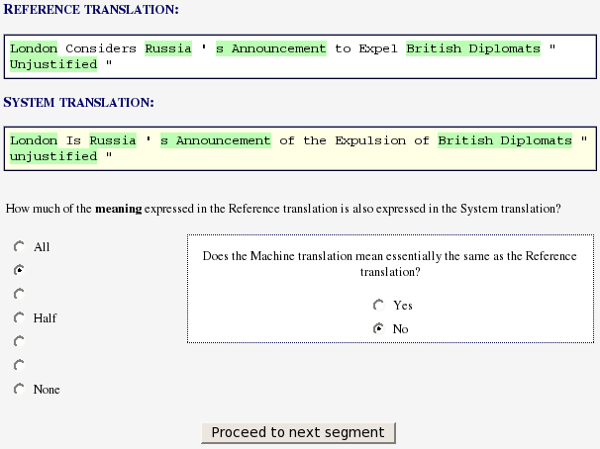
Assessment Tasks: Adequacy
Comparison of:
  1 reference translation
  1 system translation
Word matches are highlighted as a visual aid
Decisions:
  Q1: “Quantitative”
  (7-point scale)
  Q2: “Qualitative”
  (Yes/No)
Notes:
For judging semantic adequacy, we designed a two-prong question.
For both, judges compare 1 reference translation at the top against 1 system translation below.
Shading helps judges identify overlap between ref and sys.
Q1:
More quantitative question.
How much of the meaning of the Reference translation is also expressed in the System translation?
Answer on 7-point scale ranging from “All” to “None”. The wording of the question is unchanged from previous years, but we decided to increase the scale from 5 to 7 points, made an attempt at naming the anchor points more consistently, and gave judges guidelines and an example base to help them make their decision.
Q2:
More globally qualitative question.
Introduced because we felt we did not always get the full picture of adequacy with Q1 – for example, what about hallucinated information, or very small yet significant pieces of meaning (e.g. polarity) that are wrong?
Does the System translation mean essentially the same as the Reference translation? (Yes/No)
Only asked for top three scores on Q1.

Slide 11
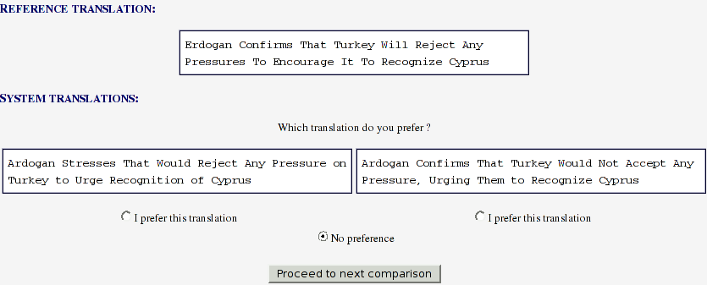
Assessment Tasks: Preference
Comparison of two system translations for one reference segment
Decision: Preference for either system or no preference
Notes:
For the Preferences task, judges see 1 ref and 2 sys translations.
They are asked to choose the translation they prefer, or “No preference” if neither is preferred.

Slide 12
Example:
NIST Open MT08
Arabic to English
9 systems
21 assessors (randomly assigned to data)
Assessment data:
 | Adequacy | Preference
Documents | 26 | 26
Segments | 206 (full docs) | 104 (first 4 per doc)
Assessors | 2 per system translation | 2 per system translation pair
Notes:
Now that you have an idea of the tool and tasks, let me move one of the first applications of TAP-ET, a slice of the NIST Open MT08 human assessments.
I will present here some first analyses for the to English task.
We are looking at 9 systems, and a total of 21 assessors who were randomly assigned to data sets.
The data to be assessed had the following characteristics:
For Adequacy, 26 documents were included with a total of 206 segments.
Each system translation was assessed by 2 assessors.
For Preference, only the first 4 segments of the same 26 documents was included; making it 104 segments. This limitation was necessary in order to keep work load on the judges manageable.
Each system translation pair was assessed by 2 assessors.
Complete pair-wise comparisons of all systems for each segment were performed.
In what follows, please keep in mind that these analyses are only preliminary and that they represent only a sample of the possible analyses that we are still in the process of performing.

Slide 13
Adequacy Test, Q1:
Inter-Judge Agreement
Notes:
Let us first take a look at the inter-judge agreement on Q1 of the Adequacy task, the question on the 7-point scale, for Newswire data.
We plot the percentage of agreement for different degrees of leniency – exact match counting as agreement, 1 scale point off still counting as agreement, etc.
For reference, let us look at the agreement rates on the MT06 human assessments first. Remember that these were done on a 5-point scale, so we expect higher agreement than on the 7-point scale. Also, the MT06 data differed from the MT08 data in several other ways, so this really is a very “soft” comparison.
You can see that, for exact scale point match, the agreement rate was only 45% on the previous 5-point scale. Agreement goes up when increasing leniency.
When adding in the agreement for the 7-point scale, the agreement is overall lower, as expected. However, once we get to 2-off leniency and beyond, the two rates of agreement become quite close.
What is noteworthy here is that agreement for the exact match is very low for both the 5-point and 7-point scale; this is a good indicator that the assessment protocols must be revised to strive for higher agreement.

Slide 14
Adequacy Test, Q1:
Correlation with Automatic Metrics
Rule-
based system
¹
Notes:
Another interesting analysis is to investigate correlation of human assessments with automatic metrics.
We plot here R-square correlations of normalized scores (formula below) for the Q1 Adequacy question with three automatic metrics, BLEU, 1 – TER, and METEOR.
Note that the correlation is quite strong for METEOR, but less so for TER and BLEU. We did have an interesting finding here. The system that looks like an outlier for BLEU and TER was a rule-based system. It has been a frequent complaint that automatic metrics do not capture the MT quality of rule-based systems adequately. When we remove this system from the analysis, you see that the correlation values for BLEU and TER go up noticeably.

Slide 15
Adequacy Test, Q1:
Correlation with Automatic Metrics
¹
Notes:
Another interesting analysis is to investigate correlation of human assessments with automatic metrics.
We plot here R-square correlations of normalized scores (formula below) for the Q1 Adequacy question with three automatic metrics, BLEU, 1 – TER, and METEOR.
Note that the correlation is quite strong for METEOR, but less so for TER and BLEU. We did have an interesting finding here. The system that looks like an outlier for BLEU and TER was a rule-based system. It has been a frequent complaint that automatic metrics do not capture the MT quality of rule-based systems adequately. When we remove this system from the analysis, you see that the correlation values for BLEU and TER go up noticeably.

Slide 16
Adequacy Test, Q1:
Scale Coverage
Adequacy Score |  | Coverage
7 (All) | Yes | 12.9% | 14.1%
 | No | 1.2%
6 | Yes | 13.1% | 23.1%
 | No | 10.0%
5 | Yes | 6.0% | 18.0%
 | No | 12.0%
4 (Half) | No | --- | 18.8%
3 | No | --- | 12.3%
2 | No | --- | 9.2%
1 (None) | No | --- | 4.4%
Coverage of 7-point scale by 3 systems with high, medium, low system BLEU scores
Notes:
Let us take a look at how the scale points on the 7-point scale were used. This chart shows scale point coverage for three systems that were chosen based on their system BLEU scores – a high-scoring one, a medium-scoring one and a low-scoring one.
As you can see, we have a spread over the scale points, with the highest percentages on the 6, 5, and 4 scale points. We were happy to see all three of these getting used; one of the reasons to move to a scale with higher granularity was to achieve more differentiation around the second-highest point that was very often selected on the 5-point scale; it appears that we are achieving this.

Slide 17
Adequacy Test, Q2: Scores by Genre
Notes:
Another interesting analysis is the Q2 Adequacy question, the more global Yes/No question on the acceptability of a translation.
We show the systems ordered by their performance on Newswire data for this question. They Y axis represents the percentage of times “Yes” was chosen for each system, indicating that the system translation means essentially the same as the reference translation.
We are plotting this separately for two data genres, Newswire and Web data. Note that the overall score for the different data genres mirrors the results for automatic metrics, with Newswire scores being generally higher than Web data scores.

Slide 18
Preference Test: Scores
Notes:
Finally, let us look at a brief analysis of results from the Preference test.
In this chart, you see the systems on Newswire data. We first plot the percentage of times that a system was Preferred, followed by how often it was neither preferred nor dis-preferred
Note that the percentage of “No Preference” choices is fairly high, around 30% for most systems. We will consider removing “No Preference” as an option.

Slide 19
Conclusions & Future Directions
Continue improving human assessments as an important measure of MT quality and validation of automatic metrics
  What exactly are we measuring that we want automatic metrics to correlate with? What questions are the most meaningful to ask?
  How do we achieve better inter-rater agreement?
Continue post-test analyses
  What are the most insightful analyses of results?
  Adjudicated “gold” score vs. statistics over many assessors?
Incorporate user feedback into tool design and assessment tasks
Notes:
Again, remember that we are still analyzing results and what I just presented here is just a sample of what we want to look at.
Let me sum up and point to future plans.

